Slide 1
E-Commerce Public Dataset by Olist Business Analysis

Slide 2
Project analysis slide 2
Project Analysis
Data Visualization
Data Importing
PROJECT
Data Analysis
Data Transformation
Data Modeling
Data Exploring

Slide 3
Project analysis slide 3
Project Analysis
Executive Summary
This report analyzes sales performance, customer behavior, and operational efficiencies for Olist based on historical e-commerce data. Key insights include the identification of peak sales periods, top-selling product categories, preferred customer locations, delivery performance metrics, and customer payment preferences. Recommendations are provided to enhance revenue growth, optimize operations, and improve customer satisfaction.

Slide 4
Project analysis slide 6
Overview
Total Revenue
$18.06M
Average Order Value
Total Freight Value
$182.7
$2.66M
Total Orders
On-time Delivery Rate
99K
92%
Average Delivery Time
12 days

Slide 5
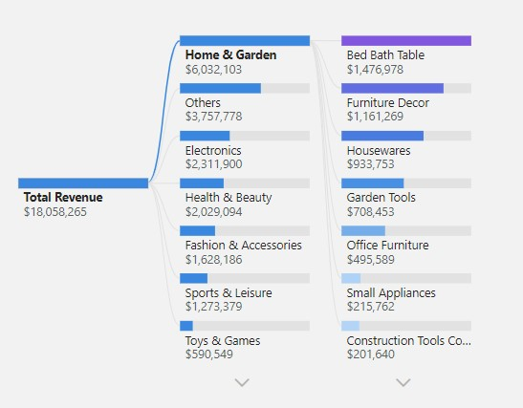
Project analysis slide 5
Sales Analysis
Top Product Segments
Home & Garden
Others (Auto, Cool Stuff, Baby)
Electronics
Health & Beauty
Fashion & Accessories
Top Product Categories
Bed Bath Table
Furniture Decor
Housewares
Garden Tools
Office Furniture

Slide 6
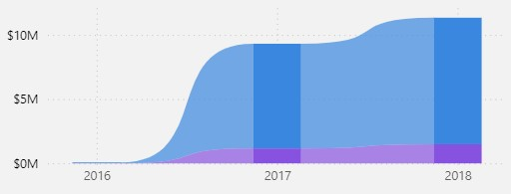
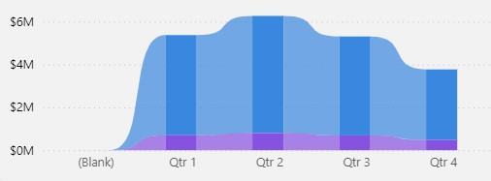
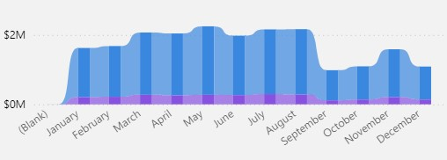
Project analysis slide 5
Sales Analysis
Peak Sales Periods
Highest sales occurred in Q2, with May as the peak sales month.
2018 recorded the most significant sales volume.

Slide 7
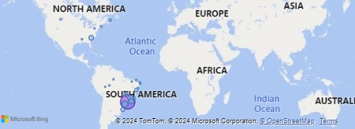
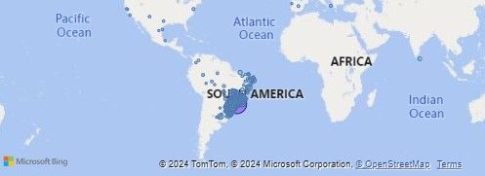
Project analysis slide 5
Sales Analysis
Top Sales Locations
Sellers' Cities:
São Paulo
Curitiba
Rio de Janeiro
Belo Horizonte
Guarulhos
Sellers' States: SP, PR, MG, SC, RJ.
Customers' Cities:
São Paulo
Rio de Janeiro
Belo Horizonte
Brasília
Porto Alegre
Customers' States: SP, RJ, MG, RS, PR.

Slide 8
Project analysis slide 3
Sales Analysis
Recommendations
Marketing and Inventory Adjustments:
Increase inventory and marketing spend on the highest-performing segments (Home & Garden, Electronics) during Q2, especially in May, to meet expected demand.
Regional Promotions:
Launch location-based promotions, particularly in São Paulo and Rio de Janeiro, to strengthen customer loyalty in these high-demand areas.
Category Expansion:
Consider expanding the Fashion & Accessories and Health & Beauty categories, as they demonstrate high demand potential.

Slide 9
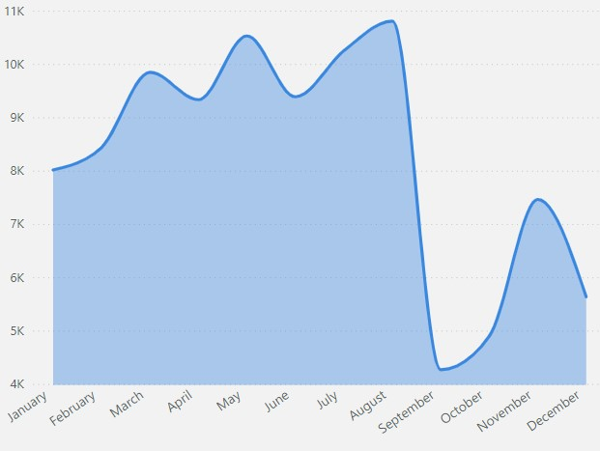
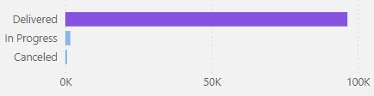
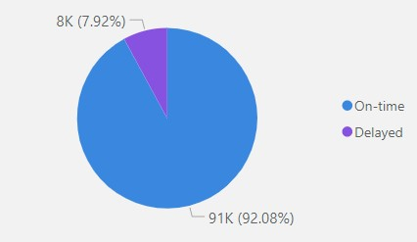

Project analysis slide 5
Order and Delivery Analysis
Key Findings
Order Overview
On-time Delivery Rate: 92%
Average Delivery Time: 12 days
Average Orders Per Month: 3.95K
Total Orders: 99,000
Delivered Orders: 96,478
In-progress Orders: 1,729
Canceled Orders: 625

Slide 10
Project analysis slide 3
Order and Delivery Analysis
Recommendations
Optimize Delivery Time:
Reducing the average delivery time from 12 days can increase customer satisfaction. Partnering with local logistics services in major cities may help streamline delivery.
Sustain High On-time Rate:
The 92% on-time delivery rate is a competitive advantage. Continued focus on efficient delivery practices, especially in high-demand regions, will help maintain or improve this rate.
Order Cancellation Management:
Investigate and address common cancellation reasons. Improving communication around in-progress orders may reduce cancellations.

Slide 11
Project analysis slide 5
Customer Behavior and Payment Analysis
Key Findings
Financials:
Total Payment Amount: $16.01M
Total Number of Installments: 296,000
Payment Method Preferences: Credit Card (primary payment method), followed by boleto.
Installment Usage: 82% of customers opted for installment payments; 17% used single payments.
Purchase Timing: Weekdays account for 77% of purchases, with weekends at 23%.

Slide 12
Project analysis slide 3
Customer Behavior and Payment Analysis
Recommendations
Emphasize Installment Benefits:
Highlight installment options in marketing materials and website interfaces to align with customer preferences and maintain high sales volume.
Boost Weekend Sales:
Introduce weekend-specific promotions to increase sales volume during typically slower periods.
Optimize for Boleto Payments:
Consider offering loyalty points or discounts for boleto payments to attract more users who prefer this method.

Slide 13
Project analysis slide 3
Project Analysis
Conclusion
The data insights from this analysis offer a comprehensive view of sales performance, operational efficiencies, and customer behavior. Implementing the above recommendations will support the company's growth objectives, enhance operational efficiency, and improve customer experience. By focusing on high-demand product segments and optimizing delivery logistics, Olist can build a robust competitive position in the e-commerce market.

Slide 14
Thank You

