Slide 1
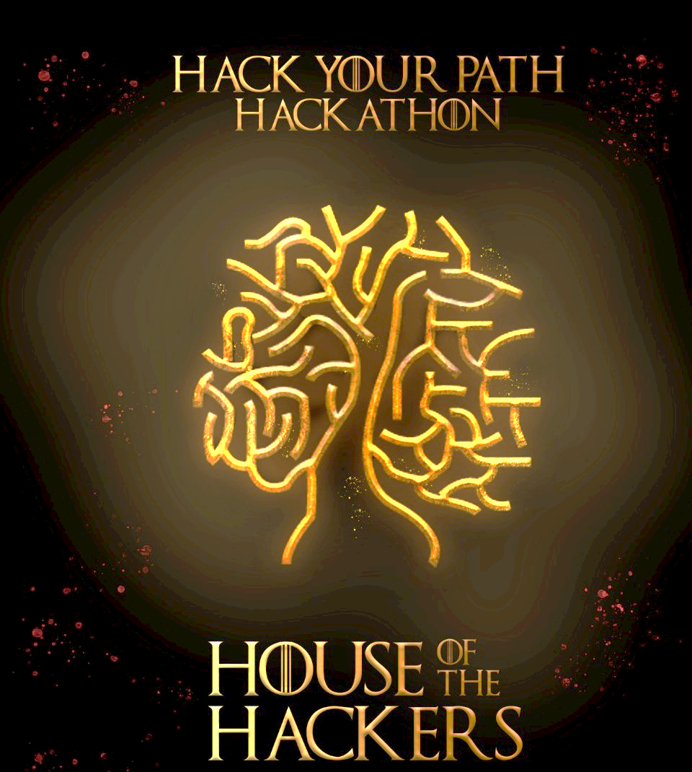
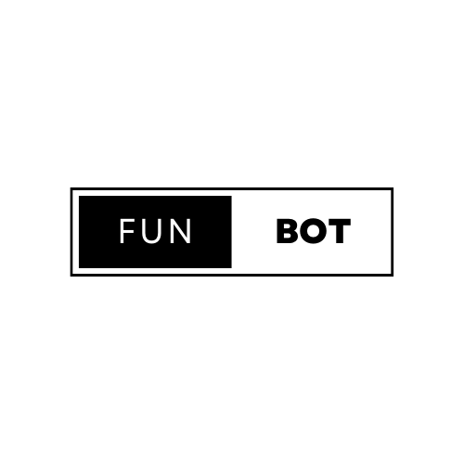

FunBot
Educate With Fun

Slide 2
TEAM MEMBERS
Name | Branch | Year | Role
Divya Tej Reddy Maddala | CSM | First year | Team Lead
Kaushik P | CSM | First year | Ideationer
Mohammed Bilal | CSM | First year | Designer

Slide 3
Theme
A robotic toy that can interact with children would be an excellent addition to any family. The FunBot would provide hours of entertainment and education for your child. It is important for children to have a toy that they can interact with so that they can learn how to socialize properly. With the FunBot, your child will never get bored, because it has many different games and activities built into it.

Slide 4
Community people who are facing this problem
We created FunBot for kids to entertain them as they learn in order to who find it difficult to concentrate on the subjects they love to study.

Slide 5
Solution
Project name : FunBot
Tagline: Educate With Fun
Description: A robotic toy that can interact with children would be an excellent addition to any family. The FunBot would provide hours of entertainment and education for your child. It is important for children to have a toy that they can interact with so that they can learn how to socialize properly. With the FunBot, your child will never get bored, because it has many different games and activities built into it.

Slide 6
Technologies used
It’s a fun toy built based on AI. It has voice recognition(speech-recognition), text to speech engine(pyttsx3), retrieve info from web(Wikipedia), solve mathematical problems and answer general knowledge question(wolfram alpha), search on browser(webbrowser) and lots more.

Slide 7
Current status of the project
Future steps
Development
After FunBot we are developing it to an advanced level and placing it in classrooms to clear student doubts, we are going to name it as FunBot 2.0.

Slide 8
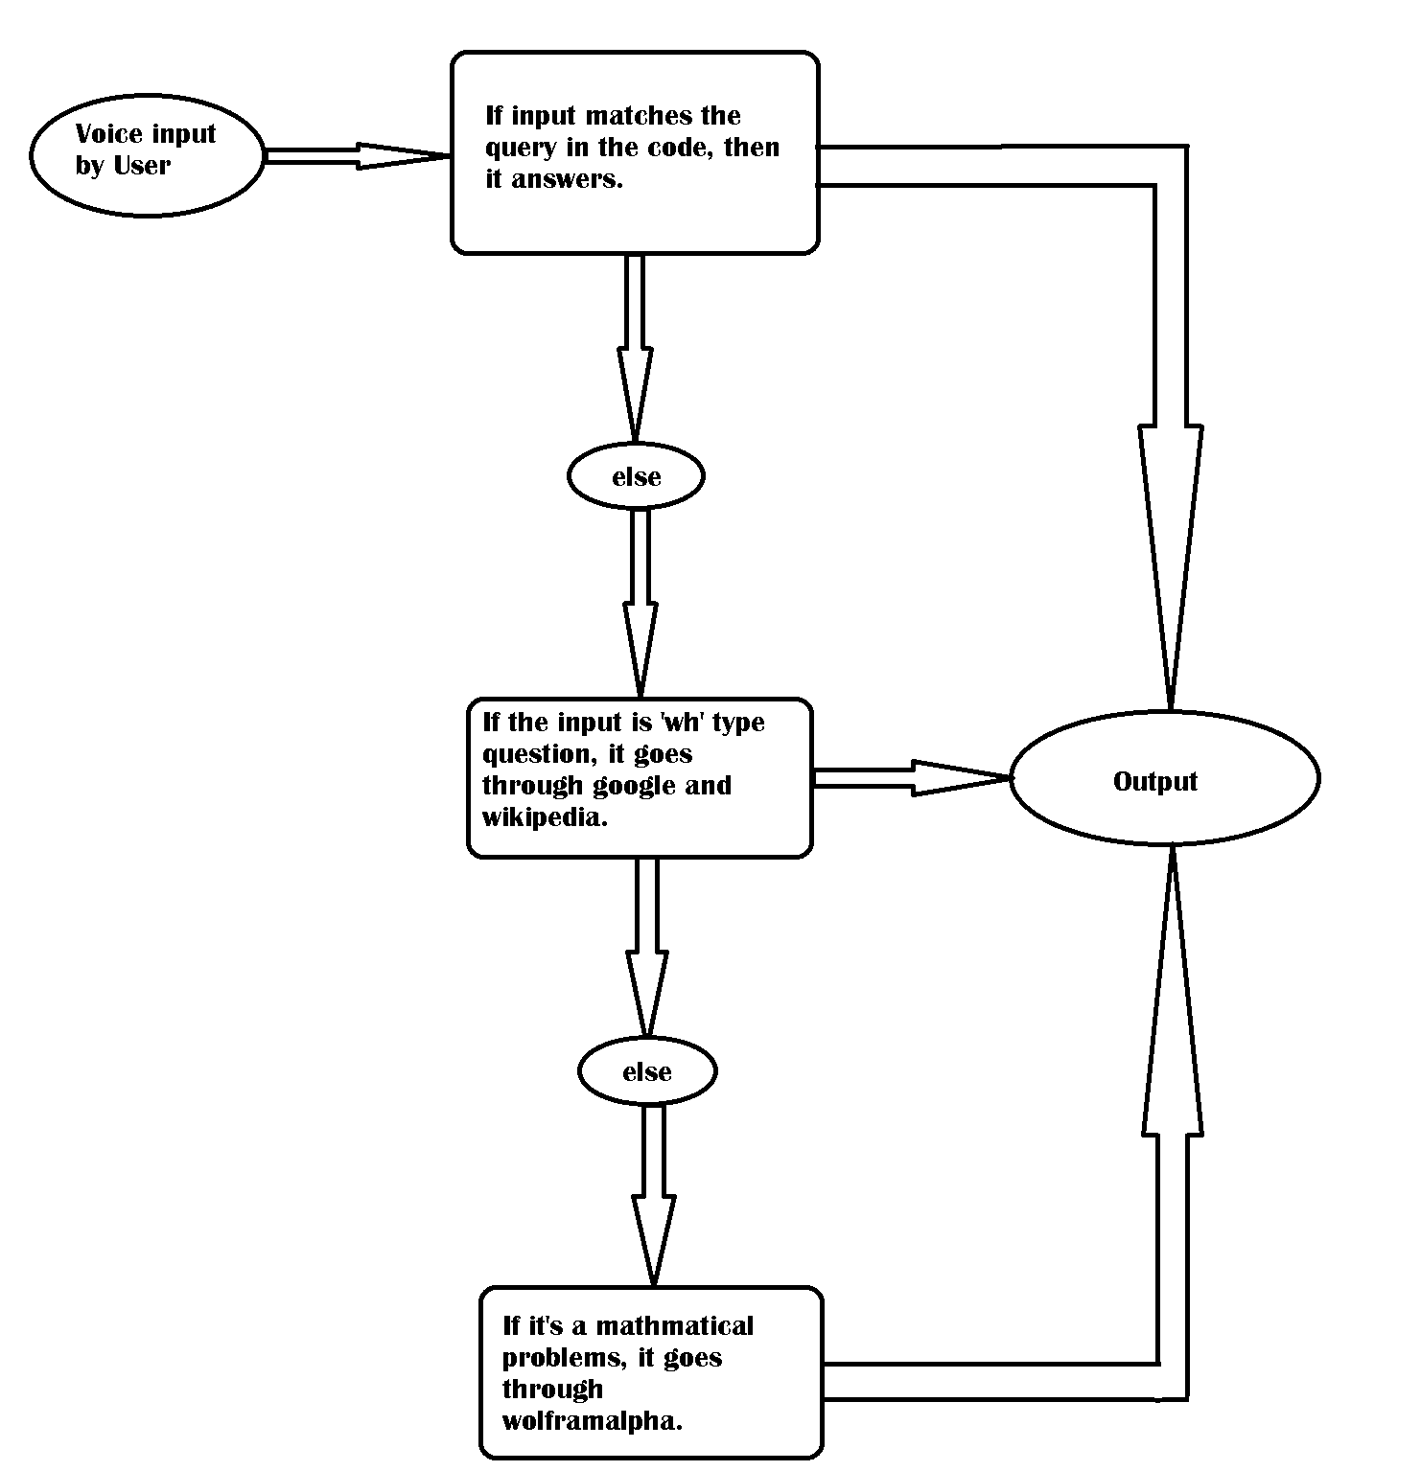
Project images

Slide 9
Advantages of FunBot
It helps children to focus on education.
It helps kids to interact with people.
It make kids Hyperactive.
It make kids think logical and creative.

