Slide 1
Case Studies
Transliteration Services
GIST Data Converter Tool
Onscreen keyboard
Search as Service

Slide 2
Transliteration as a Service Transliterating Names & Addresses

Slide 3
Transliteration as a Service
Provides the transliteration from English to IL through a web service
Based on standard SOAP protocol
Easy to integrate in any client application supporting SOAP protocol.
Languages supported
Hindi, Marathi, Gujarati, Bengali, Punjabi, Malayalam
The service can be accessible from following URL
http://gisttransliteration.in
http://gisttransliteration1.in
http://gisttransliteration2.in

Slide 4
Transliteration as a Service
POST /TransliterationService/Service.asmx HTTP/1.1
Host: localhost
Content-Type: text/xml; charset=utf-8
Content-Length: length
SOAPAction: "http://cdac.in/gist/webservices/transliterationservice/Transliterate"
<?xml version="1.0" encoding="utf-8"?>
<soap:Envelope xmlns:xsi="http://www.w3.org/2001/XMLSchema-instance" xmlns:xsd="http://www.w3.org/2001/XMLSchema" xmlns:soap="http://schemas.xmlsoap.org/soap/envelope/">
<soap:Body>
<Transliterate xmlns="http://cdac.in/gist/webservices/transliterationservice">
<iText>string</iText>
<locale>string</locale>
</Transliterate>
</soap:Body>
</soap:Envelope>
Sample SOAP 1.1 request and response.
Notes:
4

Slide 5
Transliteration as a Service
Parameters: iText - The Input text to be passed as an argument is going to contain the input raw string in English language.
locale - The locale will signify the regional language in which output need to be produced after transliteration.
Language | Locale
Hindi | hi_in
Marathi | mr_in
Gujarati | gj_in
Bengali | bn_in
Punjabi | pn_in
Malayalam | ml_in
Notes:
5

Slide 6
GIST Data Converter Tool
Converting existing data encoded in proprietary font code

Slide 7
GIST Data Converter
Quick and handy tool for converting data within the file from ISFOC format to Unicode and Transliteration from English to Indian languages and vice versa.
Supports Bulk Conversion- Large number of files can be converted in single execution
Uses data conversion and transliteration service hosted at CDAC, Pune
Available for download on http://localisation.gov.in

Slide 8
GIST Data Converter
Supported File Types
Text File (*.txt)
Microsoft Excel (*.xls, *.xlsx)
Microsoft Word (*.doc, *.docx)
Microsoft PowerPoint (*.ppt, *.pptx)
CSV File (*.csv)
HTML File (*.htm, *.html)
ODT File
ODS File
Supported Databases
MS SQL Server (2005, 2008, 2008 R2, 2012)
My Sql (5.5 or higher)
Oracle (10g or higher)

Slide 9
GIST Data Converter
Supported Fonts
CDAC GIST ISFOC Fonts for six languages – Hindi, Marathi, Gujarati, Bengali, Punjabi, Malayalam
Monolingual, Monolingual Web
Bilingual, Bilingual Web
Third-Party Fonts:
Agra, Akbar, Akruti, Akruti 2000, AkrutiDynamicYogini, AkrutiOfficeAditi, AkrutiOfficeYogini, Akruti Web, Amar ujala, Arjun, KrutiDev11, DevLys010, Manjusha, Millenium Varun, Pudhari, Shivaji, Dev Susha, Udgam, Web Dunia, Yuvraj, Akshar, APS-C-DV-Prakash, Aps Bi, Aps Mono, Aps Priyanka, Chanakya, Krishna, Sahara Narad, Sahara Rashtriya, Shree708, Shreelipi 708, Shreelipi 709, Shreelipi 711, Shreelipi 712, SuWindows, Mogara, New Natraj, Old Natraj, and Pradanya.

Slide 10
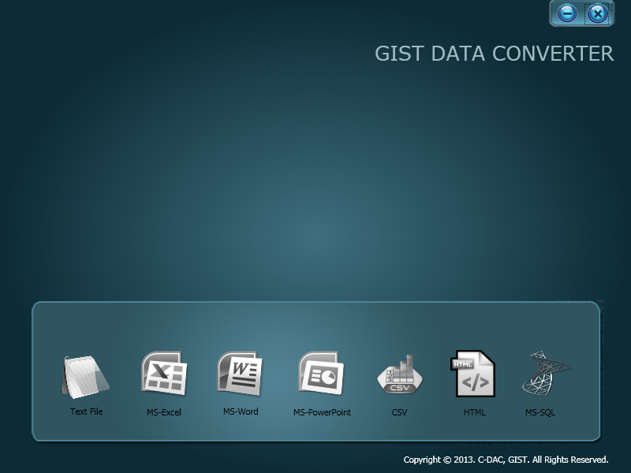
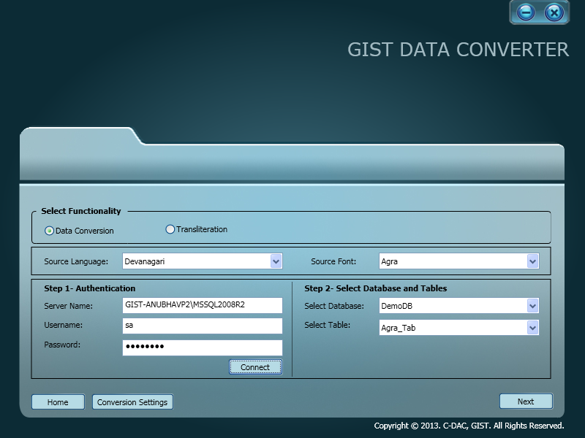
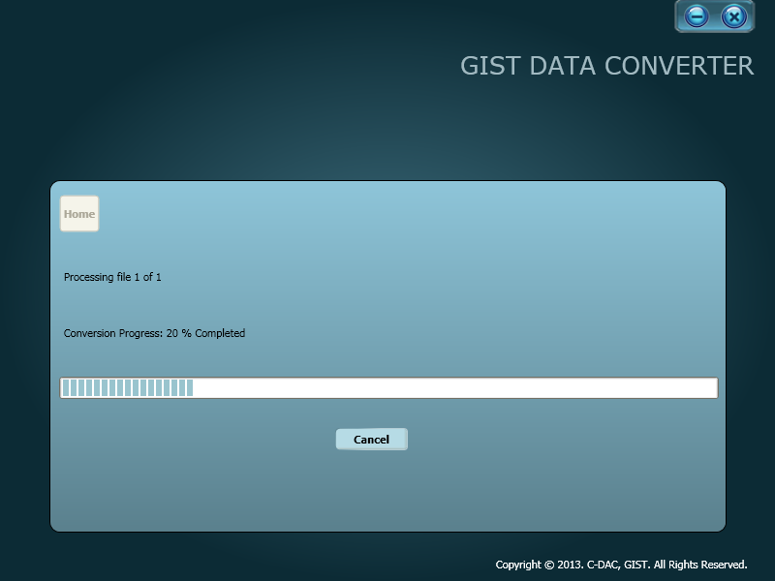
GIST Data Converter

Slide 11
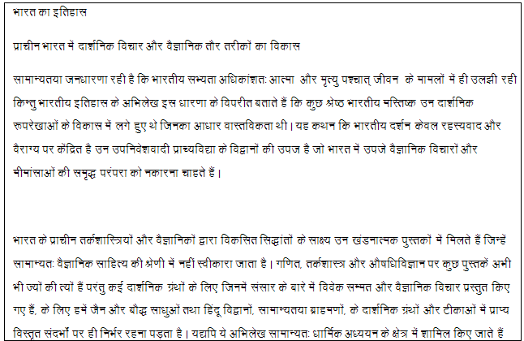
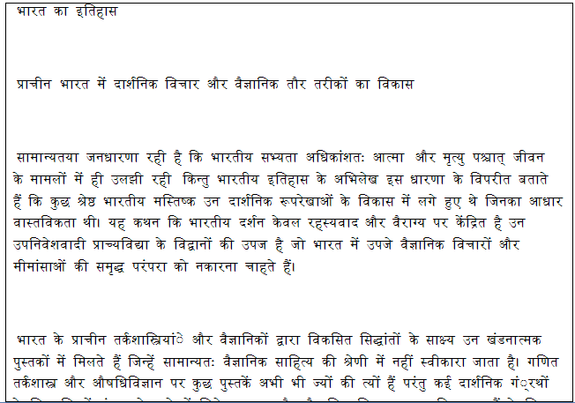
GIST Data Converter

Slide 12
INSCRIPT Floating Keyboard
INSCRIPT based typing mechanism on web

Slide 13
INSCRIPT Floating Keyboard - GIST WebOT
JavaScript based Indian language typing mechanism
It has support for Hindi, Marathi, Gujarati, Bengali, Panjabi and Malayalam languages with Unicode 6.2 enhanced INSCRIPT layouts
Support for Internet Explorer, Google Chrome, Mozilla Firefox, etc.
You can download the source code and guide for this keyboard from http://localisation.cdac.in

Slide 14
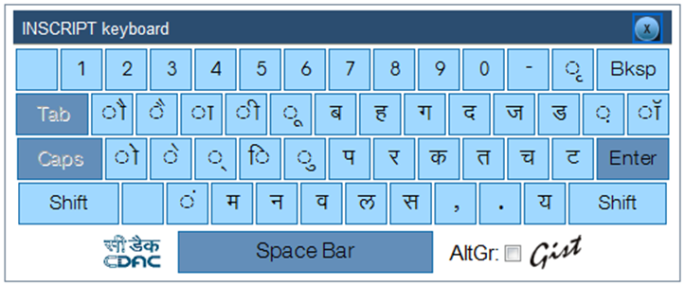
INSCRIPT Floating Keyboard - GIST WebOT
Inscript Floating Keyboard

Slide 15
Search as Service
Government of India Directory Search Engine
Search within website

Slide 16
Search as Service
C-DAC along with NIC has developed a Government of India Directory Search Engine, specifically aimed at Indian E-governance websites
This search is being provided as a Service also
This Search as Service (SAS) enables customers to enable searching on their own web sites
Uses a simple HTTP-based protocol to serve search results
Administrative panel to configure the search results
Notes:
Sample Implementation on
http://india.gov.in/
http://pmindia.nic.in/index.php
Contact NIC for integration details
Contact person from NIC: Narender Jain(nk.jain@nic.in) or Ritu(ritu@nic.in)

Slide 17
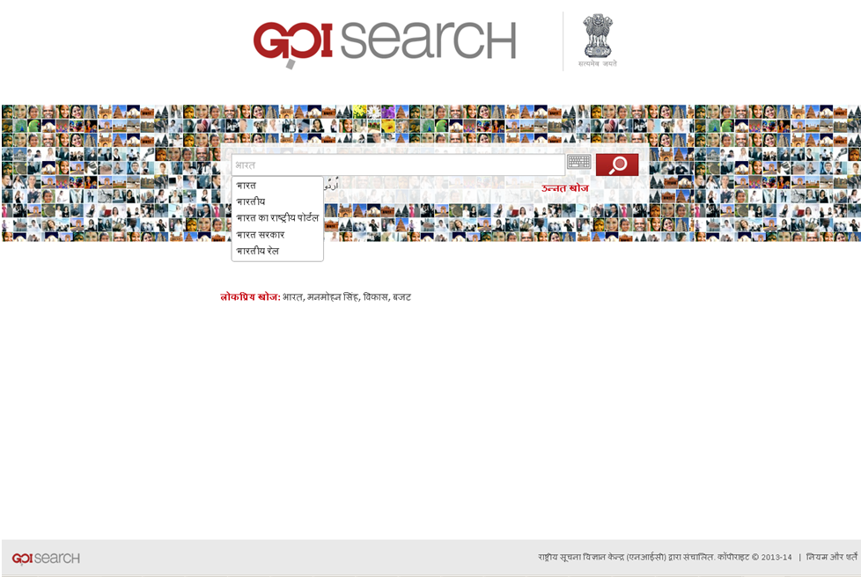
Search as Service

Slide 18
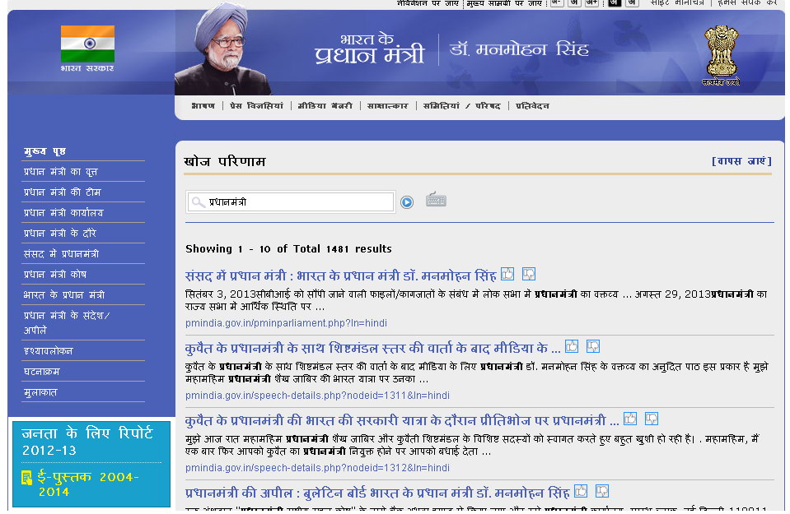
Search as Service integrated in pmindia.nic.in

Slide 19
Thank You

