Slide 1
iSuggest Typing Service

Slide 2
Indian Language Inputting on web - iSuggest
Support of 6 Indian languages –
Hindi, Marathi, Gujarati, Malayalam, Bengali and Punjabi.
Intelligent suggestion based component for typing in Indian Languages
on Web
e.g. Bharat - भारत , भरत
Backed up by enhanced transliteration engine
Spews out multiple suggestions. Best suggestion pops up at top using linguistic heuristics

Slide 3
How to use ?
The backend transliteration service can be hosted at site or in CDAC.
URLs:
http://gisttransserver.in/Transliteration.aspx
http://gisttransserver1.in/Transliteration.aspx
http://gisttransserver2.in/Transliteration.aspx
Parameters –
1. itext - Input text in English
2. transliteration -Transliteration type i.e. (Name/Address)
3. locale - Indian language locale
Easy integration in browser based application
- Add JavaScript in the webpage
- Add Custom textbox control

Slide 4
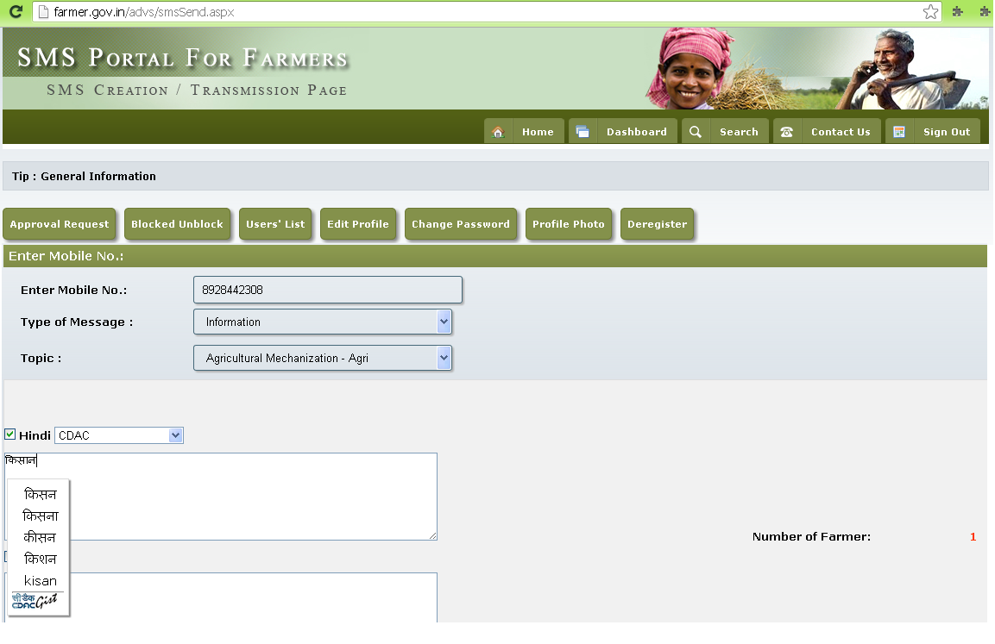
Indian Language Typing in farmer.gov.in
Integration of Transliteration based typing mechanism for typing advisory SMS for Kisan for Agriculture Department, Govt. of India

Slide 5
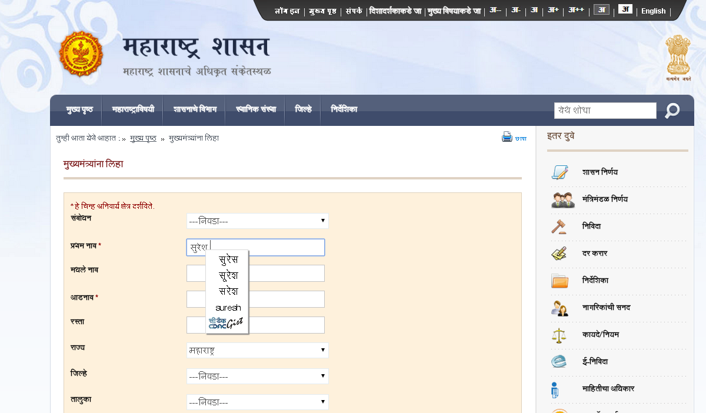
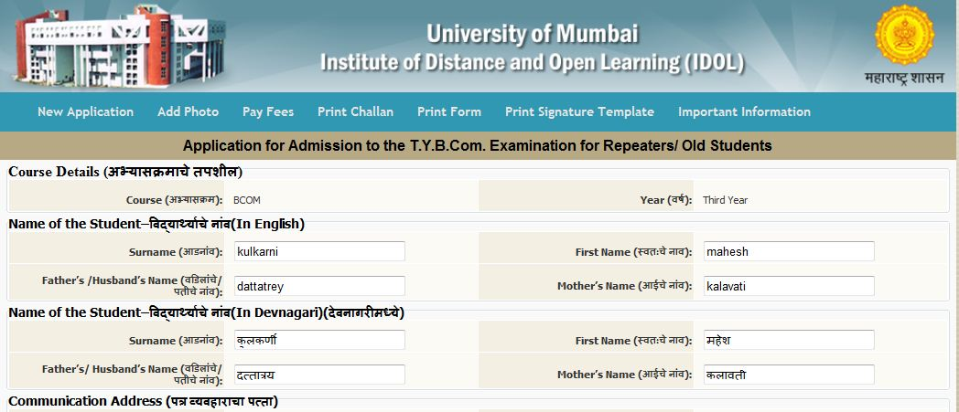
Indian Language Typing in maharashtra.gov.in, etc.
Transliteration based typing in various Maharashtra Govt. sites

Slide 6
Thank You

