Slide 1
Introduction to Indian language computing
20th MAR 2014

Slide 2
Highlights
Most Computer Systems, solutions and devices even today are designed and developed for English.
We are trying to change this mindset by covering MMPs at design and RFP stage
Localisation of applications, data, reports, code, services, devices... for Indian Languages

Slide 3
All systems can be broken down into
Input
    INSCRIPT standard, Phonetic / Transliteration, Typewriter
    Limited keys on devices
Storage / Processing
    UNICODE de-facto even though it is more expensive
Output
    UNICODE compliant Open Font format Fonts
Applications for Indian Languages should have support throughout the lifecycle of the system – rather than being an after thought.

Slide 4
India – Linguistic Scenario
One script: many languages
Devanagari – Hindi, Marathi, Konkani, Rajasthani, Sindhi, Nepali, Dogri, Santhali, etc.
Thus the data in Devanagari (code page) can support all languages using that particular script.
However tools like synonym Dictionaries, spellcheckers, and search engine crawlers and indexers, etc. are language dependent and require language information along with the data.
Though the contents would reveal the language used, it would be ideal if a special attribute code to indicate the language is inserted.
One language: many scripts
Konkani is written in Roman, Devanagari, Malayalam and Kannada.
Sindhi is written in Gurmukhi (Punjabi), Arabi (Perso-Arabic), Devanagari, Gujarati and also Roman.
Sindhi has adopted the Perso-Arabic script for representing their language. In case of Konkani, Devanagari is used as official script.

Slide 5
Language | ISO code | Official Language | Family | Script
Assamese | asm | Assam | Indo-Aryan | Assamese
Bengali | ben | Tripura and West Bengal | Indo-Aryan | Bangla
Manipuri | mni | Meitei | Tibeto-Burman | Bangla Meitei-Meyek
Boro | brx | Assam | Tibeto-Burman | Devanāgarī (modified)
Dogri | dgo | Jammu and Kashmir | Indo-Aryan | Devanāgarī (modified)
Hindi | hin | Andaman and Nicobar Islands, Bihar, Chandigarh, Chhattisgarh, Delhi, Haryana, Himachal Pradesh, Jharkhand, Madhya Pradesh, Rajasthan, Uttar Pradesh and Uttaranchal | Indo-Aryan | Devanāgarī
Konkani | kok | Goa | Indo-Aryan | Devanāgarī Roman (Latin)
Maithili | mai | Bihar | Indo-Aryan | Devanāgarī
Marathi | mar | Maharashtra | Indo-Aryan | Devanāgarī
Nepali | nep | Sikkim | Indo-Aryan | Devanāgarī

Slide 6
Language | ISO code | Official Language | Family | Script
Sanskrit | san | Pan-Indian | Indo-Aryan | Devanāgarī
Gujarati | guj | Dadra and Nagar Haveli, Daman and Diu, and Gujarat | Indo-Aryan | Gujarati
Punjabi | pan | Punjab | Indo-Aryan | Gurmukhi
Kannada | kan | Karnataka | Dravidian | Kannada
Malayalam | mal | Kerala and Lakshadweep | Dravidian | Malayalam
Santali | sat | Jharkhand | Munda | Ol Ciki
Oriya | ori | Orissa | Indo-Aryan | Oriya
Kashmiri | kas |  | Indo-Aryan | Perso-Arabic Devanāgarī
Sindhi | snd | Pan-Indian | Indo-Aryan | Perso-Arabic Devanāgarī Gujarati Roman (Latin)
Urdu | urd | Jammu and Kashmir | Indo-Aryan | Perso-Arabic
Tamil | tam | Tamil Nadu and Pondicherry | Dravidian | Tamil
Telugu | tel | Andhra Pradesh | Dravidian | Telugu

Slide 7
Working with English
Inputting
  The keys on the keyboard are mapped to ASCII characters.
  One to One mapping between keys and the English characters
Display
  The glyph representing the character pressed is displayed.
  The English font contains the glyphs at the position specified by the ASCII character set.
  One to One mapping between the characters and the glyphs
  Example:
  Hi = H + i

Slide 8
Working with English
Storage
  The ASCII value of the characters is stored.
Printing
  The glyphs representing the ASCII characters are printed.
  The printer can have embedded fonts for draft printing.

Slide 9
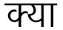
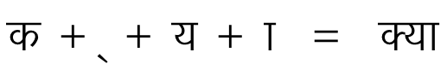
Complexity of Indian Languages
  Character Set
      Consonants (k, kh, g, gh)
      Vowels (Ae, e, E)
      Vowel Sign (Matras)
      Vowel Modifiers (Chandrabindu, anuswar, visarg)
      Other (Halant, Nukta)
  Shape of a character does not remain constant
  Example:
  According to Devnagari Script Rules
  Here the shape of the क gets modified.
  Hence no one to one mapping between character and its shape.

Slide 10
Working with Indian Languages
Inputting
  All the combinations of consonants and vowels cannot be mapped to limited set of keyboard keys.
  So a standard set of characters representing all the basic shapes is defined by Bureau of Indian Standards called as Indian Script Code for Information Interchange (ISCII).
  Each character in the set is assigned a unique value.
  One to one mapping between the keys and the ISCII characters possible.

Slide 11
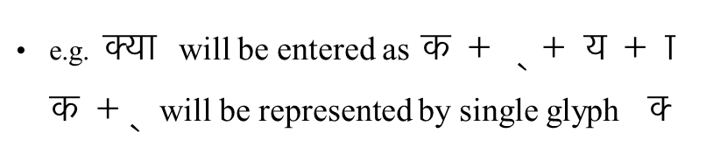
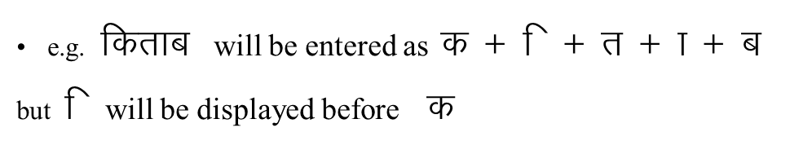
Working with Indian Languages
Display
  The characters that are inputted through keyboard are mapped to glyphs in the font.
  There is many to many mapping between characters entered and the glyphs displayed due to complexity of Indian Languages.
  There might be repositioning of characters before the actual display
    Contd...

Slide 12
Working with Indian Languages
Storage
  The data can be stored in various formats like ISCII, ISFOC, Unicode etc.
Printing
  Printing is also based on storage.
  If the storage is in font code, the font information should be there with the data.
  If the storage is ISCII based, the printer should be enabled to print ISCII else the data should be converted to font code before sending to printer.

Slide 13
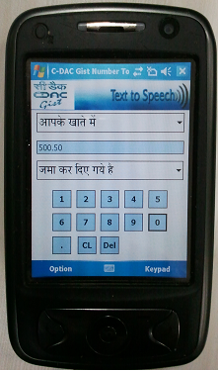
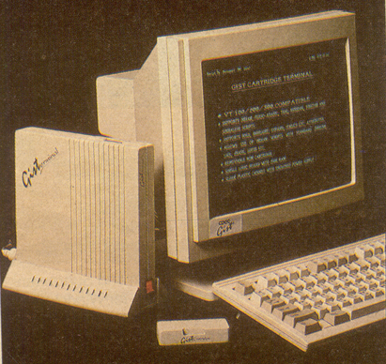
GIST Graphics and Intelligence based Script Technology
Complexities of Indian languages
Research and development 22+ Indian languages including the right to left scripts of Urdu(Naskh and Nastaleeq), Sindhi and Kashmiri
GIST has been involved in development of highly calligraphic True Type, Open Type and Bitmap Fonts for various media such as Desktop – for screen as well as printing, Web media, Broadcast / Television media, Embedded and Mobile Computing
Compared to Roman scripts Indian language fonts are very complex. Most of them have multi-tier system.

Slide 14
Standard
“a document, established by consensus and approved by a recognized body, that provides, for common and repeated use, rules, guidelines or characteristics for activities or their results, aimed at the achievement of the optimum degree of order in a given context”.
Adherence to standards ensures compatibility, safeguarded data, avoids vendor locking, proper exchange of data between various systems, applications, databases, devices, etc.

Slide 15
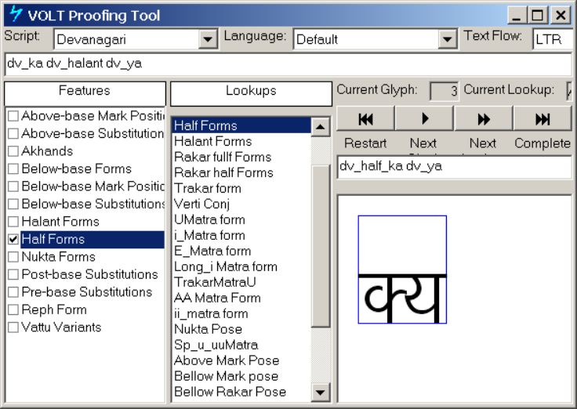
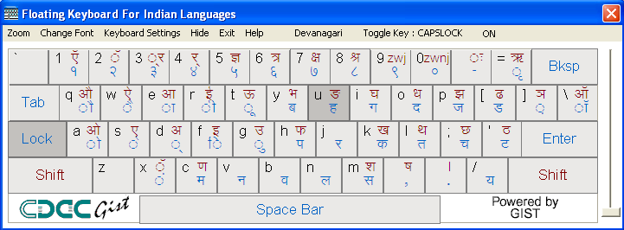
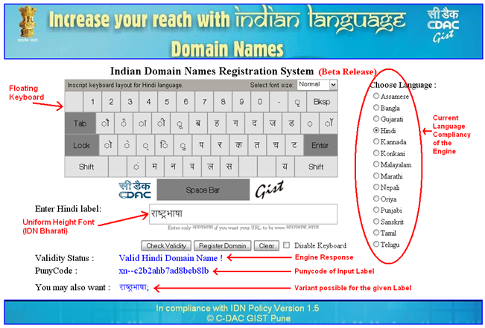
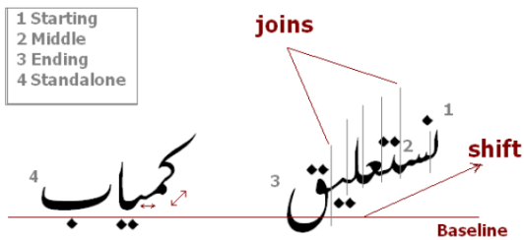
India language Standards
UNICODE
IDN – ICANN, IANA
Enhanced INSCRIPT
ISCII , INSCRIPT, PASCII
W3C for IL on Browsers and Mobile devices
1988-95 1995-2000 2000-2005 2005-2010 2010-11

Slide 16
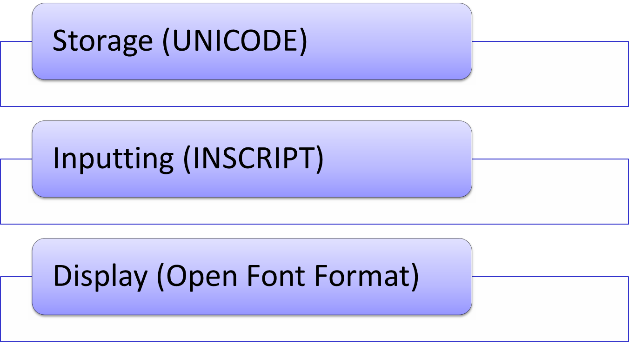
Indian language related standards

Slide 17
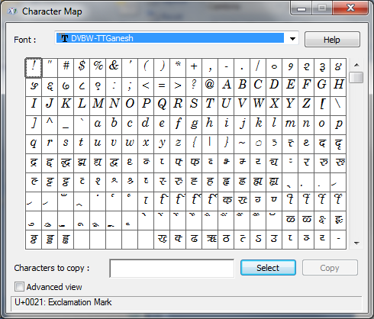
Pre-Unicode Era
Displaying multilingual data would require fonts.
Font is a set of well defined shapes to display symbols (letters, punctuation marks, special characters of the language).
An 8-bit font can represent upto 256 glyphs by giving unique index (called glyph index) and name to each glyph/shape.

Slide 18
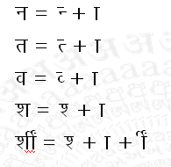
Pre-Unicode Era

Slide 19

UNICODE
Storage standard
What ascii is for english, unicode is for other languages of the world
Enables seamless exchange of data – desktops, printers, databases, browsers, devices.

Slide 20
UNICODE
Unicode consortium defines Unicode as :
“Unicode is the universal character encoding, maintained by the Unicode consortium. This encoding standard provides the basis for processing, storage and interchange of text data in any language in all modern software and information technology protocols.”
It is the superset of all the languages in the world which also includes punctuation, special characters (shapes), currency symbols, mathematical symbols etc. Using Unicode, more than 65000 different characters can be represented. Unicode comprises of many code charts.
The Unicode code charts can be referred at: http://www.unicode.org/charts

Slide 21
UNICODE
Various editors / applications / development environments / databases / browsers need to understand how to read in the given Unicode data and interpret the same. Various encoding schemes to represent Unicode are UTF-8, UTF-16, UTF-32 with a combination of endian-ness.
There are normalization rules which are required to be followed for data compatibility between various applications / underlying environment. Non adherence to some of these may lead to wrong interpretation of data and will also pose problems in searches as well.

Slide 22
UNICODE
UNICODE for Indian languages is at best a 16 bit character based encoding standard.
  A mapping of characters to numbers
  Syntax rules for display of complex scripts
  Not a font or glyph encoding!
  Not a sort algorithm!
Includes all characters in common use in modern scripts (and others)
© C-DAC GIST

Slide 23
Character semantics
The Unicode standard includes an extensive database that specifies a large number of character properties, including:
  Name
  Type (e.g., letter, digit, punctuation mark)
  Decomposition
  Case and case mappings (for cased letters)
  Numeric value (for digits and numerals)
  Combining class (for combining characters)
  Directionality
  Line-breaking behavior
  Cursive joining behavior
  For Chinese characters, mappings to various other standards and many other properties
© C-DAC GIST

Slide 24
Advantages of UNICODE
Character based encoding.
Unicode values are governed by characters (vowels and consonants).
Can be ported on any platform and any OS.
Can be ported on hand held and mobile devices
Different scripts have different code page.
All Indian languages are supported along with all other languages.
Allows multiple languages in the same data.
© C-DAC GIST

Slide 25
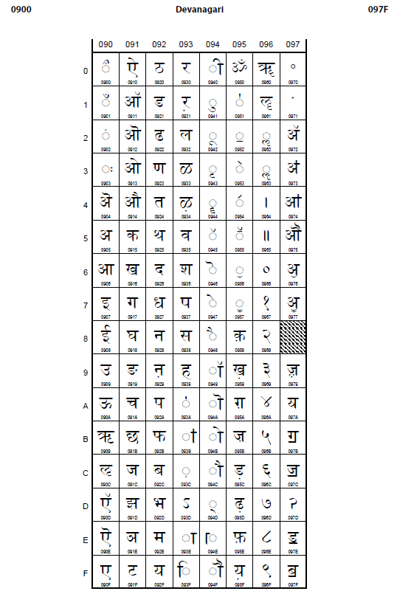
UNICODE
Devanagari
Code Page
© C-DAC GIST

Slide 26
Availability
UNICODE is not vendor specific
Backward compatible
Major database, OS, browser players support some form UNICODE encoding
Data Migration services will be provided free for e-governance developers
Currently office documents such as .doc/.docx, .xls/xlsx, .txt can be converted to UNICODE
Soon database migration tools will also be made available.

Slide 27
Enhanced INSCRIPT (2.0)
INSCRIPT is part of BIS standard – ISCII
Enhanced INSCRIPT allows user to type latest UNICODE characters such as Rupee symbol.
Unlike the phonetic or transliteration mechanism, it does not expect the user to know English to type Indian language and so caters to rural audiences as well.
Fast typing is possible as consonants are typed by one hand while vowels are typed by left hand

Slide 28
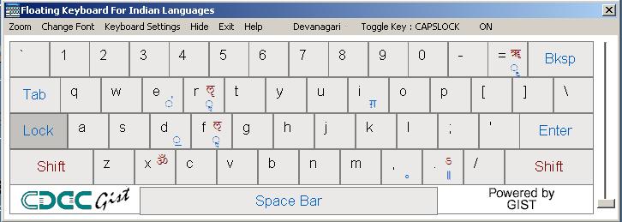
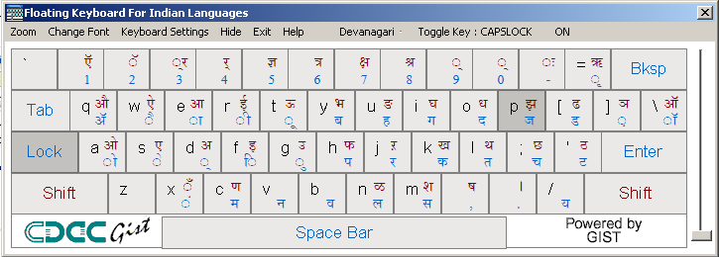
Enhanced INSCRIPT Standardization for Latest Unicode Version
Study and Research for Keyboards of various languages Normal layer and Extended layer
Along with teams from – Microsoft, Redhat and IBM
The Enhanced INSCRIPT keyboard layout provides three layers and this to accommodate all the extra characters and yet make the keyboard as ergonomic and efficient as possible

Slide 29
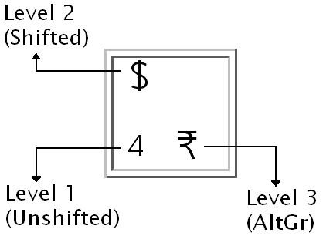
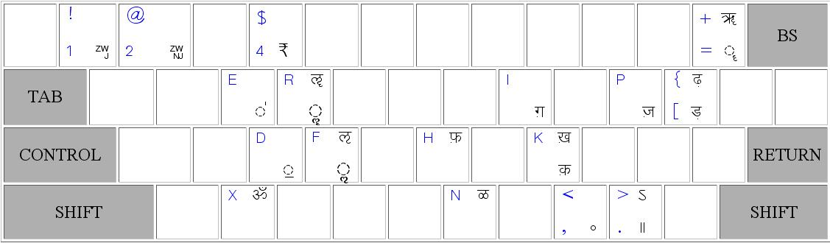
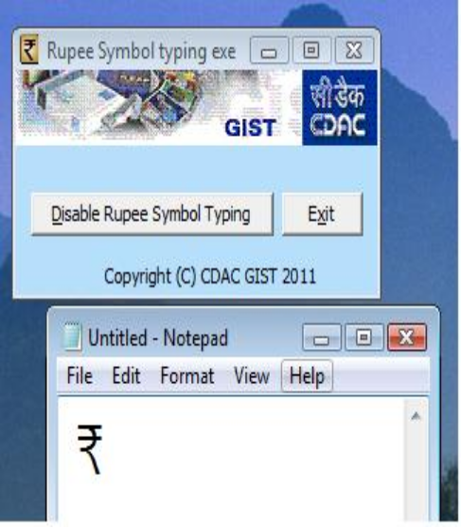
Standardization of Rupee Symbol Inputting
Made available for free download on
http://tdil-dc.in

Slide 30
Syllable (Akshar) Based Cursor Movement, addition and deletion
Cursor movement and deletion of characters should be based on syllables. A syllable is a unit of organized sequence of code points. The structure of the written syllable (akshar) is defined as per ISCII (IS 13194 : 1991).
Lets take an example string किताब

Slide 31
Basic Inputting
Basic Characters
Steps to be followed to input सीडैक:
  Logically note the sequence of characters in word सीडैक as you would pronounce.
  You may note that, we pronounce it as
      “sa-i-da-ae-ka”
  Thus, the inputting sequence becomes
    “स-ी-ड-ै-क”
© C-DAC GIST

Slide 32
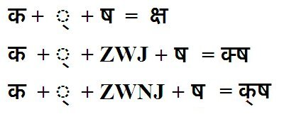
ZWJ and ZWNJ
Two special characters in Unicode
ZWJ - 200D, ZWNJ - 200C

Slide 33
Tools Availability
UNICODE typing Tool is available for free download from http://ildc.in
It has all 22 languages and supports enhanced INSCRIPT layout including the ₹ Symbol
The keyboard sticker layouts are also available for download from http://ildc.in
Onscreen Javascript for websites is made available free of cost to all e-governance developers

Slide 34
Display : Open Font format -Fonts
Joint effort by Adobe and Microsoft
16-bit Unicode compliant, more glyphs possible
Glyph substitution & positioning logic built into the font
Storage-to-display conversion is done by the rendering engine
Data is not stored in glyph codes rather in Unicode
No issue of data portability
No need to have a font glyph standard

Slide 35



Unicode and OpenType Fonts
k d k
Inscript Keyboard
Display 1
Keyboard driver
Uniscribe
OpenType
Font- 1
Unicode string
Rendering engine
Display 2
OpenType
Font- 2
File
Windows Rendering Mechanism
© C-DAC GIST

Slide 36
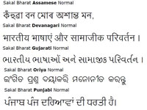
Sakal Bharati font
A single font which contains all the Indic scripts has been developed by CDAC Pune. This font has got consistent look and feel across various Indian Scripts including English language.
This font can be downloaded from the url: http://www.tdil-dc.in

Slide 37
Open font format fonts and Enhanced INSCRIPT Typing
You can download UNICODE compliant Open font format fonts and latest 22 language ENHANCED INSCRIPT Typing tool from http://ildc.in
It also supports Onscreen floating keyboard useful for novice users as well as Kiosk based applications
© 2012, C-DAC, Pune

Slide 38
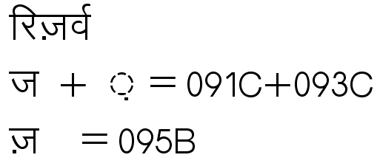

Normalization in Unicode
The Unicode data requires normalization. There are many cases where a character can be entered in more than one ways. If application or database does not normalize, searching becomes difficult.

Slide 39


Searching in Indian language Databases
Several words have multiple correct spellings and Alternate representation forms
eg: the word Hindi may be written
with a bindi on top of the first syllable or with a half na.
What should happen in case of using database queries
So also with the representations of the word vitthal

Slide 40
Searching in Indian language Websites
C-DAC along with NIC is developing a Government of India Directory Search Engine, specifically aimed at Indian E-governance websites
This search is being provided as a Service also
It also consists of ENHANCED INSCRIPT javascript floating keyboard. You can download the source code and guide for this keyboard from http://localisation.cdac.in

Slide 41
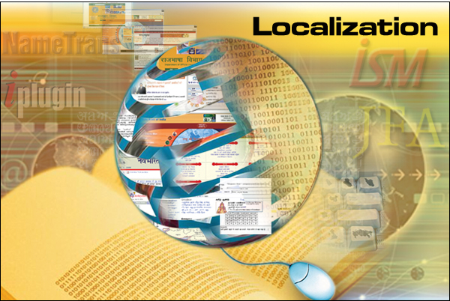
Terminology in user interface

Slide 42
Localisation of strings
Translation v/s Transliteration
Technical Term v/s common man’s Term
Physical-size of localised equivalent strings
3 out of 22 languages are right to left oriented
Location / Layout
  Positioning of back-next buttons, scroll bar positions for applications supporting right to left scripts.
  coexisting along with English (Bi-directional support)

Slide 43
Localisation of strings
Context and Domain specific meanings
  Example
  the word ‘Bank’ (Financial Entity, River bank, to trust on someone/thing, etc.)
  the word ‘Fire’ (may very in meaning depending on context) – If it is as a verb (such as fire an event) then it may suggest some action to be undertaken, If noun then the meaning changes completely
  Multi-Domain expertise as well as context may be required apart from linguistic know-how

Slide 44
Localisation of strings
Technical terminology
  Differentiating between similar meaning such as cancel, abort, terminate
  Translation v/s Transliteration (IPR and registered copyrights and trademarks)
  What should be Localised string for :
    Windows
    Mouse
    FireFox
    Internet Explorer
    Double click
    Dock Windows
    Getting consensus is difficult

Slide 45
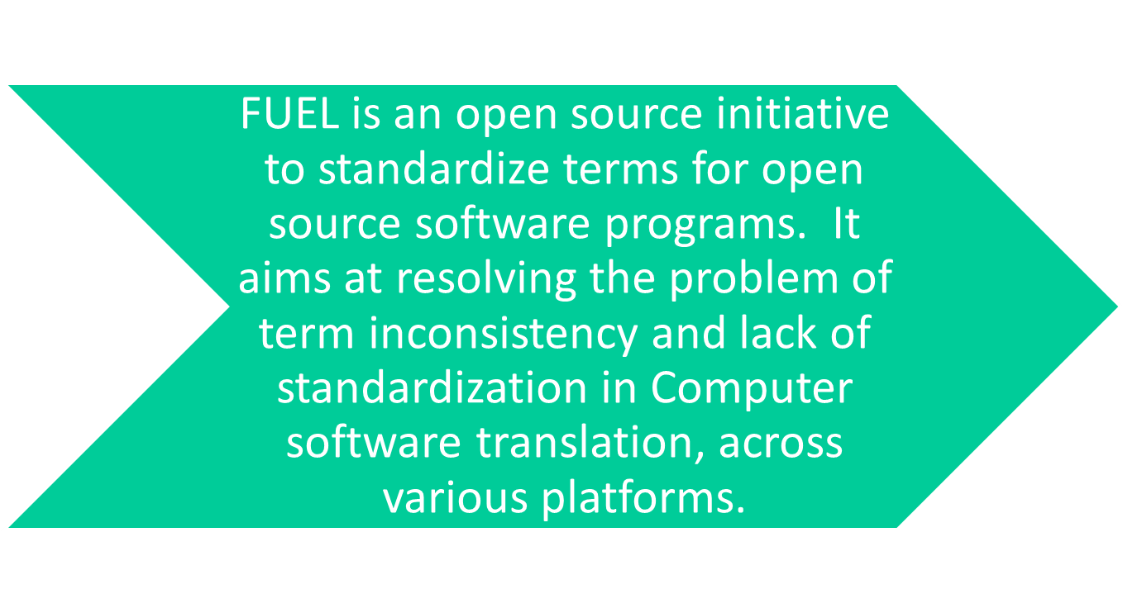
FUEL: Frequently Used Entries for Localization
https://fedorahosted.org/fuel/

Slide 46
FUEL
The GIST Group of CDAC is actively participating in the same and has initiated FUEL for “Web”, “Standalone Applications” and “Mobile” platforms.
It also works to provide a standard and consistent terminology for a language.
Following Indian language support has been added in this initiative. Following languages are being covered under the FUEL.
  Assamese, Bengali (India), Gujarati, Hindi, Maithili , Malayalam, Marathi , Punjabi, Oriya , Tamil, Telugu , Urdu, Kannada
Remaining languages work is in progress.
https://fedorahosted.org/fuel/

Slide 47
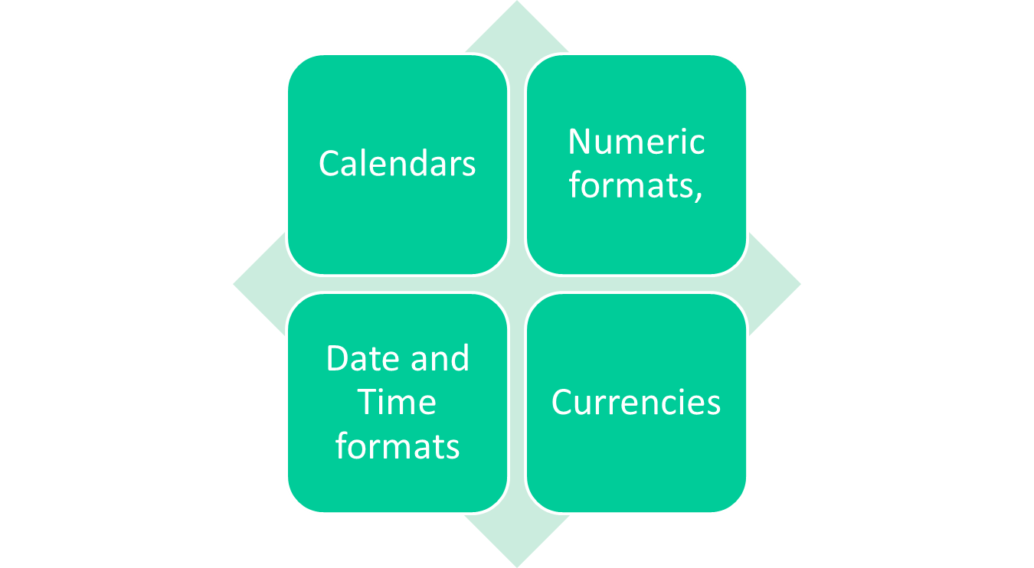
CLDR
http://cldr.unicode.org/
Notes:
The CLDR provides key building blocks for software to support the world's languages. The data in the repository is used by companies for their software internationalization and localization: adapting software to the conventions of different languages for such tasks as formatting of dates, times, time zones, numbers, and currency values; sorting text; choosing languages or countries by name; and many others.

Slide 48
Common Locale Data Repository (CLDR)
The CLDR provides key building blocks for software to support the world's languages.
The data in the repository is used by companies for their software internationalization and localization: adapting software to the conventions of different languages for such tasks as formatting of dates, times, time zones, numbers, and currency values; sorting text; choosing languages or countries by name; and many others. C.L.D.R.’s provide useful information as to the locale and are therefore crucial from the perspective of localization. Mobile based CLDRs should be made and used to enhance the localisation across different cultures and locales. CLDR mostly comprises of
Calendars
Numeric formats,
Date and Time formats
Currencies

Slide 49
Sample Extract of Dogri CLDR
<monthWidth type="wide">
<month type="1">जनवरी </month>
<month type="2"> फरवरी </month>
<month type="3">मार्च</month>
<month type="4">एप्रैल </month>
<month type="5">मेई </month>
<month type="6">जून </month>
<month type="7">जूलै </month>
<month type="8">अगस्त </month>
<month type="9">सितंबर </month>
<month type="10">अक्तूबर </month>
<month type="11">नवंबर </month>
<month type="12">दिसंबर </month>
For further details please refer: http://cldr.unicode.org/

Slide 50
धन्यवाद !
All training material available in resources section of http://localisation.gov.in

