Slide 1

CHICAGO DATA-ANALYTICS PROJECT
Chicago Safety & Commute Atlas
Where should a new hire live to stay safe and still reach the Loop on time?
Victoria · 475,651 incidents analyzed · June 2024-June 2026
Notes:
Hook: relocating to Chicago for a job in the Loop, safety is the top concern. This project finds the safest neighborhoods that still have a reasonable commute, using two years of city crime data.

Slide 2
01 · THE PROBLEM
The challenge
A SkillBridge participant is relocating to Chicago for a role at Krasan Consulting in the Loop (111 W Jackson Blvd). They're new to the city, safety is their #1 priority, and they're hearing conflicting advice about which areas are safe - with no clear, data-backed way to choose.
WHO IT'S FOR
Relocating employee
Needs a safe, commutable home
HR / relocation team
Wants a defensible recommendation
The question: Which neighborhoods are genuinely safe AND have a reasonable commute to the Loop?
Anyone new to Chicago
Vetting a specific address
Notes:
State the problem plainly. Emphasize: safety is priority one, but a safe place you can't commute from is useless - so we optimize for both. Audience is the employee, the HR team, and really anyone new to the city.

Slide 3


02 · GOALS & CRITERIA
What a good answer looks like
Safety first
Reasonable commute
Defensible & repeatable
Rank areas by VIOLENT crime, not raw totals - a low total can still hide high violence.
Favor a one-seat transit ride (or short drive/walk) to the Loop office.
Every claim traces to the data; the method works for any address.
Notes:
Three success criteria. The key analytical stance is the first one: we rank on violent crime, because total crime is misleading - which we prove a couple slides from now with Austin.

Slide 4
03 · THE DATA
Two years of Chicago crime
475,651
incidents analyzed
KEY PREP DECISIONS
•
Defined violent crime - 13 offense types (incl. arson, weapons)
24
months (Jun 2024-Jun 2026)
•
Excluded District 31 - Non-residential admin area (~21 rows)
•
Monthly averages ÷ 24 - Comparable per-month rates
22
police districts · 50 wards
•
Rebuilt day-of-week - Source column was misaligned - fixed from the date
Source: City of Chicago "Crimes - 2001 to Present" (Chicago Data Portal, ijzp-q8t2).
Notes:
Public city data. Call out that I made deliberate cleaning choices - and that I caught a real data-quality bug: the day-of-week column was shifted/misaligned for ~75% of rows, so I recomputed it from each incident's date.

Slide 5





04 · THE APPROACH
How I solved it - the Data Analytics Workflow
1
2
3
4
5
Ask
Prepare
Process
Analyze
Share
Frame the safe-+-commutable question
Pull & clean 2 yrs of city data
Flag violent crime, fix day-of-week, ÷24
Rank districts, find the patterns
Interactive dashboard + this deck
Result: a recommendation you can defend - and a tool to re-run for any address.
Notes:
Walk the five workflow stages quickly. The point: this wasn't ad-hoc - it followed a standard analytics workflow from question to shareable product.

Slide 6
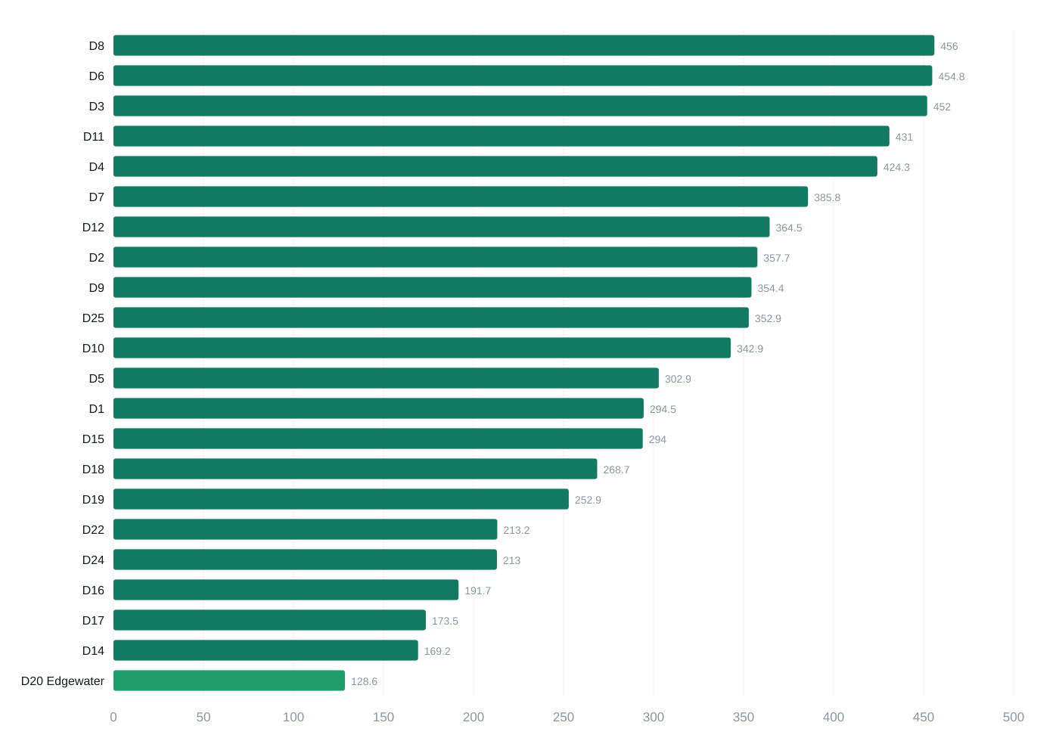
05 · FINDING 1
Edgewater is the safest district
LOWEST VIOLENT CRIME
D20
Edgewater
~129 violent / month
Also lowest on TOTAL crime - safest on both measures.
Average violent incidents per month, by police district (sorted). Chart from the live dashboard.
Notes:
Lead with the answer: Edgewater (District 20). It's lowest on violent crime AND lowest on total crime. The North-side and far-Southwest edges form the safe cluster.

Slide 7
06 · FINDING 2
Total crime alone is misleading
Same idea, three districts: a low total doesn't mean safe. Austin proves it - modest volume, but the highest violent share in the city.
SAFEST
THE TRAP
BUSY
Edgewater · D20
Austin · D15
The Loop · D1
30.6%
44.4%
25.9%
violent share
violent share
violent share
420 total/mo · 128.6 violent/mo
662 total/mo · 294 violent/mo
1137 total/mo · 294.5 violent/mo
Low total, low violence
Low-ish total, HIGH violence
High total, lower violent share
Citywide violent share ≈ 35%. Austin sits at 44% despite below-median total crime.
Notes:
This is the analytical centerpiece. Austin has lower total crime than the Loop, yet 44% of its crime is violent vs 26% in the Loop. So ranking by total crime would wrongly call Austin 'safer.' That's why we rank on violent crime.

Slide 8
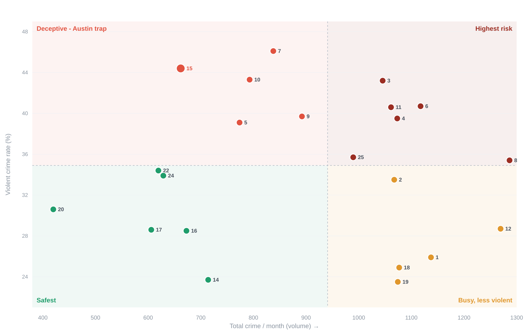
FROM THE DASHBOARD
The full landscape: volume vs. violence
Every district plotted by total crime (x) and violent share (y), split at the citywide medians into four zones:
Safest Low volume, low violence - e.g. Edgewater (20).
Deceptive Low volume but HIGH violence - Austin (15) is the trap.
Busy, less violent High volume, lower violent share - the Loop (1).
Highest risk High on both - avoid for relocation.
Interactive version (hover any district) on the live dashboard.
Notes:
This is the dashboard's signature chart. The four quadrants make the point visually: the green corner is where you want to live, and Austin sits alone in the red 'deceptive' zone - low total crime but the highest violent share. Edgewater anchors the safe corner.

Slide 9
07 · FINDING 3
Living closer to the office isn't safer
2.3×
more violent crime in the Loop than in Edgewater
~295 vs ~129 violent incidents per month
Downtown has more crime, not less - proximity to the office works against safety.
Notes:
Common assumption is that downtown = safe. The data says the opposite: the Loop runs about 2.3x Edgewater's violent crime. So you don't pay a safety premium to live near the office - you'd pay a penalty.

Slide 10
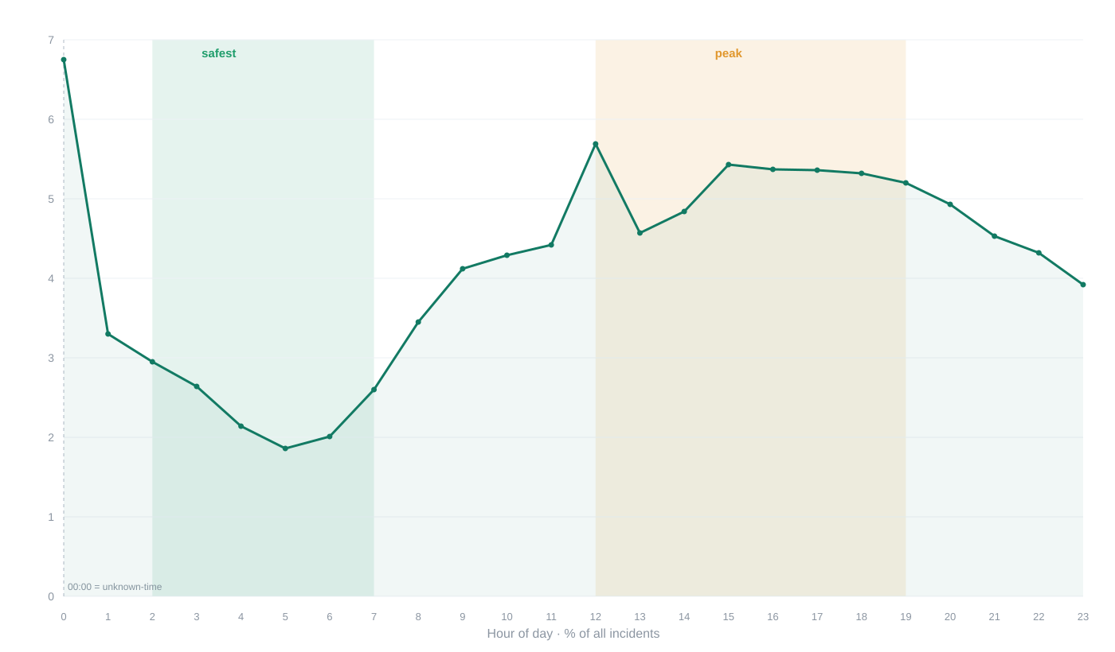
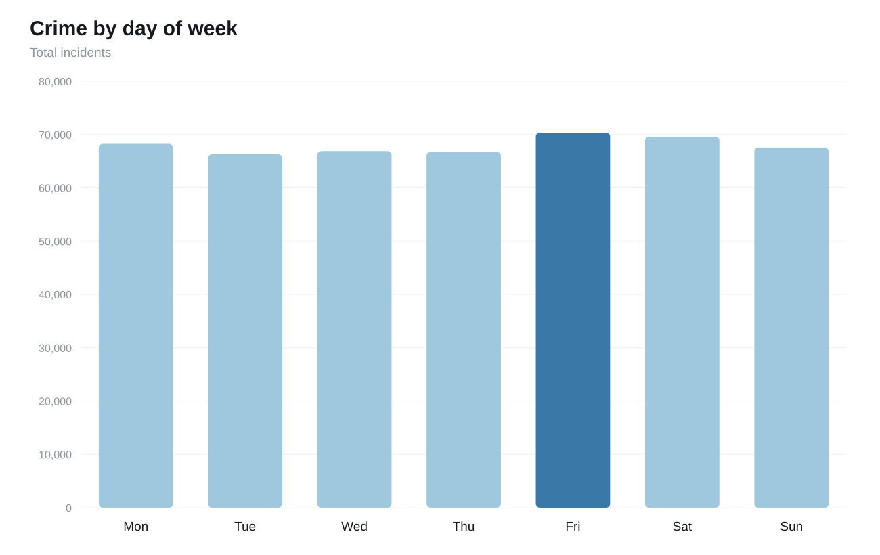
08 · FINDING 4
Time of day matters more than day of week
By hour: deep dip 2-7 AM, then a midday-and-evening peak.
By day: nearly flat - Friday only barely highest.
Takeaway: plan around the hour, not the day. (The 00:00 point is inflated by unknown-time reports.) Both charts from the live dashboard.
Notes:
Two time findings, both straight from the dashboard. Risk is lowest 2-7 AM and peaks midday through evening, but day of week is essentially flat (Friday barely highest), so it isn't worth acting on. The midnight spike is a data artifact - unknown times default to 00:00.

Slide 11
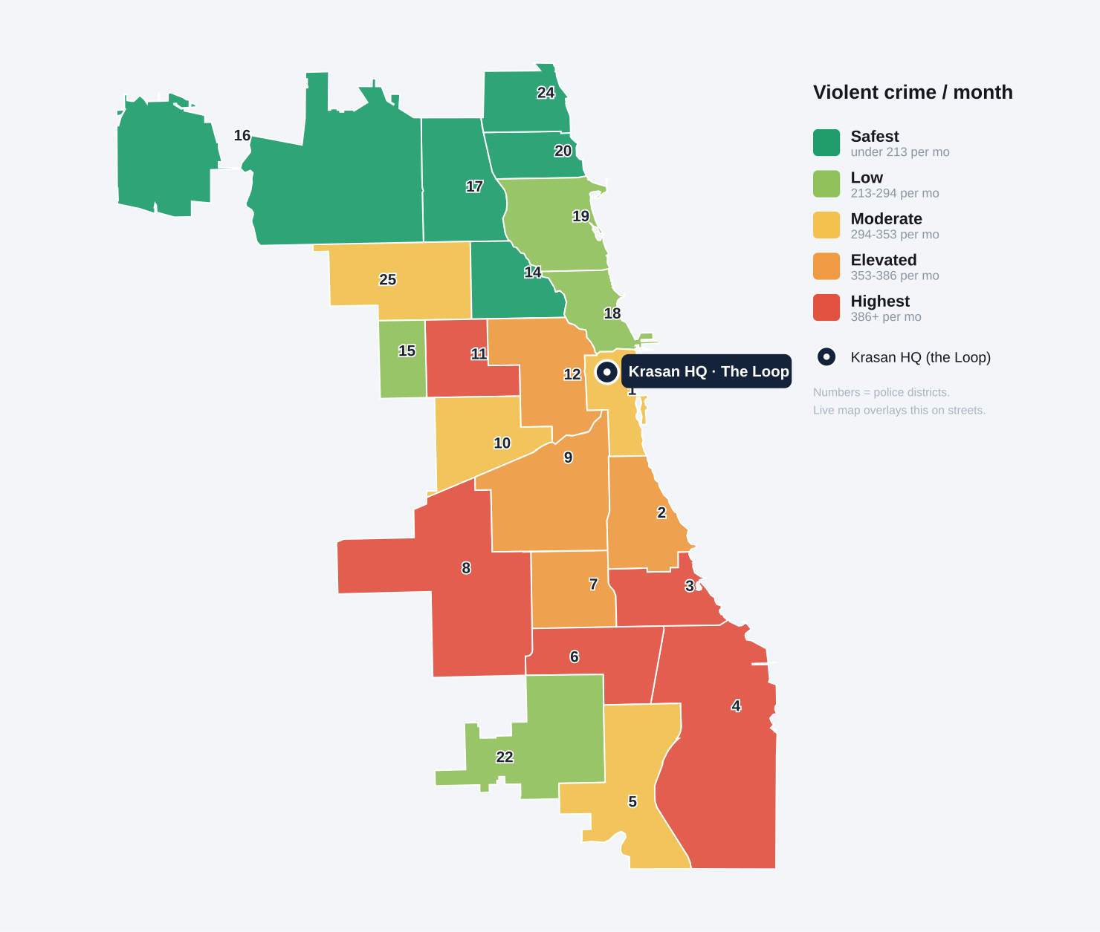
FROM THE DASHBOARD
The safety gradient, mapped
Every police district shaded by violent crime per month - the same green-to-red scale as the live map.
Safe ring up north Edgewater, Jefferson Park, Albany Park, Logan Square - all green.
Hotter west & south Most red districts sit far from the office anyway.
HQ in the Loop Central, busy, mid-range on violence - live near transit, not here.
Reproduced from the dashboard's district layer (street basemap not shown).
Notes:
This is the dashboard's map view - districts shaded by violent crime per month on the same green-to-red scale. The safe districts form a ring across the far north side; the higher-crime districts are mostly west and south, away from downtown. The HQ pin sits in the Loop, which is mid-range, reinforcing: live near good transit on the north side, not downtown.

Slide 12
09 · RECOMMENDATIONS
Five neighborhoods that fit
# | Neighborhood | Dist. | Violent/mo | Commute to the Loop | Why
1 | Edgewater | 20 | ~129 | Red Line direct, ~35 min | Best all-around
2 | Beverly | 22 | ~213 | Metra Rock Island → LaSalle, ~25-30 min | Easiest commute
3 | Logan Square | 14 | ~169 | Blue Line direct, ~20 min | Fastest in
4 | Jefferson Park | 16 | ~192 | Blue Line direct, ~40 min | Quietest feel
5 | Albany Park | 17 | ~174 | Brown Line, ~45 min | Best value
Top pick: Edgewater - safest overall. Easiest commute: Beverly - Metra drops you a block from the office.
Notes:
Five concrete recommendations, all safe AND commutable - proving there's no hard tradeoff. Edgewater is the all-around winner; Beverly is the commute winner with a Metra stop a block from Krasan.

Slide 13



10 · THE DELIVERABLE
An interactive atlas - not just a report
Map any layer
Search any address
Shade districts, wards, or beats by violent or total crime.
Get its ½-mile crime count and nearest CTA/Metra stop.
Compare the commute
Smart recommendation
Live driving route + walk + transit time to the Loop.
Suggests walk vs. transit automatically by distance.
Live: techwithvictoria.github.io/chicago-crime-dashboard
Notes:
The deliverable is an interactive dashboard, not a static report. Demo if time allows: type an address, show the ½-mile crime count and the commute card that recommends walk vs transit. This is what makes it reusable for any address.

Slide 14


11 · NEXT STEPS
What I'd do with more time
Per-capita rates
Real transit times
Bring in district population to normalize for size - fairer than raw counts.
Add a transit API for exact door-to-door commute minutes in-app.
More history & trends
Cost & amenities
Extend beyond 2 years to test whether areas are improving or worsening.
Layer in rent, schools, and grocery access for a true livability score.
Notes:
Honest about limits: raw counts not per-capita, transit time via a link not in-app, only 2 years. With more time I'd normalize by population, add a transit API, extend the history, and layer in cost/amenities for a full livability score.

Slide 15
In one line
Edgewater is the safest bet, the Loop is riskier than it looks, and every safe pick still reaches the office.
475,651 incidents · ranked on violent crime · matched to commute
Thank you · techwithvictoria.github.io/chicago-crime-dashboard
Notes:
Close on the one-line takeaway and invite questions. Recap: ranked on violent crime (not totals), proved closer isn't safer, and delivered both a recommendation and a reusable tool.

