Slide 1
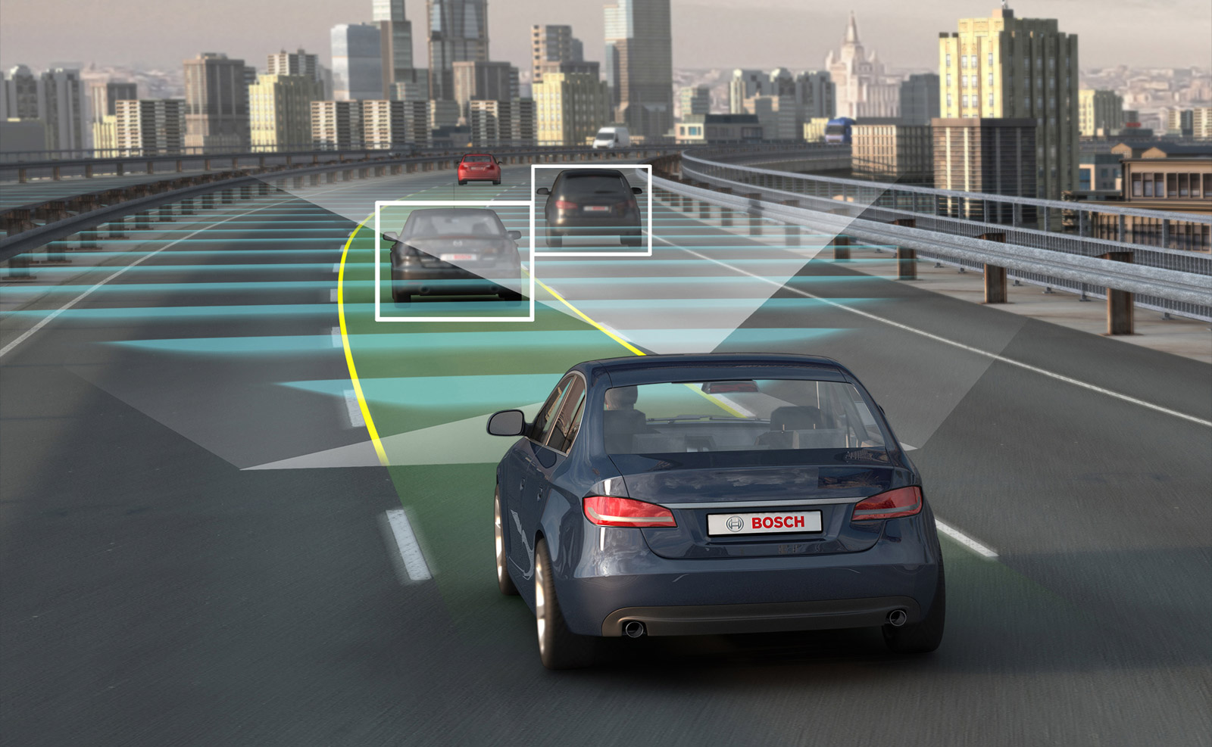
VIRTUAL SELF DRIVING CAR ENVIRONMENT
Name register number
Arihant jain ra1511003020282
Satyam Agarwal ra1511003020280
Aubhropratim manna ra1511003020310
Naveen bakshi ra1511003020309

Slide 2
ABSTRACT
The object of the project is to design and finalise contstruction of a remotely controlled car (which maybe controlled via an operating system installed in a computer or cell phone, etc)
The car will possess the ability to detect objects and classify them according to multiple machine learning and statistical algorithms which we will be carefully selected and implemented to obtain the optimal results with minimal redundant flaws.
Various classifying, clustering algorithms will be used to train the car’s AI after supplying it with ample datasets obtained through dry runs and trial and error.

Slide 3
Existing
With the work of Dalal & Triggs (2005), linear Support Vector Machines (SVMs), that maximizes the margin of all samples from a linear decision boundary, in combination with Histogram of Orientation (HOG) features have become popular tools for classification. However, all previous methods rely on hand-crafted features that are difficult to design. With the renaissance of deep learning, convolutional neural networks have automated this task while significantly boosting performance.

Slide 4
Proposed
In order to detect the car based on our feature set, we would need a prediction model. For this particular case we will be using Linear Support Vector Machines(Linear SVMs). It is a supervised learning model which will be able to classify whether something is a car or not after we train it.
Histogram oriented gradients features have been scaled to zero mean and unit variance.

Slide 5
Literature Survey
An internetworked openCV vehicle with object detection and classification Published in: System of Systems Engineering Conference (SoSE), 2017 Date of Conference: 18-21 June 2017
Self-driving cars are posed to create a major change in the way people are transported. They may reduce car ownership with low-cost shared-vehicle services moving from one transport job to the next . For those that choose to still own vehicles, they may make transportation faster, safer and more reliable. They may even allow certain pickup and delivery tasks to be performed without a driver. Current commercially available vehicles offer some automation, such as self-parking and even limited driving in some circumstances . Commercial testing of more fully autonomous vehicles is currently underway . These vehicles, however, must - and are designed to - interact with human-driven vehicles. While human drivers may be common for the foreseeable future, many additional benefits of autonomous vehicles can only be realized through vehicle-to-vehicle coordination.

Slide 6
Literature Survey
Self-driving and driver relaxing vehicle Published in: Robotics and Artificial Intelligence (ICRAI), 2016 2nd International Conference Date Added to IEEE Xplore: 22 December 2016
Automated vehicles are technological development in the field of automobiles. Although the automated vehicles are for ease of humankind yet they are the most expensive vehicles. In the paper considering the different features and the cost, on a small scale a three wheel Vehicular Robotic prototype has been designed that will automatically reach the destination of another vehicle to which it is supposed to follow. Since taking intelligent decisions in the traffic is also an issue for the automated vehicle so this aspect has been also under consideration in this paper.

Slide 7
Literature Survey
Cloud Based Self Driving Cars : This paper presents a novel idea for reducing the data storage problems in the self-driving cars. Self-driving cars is a technology that is observed by the modern word with most curiosity. However the vulnerability with the car is the growing data and the approach for handling such huge amount of data growth. This paper proposes a cloud based self-driving car which can optimize the data storage problems in such cars. The idea is to not store any data in the car, rather download everything from the cloud as per the need of the travel. This allows the car to not keep a huge amount of data and rely on a cloud infrastructure for the drive.

Slide 8
Literature Survey
Virtual Assistants and Self-Driving : To what extent is Artificial Intelligence needed in Next-Generation Autonomous Vehicles?
Self-driving cars are technologically a reality and in the next decade they are expected to reach the highest level of automation. While there is general agreement that an advanced human-autonomous vehicle (HA V) interaction is key to achieve the benefits of self-driving cars, it is less clear what role artificial intelligence (AI) should play in this context. While the scientific community is debating on the role and intersections of AI, autonomous vehicles and related issues, above all ethics, the automotive industry is already presenting AI-based products and services that may influence, in a direction or in another, our technological and societal futures. This paper focuses on virtual assistants, the personification of the car intelligence incorporating, among others, an algorithmic "brain", a synthetic human "voice" and powerful sensor-based "senses". Should virtual assistants just assist humans or replace them whenever necessary? Should their scope of action be limited to safetyrelated driving tasks or to any activity performed in the car or controlled from the car? Although at a very early stage of commercial development, the paper will review the state-of-theart of in-car virtual assistants underlining their role and functions in the connected and automated driving ecosystem. By drawing from earlier reflections on automation, robots and intelligent agents, it will then identify a series of issues to be addressed by the scientific community, policy-makers and the automotive industry stakeholders.

Slide 9
Literature Survey
Self-Driving Cars:
Significant improvements in the last decade have greatly advanced self-driving car technology. These new capabilities will have profound global impacts that could markedly change society, not to mention the significant improvements they bring to the overall efficiency, convenience, and safety of our roadways and transportation systems. Addressing self-driving technology– related concerns is important, particularly given these broad potential impacts. Worldwide, 10 trillion automobile miles are driven each year, with complex and novel conditions generating millions of situations in which autonomous vehicles could fail. Yet there are many challenges that remain across all levels of system functionality. .

Slide 10
Paper Research
S.No | PAPER NAME | PROS | DRAWBACKS
1 | Self-driving and driver relaxing vehicle | Vehicular Robotic prototype has been designed that will automatically reach the destination of another vehicle to which it is supposed to follow | No scope for enhancement since setup is rugged and predominantly operated in a singular way
2 | An internetworked openCV vehicle with object detection and classification | It developed a Object detection algorithm which is advanced than previous build uses yolo detection | Feature pixilation not wide enough for some objects to identify and for the vehicle to react to their presence
3 | Self driving cars: A peep into the future | It deals with new capabilities will have profound global impacts that could markedly change society in future, they bring to the overall efficiency, convenience, and safety of our roadways and transportation systems. | Algorithms used not updated and more efficient and easier algorithms are available to be used
4 | Cloud Based Self Driving Cars | It deals with training and deployment of self driving car model in cloud and its implementations | Susceptible to security threats like malicious intermediary that may interfere with the operation scheduling of the vehicle

Slide 11
S.No | PAPER NAME | PROS | DRAWBACKS
5 | Virtual Assistants and Self-Driving | It aims to provide virtual assistant to the driver mainly discusses in traffic, highways | Does not deal with a backup in case of automated system failure
6 | Driving tests for self-driving cars | Created a cloud environment to deploy and test self driving model | Implementations of updated algorithms not supported
7 | Interpretable Learning for Self-Driving Cars by Visualizing Causal Attention | It shows how to train self car driving car model efficiently fast using visualizing causal attention | The methodology is neither the most accurate nor the most cost efficient.
8 | End-To-End Ego Lane Estimation Based on Sequential Transfer Learning for Self-Driving Cars | It deals with end to end lane estimation of vehicles based on Sequential learning for self driving car | Hard coding of numerous scenarios with the inability to learn from preceding tests.
9 | Detecting unexpected obstacles for self-driving cars: Fusing deep learning and geometric modelling | It develops and modifies the previous object detection algorithm to detect unexpected object detection | It involves advanced techniques and recommended for semi-experts
10 | Controlled parking for self-driving cars | It develops algorithm to assist driver in parking of vechile | Deals with one of the many aspects of an autonomous system(although highly efficient)

Slide 12
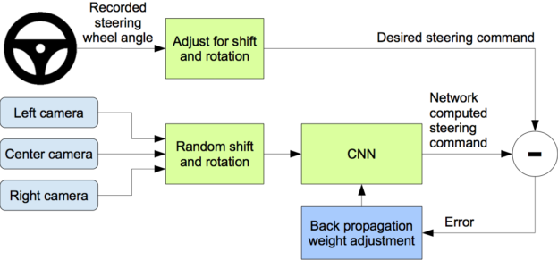
Architecture Diagram

Slide 13
Modules
SENSOR FUSION: The systems can fuse data from multiple cameras, as well as lidar, radar, and ultrasonic sensors. This allows algorithms to accurately understand the full 360-degree environment around the car to produce a robust representation, including static and dynamic objects. Use of deep neural networks for the detection and classification of objects dramatically increases the accuracy of the fused sensor data.

Slide 14
Modules
ARTIFICIAL INTELLIGENCE AND DEEP LEARNING
AI platforms are built around deep learning. With a unified architecture, deep neural networks can be trained on a system in the datacentre, and then deployed in the car. Systems can reduce neural network training in the data centre from months to just days. The resulting neural net model runs in real-time on DRIVE hardware inside the vehicle.

Slide 15
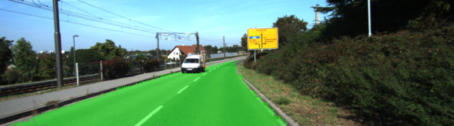
Modules
Semantic Segmentation
The object of this project is to label the pixels of a road image using the Fully Convolutional Network (FCN) described in the Fully Convolutional Networks for Semantic Segmentation. More or less the idea is to reproduce the results obtained. Here is an image showing the result of the segmentation.

Slide 16
Our Aim
As In Traffic the driver gets frustrated by handling clutch , break and steering continuously for very short distance . Sometimes in traffic the changes in break , clutch and steering are not made fast and accurate which leads to car or truck moving backwards or hitting someone at front . The driver also gets tensed and anxiety about it and try to avoid traffic by overtaking , rash driving etc.
Moreover to give driver , a relax in the traffic jam ,the self driving car can be more useful. The driver need not to worry about the car and can concentrate on other jobs.

Slide 17
THANK YOU

