Slide 1
MATHEMATICAL FOUNDATIONS FOR COMPUTING
SEMESTER 1

Slide 2
SETS
collection of well defined and distinct objects, considered as an object in its own right
N : the set of all natural numbers
Z : the set of all integers
Q : the set of all rational numbers
R : the set of real numbers
Z+: the set of positive integers
Q+: the set of positive rational numbers
R+: the set of positive real numbers.

Slide 3
(i) Objects, elements and members of a set are synonymous terms.
(ii) Sets are usually denoted by capital letters A, B, C, X, Y, Z, etc.
(iii) The elements of a set are represented by small letters a, b, c, x, y, z, etc.

Slide 4
Representing a set
(i) Roster or tabular form
(ii) Set-builder form.

Slide 5
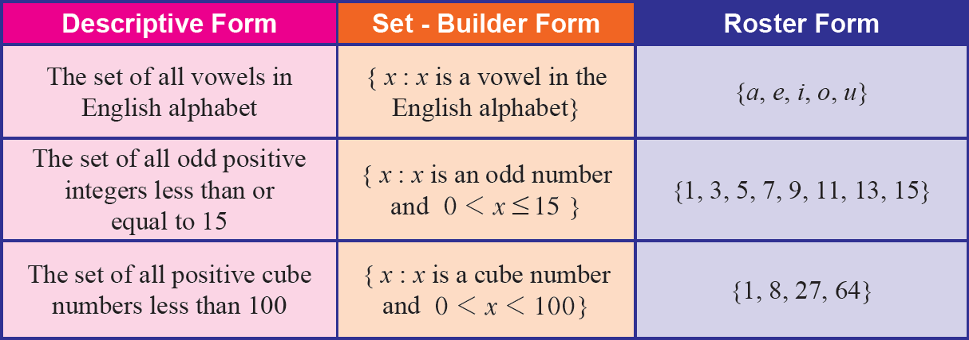

Slide 6
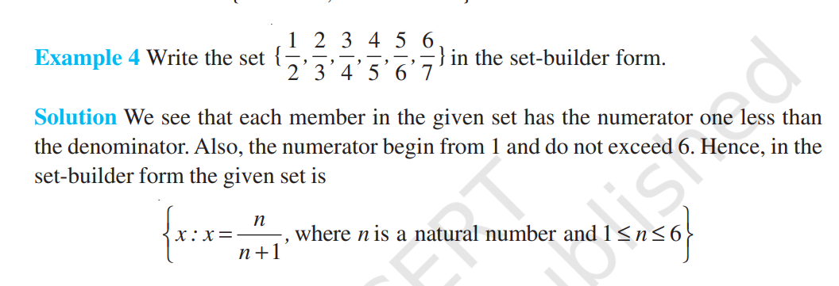
example
Example 4 Write the set
1 2 3 4 5 6 { }
2 3 4 5 6 7
, , , , , in the set-builder form.

Slide 7

Empty set / Null set / Void set
B = { x : x is a student presently studying in both Classes X and XI }
In mathematics, the empty set is the unique set having no elements; its size or cardinality (count of elements in a set) is zero. Some axiomatic set theories ensure that the empty set exists by including an axiom of empty set, while in other theories, its existence can be deduced.
empty set is denoted by the symbol φ or { }

Slide 8
Finite and Infinite Sets
A = {1, 2, 3, 4, 5}
C = { men living presently in different parts of the world}
A set which is empty or consists of a definite number of elements is called finite
Otherwise, the set is called infinite.

Slide 9
Equal Sets
Let A = {1, 2, 3, 4} and B = {3, 1, 4, 2}. Then A = B
sets A = {1, 2, 3} and B = {2, 2, 1, 3, 3} are equal

Slide 10
Subsets
A set A is said to be a subset of a set B if every element of A is also an element of B
A ⊂ B if a ∈ A ⇒ a ∈ B

Slide 11
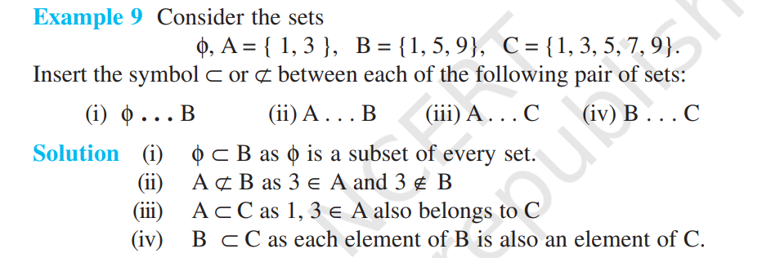
example

Slide 12
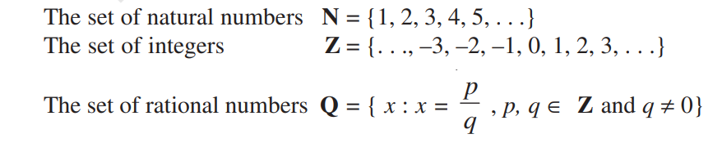
Subsets of set of real numbers

Slide 13
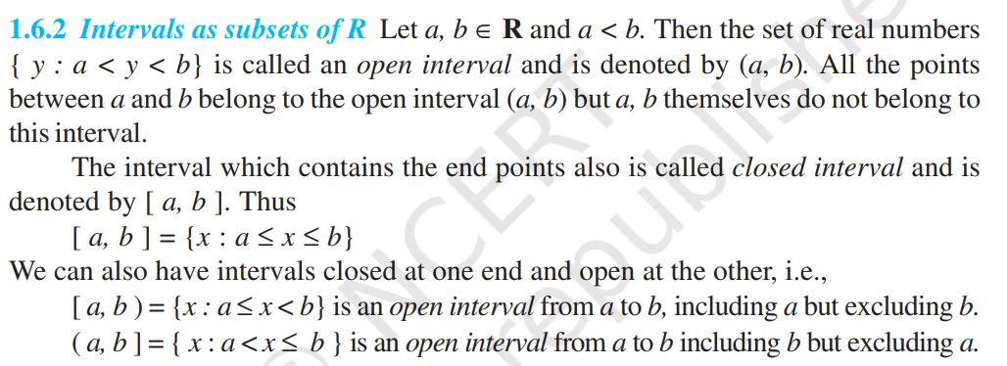

Slide 14
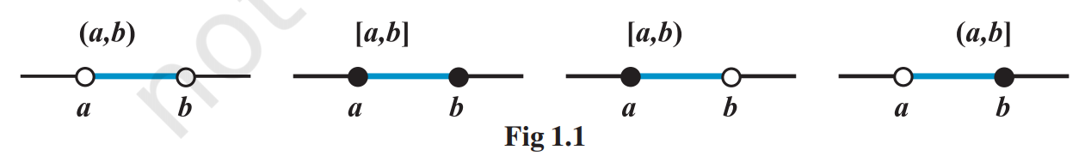

Slide 15
Power Set
The collection of all subsets of a set A is called the power set of A
It is denoted by P(A). In P(A), every element is a set
P( A ) = { φ,{ 1 }, { 2 }, { 1,2 }}

Slide 16
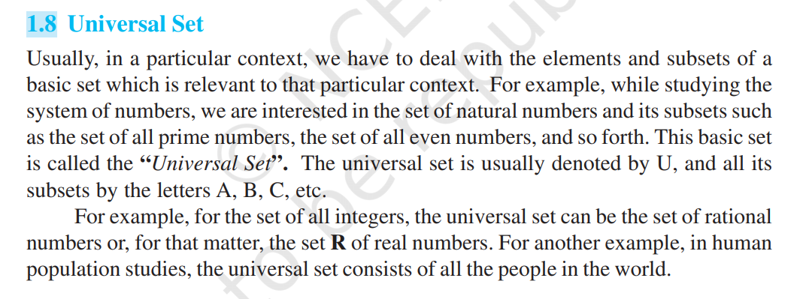
Universal Set

Slide 17
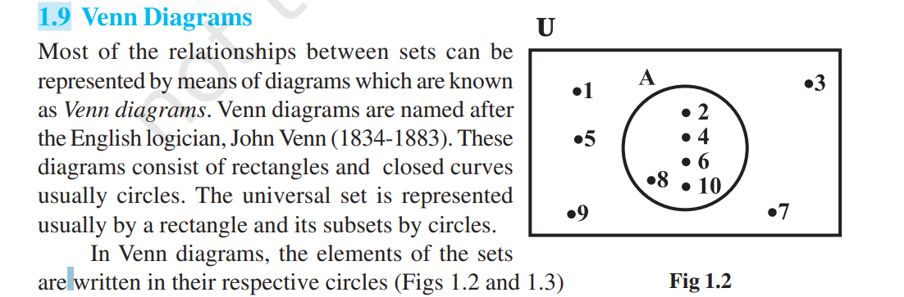
Venn Diagrams

Slide 18
Operations on Sets
Union of sets
A ∪ B and usually read as ‘A union B’
Intersection of sets
A ∩ B = {x : x ∈ A and x ∈ B}
Difference of sets
A – B and read as“ A minus B”

Slide 19
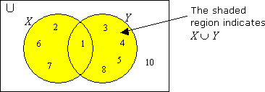
Union of sets
(i) A ∪ B = B ∪ A (Commutative law)
(ii) ( A ∪ B ) ∪ C = A ∪ ( B ∪ C) (Associative law )
(iii) A ∪ φ = A (Law of identity element, φ is the identity of ∪)
(iv) A ∪ A = A (Idempotent law)
(v) U ∪ A = U (Law of U)

Slide 20
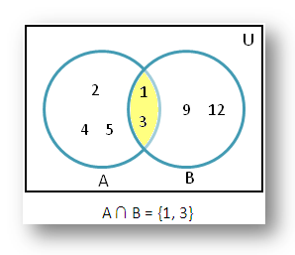
Intersection of sets
(i) A ∩ B = B ∩ A (Commutative law).
(ii) ( A ∩ B ) ∩ C = A ∩ ( B ∩ C ) (Associative law).
(iii) φ ∩ A = φ, U ∩ A = A (Law of φ and U).
(iv) A ∩ A = A (Idempotent law)
(v) A ∩ ( B ∪ C ) = ( A ∩ B ) ∪ ( A ∩ C ) (Distributive law ) i. e.,
∩ distributes over ∪

Slide 21
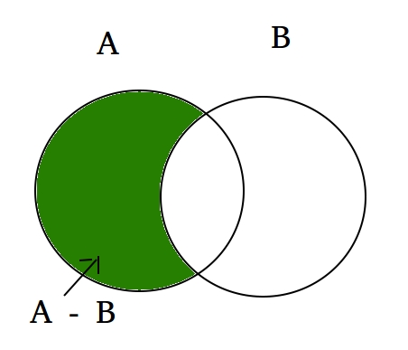
Difference of sets
A – B = { x : x ∈ A and x ∉ B }

Slide 22
Complement of a Set
Let U be the universal set and A a subset of U. Then the complement of A is the set of all elements of U which are not the elements of A.
Symbolically, we write A′ to denote the complement of A with respect to U. Thus,
A′ = {x : x ∈ U and x ∉ A }. Obviously A′ = U – A

Slide 23
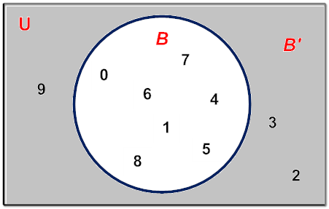

Slide 24
Properties of Complement Sets
1. Complement laws: (i) A ∪ A′ = U (ii) A ∩ A′ = φ
2. De Morgan’s law: (i) (A ∪ B)´ = A′ ∩ B′ (ii) (A ∩ B)′ = A′ ∪ B′
3. Law of double complementation : (A′)′ = A
4. Laws of empty set and universal set φ′ = U and U′ = φ.

Slide 25
Thank You ...

