Slide 1

Police Feedback System A Comprehensive Solution for Transparent Communication
TechDudes
Janesh Atrey, Captain
Ravi Bairwa, Team Member 2
Vivekananda Global University, Jaipur

Slide 2
The Need for Open Dialogue
Building trust between police and communities is crucial for public safety.
Traditional feedback methods (phone calls, surveys) have limitations.
We need a modern, accessible platform for open communication.
January 17, 2024

Slide 3
Introducing the Police Feedback System
Overview
Developed a comprehensive Police Feedback System to enhance community engagement and safety.
Objective
Facilitate seamless communication between law enforcement and the community through a user-friendly platform.
Importance
Emphasize the crucial role of community feedback in improving law enforcement services.

Slide 4
Features at a Glance
Quick Feedback Submission
Dynamic Feedback Statistics
Community Stories
Latest Feedback Feed
Engagement Features
Emergency Contact Information
Safety Tips Section
Upcoming Events Calendar
Notification Banners
Responsive Design
About Section
Social Media Integration
Community Updates or Announcements
Feedback Categorization - Politeness, Safety, Response Time
Chatbot

Slide 5
Technical Stack
HTML
Used for structuring the content and layout of the web application.
CSS
Applied for styling and designing the visual presentation of the user interface.
JavaScript
Implemented to add interactivity, dynamic content, and enhance the user experience.

Slide 6
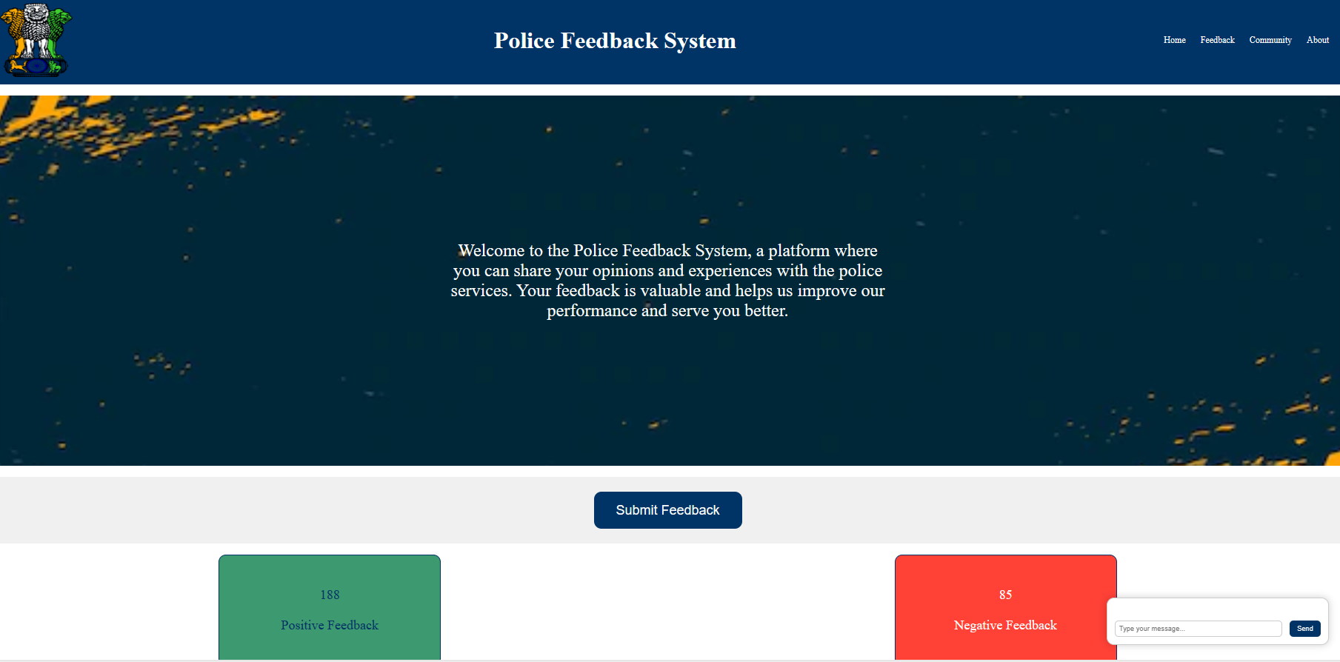
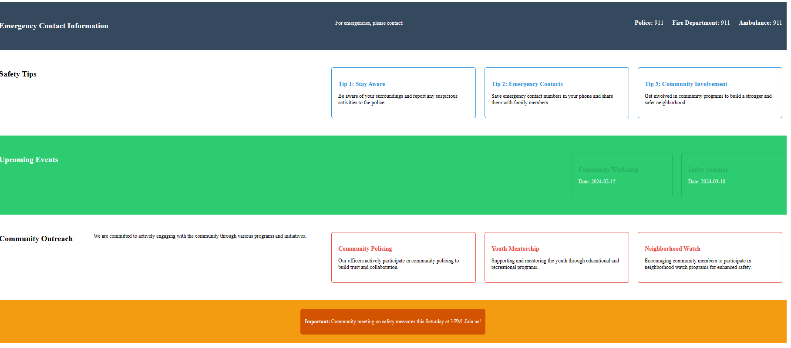
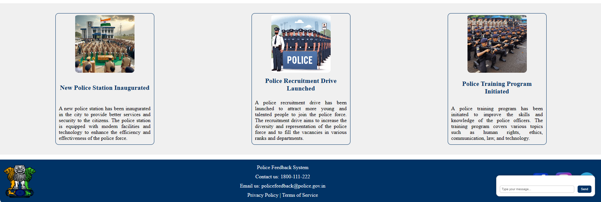
Demonstration

Slide 7
Benefits for Police
Improved training and procedures based on community feedback.
Increased accountability and public trust.
Enhanced community partnerships.

Slide 8
Benefits for Public
Voice their concerns and have them heard.
Contribute to positive change in police practices.
Feel safer and more connected to the police.

Slide 9
Future Enhancements
Advanced Feedback Analysis
Machine Learning Integration
Mobile Application Development
Multi-language Support
Enhanced Chatbot Functionality
User Authentication and Authorization

Slide 10
Conclusion
Strengthens the bond between the community and law enforcement.
Express gratitude to the community and law enforcement for their support and participation.
Emphasized the collaborative effort needed for a safer and connected community.
Excited about the future possibilities and the positive impact the Police Feedback System can continue to make.

Slide 11
Conclusion
Strengthens the bond between the community and law enforcement.
Express gratitude to the community and law enforcement for their support and participation.
Emphasized the collaborative effort needed for a safer and connected community.
Excited about the future possibilities and the positive impact the Police Feedback System can continue to make.

Slide 12
"The public are our partners, not our subjects. Without their trust and cooperation, we cannot effectively fulfill our mission." - Sir Robert Peel, Founder of Modern Policing.

Slide 13
Q&A
How can community members submit feedback quickly?
How is feedback categorized?
Why did you choose to primarily highlight frontend technologies in your presentation, with limited mention of backend technologies?
We have a user-friendly interface that allows for quick and easy feedback submission. Simply navigate to the designated section on our platform and follow the prompts.
Feedback is categorized based on key aspects such as Politeness, Safety, and Response Time. This categorization helps us address specific areas of improvement.
Thank you for your question. In the development of the Police Feedback System, we chose to focus on creating a seamless and user-friendly frontend experience to prioritize quick and accessible community feedback. As of now, the system operates in a simplified manner where the frontend directly handles user interactions and data presentation.

Slide 14
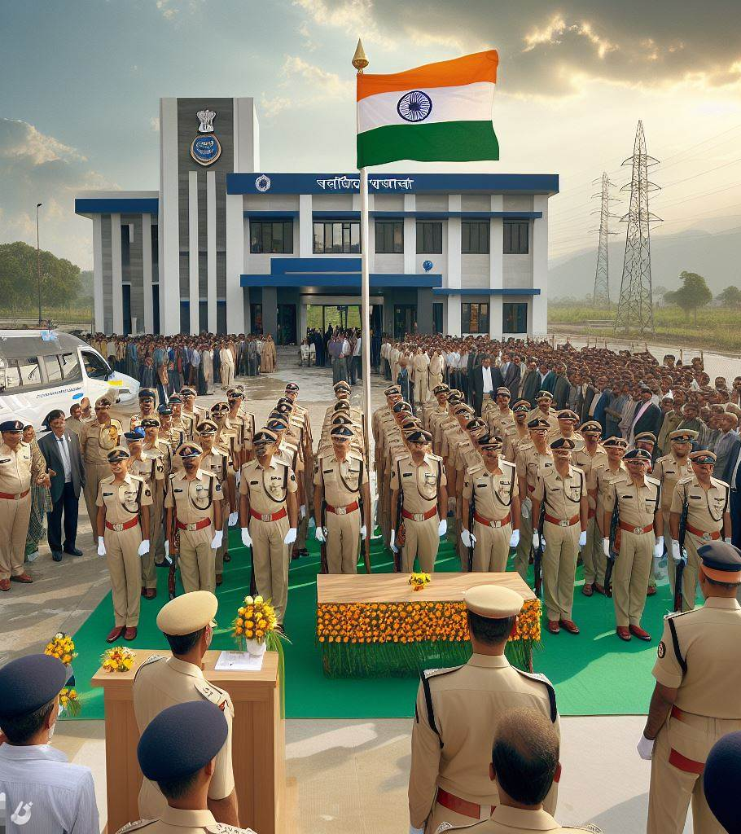
Thank you
Thank you for taking the time to join us today and explore the Police Feedback System. Your presence and engagement have made this presentation truly special.
TechDudes

