Slide 1

SOFTWARE AND HARDWARE PREFETCHING
By-
Rahul Sahani-18114062
Ritik Jain-18114068
Prateek Sachan-18114062
Vikas Upadhyay-18116083

Slide 2
INTRODUCTION :
Prefetching is a technique used by computer processors to boost execution performance by fetching instructions or data from their original storage in slower memory to a faster local memory before it is actually needed . Most modern computer processors have fast and local cache memory in which prefetched data is held until it is required. The source for the prefetch operation is usually main memory. Because of their design, accessing cache memories is typically much faster than accessing main memory, so prefetching data and then accessing it from caches is usually many orders of magnitude faster than accessing it directly from main memory

Slide 3
PREFETCH TYPES :
Hardware based prefetching
Software based prefetching

Slide 4
HARDWARE BASED PREFETCHING :
Hardware based prefetching is typically accomplished by having a dedicated hardware mechanism in the processor that watches the stream of instructions or data being requested by the executing program, recognizes the next few elements that the program might need based on this stream and prefetches into the processor's cache.
The hardware prefetching scheme is used to prefetch instructions via the use of additional hardware support, which increases the power consumption and the cost.
The scheme optimizes the instructions temporarily, i.e. It uses temporal locality.
Our implementation analyzes we used sequential and stride prefetching with GHB.

Slide 5
SOFTWARE BASED PREFETCHING :
Software based prefetching is typically accomplished by having the compiler analyze the code and insert additional "prefetch" instructions in the program during compilation itself.
The success of software prefetching depends primarily on identifying and inserting prefetch instructions only for those accesses that are most likely to generate cache misses.

Slide 6
SOFTWARE PREFETCHING :
To evaluate the techniques intel's mmprefetch instruction is used which is supported by g++ compiler. It basically fetches the line of data from memory that contains the byte specified with the source operand to a location in the cache hierarchy specified by a locality hint.
We also used __m128d data type for memory blocks as it supports memory alignment.
Compiler directed prefetching is used within loops with a large number of iterations. The compiler predicts future cache misses and inserts a prefetch instruction based on the miss penalty and execution time of the instructions.

Slide 7
We calculate parameters with and without prefetch enabled.
These prefetches are non-blocking memory operations, i.e. these memory accesses do not interfere with actual memory accesses.
They do not change the state of the processor or cause page faults.
So time taken is found to be significantly reduced by 20-25%.

Slide 8
Hardware Prefetching

Slide 9
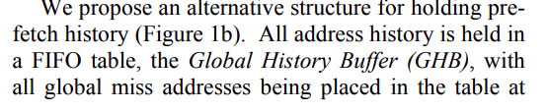
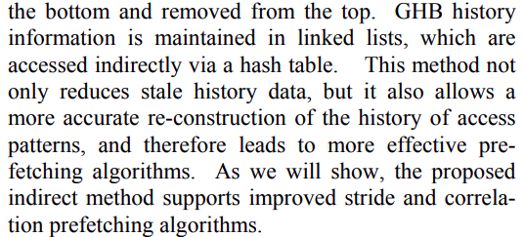
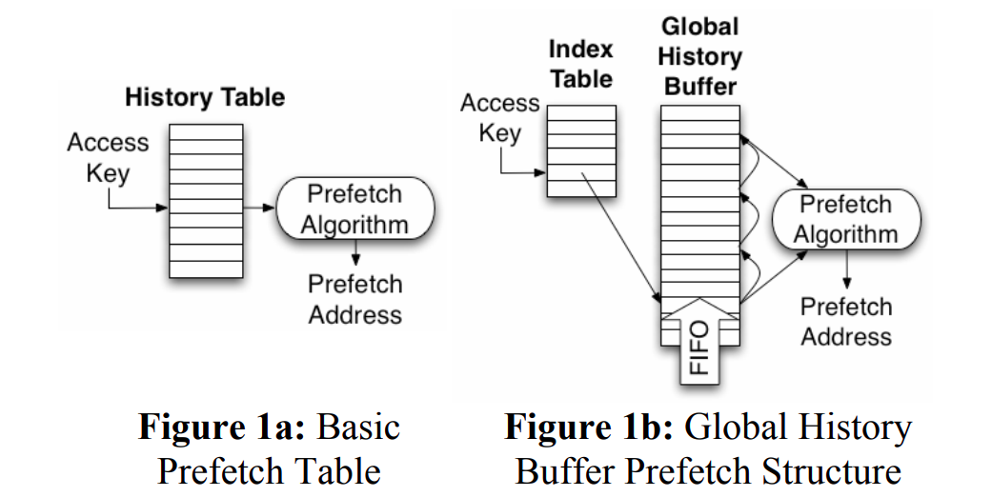
Global History Buffer (GHB) Structure :

Slide 10
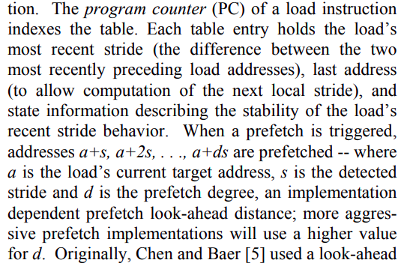
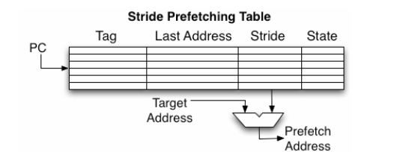
Stride Prefetching :

Slide 11
Sequential Prefetching :

Slide 12
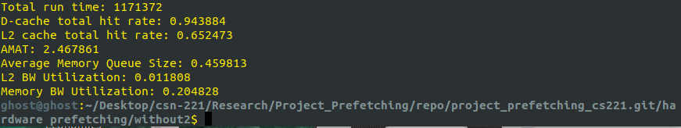
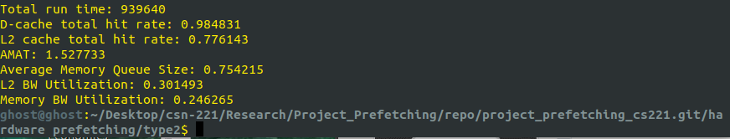
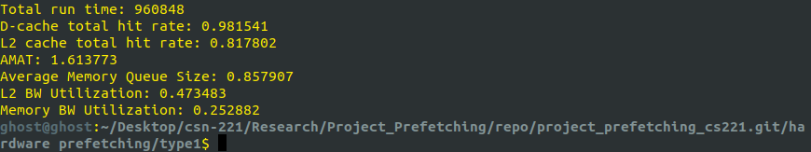

Slide 13
HARDWARE VS SOFTWARE PREFETCH :
The hardware scheme has no information that allows it to avoid unnecessary prefetches.
There is no CPU-overhead associated with these extra prefetches as long as they are not on the critical path of the processor in hardware prefetching.
Since the prefetches have no knowledge of potential reuse, the hardware scheme is more likely to bring data that are not useful.
On the other hand, the hardware mechanism can prefetch data that have been replaced due to conflict misses.

Slide 14
EVALUATION :
The evaluation of the prefetching scheme was done using 3 of the
standard benchmarks/ traces :
(i) g++
(ii) grep
(iii) plamap

Slide 15
HARDWARE PREFETCHING DATA

Slide 16
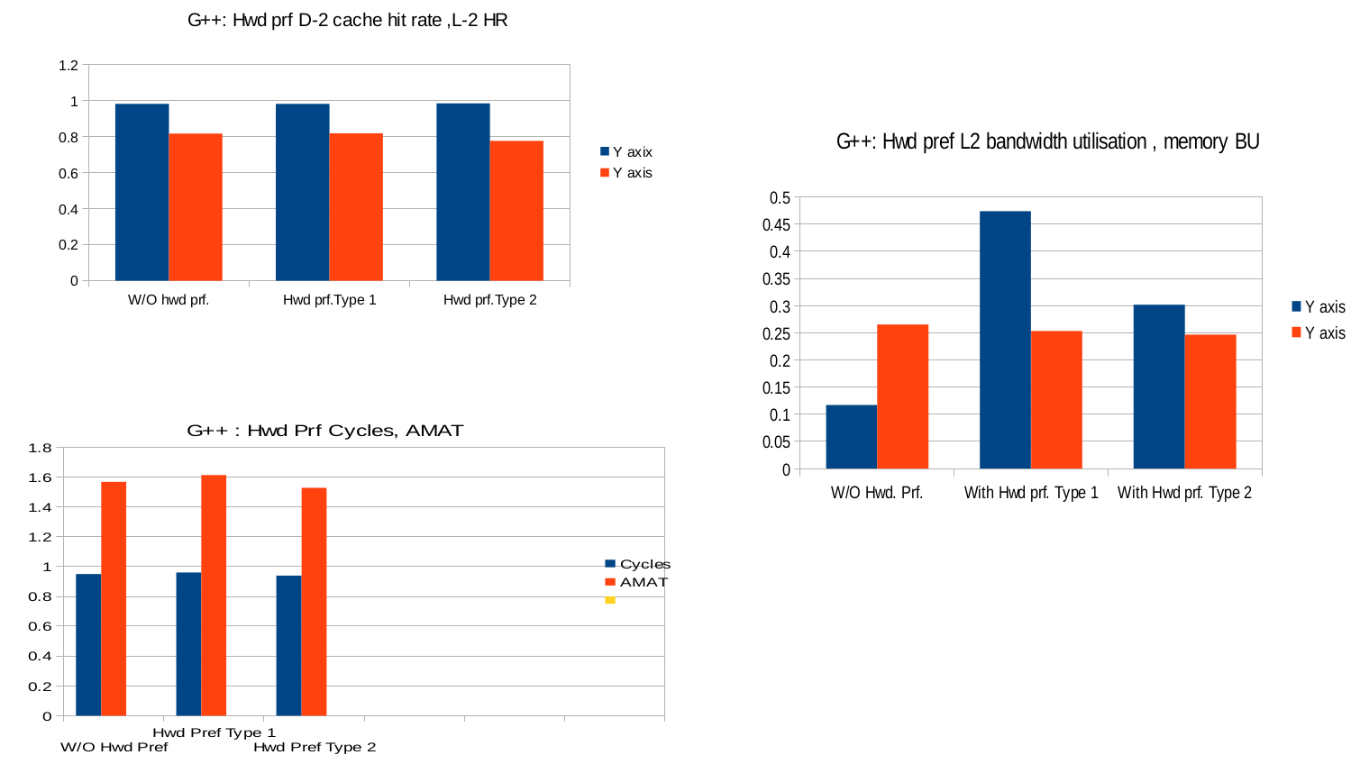
Benchmark/ Trace File : g++

Slide 17
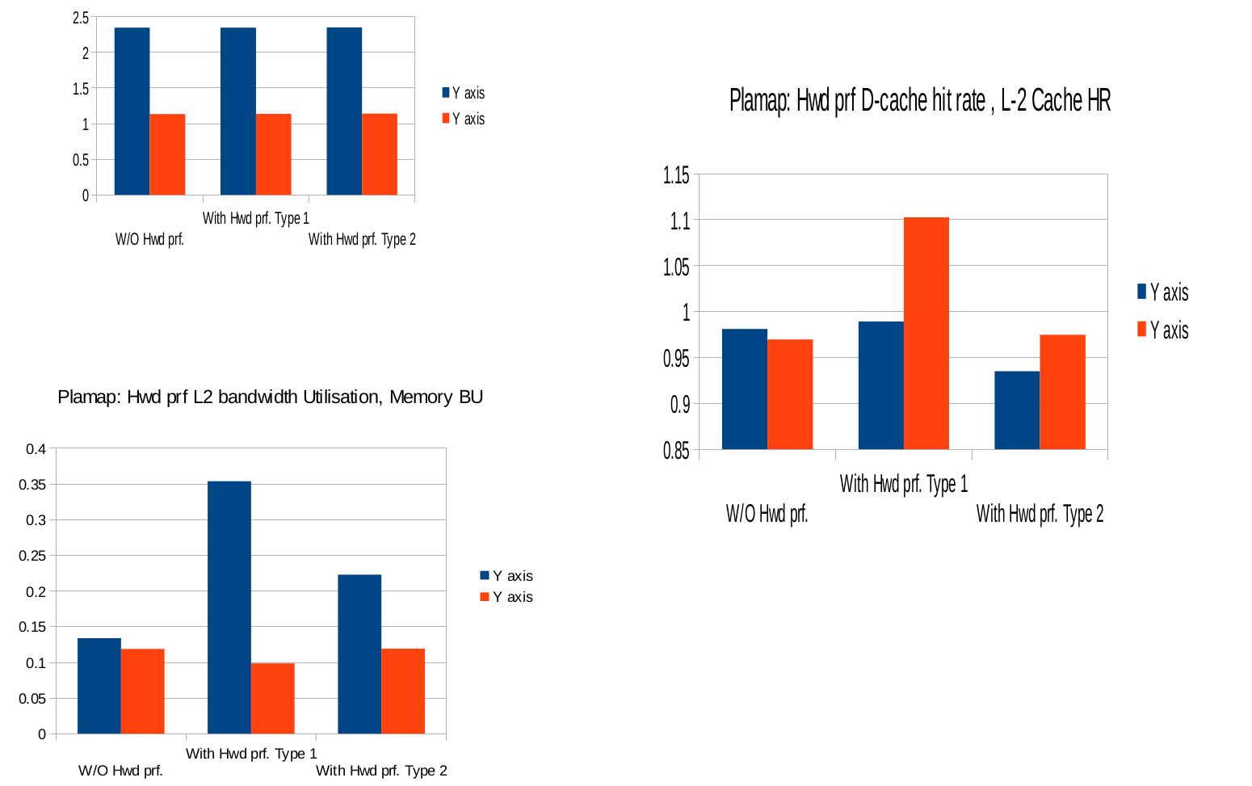
Benchmark/ Trace File : plamap

Slide 18
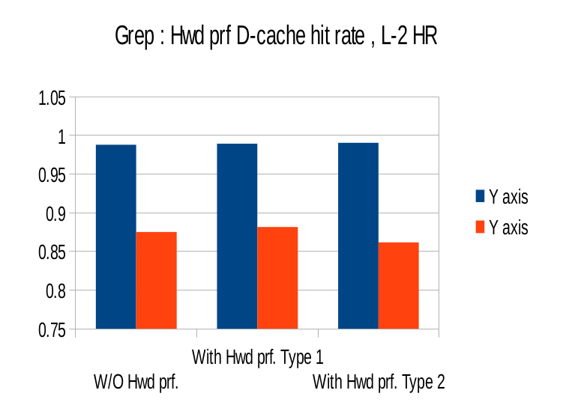
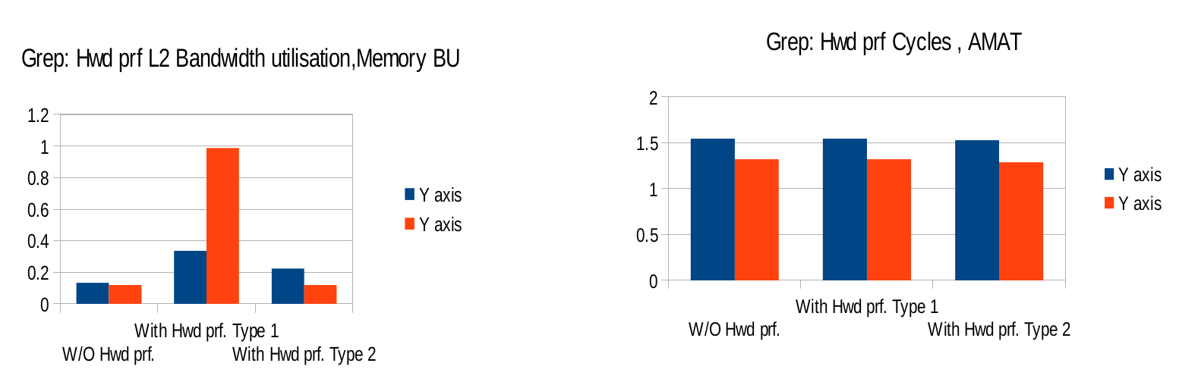
Benchmark/ Trace File : grep

Slide 19
SOFTWARE PREFETCHING DATA

Slide 20
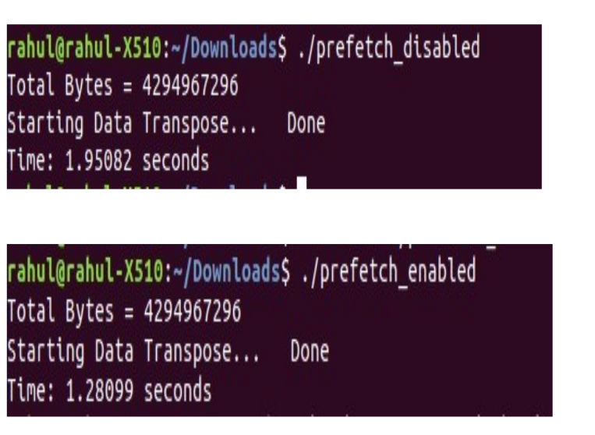

Slide 21

THANK YOU...

