Slide 1


CGI
CLAUDE CODE SECURITY
Safe YOLO Mode
Agreed: --dangerously-skip-permissions with no guardrails is off the table
Options weighed — Sandbox · Docker · Dedicated VM · WSL-2
Winner: a hardened but developer-friendly, throwaway WSL-2 distro
Result: full YOLO productivity, blast radius shrunk to a disposable Linux box
© CGI Inc. · Confidential

Slide 2


THE CORE IDEA
CGI
Don't trust the agent — contain it
THREAT MODEL
THE MOVE
“A compromised Claude tries to steal credentials and fetch malicious payloads.”
Give the agent its own disposable, locked-down Linux environment.
Kept separate from where my real credentials and personal data live — so a rogue agent can't reach anything that matters.
Goal — shrink the blast radius to almost nothing.
© CGI Inc. · Confidential
02

Slide 3
UNDER THE HOOD
CGI
How WSL2 actually runs on Windows
ROOT PARTITION
CHILD PARTITION
= Windows itself — the privileged host
= ONE lightweight utility VM, running a real Microsoft-built Linux kernel
Ubuntu-1
Ubuntu-2
Hyper-V hypervisor (type-1 — boots BEFORE Windows, owns the CPU)
CPU hardware virtualization — Intel VT-x / AMD-V
the silicon
Windows itself is a VM. All your distros live inside that single utility VM — Linux namespaces over one shared kernel, each its own .vhdx.
© CGI Inc. · Confidential
04

Slide 4


ARCHITECTURE
CGI
Two WSL-2 distros — one purpose each
WINDOWS HOST
Ubuntu-1 · primary
Ubuntu-2 · wsl-dev · the sandbox
Personal + work creds, cloud CLIs, daily driver
Claude runs here too — but NEVER in YOLO mode
Normal, permission-prompted sessions only
YOLO RUNS HERE ONLY
Outbound firewall — default DROP
No bridge to Windows files / processes
Rootless Docker
Account that can't escalate
No credentials worth stealing
The sandbox is the deliverable — scripted, rebuildable, snapshotted.
© CGI Inc. · Confidential
03

Slide 5

LAYER 1 · /etc/wsl.conf
CGI
No bridge to the Windows host
Two escape routes to Windows — both closed:
No /mnt/c — Linux can't browse Windows files
automount = false
Can't launch powershell.exe, notepad.exe, any Windows binary
interop = false
Windows PATH is not inherited
appendWindowsPath = false
The agent lives in Linux — and stays in Linux.
© CGI Inc. · Confidential
05

Slide 6

LAYER 2 Outbound Firewall
CGI
The outbound firewall
Default policy: DROP everything outbound — then allow a small, curated list.
terminal
$ curl -I https://api.github.com
✓ succeeds
$ curl https://www.google.com
⛔ times out — not on the list
~90
1,000s
hand-curated entries
(75 domains + ~13 IPs/CIDRs)
CIDRs expanded & rebuilt
fresh on every boot
Some entries delegate to providers' official ranges — GitHub, AWS, Google
Curated domains include api.anthropic.com, npm, PyPI, apt mirrors, VS Code
Anything not on the resulting list simply times out – very annoying, it is what it is
If the agent is tricked into “send these secrets to evil-site.com”, the packets never leave the machine.
© CGI Inc. · Confidential
06

Slide 7




LAYER 2 · DETAIL
CGI
Why an allow-list is hard to get right
The firewall sees IPs, not domains
It matches at layer 3 (iptables / ipset). A name like stackoverflow.com only becomes a rule after it resolves to an IP — the name is invisible.
Modern services have no fixed IP
One hostname answers from many addresses that change constantly — the IP you resolved and whitelisted is a moving target.
A CIDR range doesn't always save you
Allowing a neighbouring block works only if the service stays put. Some (e.g. Stripe) answer from completely different networks.
Best fix: don't guess IPs
Pull the providers' own published ranges — GitHub /meta, AWS ip-ranges.json, Google goog.json — fresh on every boot.
The real annoyance: it just hangs
A blocked host doesn't prompt like sandbox mode — Claude just hangs. Spot the hang, add the host, reload (no reboot).
© CGI Inc. · Confidential
07

Slide 8
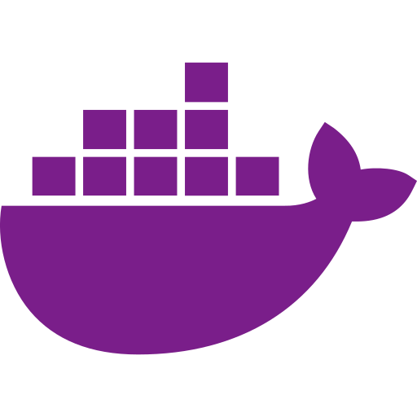
LAYER 3
CGI
Rootless Docker
The daemon runs as my unprivileged user
Not root — the way Docker traditionally runs.
No Docker Desktop, no Windows-side daemon
The whole engine lives inside the sandbox.
Essential for real work — kept fully inside the sandbox.
A container breakout lands powerless
It hits a nobody account, not root — nothing worth stealing.
© CGI Inc. · Confidential
08

Slide 9


LAYER 4 · LEAST PRIVILEGE
CGI
The account itself is boxed in
CAN'T ESCALATE
OWNS NOTHING VALUABLE
No passwordless sudo
Every command prompts for a password the agent doesn't have — a hijacked Claude can't run sudo iptables -F.
No su to root
Root is out of reach.
One deliberate exception
A single harmless umount is passwordless — plumbing, nothing more.
No cloud credentials at all
AWS / Azure / GCP logins stay in the primary distro.
Scoped GitHub token
Reasonably scoped, and auto-expires every 30 days.
Passphrase-protected SSH keys
A leaked key file can't be used on its own.
© CGI Inc. · Confidential
09

Slide 10


RECOVERY
CGI
Disposable by design — snapshot + blueprint
Two ways back to a known-good state — both part of the security model:
Snapshot restore
Blueprint rebuild
The entire distro is exported to a single .vhdx file. Something looks off? Throw it away, re-import the snapshot, back to pristine.
A script — setup-dev-distro.ps1 -Mode Fresh — recreates the whole thing from scratch: hardening, firewall, toolchain. No snapshot required.
© CGI Inc. · Confidential
10

Slide 11




CGI
Yes — it's still a pleasant place to work
The hardening is invisible day-to-day:
VS Code
All the tools
Full IDE via Remote-SSH — auto-wakes the distro on connect.
Docker, git, gh, Node, Python, bun — preinstalled and working.
Audio notifications
Fast
Claude pings me through Windows speakers when it needs me or finishes.
Near-native Linux performance — no VM overhead.
© CGI Inc. · Confidential
11

Slide 12
APPENDIX ·
CGI
Questions
© CGI Inc. · Confidential
13

