Slide 1

Maker Space Session
Bluefruit Intro & Pre-Requisites

Slide 2
Session Goals: MCU Fundamentals Install Pre-Requisites Make a blinky thing

Slide 3
Assumptions: You have software development experience. You may not have much hardware or microcontroller experience.

Slide 4
Maker Space Session
Fundamentals
& Intro
To Microcontrollers

Slide 5
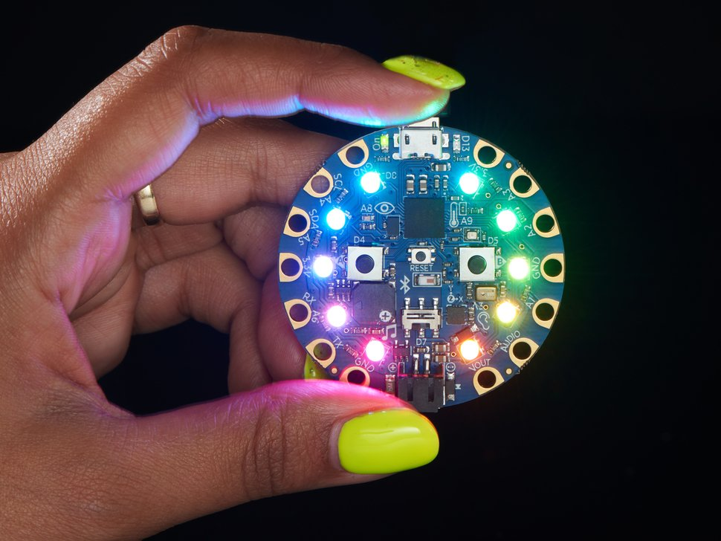
Introduction What is this thing?
Notes:
https://www.adafruit.com/product/4333

Slide 6
Demonstration
Notes:
https://www.adafruit.com/product/4333

Slide 7
A very full featured device. A great intro to micro controllers and programming.

Slide 8
Key Features Blinky Lights (Neopixels) Jiggle Detection (LIS3DH) Light, Sound, Temp Sensors Beepy Thing (Speaker) Pushy Things (button, Switches) Shiny Metal (GPIO /Interface Pins)

Slide 9
What is a Micro Controller (MCU)? A compact circuit designed for a specific single purpose, in an embedded system.

Slide 10
Similarities to a Computer Has a CPU, Ram, and I/O* * but a lot less (Bluefruit has 2MB of Flash storage, and 32K ram- enough for a few hundred lines program. Flash can also store libraries and data structures referenced from code. )
Notes:
https://www.electrokit.com/uploads/productfile/41016/adafruit-circuit-playground-express.pdf

Slide 11
MCU vs. Computer Doesn’t run an OS Typically, only has basic interfaces (I2C, SPI, UART) Lower Power Requirements
Notes:
https://www.microcontrollertips.com/microcontrollers-vs-microprocessors-whats-difference/
Protocol rundown: https://www.seeedstudio.com/blog/2019/09/25/uart-vs-i2c-vs-spi-communication-protocols-and-uses/

Slide 12
MCU’s Commonly Used: Robotics 3d Printing, Drones, Automobiles, Cell Phones, IoT Devices
Notes:
https://en.wikipedia.org/wiki/Microcontroller

Slide 13
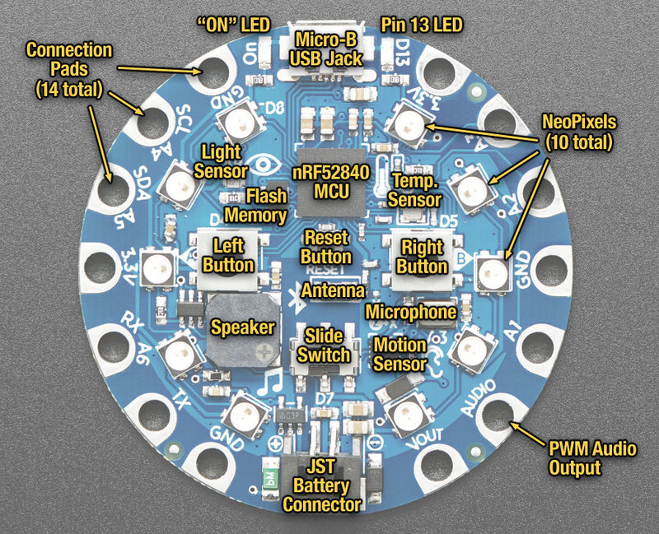
Notes:
https://learn.adafruit.com/adafruit-circuit-playground-bluefruit/guided-tour

Slide 14
How do you Program it? Circuit Python or Arduino/C++
Notes:
https://en.wikipedia.org/wiki/CircuitPython#:~:text=CircuitPython%20is%20a%20full%20Python,selection%20of%20core%20Python%20libraries.

Slide 15
Circuit Python: Higher Level Language (like Java or .NET) Arduino: Lower Level Language (C++)
Notes:
https://en.wikipedia.org/wiki/CircuitPython#:~:text=CircuitPython%20is%20a%20full%20Python,selection%20of%20core%20Python%20libraries.

Slide 16
Circuit Python: “Easier” to code White Space Language Arduino/C++ Lower Level, more control, Best performance, *more familiar
Notes:
https://en.wikipedia.org/wiki/CircuitPython#:~:text=CircuitPython%20is%20a%20full%20Python,selection%20of%20core%20Python%20libraries.

Slide 17
What is the Development Process?
Development
IDE/Editor
Bootloader
Copy file to USB
(.py)
Program
Program
Or “Flash” program
Via AVRDude
Notes:
https://scl.utah.edu/pdf/mac_mgrs/20200219_mm/20200219_mm_hid.pdf

Slide 18
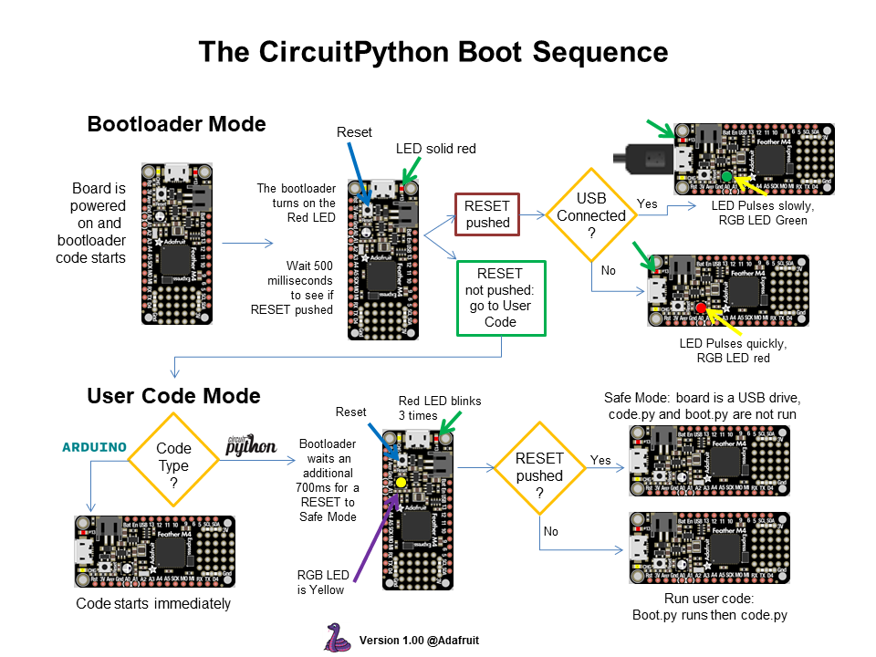
Notes:
https://learn.adafruit.com/assets/75708

Slide 19
What about Debugging? It’s a bit more challenging on Micro Controllers w/o specialized hardware.
Serial.Print(“Here!”);
Notes:
https://en.wikipedia.org/wiki/CircuitPython#:~:text=CircuitPython%20is%20a%20full%20Python,selection%20of%20core%20Python%20libraries.

Slide 20
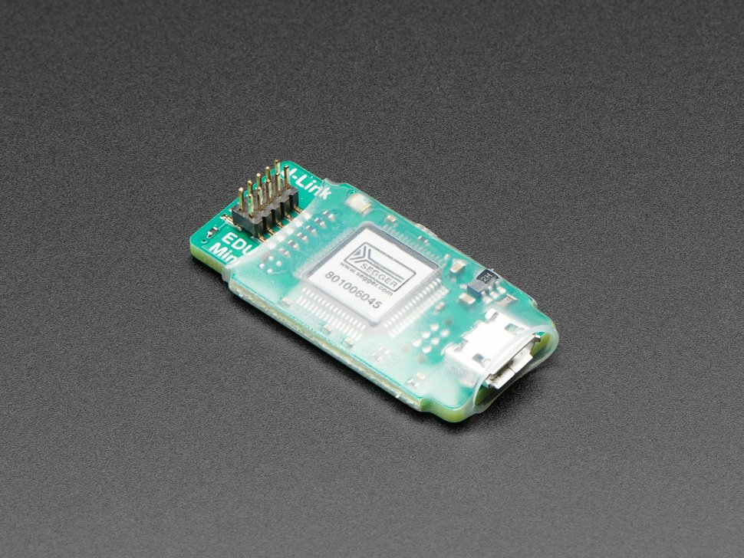
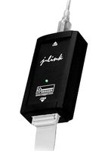
Circuit Python recommended Debugger (for SWD or JDAG Interface): J-Link
($20 – Non Commercial)
($400 – Commercial)
Notes:
https://www.adafruit.com/product/3571?gclid=Cj0KCQiA-qGNBhD3ARIsAO_o7ynLobazrOFuuZ19zNCkEUJVh7YbmzOh0KBWZ-1dqMsDt2ntaOQijqYaAvAFEALw_wcB
(Other debuggers available for other hardware.ST Link is similar and very popular. https://www.digikey.com/en/products/detail/stmicroelectronics/STLINK-V3SET/9636028?utm_adgroup=Development%20Boards%2C%20Kits%2C%20Programmers&utm_source=google&utm_medium=cpc&utm_campaign=Shopping_Supplier_STMicroelectronics_0497_Co-op&utm_term=&utm_content=Development%20Boards%2C%20Kits%2C%20Programmers&gclid=Cj0KCQiA-qGNBhD3ARIsAO_o7ym38PhEbNY3iIcjofnmYX4hXvXQ95ajiJ_zfnhPICHstwvNeqHDIfIaAtGaEALw_wcB

Slide 21
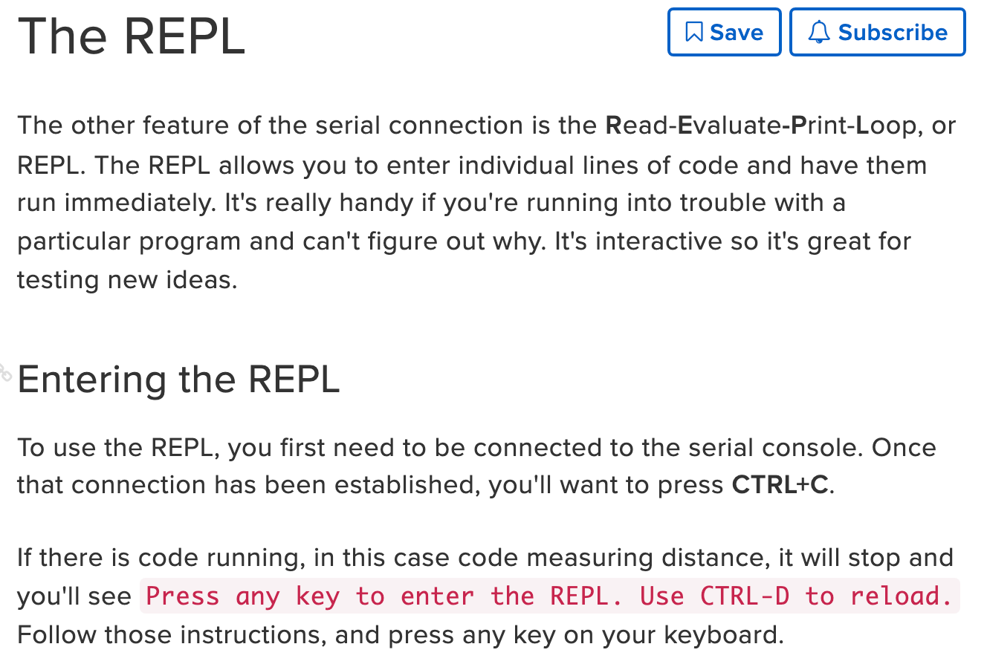
Circuit Python: the REPL
Notes:
https://learn.adafruit.com/adafruit-circuit-playground-bluefruit/the-repl

Slide 22
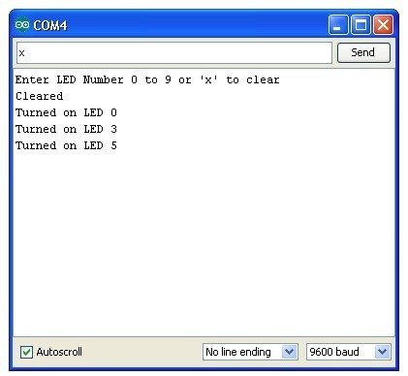
Arduino: Serial Monitor
** There is a relatively new “Arduino Extension for VS Code” Available (In Preview), allows more robust debugging of Arduino without specialized hardware.
Notes:
https://marketplace.visualstudio.com/items?itemName=vsciot-vscode.vscode-arduino
https://learn.adafruit.com/adafruit-arduino-lesson-5-the-serial-monitor/the-serial-monitor

Slide 23
Prepping BlueFruit &
Installing Mu

Slide 24
Bluefruit Device Pre-Requisites
Install latest stable release of CircuitPython Runtime
https://circuitpython.org/board/circuitplayground_bluefruit/
Steps:
Connect Bluefruit with a USB cable you know works with Data
Double click middle button of Bluefruit to enter DFU mode (Device Firmware Update mode)
Browse to the USB drive (CPLAYBTBOOT)
Copy the .UF2 file you just downloaded to the CPLAYBTBOOT root directory (Wait for light sequence to change)
After updating, your drive will be renamed to CIRCUITPY and you will have a few files in there (code.py, which is a "Hello World" sketch).

Slide 25
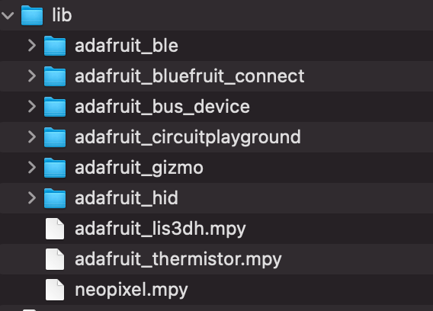
Circuit Python Libraries (V7)
Optional- Windows Only (Driver): https://github.com/adafruit/Adafruit_Windows_Drivers/releases/tag/2.5.0.0
Download Circuit Python Libraries (v7): https://circuitpython.org/libraries
Copy over these to a folder called “lib” on your Bluefruit:
Notes:
https://learn.adafruit.com/circuitpython-made-easy-on-circuit-playground-express/first-things-first

Slide 26
Download & Install Mu
https://codewith.mu
Notes:
https://learn.adafruit.com/adafruit-circuit-playground-bluefruit/the-repl

Slide 27
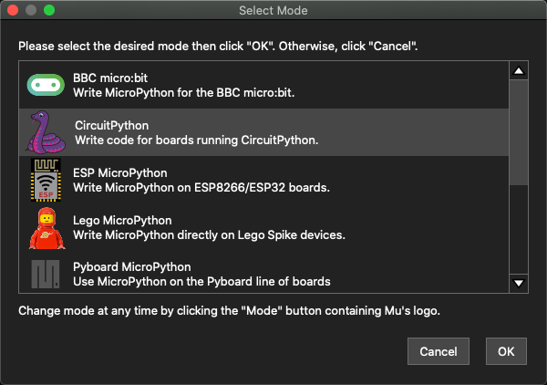
Open Mu, and select “CircuitPython”

Slide 28
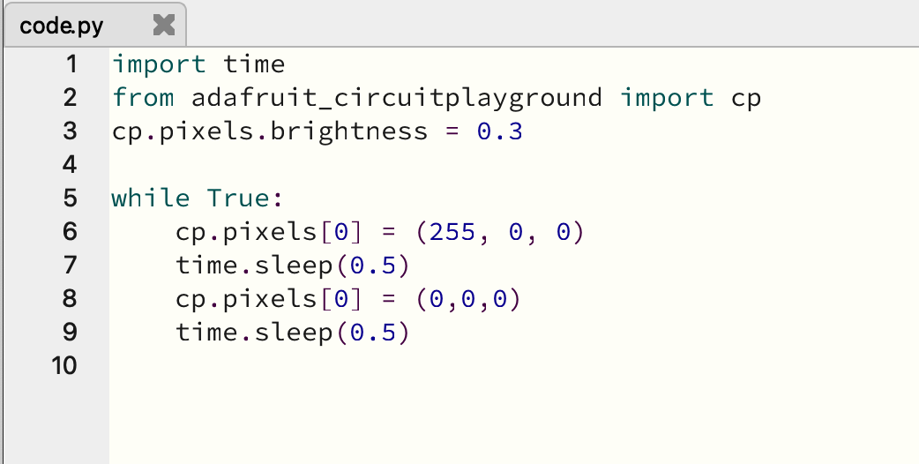
Creating your first program
Save as “code.py” into root folder of CIRCUITPY USB Drive and watch the magic happen.
Notes:
https://learn.adafruit.com/adafruit-circuit-playground-bluefruit/creating-and-editing-code

Slide 29
Got it working?
Exercise 2: Modify the code to make all of the neopixels blink. Bonus points for efficient code (12 lines or less).
(Difficulty Level: Easy)
Notes:
https://learn.adafruit.com/circuitpython-made-easy-on-circuit-playground-express/slide-switch
https://learn.adafruit.com/circuitpython-made-easy-on-circuit-playground-express/buttons

Slide 30
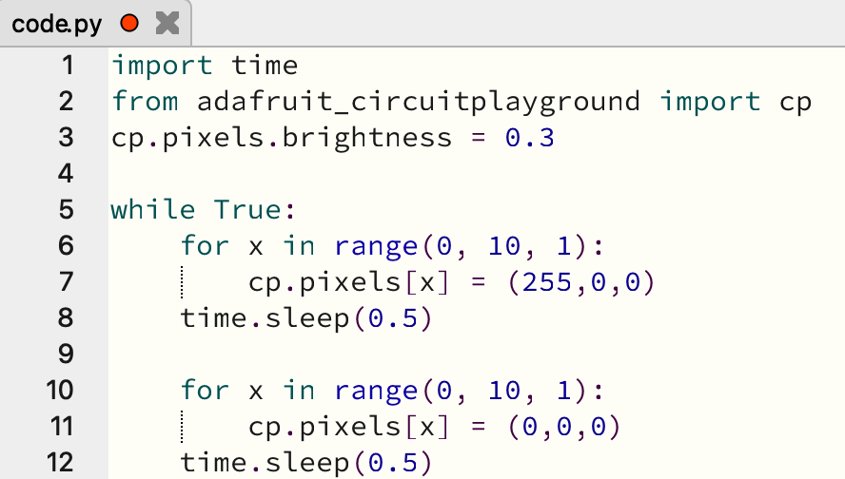
Exercise #2
Save as “code.py” into root folder of CIRCUITPY USB Drive and watch the magic happen.
Notes:
https://learn.adafruit.com/adafruit-circuit-playground-bluefruit/creating-and-editing-code

Slide 31
Got it working?
Exercise 3: Use the switch to toggle the LED’s from blinking on and off (hint: check the status of cp.switch, which is a boolean)
(Difficulty Level: Super Easy)
Notes:
https://learn.adafruit.com/circuitpython-made-easy-on-circuit-playground-express/slide-switch
https://learn.adafruit.com/circuitpython-made-easy-on-circuit-playground-express/buttons

Slide 32
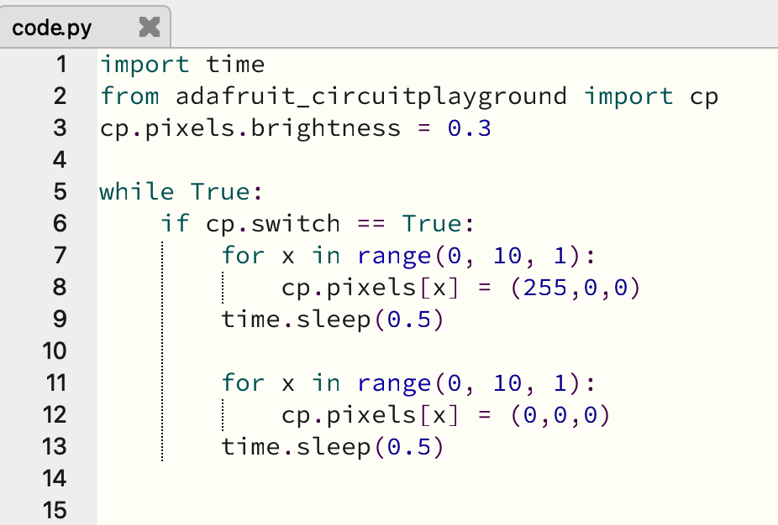
Exercise #3
Save as “code.py” into root folder of CIRCUITPY USB Drive and watch the magic happen.
Notes:
https://learn.adafruit.com/adafruit-circuit-playground-bluefruit/creating-and-editing-code

Slide 33
Got it working?
Exercise 4: Press the a button to cycle colors forward (red, yellow, green, cyan, purple, white) for all Neopixels, and the b button to cycle back to the previous set of color.
Hint: Buttons are referenced by cp.button_a and cp.button_b and have a boolean value)
Hint: Utilize an Array to define and iterate colors
Hint: Don’t forget to use REPL for helpful debugging!
(Difficulty Level: Medium)
Notes:
https://learn.adafruit.com/circuitpython-made-easy-on-circuit-playground-express/slide-switch
https://learn.adafruit.com/circuitpython-made-easy-on-circuit-playground-express/buttons

Slide 34
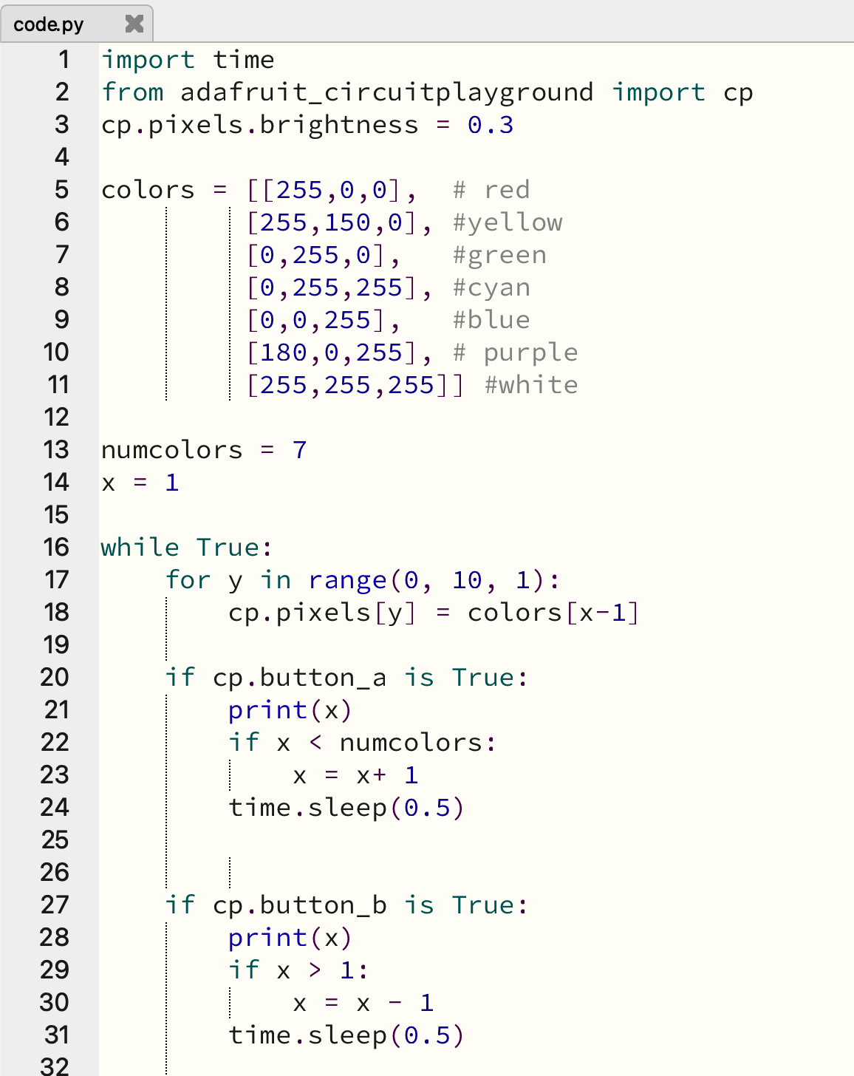
Exercise #4
Save as “code.py” into root folder of CIRCUITPY USB Drive and watch the magic happen.
Notes:
https://learn.adafruit.com/adafruit-circuit-playground-bluefruit/creating-and-editing-code

Slide 35
So now what?
Like the Hardware? Purchase a BlueFruit Ticket on Eventbrite (supplies limited) to buy a kit ($38). Otherwise, please return hardware to a volunteer.
Want to do more? Hang out in the Maker Space, and visit the self paced examples on the Adafruit Web Site.
https://learn.adafruit.com/adafruit-circuit-playground-bluefruit/circuitpython-neopixel
Notes:
https://learn.adafruit.com/circuitpython-made-easy-on-circuit-playground-express/slide-switch
https://learn.adafruit.com/circuitpython-made-easy-on-circuit-playground-express/buttons

Slide 36
Bluefruit Challenge
Got some spare time? Work in the Maker Space to make something awesome. Consider incorporating 3d printing and other electronics into your design.
Provide a demonstration by 1pm Friday in the Maker Space.
Awards will be given for the following (original designs only):
Most Impressive (individual)
Most Creative (individual)
Most Collaborative / Best Teamwork (up to 3 people)

Slide 37
Advanced Projects
Get a buddy and play Quick Draw- with 2 Bluefruits! https://learn.adafruit.com/circuit-playground-quick-draw/circuitpython
Pick a color with an app on your phone, and change the color of the Bluefruit (Arduino): https://learn.adafruit.com/adafruit-circuit-playground-bluefruit/ble-uart-controller
Notes:
https://learn.adafruit.com/circuitpython-made-easy-on-circuit-playground-express/slide-switch
https://learn.adafruit.com/circuitpython-made-easy-on-circuit-playground-express/buttons

