Slide 1
ABSTRACT INTRODUCTION
In today's world where most of us depend on buying product online, it takes a lot of manual effort to find out on which website price tag is lowest. So what most of us do is go to one of the most popular websites like Amazon or Flipkart and buy those products. What if we could easily develop a price comparison tool that can compare the prices from different websites and can then show any user the optimal price and associated information about that product from different websites in a single place.

Slide 2
OBJECTIVE
Problem Statement
Sometimes going on numerous website compare product information and price can get tiring, therefore minding this problem, our project giving you all the information of product on a single platform so it provides the user friendly content and less time consuming.
The main objective of this project is to give the price of searched product that serving on multiple website on a single plateform .
This project is totally user friendly and they can easily search their product and get the result for which they are looking for and if the user want to buy the product, they’ll taken to the merchant website .

Slide 3
GOALS
Maximize sales from costs
Get more niches affiliates.
Price comparison targeting a niche market , then there will be plenty of brands that you can approach directly .
It also saves time.

Slide 4
PURPOSE
Monitoring price comparison for a particular product on different e-commerce websites using python. We use beautifulSoup for scraping data from different websites like Amazon and Flipkart and with that we provide direct link to different websites of our search product.
The price of the searched product from the sources(Amazon and Flipkart) are displayed so that buyer can see the prices and make the decision to buy from the platform which offers the lowest price.
Considering the fact that Indian Consumers are very much price sensitive and hence price plays a very important role in Indian economy. And since the number of ecommerce websites in India is quite a big in number, customers do need a platform where they can compare the prices of products over different websites and chose the cheapest one with good customer service and with the help of this project they can easily get what they want.

Slide 5
PROJECT SCOPE
The project has a wide scope, as it is not intended to a particular organization. This project is going to develop generic software, which can be applied by any businesses organization . More over it provides facility to its users. Also the software is going to provide a huge amount of summary data.
Hence, as per my opinion future of price comparison is quite bright in India if along with the price comparison they also provide with the statistics related to level of customer satisfaction on purchases made from respective websites so that customers can know that they are not getting the product cheap at the cost of poor after sales service.

Slide 6
LANGUAGES USED
Python--(packages used)
1-BeautifulSoup - helps in extracting data(like price, product description)
out of markuplanguages like HTML and XML.
2-requests - allows you to send HTTP/1.1 requests extremely easily.
3-slugify - It is used to convert a string into url.
4-tkinter - It is used for Graphical user interface.

Slide 7
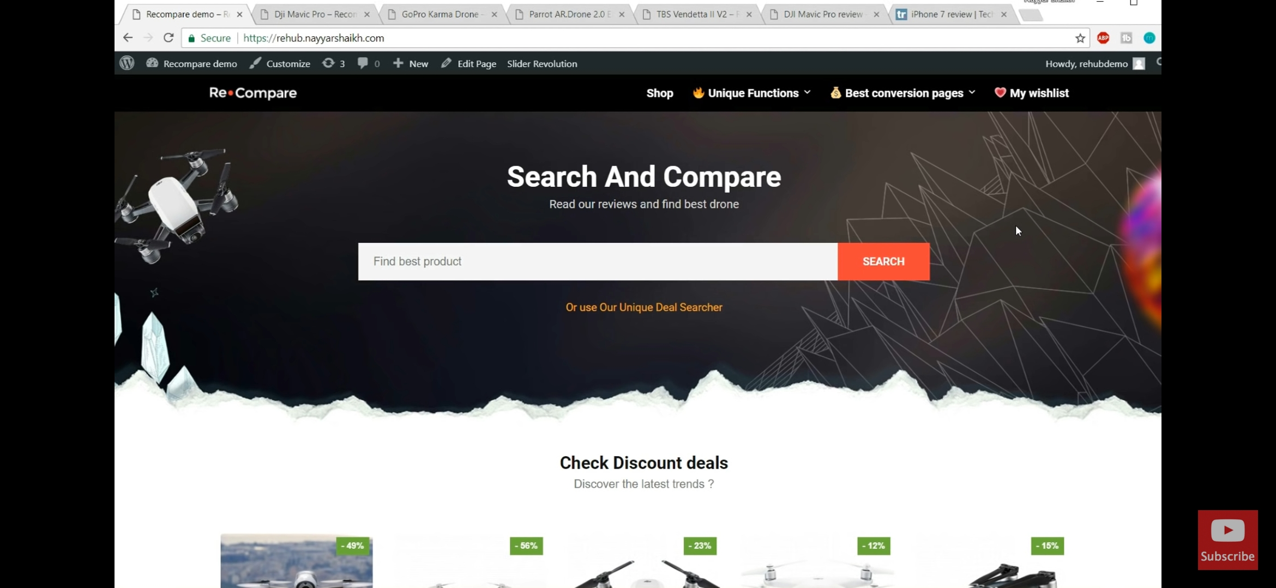
METHODOLOGY
Web scraping setup --
Web Scraping is a process of collecting relevant information from a particular webpage and then exporting that information in a proper format according to our needs.
First installing beautifulSoup library in local system. Then sending request to Amazon and Flipkart websites then getting the response as webpage source code as response after getting the response then parsing the webpage source code. Getting the price and information of Amazon and Flipkart products then tracking the price using web scraping using python.
packages used—
1-BeautifulSoup - helps in extracting data out of markuplanguages like HTML and XML.
2-requests - allows you to send HTTP/1.1 requests extremely easily.
3-slugify - It is used to convert a string into url.
4-tkinter - It is used for Graphical user interface.

Slide 8
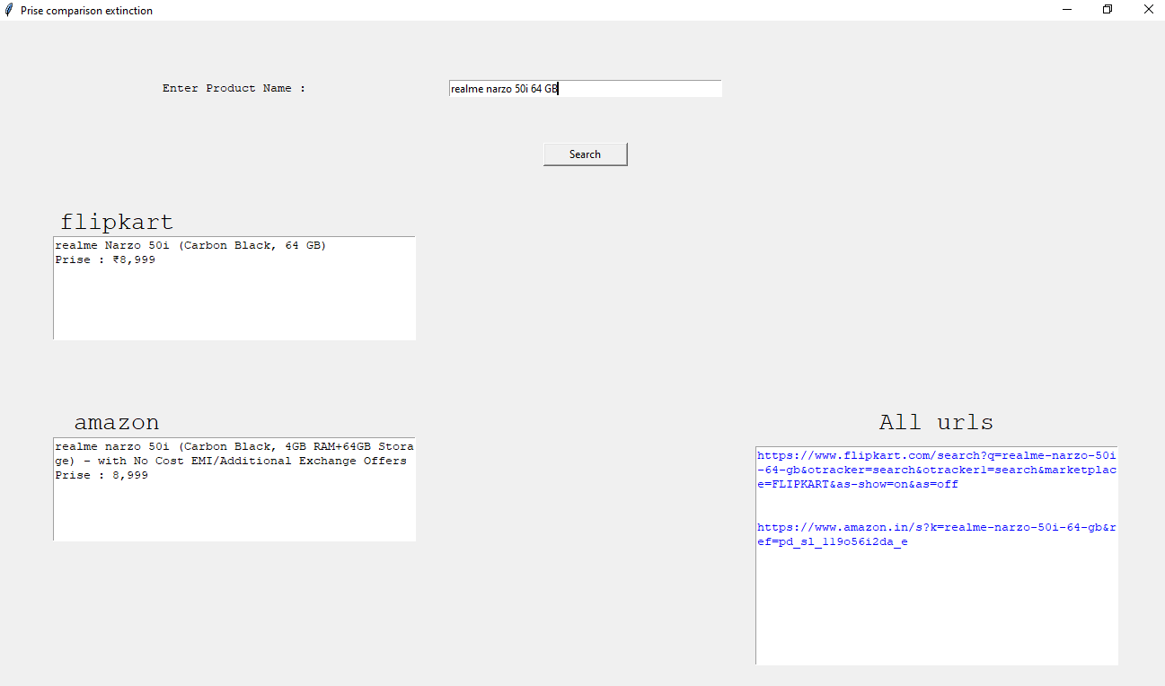

Slide 9
FUTURE SCOPE AND CONCLUSION
FUTURE SCOPE
The project has a wide scope, as it is not intended to a particular organization. This project is going to develop generic software, which can be applied by any businesses organization . More over it provides facility to its users. Also the software is going to provide a huge amount of summary data.
Hence, as per my opinion future of price comparison is quite bright in India if along with the price comparison they also provide with the statistics related to level of customer satisfaction on purchases made from respective websites so that customers can know that they are not getting the product cheap at the cost of poor after sales service.
CONCLUSION
E-commerce industry is growing at a rapid speed in India and is expected to grow rapidly for years to come. More and more people are now looking towards online retailers as an viable option to make their purchases. And it is also very much clear that the number of ecommerce websites are also increasing day by day and prices and offers offered by each of them are different.
Considering the fact that Indian Consumers are very much price sensitive and hence price plays a very important role in Indian economy. And since the number of ecommerce websites in India is quite a big in number, customers do need a platform where they can compare the prices of products over different websites and chose the cheapest one with good customer service.

