Slide 1

Simple Sort Algorithms
Selection Sort
Bubble Sort
Insertion Sort
Notes:
First 5 are simple (conceptually and to program). First 4 done in chapters 2 and 3. Shaker sort and shell sort are in the enrichment section of the text’s Web site. The remaining three are done in the algorithm design chapters of the text.

Slide 2
Sorting
Basic problem
order elements in an array or vector
Use
  Need to know relationship between data elements
  (e.g., top N students in class)
  Searching can be made more efficient (e.g., binary search)
Implementation
  Simple implementation, relatively slow: O(n2)
  Complex implementation, more efficient: O(n.logn)
Notes:
Strictly speaking, nondecreasing order: 2, 2, 3, 6, 8, 8, 10.

Slide 3
Complex Sort Alogrithms
Count Sort
Shaker Sort
Shell Sort
Heap Sort
Merge Sort
Quick Sort
Notes:
First 5 are simple (conceptually and to program). First 4 done in chapters 2 and 3. Shaker sort and shell sort are in the enrichment section of the text’s Web site. The remaining three are done in the algorithm design chapters of the text.

Slide 4

Sorting
Rearrange
a[0], a[1], …, a[n-1]
into ascending order.
When done,
a[0] <= a[1] <= … <= a[n-1]
8, 6, 9, 4, 3 => 3, 4, 6, 8, 9
Notes:
Strictly speaking, nondecreasing order: 2, 2, 3, 6, 8, 8, 10.

Slide 5
General Sorting
Assumptions
  data in linear data structure
  availability of comparator for elements
  availability of swap routine (or shift )
  no knowledge about the data values

Slide 6
Swap (in an Array)
public static void swap
(int data[], int i, int j)
{
int temp = data[i];
data[i] = data[j];
data[j] = temp;
}

Slide 7
Selection Sort
Take multiple passes over the array
Keep already sorted array at high-end
Find the biggest element in unsorted part
Swap it into the highest position in unsorted part
Invariant: each pass guarantees that one more
element is in the correct position (same as
bubbleSort)
a lot fewer swaps than bubbleSort!

Slide 8
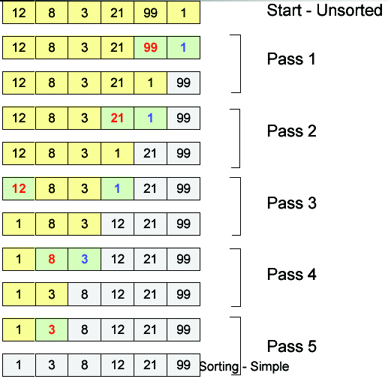

Selection Sort

Slide 9
Selection Sort
public static int max(int[] a, int n)
{
int currentMax = 0;
for (int i = 1; i <= n; i++)
if (a[currentMax] < a[i])
currentMax = i;
return currentMax;
}

Slide 10
Selection Sort
public static void
selectionSort(int[] a)
{
for (int size = a.length;
size > 1; size--)
{
int j = max(a, size-1);
swap(a, j, size - 1);
}
}

Slide 11
Algorithm Complexity
Space/Memory
Time
  Count a particular operation
  Count number of steps
  Asymptotic complexity
Notes:
Other types of complexity: programming complexity, debugging complexity, complexity of comprehension.

Slide 12
selectionSort – Algorithm Complexity
How many compares are done?
  n+(n-1)+(n-2)+...+1, or O(n²)
How many swaps are done?
  Note swap is run even if already in position n, or O(n)
How much space?
  In-place algorithm (note the similarity)

Slide 13
Bubble Sort
Take multiple passes over the array
Swap adjacent places when values are out of order
Invariant: each pass guarantees that
largest remaining element is in the correct (next last) position

Slide 14
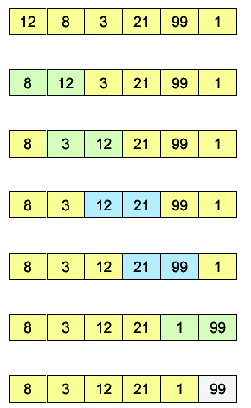
Bubble Sort
Start – Unsorted
Compare, swap (0, 1)
Compare, swap (1, 2)
Compare, no swap
Compare, noswap
Compare, swap (4, 5)
99 in position

Slide 15
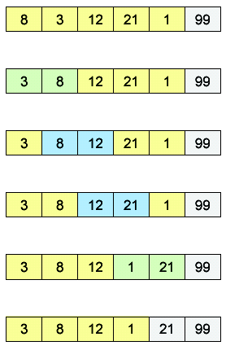
Bubble Sort
Pass 2
swap (0, 1)
no swap
no swap
swap (3, 4)
21 in position

Slide 16
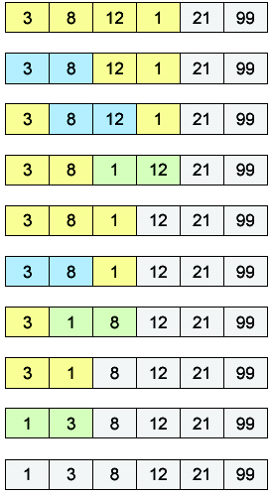
Bubble Sort
Pass 3
no swap
no swap
swap (2, 3)
12 in position, Pass 4
no swap
swap (1, 2)
8 in position, Pass 5
swap (1, 2)
Done

Slide 17
bubbleSort – Algorithm Complexity
Time consuming operations
  compares, swaps.
#Compares
  a for loop embedded inside a while loop
  (n-1)+(n-2)+(n-3) …+1 , or O(n²)
#Swaps
  inside a conditional -> #swaps data dependent !!
  Best Case 0, or O(1)
  Worst Case (n-1)+(n-2)+(n-3) …+1 , or O(n²)
Space
  size of the array
  an in-place algorithm

Slide 18
Insertion Sort
Take multiple passes over the array
Keep already sorted array at low-end
Find next unsorted element
Insert it in correct place, relative to the ones already sorted
Invariant: each pass increases size of
sorted portion. Different invariant vs.
bubble and selection sorts.

Slide 19
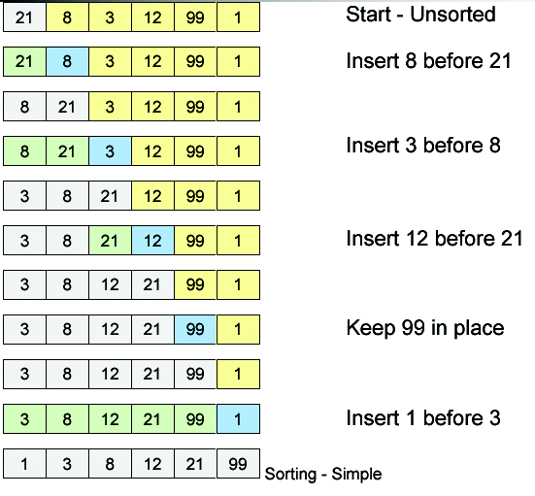
Insertion Sort

Slide 20
Insert An Element
public static void insert
(int[] a, int n, int x)
{
// insert t into a[0:i-1]
int j;
for (j = i - 1;
j >= 0 && x < a[j]; j--)
a[j + 1] = a[j];
a[j + 1] = x;
}

Slide 21
Insertion Sort
for (int i = 1; i < a.length; i++)
{
// insert a[i] into a[0:i-1]
insert(a, i, a[i]);
}

Slide 22
insertionSort – Algorithm Complexity
How many compares are done?
  1+2+…+(n-1), O(n2) worst case
  (n-1)* 1 , O(n) best case
How many element shifts are done?
  1+2+...+(n-1), O(n2) worst case
  0 , O(1) best case
How much space?
  In-place algorithm

Slide 23
Worst Case Complexity
Bubble:
  #Compares: O(n²)
  #Swaps: O(n²)
Selection:
  #Compares: O(n²)
  #Swaps: O(n)
Insertion
  #Compares: O(n²)
  #Shifts: O(n²)

Slide 24
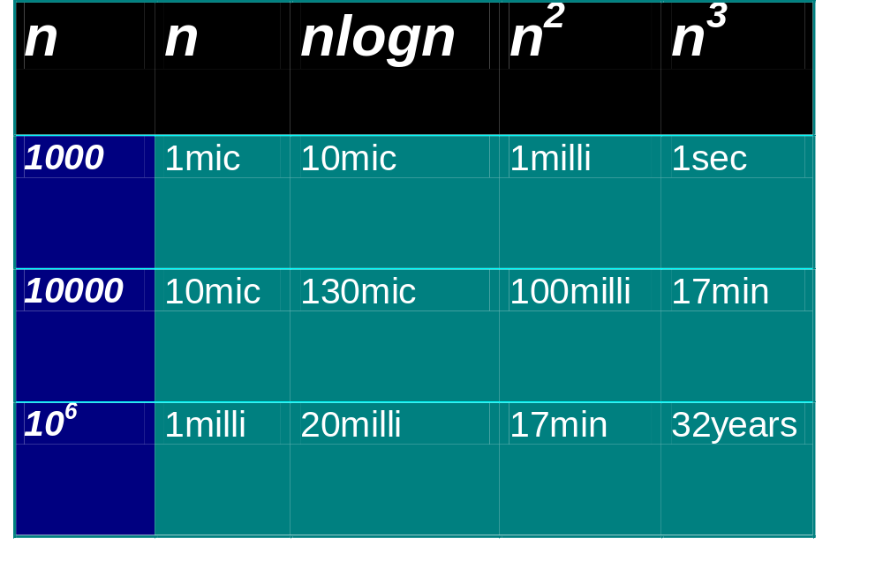
Practical Complexities
10⁹ instructions/second
Notes:
Teraflop computer the 32yr time becomes approx 10 days.

Slide 25
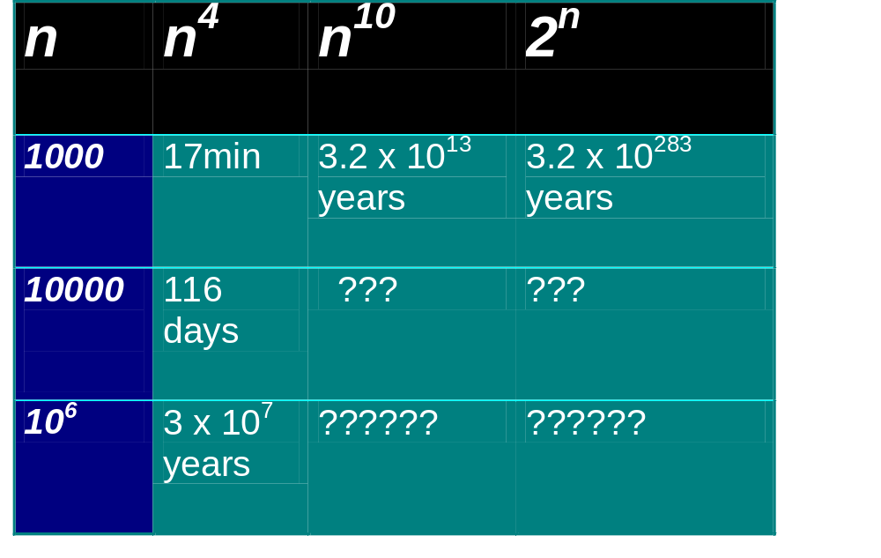
Impractical Complexities
10⁹ instructions/second

Slide 26


Faster Computer Vs Better Algorithm
Algorithmic improvement more useful
than hardware improvement.
E.g. 2^{n} to n³

