Slide 1
JavaServer Faces, XDoclet, Hibernate
Eben Hewitt

Slide 2
JavaServer Faces
Background
Overview of Features
Future of these Technologies
Links
Books

Slide 3
JSF Background
Created by Sun in late 2001. JSR-127 was introduced to:
Provide Java developers with a standard API for sophisticated user interface components.
Give Java tools developers a way to create tools with those components that provide a rich design-time experience.

Slide 4
Faces Origin
Craig McClanahan was the original creator of the Struts Framework, and co-specification lead for JavaServer Faces 1.0 (JSF).
JSF 1.0 was released in March 2004, followed by a maintenance release (1.1) in May 2004.

Slide 5
Reason for Faces
Offers Swing-like action event model
More robust UI model than Struts
Reduction of third-party UI tag integration (Pager taglib)
Compete with .NET
An API useful with tools, which Struts is not.

Slide 6
Studio Creator
Sun’s tool for creating JSF applications is called Java Studio Creator, similar to Visual Studio .NET
Built on NetBeans.
Not necessary to writing JSF: all you need is the JAR file.
Allows drag and drop of Faces components.
Drag a Data Table component onto a page, drop a JDBC rowset test on it, and the component instantly adapts to the columns that are in that particular rowset.
In the coming version of Creator, we will be able to consume session Enterprise JavaBeans as data sources.
Amazon has a deal through Sun to get the book and the software for $50.
Free trial available.

Slide 7
JSF Feature Overview
UI Components
Datatables
Do no iteration code. Just point to a Collection, Map, JSTL Result, or ResultSet. A few lines of code make the result sortable.
Built-in Controller
Actions
ActionListeners
Validation/Messages
Custom components
JTree, JMenu, JSlider, JSpinner, etc

Slide 8
Struts and JSF
Struts and Faces overlap in the view tier.
Struts is not going away, and improvements will be made in the controller architecture.
But Struts tags are not undergoing new development according to McClanahan. They are superceded by the JSF tags, which provide richer functionality and are simpler to use.
While Tiles are perceived as part of the Struts framework, they are not. Faces has full support for use of Tiles, which are actually a separate third-party framework.
Struts 2.0 will be modeled closely after Faces
Struts has a rich validation framework that is just as rich in Faces, and easier to use.

Slide 9
How to Use Faces

Slide 10
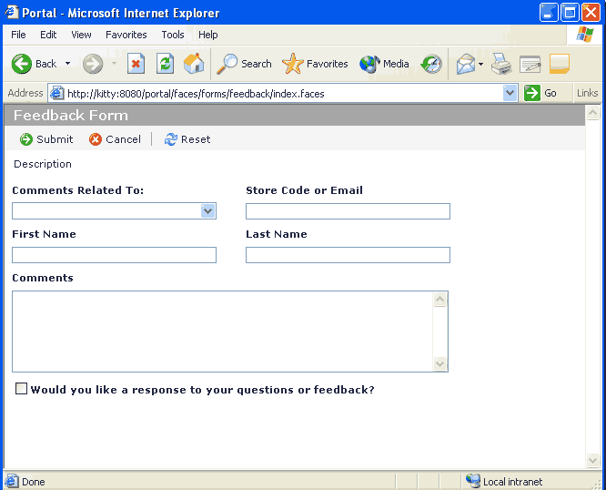
Feedback Form

Slide 11
Faces-config.xml
Identifies managed beans and navigation rules
<?xml version="1.0"?>
<!DOCTYPE faces-config PUBLIC
"-//Sun Microsystems, Inc.//DTD JavaServer Faces Config 1.0//EN"
"http://java.sun.com/dtd/web-facesconfig_1_0.dtd">
<faces-config>
<application>
<locale-config>
<default-locale>en</default-locale>
</locale-config>
<message-bundle>messages</message-bundle>
</application>
<managed-bean>
<managed-bean-name>feedbackForm</managed-bean-name>
<managed-bean-class>com.dte.portal.faces.feedback.FeedbackForm
</managed-bean-class>
<managed-bean-scope>request</managed-bean-scope>
</managed-bean>

Slide 12
Feedback JSP Body
<!-- VIEW -->
<jsp:root version="1.2"
  xmlns:jsp="http://java.sun.com/JSP/Page"
  xmlns:f="http://java.sun.com/jsf/core"
  xmlns:h="http://java.sun.com/jsf/html">
  <jsp:directive.page contentType="text/html" />
  <f:view>
  <f:loadBundle basename="feedback" var="msgs" />
  <html xmlns="http://www.w3.org/1999/xhtml">
  <head>
  <title>
  <h:outputText value="#{msgs['window.title']}" />
  </title>
  </head></body>
  <h:form id="feedbackForm">...

Slide 13
Feedback Input Field
<h:inputText id="firstName" value="#{feedbackForm.firstName}" required="true" styleClass="textBox1" />
<div>
<h:message for="firstName" errorClass="errorTextSmall" />
</div>

Slide 14
Feedback JSP Submit
<!-- SUBMIT -->
<h:commandLink id="btnSubmit"
action="#{feedbackForm.submit}">
<h:graphicImage value="/images/iconSubmit.gif"
styleClass="icon" />
<h:outputText value="#{msgs['button.submit']}" />
</h:commandLink>
<!– MESSAGES: Summary shows here-->
<td>
  <h:messages errorClass="errorMessages"
  infoClass="infoMessages" />
</td>

Slide 15
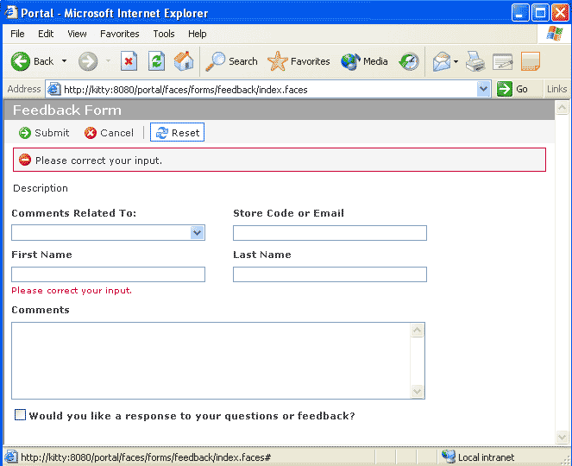
Feedback Form Error

Slide 16
JSF Select Items
//no looping…
<h:selectOneMenu id="commentsRelatedTo" styleClass="dropDown1">
<f:selectItems value="#{feedbackForm.commentsRelatedTo}" />
</h:selectOneMenu>

Slide 17
JSF Backing Bean Select
public List getCommentsRelatedTo() {
if (commentsRelatedTo == null) {
commentsRelatedTo = new ArrayList();
Locale locale = FacesContext.getCurrentInstance().getViewRoot().
getLocale();
ResourceBundle resourceBundle = ResourceBundle.getBundle("feedback", locale);
commentsRelatedTo.add(
new SelectItem(
resourceBundle.getString("select.value.cs"),
resourceBundle.getString("select.label.cs")));
…}

Slide 18
JSF Backing Bean Submit
public String submit() {
// Send Email
FacesContext context = FacesContext.getCurrentInstance();
Application application = context.getApplication();
String messageBundle = application.getMessageBundle();
Locale locale = context.getViewRoot().getLocale();
ResourceBundle resourceBundle = ResourceBundle.getBundle(messageBundle, locale);
FacesMessage message = new FacesMessage(FacesMessage.SEVERITY_INFO,
resourceBundle.getString(SUCCESS), null);
context.addMessage(null, message);
return null;
}

Slide 19
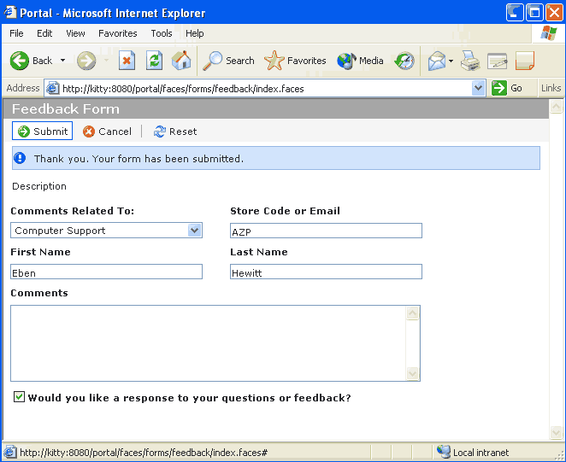
Feedback Form OK

Slide 20
Faces Future
JavaServer Pages 2.1 and JavaServer Faces 1.2 will be closely aligned in their use of EL and close interoperability.
JavaServer Faces API will be part of Java 2 Platform, Enterprise Edition 5.0. That means that Faces is a real, supported standard that will be part of any container that runs J2EE. Faces is the web application that Sun intends to grow and build out.

Slide 21
JSF Links
Craig McClanahan's Weblog
http://blogs.sun.com/roller/page/craigmcc/
Interview with Craigh McClanahan on Faces
http://java.sun.com/developer/technicalArticles/Interviews/jsf_mcClanahan.html
Sun’s Faces Site
http://java.sun.com/j2ee/javaserverfaces/
Faces Spec
https://javaserverfaces-spec-public.dev.java.net/
Building Applications with Faces
http://java.sun.com/developer/technicalArticles/GUI/JavaServerFaces/
Building JSF Components
http://developers.sun.com/prodtech/javatools/jscreator/reference/themes/jsf/index.html
Sun’s Creator Site
http://www.sun.com/software/products/jscreator/
Sun Creator Article
http://java.sun.com/developer/technicalArticles/WebServices/jscoverview/

Slide 22
JSF Books
Sun Java Studio Creator Development Pack: Field Guide and Creator Software Package (Prentice Hall) by Gail Anderson, Paul Anderson
Core JavaServer Faces (Prentice Hall) by David Geary, Cay Horstmann.Geary is on EG for Faces and early contributor to Struts
JavaServer Faces in Action (Manning) by Kito D. Mann
JavaServer Faces (O’Reilly) by Hans Bergsten
Mastering JavaServer Faces (Wiley) by Bill Dudney
JavaServer Faces Programming (McGraw-Hill) by Budi Kurniawan
JavaServer Faces Kick Start (Sams) by James Turner

Slide 23
XDoclet

Slide 24
XDoclet Background
XDoclet allows attribute-oriented programming in many different applications.
Attribute programming means that you type special comments along with your JavaDoc, and the XDoclet tool reads those comments and generates code based on their values.

Slide 25
Benefit of AOP
The benefit of AOP is realized when you have many files that need to be updated to support a file.
For example, deploying a single EJB means you must define descriptor files and interfaces, and include a lot of boilerplate method signatures that may never actually be implemented. With XDoclet, you write the EJB class, and it generates the interfaces and config files for you.

Slide 26
XDoclet Features
Executes as Ant tasks. Just put the xdoclet jars on your classpath.
XDoclet comes bundled with modules for all the leading application servers: JBoss, BEA WebLogic, IBM WebSphere, Oracle IAS, Orion, Borland, Macromedia JRun, Jonas, Pramati, Sybase EAServer and many more.
Supported tools: Castor, Hibernate, several JDO vendors, Struts, WebWork, MockObjects and many more.

Slide 27
Benefits of XDoclet
Eliminate redundant or "boiler plate" work.
Makes your work easy: XDoclet generates interfaces, value objects, Struts forms, struts-config.xml, faces-config.xml, hibernate config, service locators, much more.
It’s extensible (write your own generative modules).
Free, open-source, widely used and supported.

Slide 28
How to Use it
Executes as an Ant task
Just put the XDoclet JARs on your classpath
Add comments to your classes and methods to annotate them. XDoclet automatically picks them up
Use “merge” files for inserting attributes outside business files.

Slide 29
XDoclet Example
package com.global.ejb.xdoc;
import java.rmi.RemoteException;
import javax.ejb.*;
/**
* A test EJB.
* Dec 30, 2004 10:18:27 AM
* @author E Hewitt
* @ejb.bean
* name="Test"
* type="Stateless"
* view-type="local"
* jndi-name="ejb/TestEJB"
* local-jndi-name="ejb/TestEJBLocal"
* @ejb.util
* generate="physical“ //generate service locator to use the JNDI name //referring to the global namespace instead on the local env.
* cacheHomes="true"
*/
public class TestEJB implements SessionBean {
//continued on next slide…

Slide 30
EJB Doclet Example cont.
private String value = "Default EJB Value";
public void ejbCreate() { }
/**
* @ejb.interface-method
*/
public String getValue(){ return this.value; }
/**
* @ejb.interface-method
*/
public void setValue(String value){ this.value = value; }

Slide 31
Code Generated
/* Generated by XDoclet - Do not edit! */
package com.global.ejb.xdoc;
/** * Local interface for Test.
* @xdoclet-generated at 21-01-05
* @author XDoclet
* @version ${version}
*/
public interface TestLocal extends javax.ejb.EJBLocalObject {
public java.lang.String getValue( ) ;
public void setValue( java.lang.String value ) ;
} //also generates Service Locator called TestUtil

Slide 32
XDoclet Links
XDoclet Home Page
http://xdoclet.sourceforge.net/xdoclet
Many samples come with distro. Also at: http://cvs.sourceforge.net/viewcvs.py/xdoclet/xdoclet/samples/src/

Slide 33
XDoclet Books
XDoclet in Action (Manning) -- by Craig Walls

Slide 34
Hibernate

Slide 35
Hibernate Background
Hibernate is free and open source. Its purpose is to provide a consistent, transparent Object-Relational Mapping technology for Java developers.

Slide 36
Advantage
A fully relational database has a fundamentally different method of representing data than an object model does.
The advantage to Java developers of doing ORM is that we can focus almost exclusively on implementing our object model just as we want, and do not have to squeeze out non-domain objects to persistence.

Slide 37
Hibernate and JDO
Sun recognizes this problem and came up with their own spec, Java Data Objects. Hibernate and JDO are considered alternatives to using EJB CMP or JDBC
Similar to JDO, with key differences:
    JDO is a spec, and Sun has an RI for it. Hibernate is an implementation.
    JDO rewrites your bytecode at compile time, Hibernate uses runtime bytecode generation

Slide 38
What you Do
Configure the datasource
You write mappings in a file called <bean>.hbm.xml, similar to a struts-config. This document tells hibernate to map fields in your Java classes to database columns.
You can also use either MetaData (Java 5.0) or XDoclet annotations to generate this file so you don’t have to update it when your Java class changes.

Slide 39
Configuring the Datasource
Put something like this in your hibernate.properties file
hibernate.dialect=net.sf.hibernate.dialect.MySQLDialect
hibernate.connection.driver_class=org.gjt.mm.mysql.Driver
hibernate.connection.driver_class=com.mysql.jdbc.Driver hibernate.connection.url=jdbc:mysql:///test hibernate.connection.username=testuser hibernate.connection.password=secret

Slide 40
Write the Mapping
<hibernate-mapping>
<class name="com.dte.example.Item" table=”Item" >
<id name="id" column="id" type="java.lang.Long"
unsaved-value="0">
<generator class="identity"/>
</id>
<property name="name" column="name" type="java.lang.String" />
<property name="description" column="description" type="java.lang.String" />
</class>
</hibernate-mapping>

Slide 41
Hibernate Features
Integrates with all popular J2EE application servers and web containers.
You do not have to write any code into your Java class or implement any interface or write SQL queries. Hibernate does it for you.
Multiple synthetic key generation means:
    identity (auto-increment) columns
    sequences
    UUID algorithm

Slide 42
Hibernate Features cont.
Allows for the following sophisticated mappings:
Multiple-objects to single-row mapping
Single-object to multiple-table mapping
Support for hand-written SQL
Support for cursors
Table joins expressed as property paths

Slide 43
Hibernate Advanced Features
Support for SQL functions and operators
Support for SQL aggregate functions sum, avg, min, max, count
Support for left|right outer join, full join
Support for group by, having and order by
Support for subqueries (on databases which support SQL subselects)

Slide 44
Hibernate Future
Will be incorporated into EJB 3.0 in some version, as CMP is considered unwieldy. Java 5.0 introduces MetaData annotations, and Hibernate will take advantage of these.
Hibernate will also incorporate generics.
The EJB3 specification will support transparent POJO persistence, and use Hibernate facilities to do so. The Hibernate team is on the EG for EJB3.

Slide 45
Hibernate Links
Website has forums, mailing lists, documentation, general support, Wiki, Blog, demos, tutorials.
Hibernate Website: http://www.hibernate.org

Slide 46
Hibernate Books
Hibernate: A J2EE Developer's Guide by Will Iverson
Hibernate in Action (Manning)
by Christian Bauer, Gavin King
Hibernate: A Developer's Notebook
by James Elliott

