Slide 1
The Java Virtual Machine
The University of North Carolina at Chapel Hill
COMP 144 Programming Language Concepts
Spring 2003
Stotts, Hernandez-Campos

Slide 2
The Java Virtual Machine
“Java Architecture”
Java Programming Language
Java Virtual Machine (JVM)
Java API

Slide 3
Reference
The content of this lecture is based on Inside the Java 2 Virtual Machine by Bill Venners
  Chapter 1Introduction to Java's Architecture
    http://www.artima.com/insidejvm/ed2/introarchP.html
  Chapter 5 The Java Virtual Machine
    http://www.artima.com/insidejvm/ed2/jvmP.html
  Interactive Illustrations
    http://www.artima.com/insidejvm/applets/index.html

Slide 4
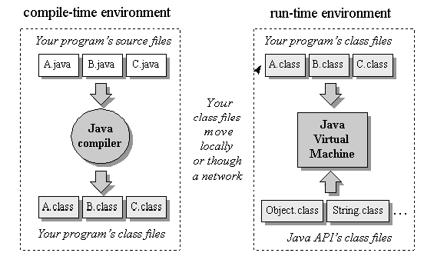
The Java Programming Environment

Slide 5
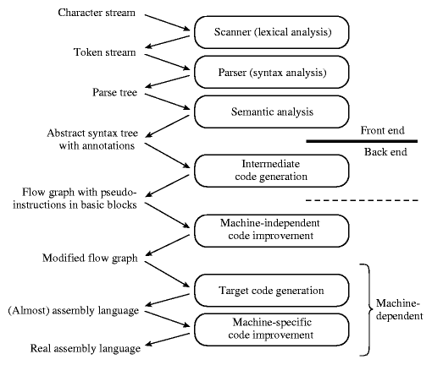
Phases of Compilation

Slide 6
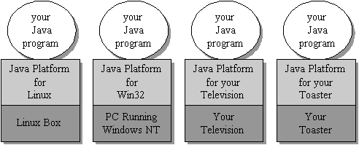
The Java Platform
The byte code generated by the Java front-end is an intermediate form
Compact
Platform-independent

Slide 7
The Class File
Java class file contains
Byte code for data and methods (intermediate form, platform independent) (remember byte code? )
Symbolic references from one class file to another
  Class names in text strings
  Decompiling/reverse engineering quite easy
Field names and descriptors (type info)
Method names and descriptors (num args, arg types)
Symbolic refs to other class methods/fields, own methods/fields

Slide 8
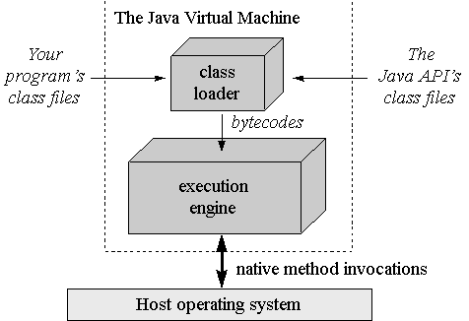
The Role of the Virtual Machime
Local or
Remote

Slide 9
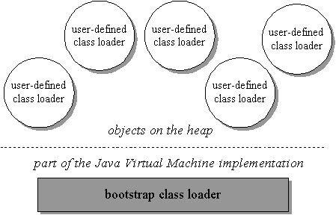
Class Loaders
Bootstrap (default) loader (in the JVM)
User-defined (custom) loaders

Slide 10
Dynamic Class Loading
You don't have to know at compile-time all the classes that may ultimately take part in a running Java application.
User-defined class loaders enable you to dynamically extend a Java app at run-time
As it runs, your app can determine what extra classes it needs and load them
Custom loaders can download classes across a network (applets), get them out of some kind of database, or even calculate them on the fly.

Slide 11
The Execution Engine
Back-end transformation and execution
Simple JVM
  byte code interpretation
Just-in-time compiler
  Method byte codes are compiled into machine code the first time they are invoked
  The machine code is cached for subsequent invocation
  It requires more memory
Adaptive optimization
  The interpreter monitors the activity of the program, compiling the heavily used part of the program into machine code
  It is much faster than simple interpretation, a little more memory
  The memory requirement is only slightly larger due to the 20%/80% rule of program execution (In general, 20% of the code is responsible for 80% of the execution)

Slide 12
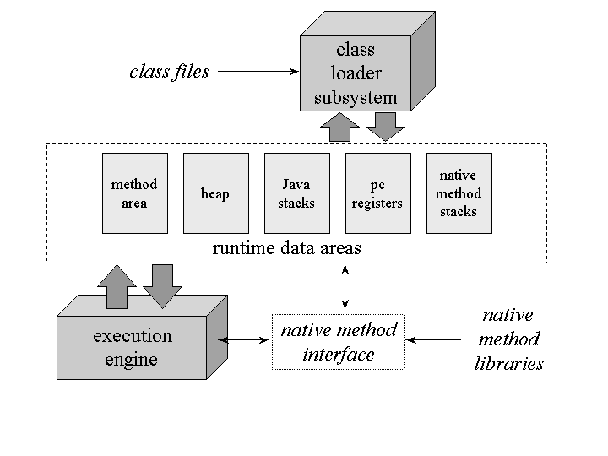
The Java Virtual Machine

Slide 13
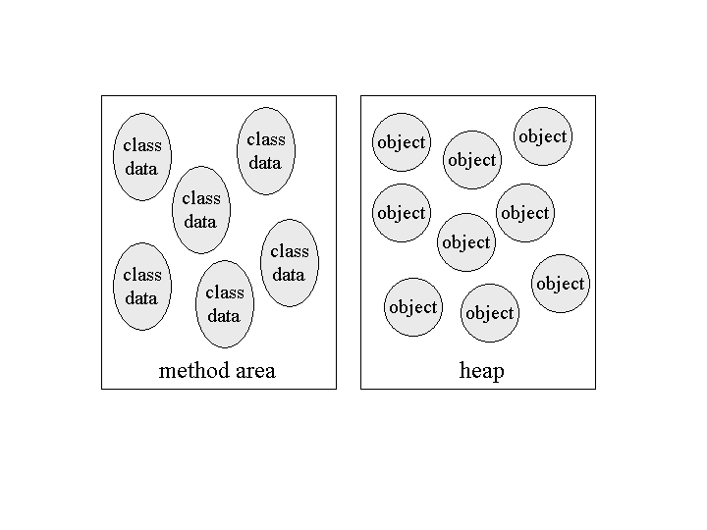
Shared Data Areas
Each JVM has one of each:
Method area: byte code and class (static) data storage
Heap: object storage

Slide 14
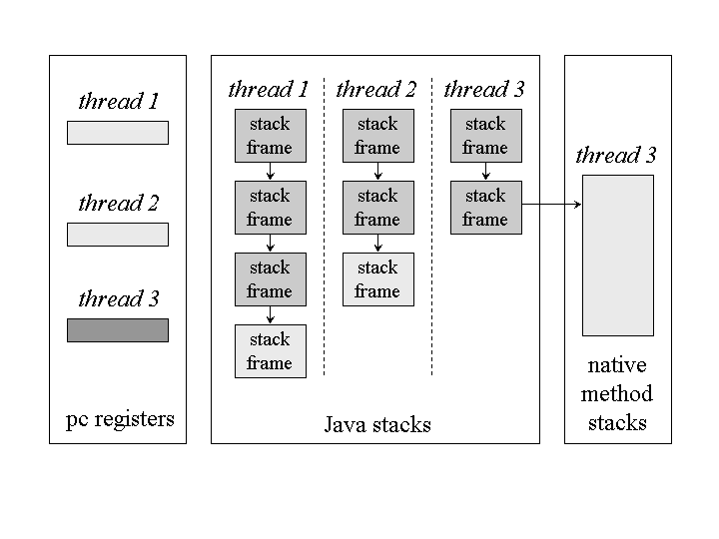
Thread Data Areas
Frame in Execution

Slide 15
Stack Frames
Stack frames have three parts
Local variables
Operand stack
Frame data

Slide 16
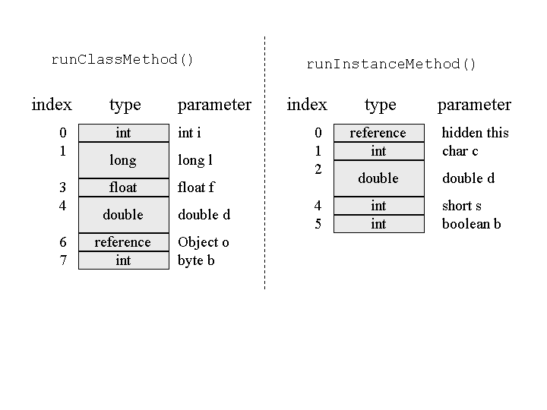
Stack Frame
Local Variables
class Example3a {
public static int runClassMethod(int i, long l, float f, double d, Object o, byte b) {
return 0;
}
public int runInstanceMethod(char c, double d, short s, boolean b) {
return 0;
}
}

Slide 17
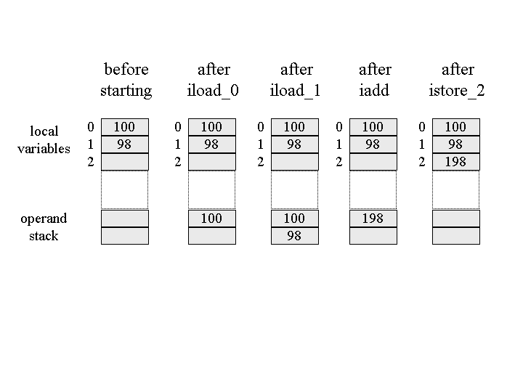
Stack Frame
Operand Stack
Adding 2 numbers
iload_0
iload_1
Iadd
istore_2
Compiler can tell how many slots the op stack will need for a method

Slide 18
Stack Frame
Frame Data
The stack frame also supports
  Constant pool resolution
  Normal method return
  Exception dispatch

Slide 19
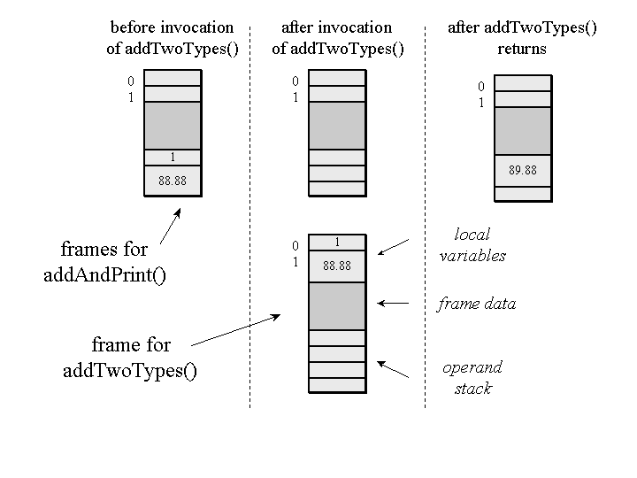
Stack Frame
Frame Allocation in a Heap
class Example3c {
public static void addAndPrint() {
double result = addTwoTypes(1, 88.88);
System.out.println(result);
}
public static double addTwoTypes(int i, double d) {
return i + d;
}
}

Slide 20
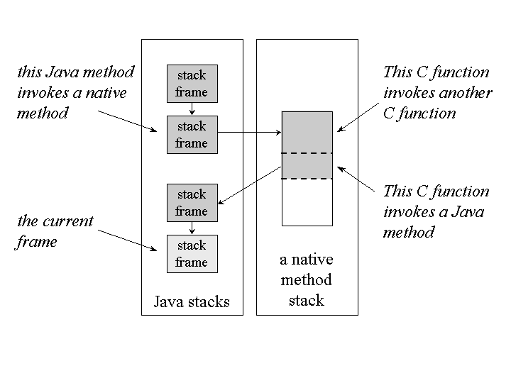
Stack Frame
Native Method
A simulated stack of the target language (e.g. C) is created for JNI

Slide 21
The Heap
Class instances (objects) and arrays are stored in a single, shared heap
Each Java application has its own heap
  Isolation
  But a JVM crash will break this isolation
JVM heaps always implement garbage collection mechanisms

Slide 22
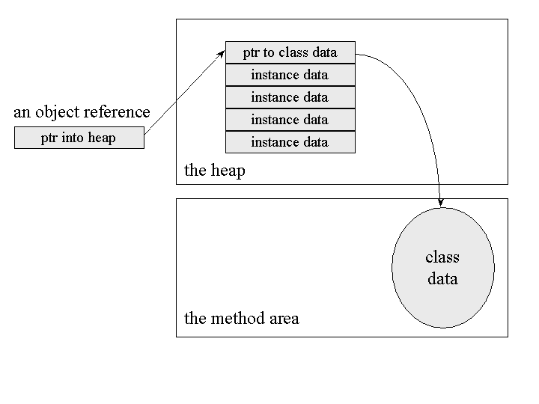
Heap
Monolithic Object Representation

Slide 23
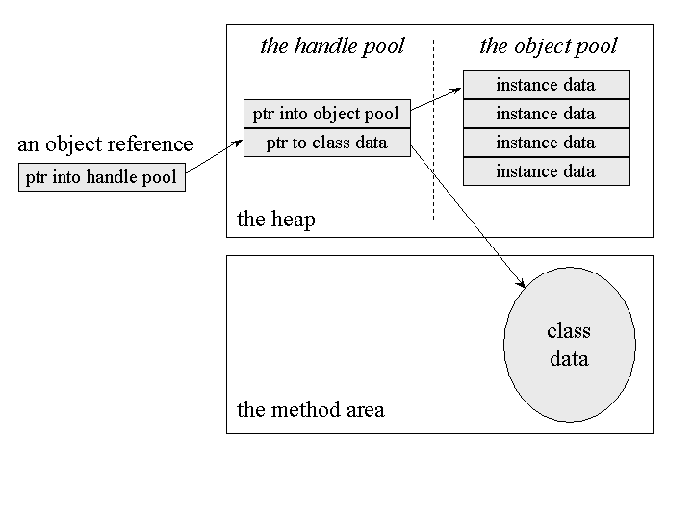
The Heap
Split Object Representation

Slide 24
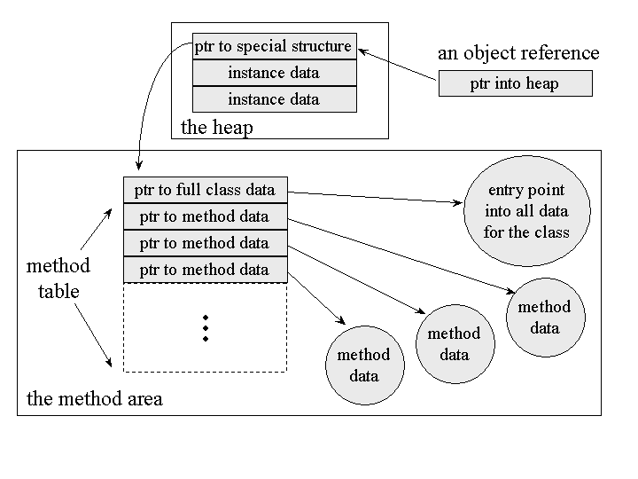
The Heap
Memory/Speed Tradeoff

Slide 25
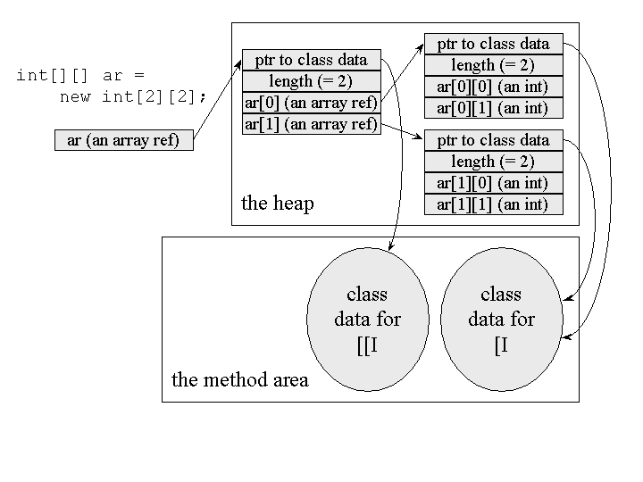
The Heap
Arrays as Objects

Slide 26
Examples
HeapOfFish
  http://www.artima.com/insidejvm/applets/HeapOfFish.html
  Object allocation illustration
Eternal Math Example
  http://www.artima.com/insidejvm/applets/EternalMath.html
  JVM execution, operand stack, illustration

Slide 27
Reading Assignment
Inside the Java 2 Virtual Machine by Bill Venners
  Ch 1
  Ch 5
  Illustrations

