Slide 1
Java and the JVM
Martin Schöberl

Slide 2
Overview
History and Java features
Java technology
The Java language
A first look into the JVM
Disassembling of .class files

Slide 3
History of a Young Java
1992 Oak for a PDA on a SPARC (*7)
1995 Official release as Java – Internet
1997 picoJava – Sun’s Java processor
1998 RTSJ specification start as JSR-01
1999 split into J2SE and J2EE
2000 J2ME
2002 RTSJ final release
2002 first version of JOP ;-)

Slide 4
Java features
Simple and object oriented
  Look and feel of C
  Simplified object model with single inheritance
Portability
  Java compiler generates bytecodes
  Runtime systems for various platforms
  Size and behavior of basic data types defined
  Write once, run/debug anywhere

Slide 5
Java features cont.
Availability
  Windows, Linux, Solaris,…
  Embedded systems
  Compiler and runtime are free
  Free IDEs: Eclipse, Netbeans
Library
  Rich class library
  Part of the definition
  Standard GUI toolkit

Slide 6
Java features cont.
Built-in model for concurrency
  Threads at the language level
  Synchronization
  Libraries are thread-safe
Safety
  No Pointer!
  Extensive compile-time checking
  Runtime checking
  Automatic memory management – GC

Slide 7
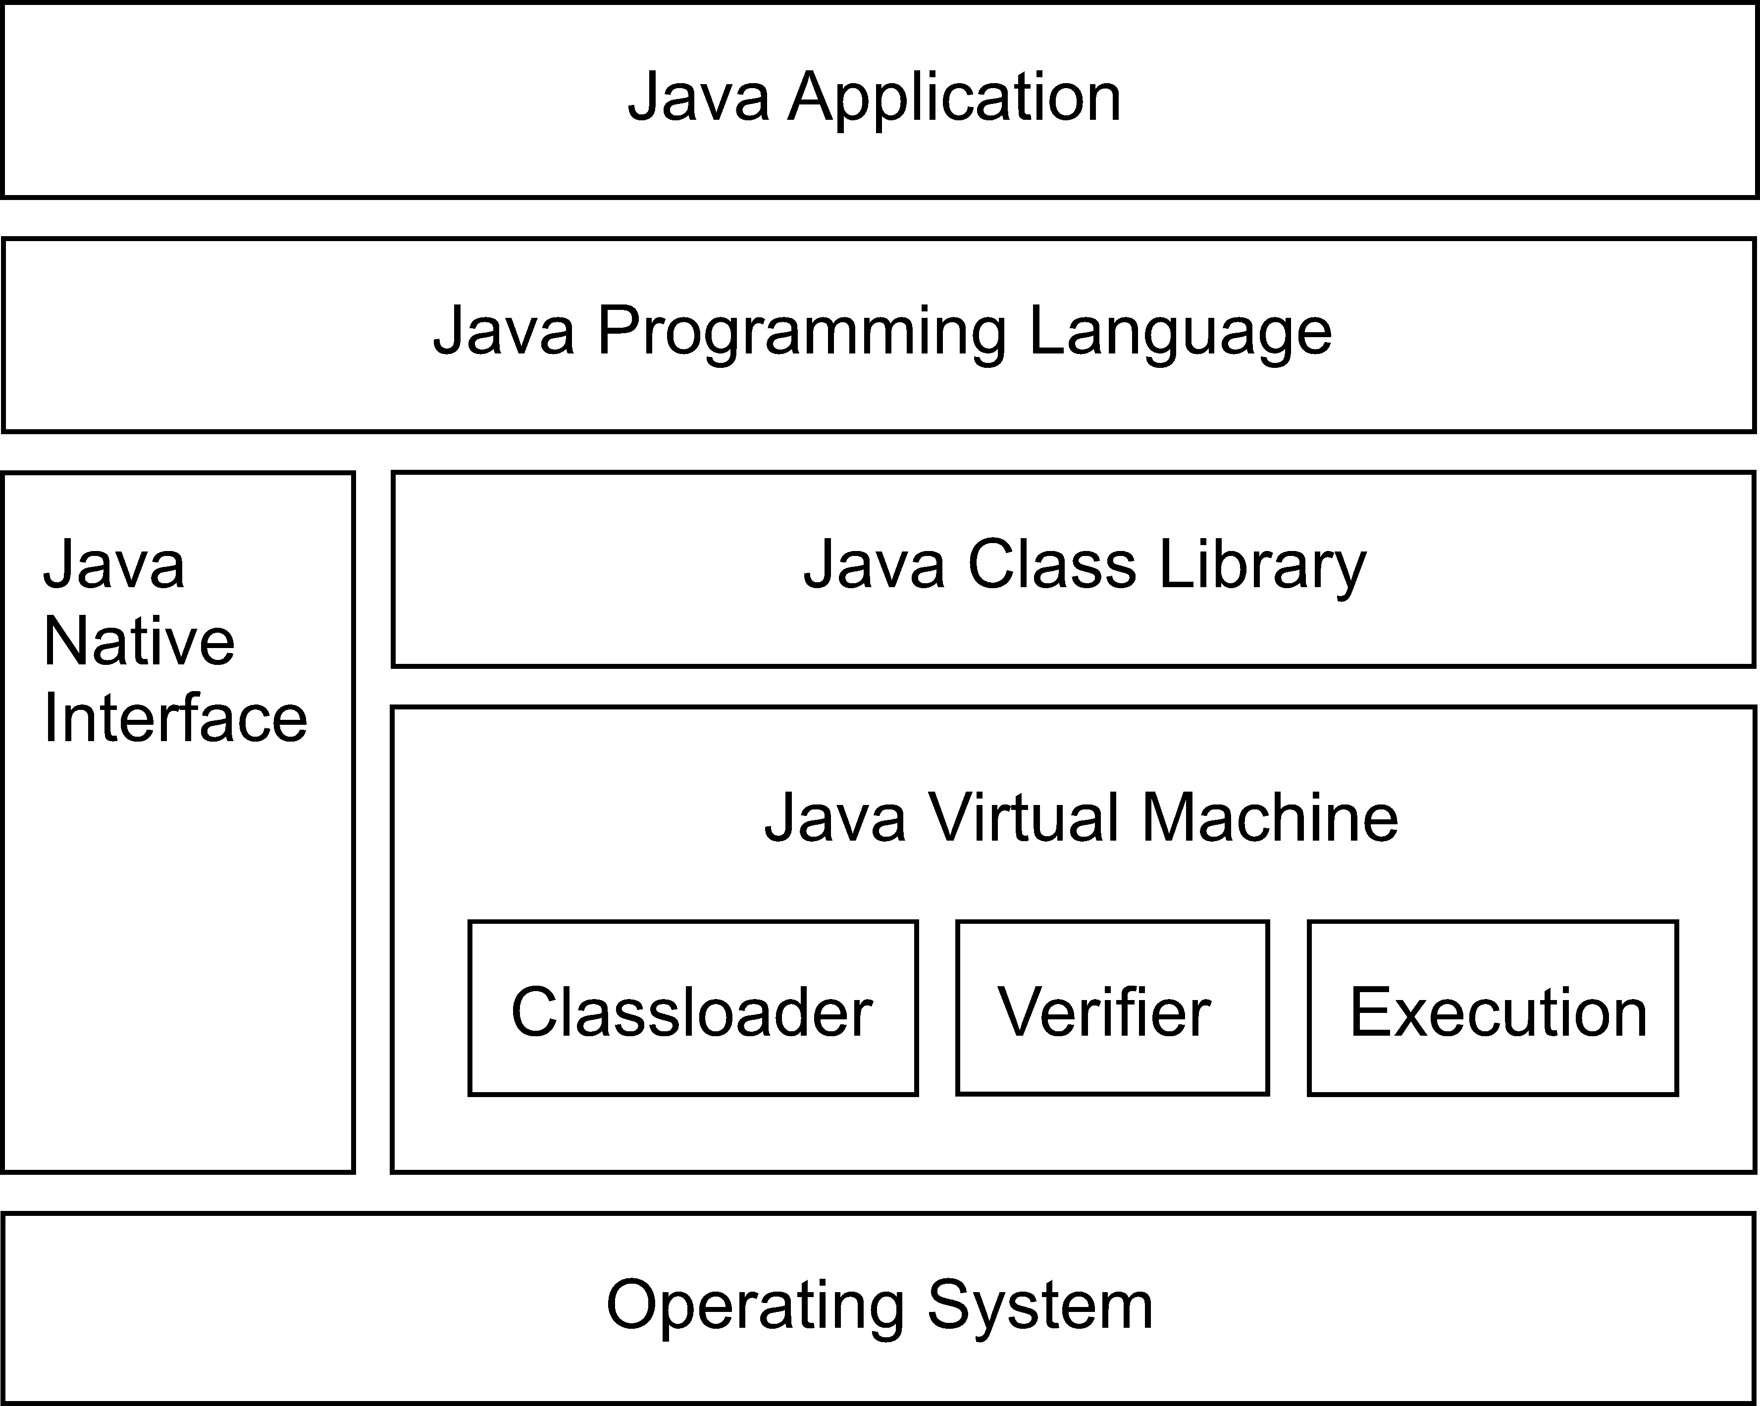
Java system overview

Slide 8
Java Technology
The Java programming language
The library (JDK)
The Java virtual machine (JVM)
  Instruction set
  Binary format
  Verification

Slide 9
Java Primitive Data Types
boolean | either true or false
char | 16-bit Unicode character (unsigned)
byte | 8-bit integer (signed)
short | 16-bit integer (signed)
int | 32-bit integer (signed)
long | 64-bit integer (signed)
float | 32-bit floating-point (IEEE 754-1985)
double | 64-bit floating-point (IEEE 754-1985)

Slide 10
Objects
Everything belongs to an object (or a class)
  No global variables
Namespace for objects
Single inheritance
Interfaces
Allocated on the heap
Shared among threads
No free() – garbage collector

Slide 11
What is a Virtual Machine?
A virtual machine (VM) is an abstract computer architecture
Software on top of a real hardware
Can run the same application on different machines where the VM is available

Slide 12
The Java Virtual Machine
An abstract computing machine that executes bytecode programs
  An instruction set and the meaning of those instructions – the bytecodes
  A binary format – the class file format
  An algorithm to verify the class file

Slide 13
JVM cont.
Runtime environment for Java
Implementation NOT defined
Runs Java .class files
Has to conform to Sun‘s specification

Slide 14
Implementations of the JVM
Interpreter
  Simple, compact
  Slow
Just-in-time compilation
  State-of-the-art for desktop/server
  Too resource consuming in embedded systems
Batch compilation
Hardware implementation
  Our topic!

Slide 15
JVM Data Types
reference | Pointer to an object or array
int | 32-bit integer (signed)
long | 64-bit integer (signed)
float | 32-bit floating-point (IEEE 754-1985)
double | 64-bit floating-point (IEEE 754-1985)
No boolean, char, byte, and short types
  Stack contains only 32-bit and 64-bit data
  Conversion instructions

Slide 16
Memory Areas for the JVM
Method area
  Class description
  Code
  Constant pool
Heap
  Objects and Arrays
  Shared by all threads
  Garbage collected

Slide 17
Memory Areas for the JVM
Stack
  Thread private
  Logical stack that contains:
    Invocation frame
    Local variable area
    Operand stack
  Not necessary a single stack
  Local variables and operand stack are accessed frequently

Slide 18
JVM Instruction Set
32 (64) bit stack machine
Variable length instruction set
Simple to very complex instructions
Symbolic references
Only relative branches

Slide 19
JVM Instruction Set
Load and store
Arithmetic
Type conversion
Object creation and manipulation
Operand stack manipulation
Control transfer
Method invocation and return

Slide 20
Dissassembling Java
Compile
  javac Hello.java
Run
  java Hello
Dissassemble
  javap -c Hello

Slide 21
A Bytecode Example
public class X {
public static void
main(String[] args) {
add(1, 2);
}
public static int
add(int a, int b) {
return a+b;
}
}
public static void main(java.lang.String[]);
Code:
0: iconst_1
1: iconst_2
//Method add:(II)I
2: invokestatic #2; 5: pop
6: return
public static int add(int,int);
Code:
0: iload_0
1: iload_1
2: iadd
3: ireturn

Slide 22
Coding: Avoiding garbage
System.out.println("Result = "+i);
getstatic #3; // Field System.out:Ljava/io/PrintStream;
new #4; // class StringBuffer
dup
invokespecial #5; // StringBuffer."<init>":()V
ldc #6; // String Result =
invokevirtual #7; // StringBuffer.append:(LString;)LStringBuffer
iload_1
invokevirtual #8; // StringBuffer.append:(I)LStringBuffer;
invokevirtual #9; // StringBuffer.toString:()LString;
invokevirtual #10;// PrintStream.println:(LString;)V

Slide 23
Coding: Avoiding garbage
System.out.print("Result = ");
System.out.println(i);
getstatic #3; //Field System.out:Ljava/io/PrintStream;
ldc #4; //String Result =
invokevirtual #5; //Method PrintStream.print:(LString;)V
getstatic #3; //Field System.out:LPrintStream;
iload_1
invokevirtual #6; //Method PrintStream.println:(I)V

Slide 24
Java for Embedded Systems?
+ Simpler than C/C++
+ Safer than C/C++
+ Threads are part of the language
- Interpreting JVM is slow
- JIT needs a lot of memory
- GC and real-time?

Slide 25
Summary Java/JVM
Java language definition
Class library
The Java virtual machine (JVM)
  An instruction set – the bytecodes
  A binary format – the class file
  An algorithm to verify the class file

Slide 26
Summary Java Features
Safe OO Language
  No pointers
  Type-safety
  Garbage Collection
Built in model for concurrency
Platform independent
Very rich standard library

Slide 27
More Information
Java
  James Gosling, Bill Joy, Guy Steele, and Gilad Bracha. The Java Language Specification, Addison-Wesley, 2000, JavaSpec.
JVM
  Tim Lindholm and Frank Yellin. The Java Virtual Machine Specification. Addison-Wesley, 1999, JVMSpec.

