Slide 1
Apache Hadoop and Hive
Dhruba Borthakur
Apache Hadoop Developer
Facebook Data Infrastructure
dhruba@apache.org, dhruba@facebook.com
Condor Week, April 22, 2009

Slide 2
Outline
Architecture of Hadoop Distributed File System
Hadoop usage at Facebook
Ideas for Hadoop related research

Slide 3
Who Am I?
Hadoop Developer
  Core contributor since Hadoop’s infancy
  Project Lead for Hadoop Distributed File System
Facebook (Hadoop, Hive, Scribe)
Yahoo! (Hadoop in Yahoo Search)
Veritas (San Point Direct, Veritas File System)
IBM Transarc (Andrew File System)
UW Computer Science Alumni (Condor Project)

Slide 4
Hadoop, Why?
Need to process Multi Petabyte Datasets
Expensive to build reliability in each application.
Nodes fail every day
– Failure is expected, rather than exceptional.
– The number of nodes in a cluster is not constant.
Need common infrastructure
– Efficient, reliable, Open Source Apache License
The above goals are same as Condor, but
  Workloads are IO bound and not CPU bound

Slide 5
Hive, Why?
Need a Multi Petabyte Warehouse
Files are insufficient data abstractions
  Need tables, schemas, partitions, indices
SQL is highly popular
Need for an open data format
– RDBMS have a closed data format
– flexible schema
Hive is a Hadoop subproject!

Slide 6
Hadoop & Hive History
Dec 2004 – Google GFS paper published
July 2005 – Nutch uses MapReduce
Feb 2006 – Becomes Lucene subproject
Apr 2007 – Yahoo! on 1000-node cluster
Jan 2008 – An Apache Top Level Project
Jul 2008 – A 4000 node test cluster
Sept 2008 – Hive becomes a Hadoop subproject

Slide 7
Who uses Hadoop?
Amazon/A9
Facebook
Google
IBM
Joost
Last.fm
New York Times
PowerSet
Veoh
Yahoo!

Slide 8
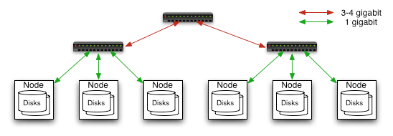
Commodity Hardware
Typically in 2 level architecture
– Nodes are commodity PCs
– 30-40 nodes/rack
– Uplink from rack is 3-4 gigabit
– Rack-internal is 1 gigabit

Slide 9
Goals of HDFS
Very Large Distributed File System
– 10K nodes, 100 million files, 10 PB
Assumes Commodity Hardware
– Files are replicated to handle hardware failure
– Detect failures and recovers from them
Optimized for Batch Processing
– Data locations exposed so that computations can move to where data resides
– Provides very high aggregate bandwidth
User Space, runs on heterogeneous OS

Slide 10
HDFS Architecture
Cluster Membership
NameNode
1. filename
2. BlckId, DataNodes
o
Secondary
NameNode
Client
3.Read data
Cluster Membership
NameNode : Maps a file to a file-id and list of MapNodes
DataNode : Maps a block-id to a physical location on disk
SecondaryNameNode: Periodic merge of Transaction log
DataNodes

Slide 11
Distributed File System
Single Namespace for entire cluster
Data Coherency
– Write-once-read-many access model
– Client can only append to existing files
Files are broken up into blocks
– Typically 128 MB block size
– Each block replicated on multiple DataNodes
Intelligent Client
– Client can find location of blocks
– Client accesses data directly from DataNode

Slide 12
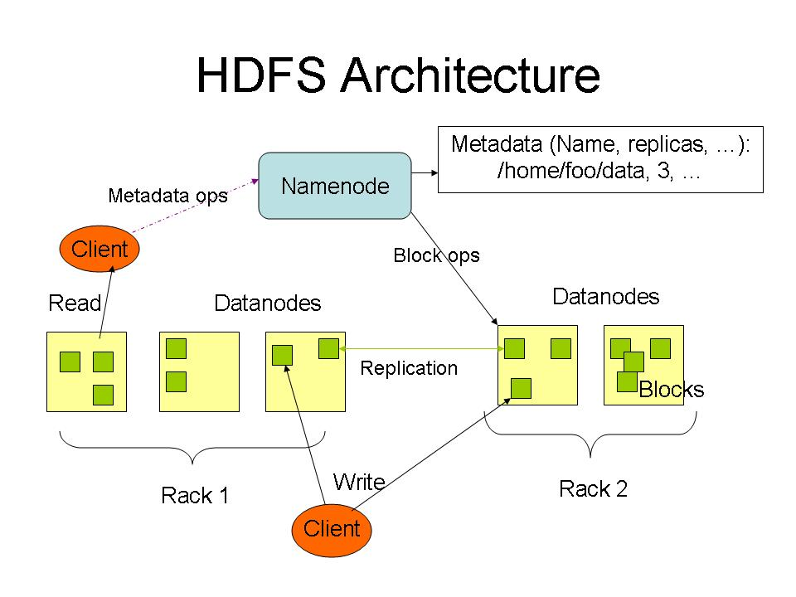

Slide 13
NameNode Metadata
Meta-data in Memory
– The entire metadata is in main memory
– No demand paging of meta-data
Types of Metadata
– List of files
– List of Blocks for each file
– List of DataNodes for each block
– File attributes, e.g creation time, replication factor
A Transaction Log
– Records file creations, file deletions. etc

Slide 14
DataNode
A Block Server
– Stores data in the local file system (e.g. ext3)
– Stores meta-data of a block (e.g. CRC)
– Serves data and meta-data to Clients
Block Report
– Periodically sends a report of all existing blocks to the NameNode
Facilitates Pipelining of Data
– Forwards data to other specified DataNodes

Slide 15
Block Placement
Current Strategy
-- One replica on local node
-- Second replica on a remote rack
-- Third replica on same remote rack
-- Additional replicas are randomly placed
Clients read from nearest replica
Would like to make this policy pluggable

Slide 16
Data Correctness
Use Checksums to validate data
– Use CRC32
File Creation
– Client computes checksum per 512 byte
– DataNode stores the checksum
File access
– Client retrieves the data and checksum from DataNode
– If Validation fails, Client tries other replicas

Slide 17
NameNode Failure
A single point of failure
Transaction Log stored in multiple directories
– A directory on the local file system
– A directory on a remote file system (NFS/CIFS)
Need to develop a real HA solution

Slide 18
Data Pipelining
Client retrieves a list of DataNodes on which to place replicas of a block
Client writes block to the first DataNode
The first DataNode forwards the data to the next DataNode in the Pipeline
When all replicas are written, the Client moves on to write the next block in file

Slide 19
Rebalancer
Goal: % disk full on DataNodes should be similar
  Usually run when new DataNodes are added
  Cluster is online when Rebalancer is active
  Rebalancer is throttled to avoid network congestion
  Command line tool

Slide 20
Hadoop Map/Reduce
The Map-Reduce programming model
– Framework for distributed processing of large data sets
– Pluggable user code runs in generic framework
Common design pattern in data processing
cat * | grep | sort | unique -c | cat > file
input | map | shuffle | reduce | output
Natural for:
– Log processing
– Web search indexing
– Ad-hoc queries

Slide 21
Hadoop at Facebook
Production cluster
  4800 cores, 600 machines, 16GB per machine – April 2009
  8000 cores, 1000 machines, 32 GB per machine – July 2009
  4 SATA disks of 1 TB each per machine
  2 level network hierarchy, 40 machines per rack
  Total cluster size is 2 PB, projected to be 12 PB in Q3 2009
Test cluster
  800 cores, 16GB each

Slide 22



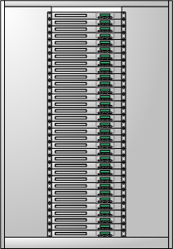


Data Flow
Web Servers
Scribe Servers
Network Storage
Oracle RAC
Hadoop Cluster
MySQL
Notes:
This is the architecture of our backend data warehouing system. This system provides important information on the usage of our website, including but not limited to the number page views of each page, the number of active users in each country, etc.
We generate 3TB of compressed log data every day. All these data are stored and processed by the hadoop cluster which consists of over 600 machines. The summary of the log data is then copied to Oracle and MySQL databases, to make sure it is easy for people to access.

Slide 23
Hadoop and Hive Usage
Statistics :
  15 TB uncompressed data ingested per day
  55TB of compressed data scanned per day
  3200+ jobs on production cluster per day
  80M compute minutes per day
Barrier to entry is reduced:
  80+ engineers have run jobs on Hadoop platform
  Analysts (non-engineers) starting to use Hadoop through Hive

Slide 24
Ideas for Collaboration

Slide 25
Condor and HDFS
Run Condor jobs on Hadoop File System
  Create HDFS using local disk on condor nodes
  Use HDFS API to find data location
  Place computation close to data location
Support map-reduce data abstraction model

Slide 26
Power Management
Power Management
  Major operating expense
  Power down CPU’s when idle
  Block placement based on access pattern
    Move cold data to disks that need less power
Condor Green

Slide 27
Benchmarks
Design Quantitative Benchmarks
  Measure Hadoop’s fault tolerance
  Measure Hive’s schema flexibility
Compare above benchmark results
  with RDBMS
  with other grid computing engines

Slide 28
Job Sheduling
Current state of affairs
  FIFO and Fair Share scheduler
  Checkpointing and parallelism tied together
Topics for Research
  Cycle scavenging scheduler
  Separate checkpointing and parallelism
  Use resource matchmaking to support heterogeneous Hadoop compute clusters
  Scheduler and API for MPI workload

Slide 29
Commodity Networks
Machines and software are commodity
Networking components are not
  High-end costly switches needed
  Hadoop assumes hierarchical topology
Design new topology based on commodity hardware

Slide 30
More Ideas for Research
Hadoop Log Analysis
  Failure prediction and root cause analysis
Hadoop Data Rebalancing
  Based on access patterns and load
Best use of flash memory?

Slide 31
Summary
Lots of synergy between Hadoop and Condor
Let’s get the best of both worlds

Slide 32
Useful Links
HDFS Design:
  http://hadoop.apache.org/core/docs/current/hdfs_design.html
Hadoop API:
  http://hadoop.apache.org/core/docs/current/api/
Hive:
  http://hadoop.apache.org/hive/

