Slide 1



Financial Assistant
MicAl Tecle, TIhut Sleshi, Afomiya Alemayehu, Annorah Lewis

Slide 2
Project Description
Our project objective is to develop a financial assistant tool that enables financial professionals to view all their clients' expenses, budgets, and other financial attributes, while ensuring each client has access to their own information.
Each client will have access only to their own information, ensuring privacy and security.

Slide 3
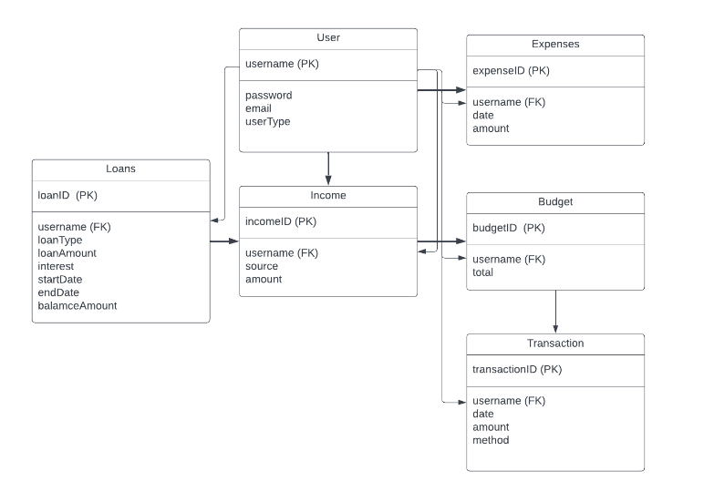
Relational Schema

Slide 4

Demo

Slide 5
Plans for Further Development
Implement functionality for User to Add, Delete, and Update tables
Show how changes in one table can affect other tables, as well as restrictions based on already established cardinality ratios and participation constraints
Connect Admin/Financial Advisor view to Login
Also include designated user types at the creation of an account
Improve error handling
Fix styling of GUI

Slide 6

Questions?
Thank you!

