Slide 1



Financial Assistant
Mical Tecle, TIhut Sleshi, Afomiya Alemayehu, Annorah Lewis

Slide 2
Problem & Solution Description
Our project aims to create a database that helps small businesses, non-profits, and college students to manage their finances.
They will be able to set budgets, input transactions, and keep track of their recurring expenses.
There will be customizable features to differentiate a student account to a business account.
Small businesses and non-profits can have their accountant view their transactions and financial statements.

Slide 3
System Users & Privileges
User | Privilege
Student | Add/delete/retrieve budget and spending information
Small business/non-profit owner | Add/delete/retrieve budget and spending information
Business Accountant | Retrieve business spending information for taxes
Administrator | Add/delete budgeting categories

Slide 4
Entities
Entity | Description
Income | Represents different sources of income for users, including salaries, allowances and grants
Loans | This would include student loans, car loans, etc.
Expenses | Represents all the recurring expenses the users have such as rent, phone bills and subscriptions
Transactions | Represent everyday/minimal monetary transactions such as small material or food purchases, and payments through CashApp, Zelle, etc.
Budget | Represents financial goals the users would like to achieve or save for, or how much money is allocated for a specific category

Slide 5
Relationships
Relationship | Representation
Handles | A user can handle their expenses by tracking them
Supports | A loan can support a user's income by adding to it
Increases | Any income can increase the budget of a user for specific categories
Decreases | By making transactions, the budget left for certain categories can decrease
Earns | A user earns their income through different means

Slide 6
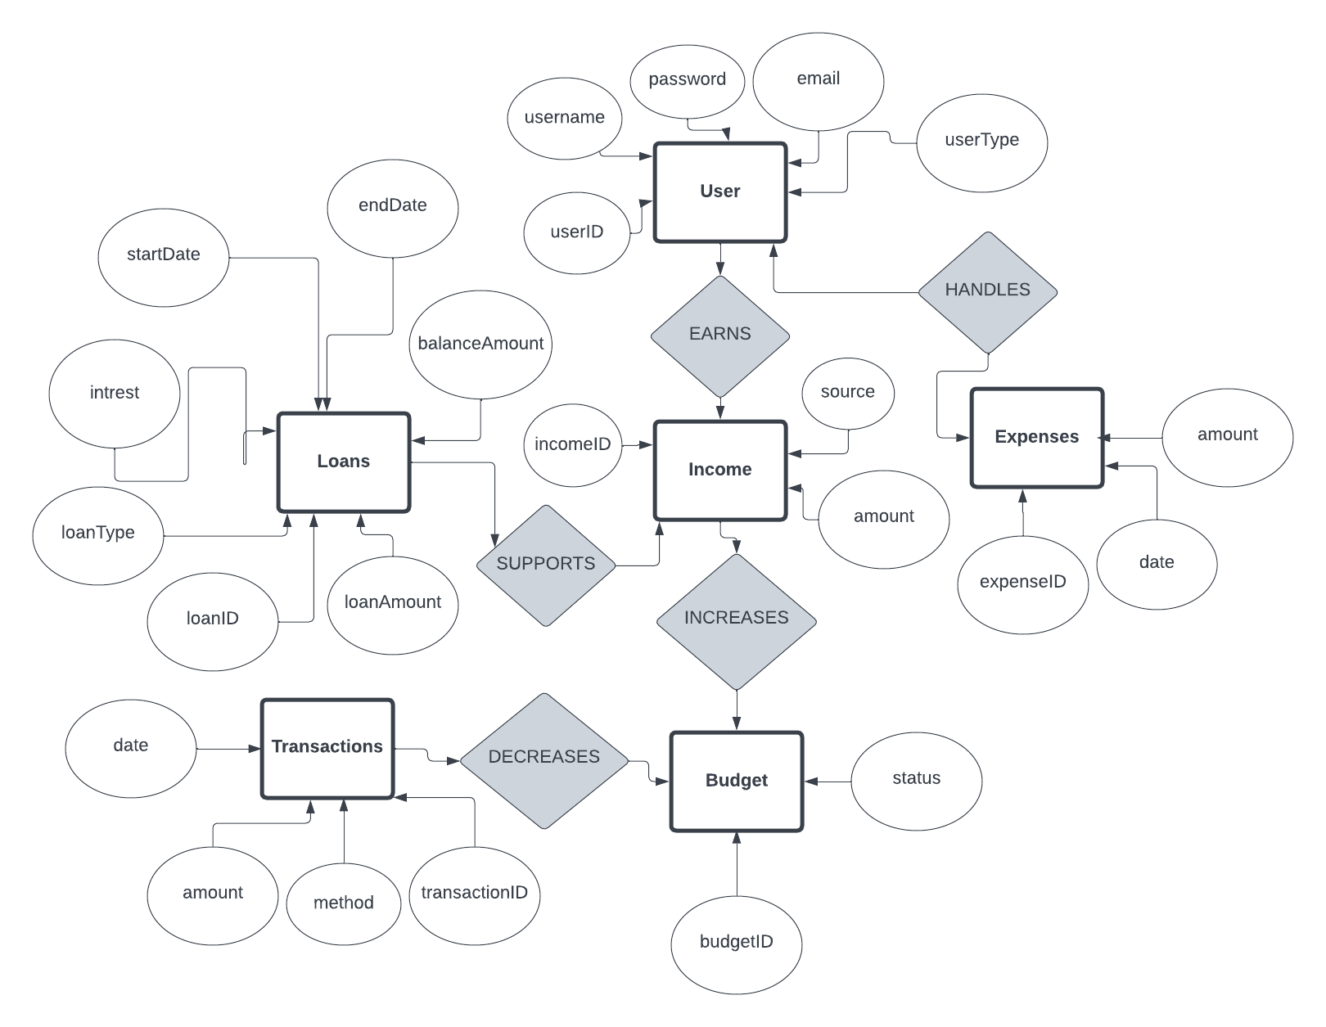
ER Diagram

Slide 7

Questions?
Thank you!

