Slide 1


CS101: Introduction to Computing Lecture 4: Getting started with code
Dr. Mohammad Nauman
Assistant Professor (CS), National University of Computer and Emerging Sciences
mohammad.nauman@nu.edu.pk
http://recluze.wordpress.com

Slide 2
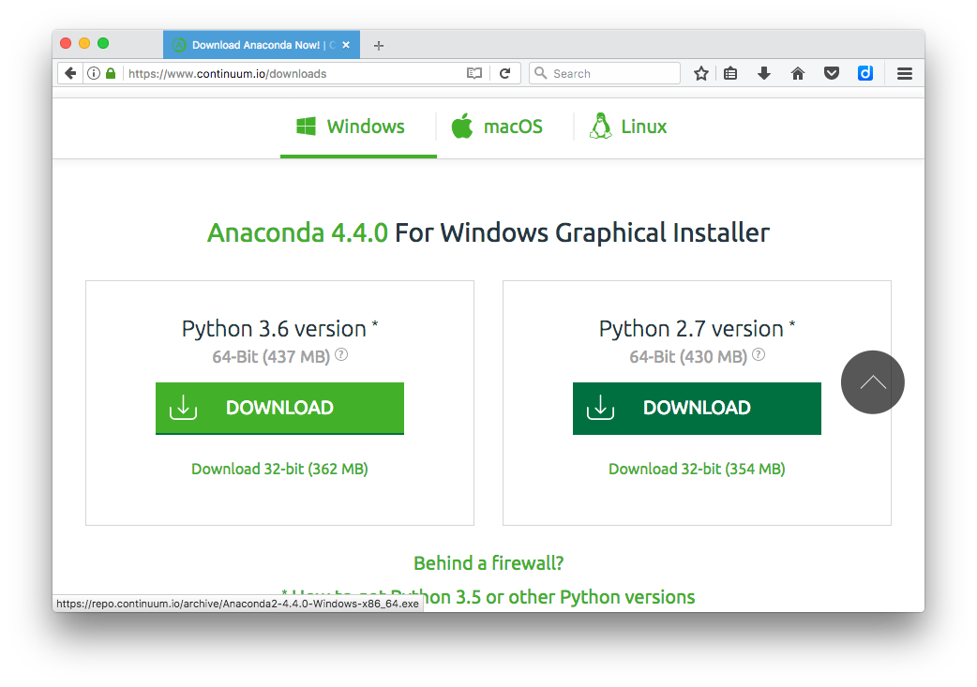
Install Python

Slide 3
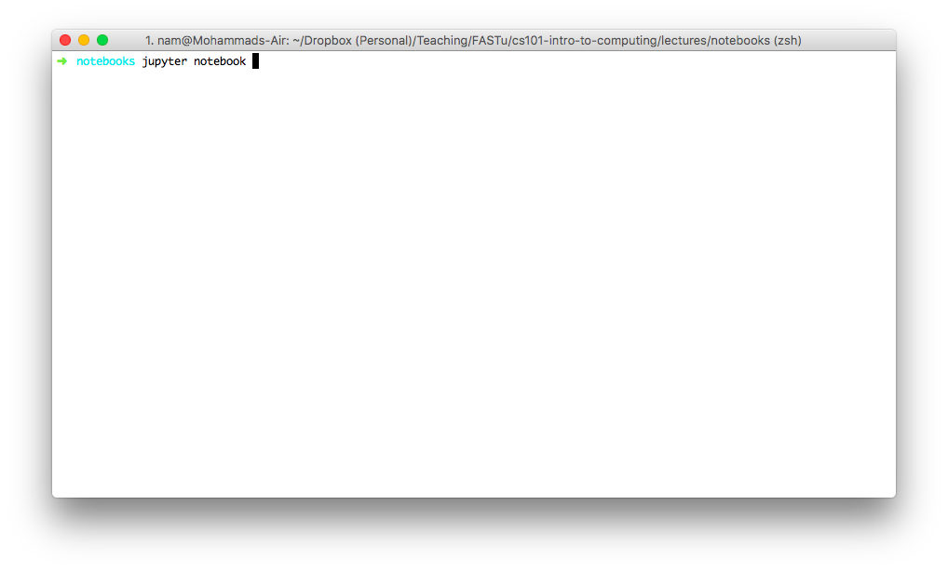
Starting your notebook server

Slide 4
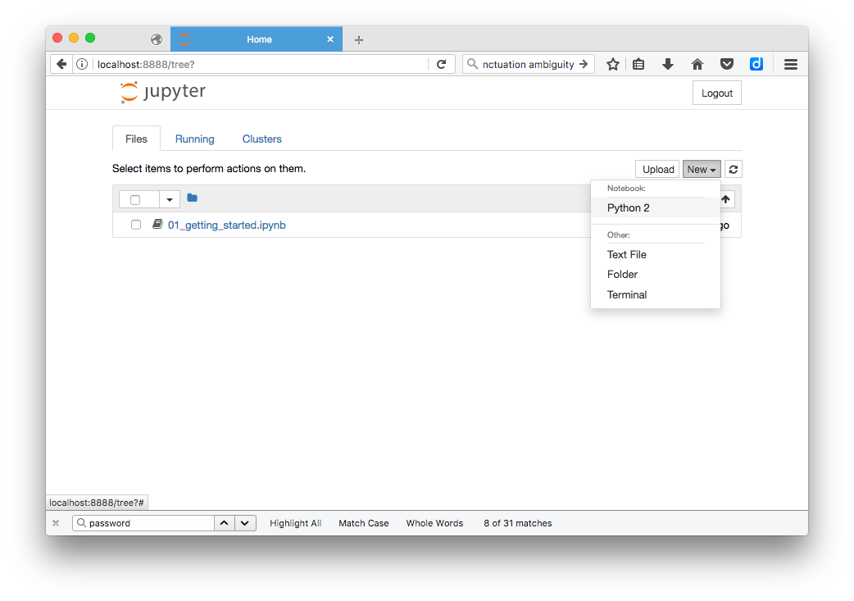
Creating a notebook

Slide 5
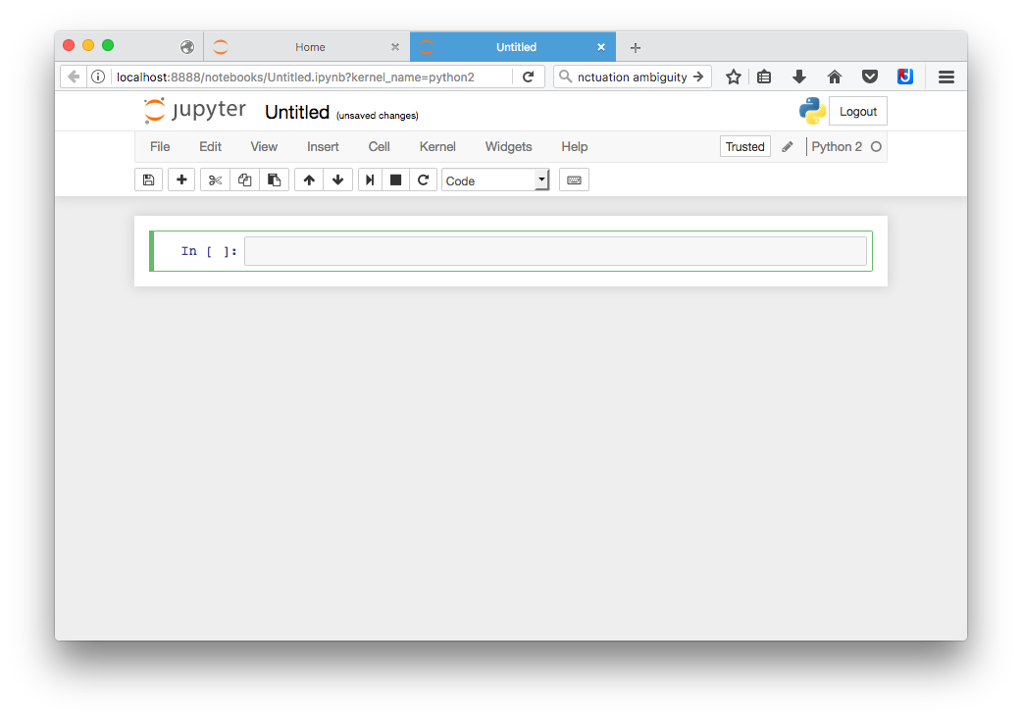
Notebook view

Slide 6
Working in notebooks
Let’s move to the notebook …

Slide 7
Expressions
-2 + 15

Slide 8
Precedence
2 + 2 * 2

Slide 9
Prefix
max ( 7 , 9 )

Slide 10
Prefix (with evaluation)
max ( 2+5 , 9 )

Slide 11
Nesting
max( min(1, -2), min( pow(3, 5) ,-4))

Slide 12
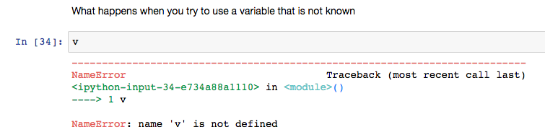
Undefined variables

