Slide 1


CS101: Introduction to Computing Lecture 5: Functions
Dr. Mohammad Nauman
Assistant Professor (CS), National University of Computer and Emerging Sciences
mohammad.nauman@nu.edu.pk
http://recluze.wordpress.com

Slide 2
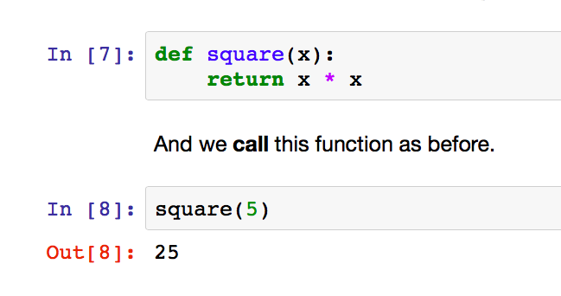
Function definitions

Slide 3
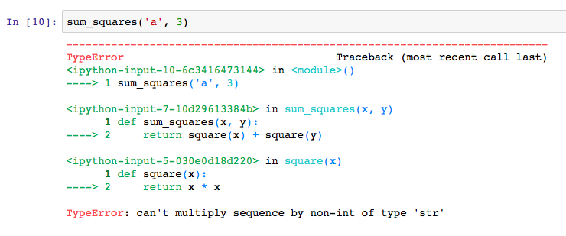
Trace

