Slide 1
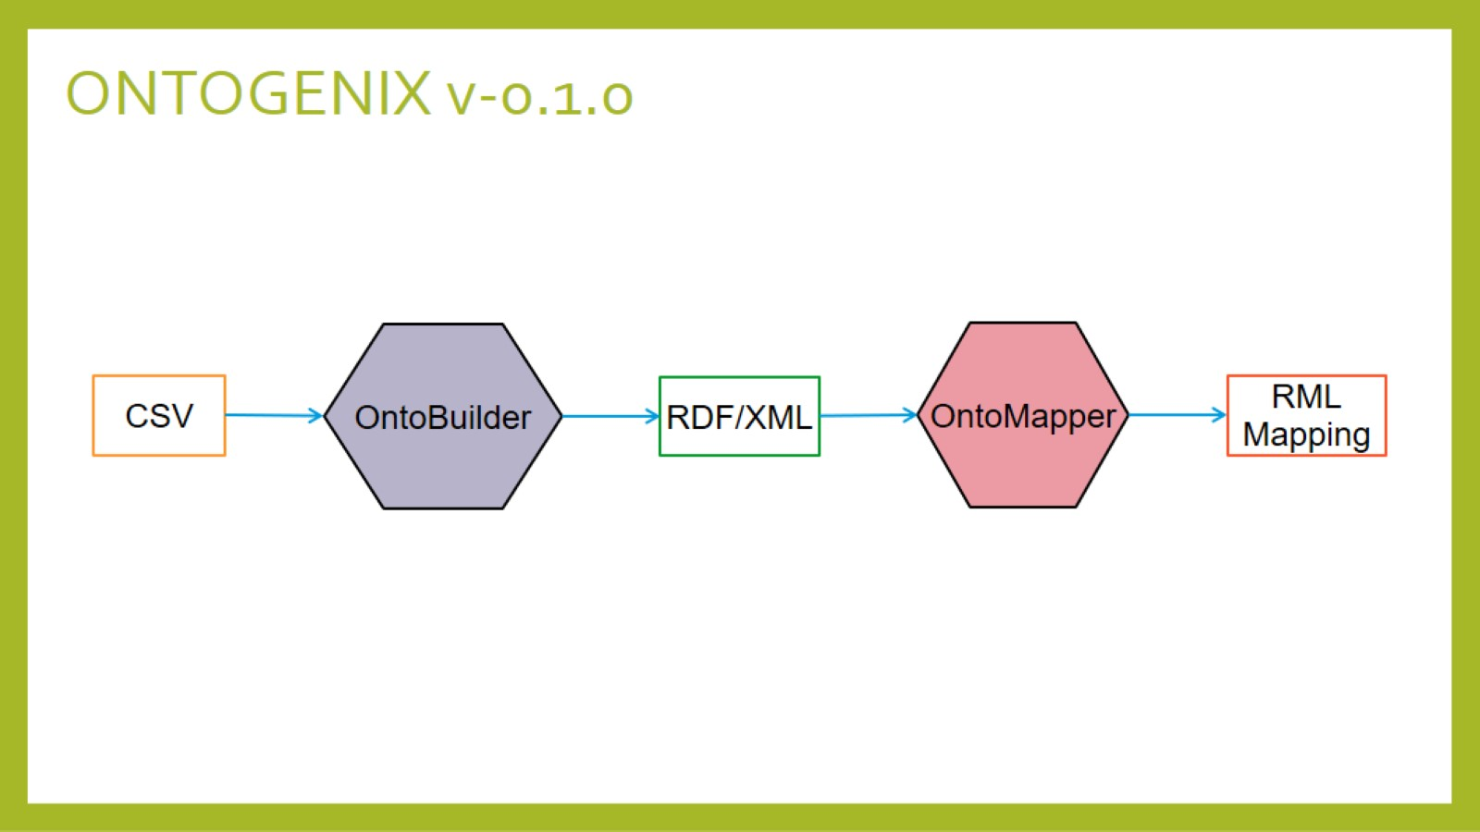
ONTOGENIX v-0.1.0

Slide 2
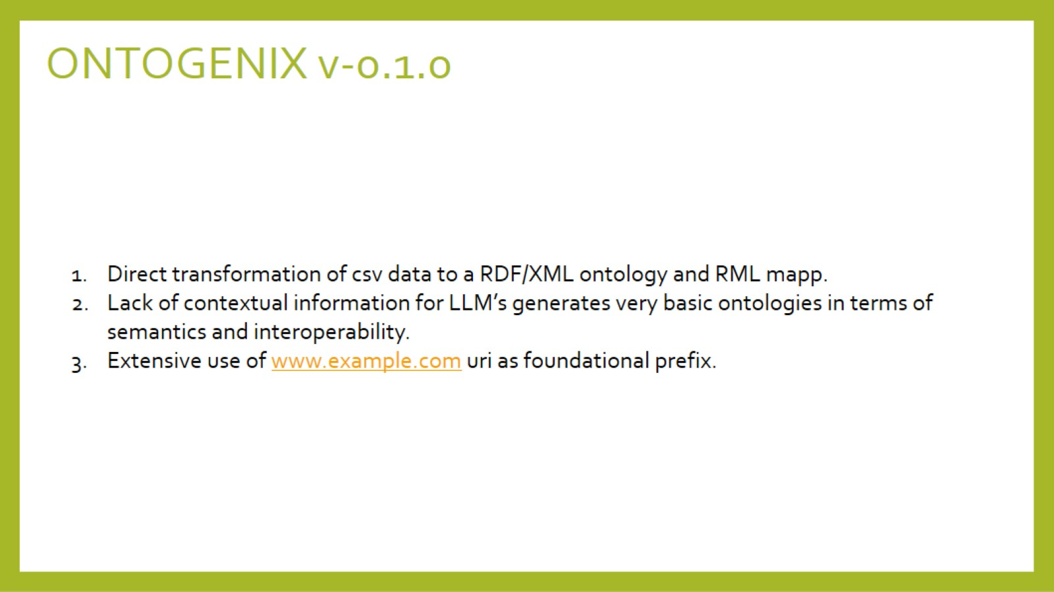
ONTOGENIX v-0.1.0

Slide 3
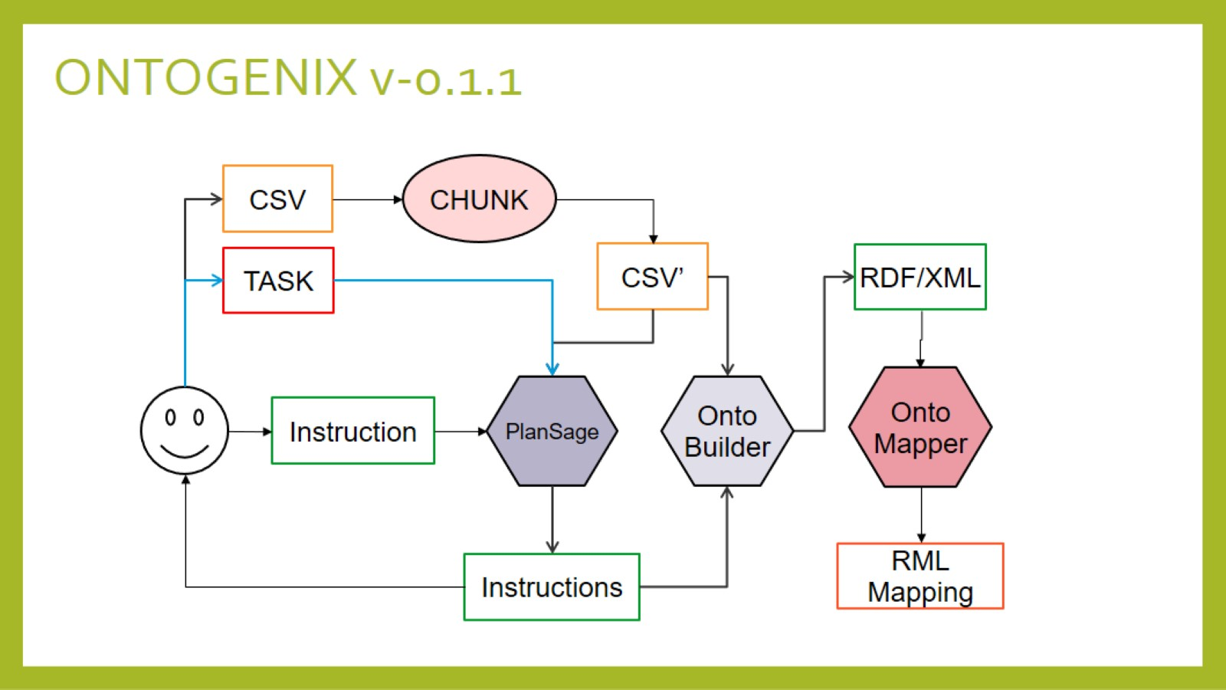

Slide 4
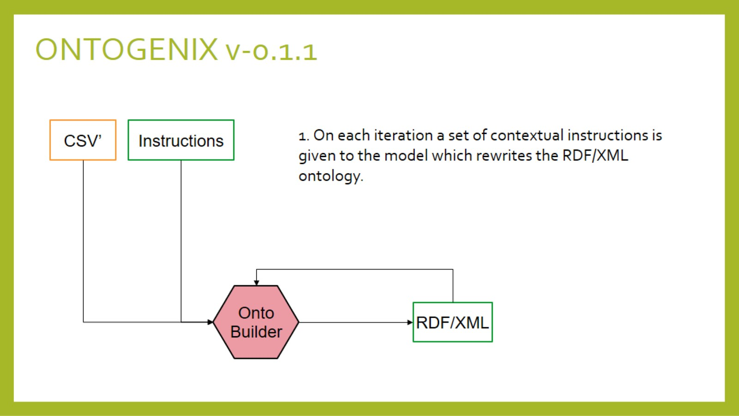

Slide 5
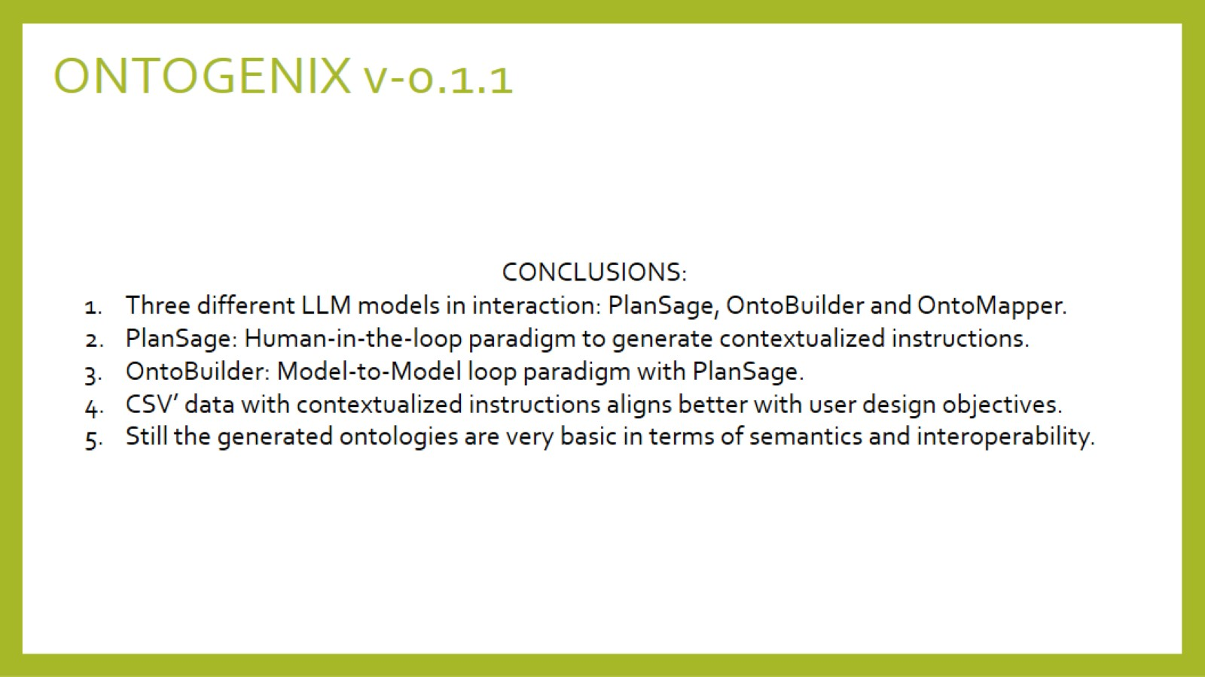

Slide 6
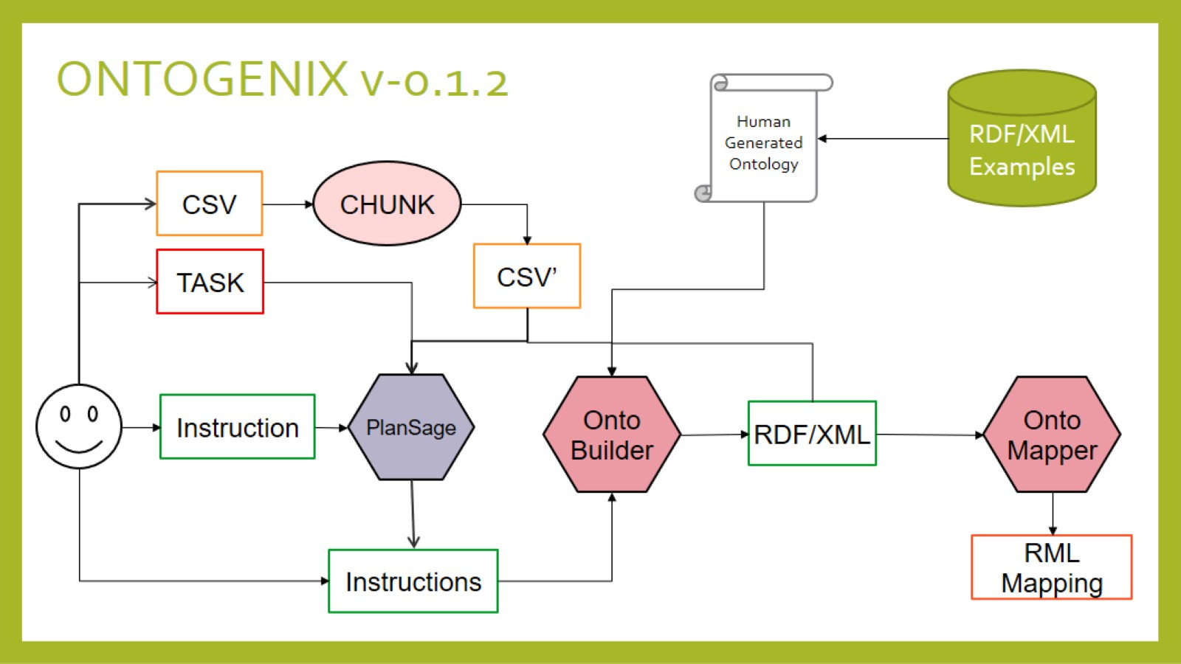

Slide 7


Slide 8
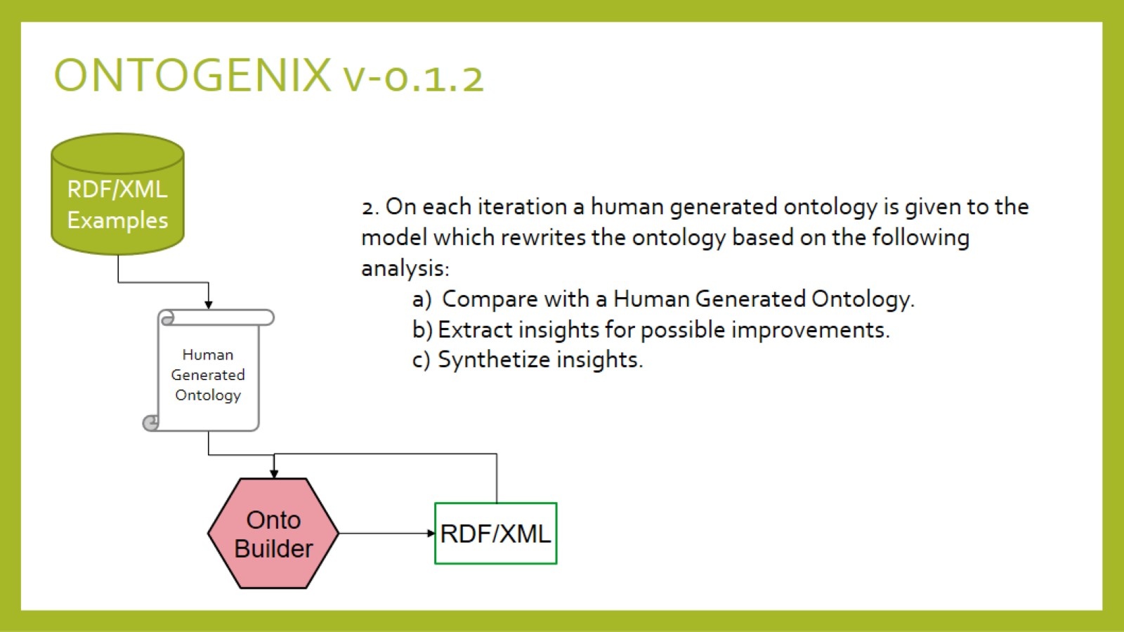

Slide 9
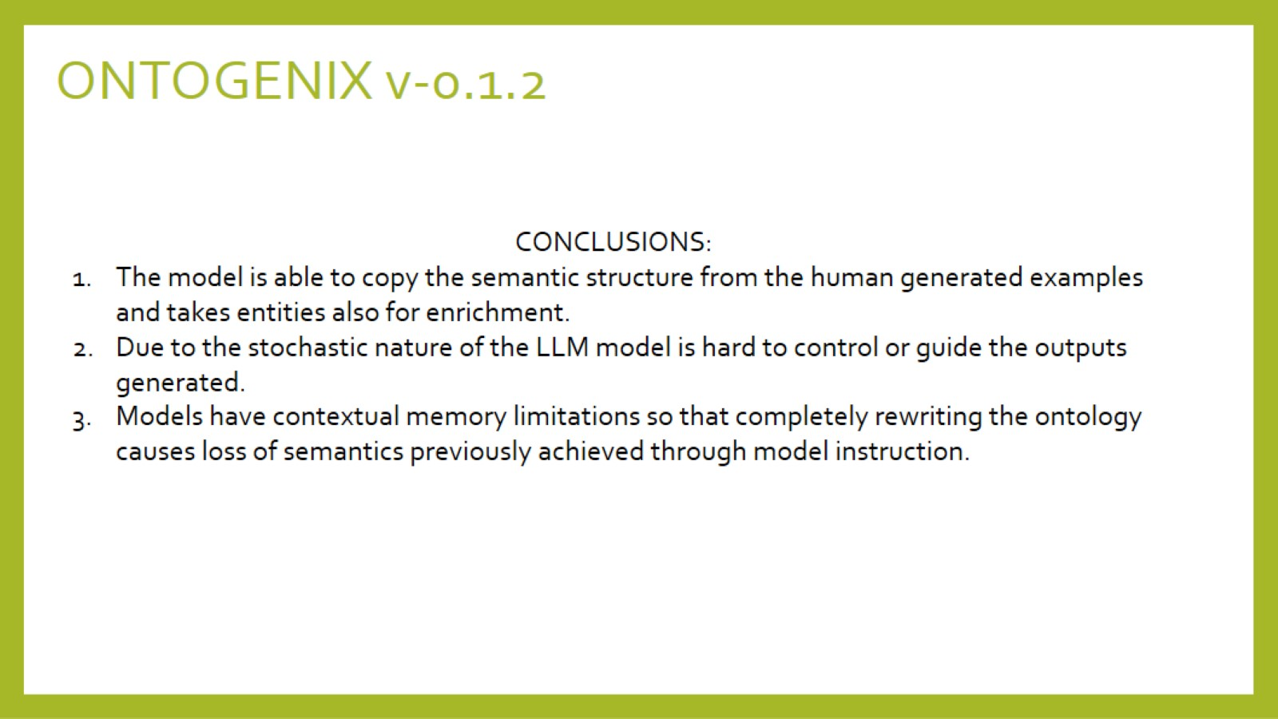

Slide 10
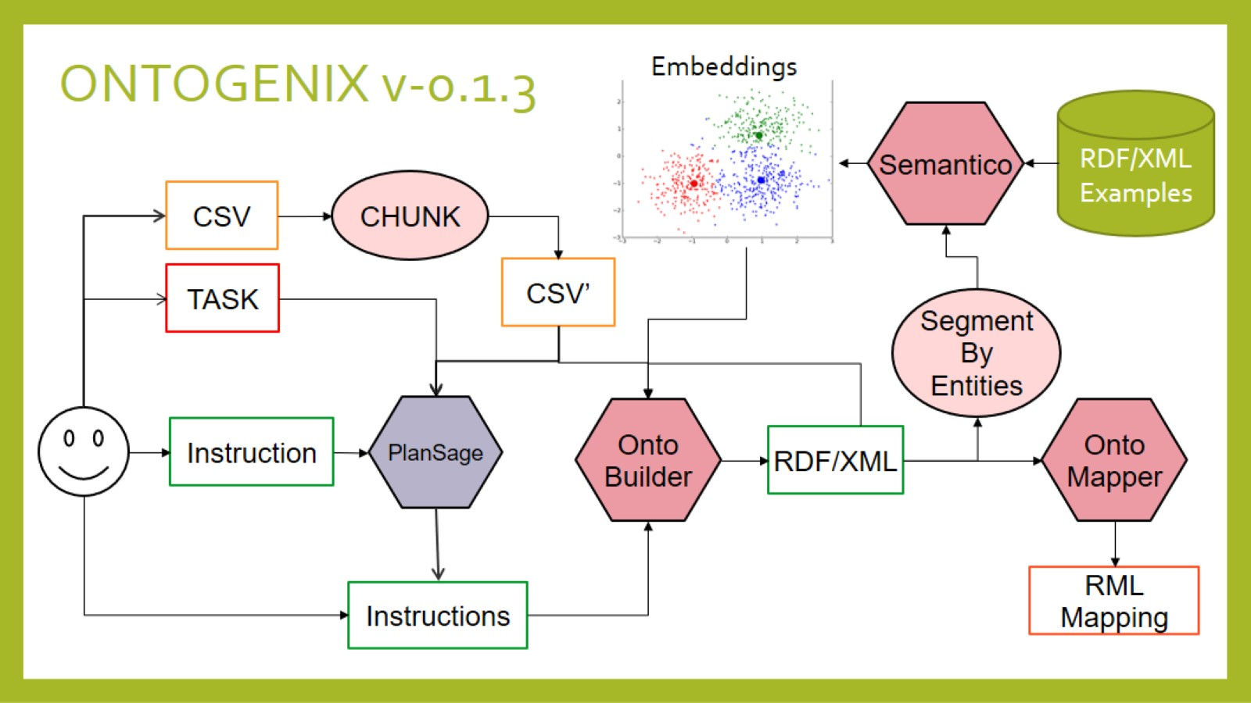

Slide 11


Slide 12
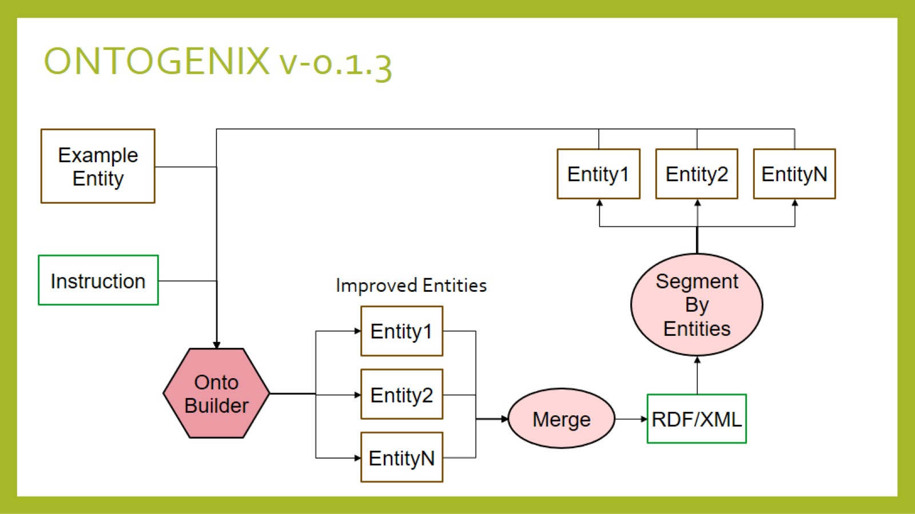

Slide 13
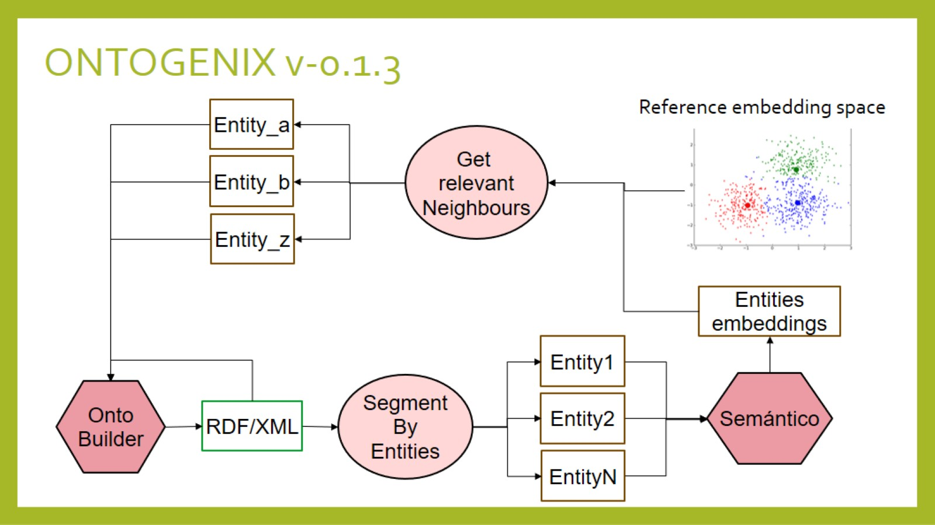

Slide 14
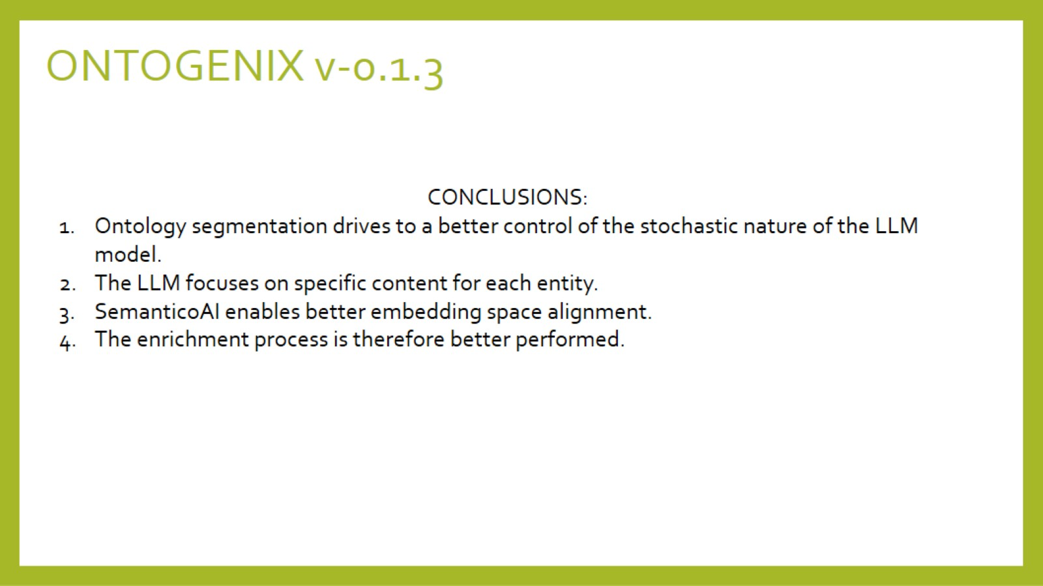

Slide 15
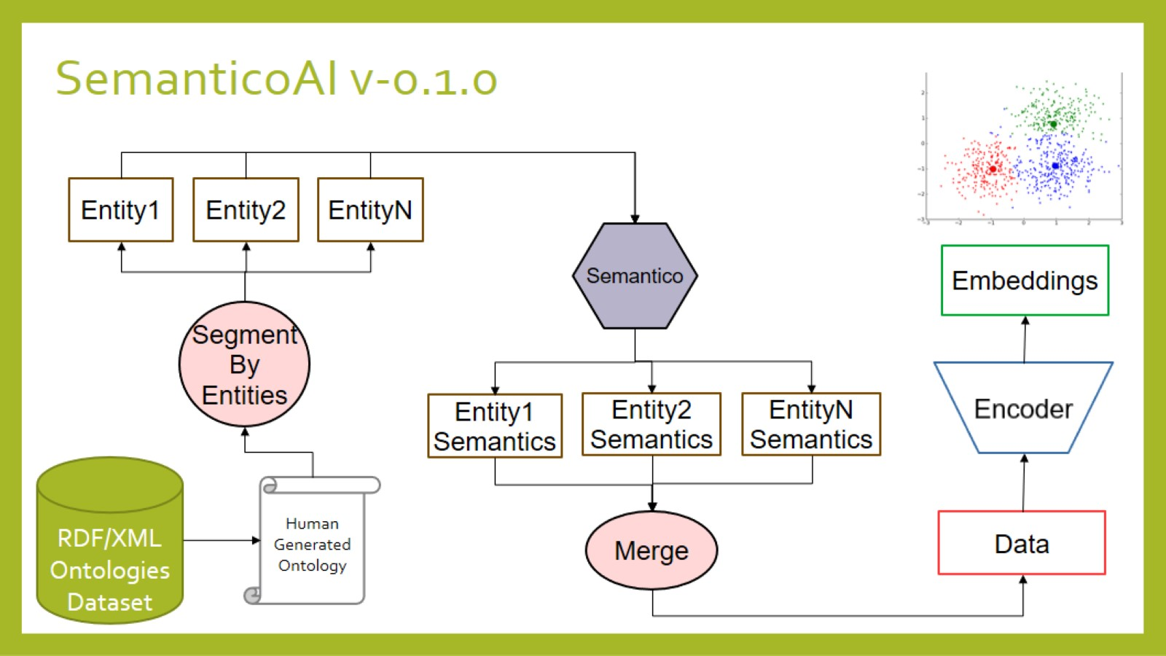

Slide 16
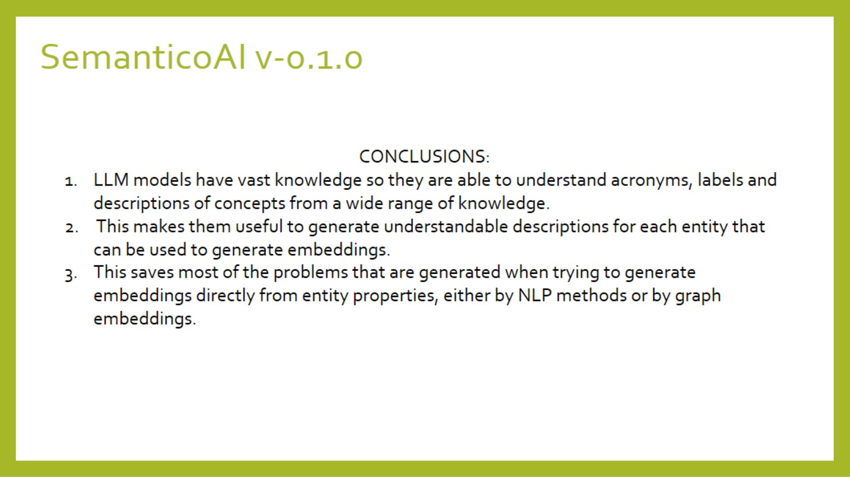

Slide 17

ONTOGENIX v-0.1.4
KGEN
Tripplets
RML
Preprocessing
RAG
TASK
Ontology Generator
Entity N
RDF/XML
SemanticoAI

Slide 18
ONTOGENIX v-0.1.4
Tripplets
CSV
CHUNK
CSV’
KGEN
Preprocessing
TASK
Kgraph-Generator
Onto
Builder
Plan
Sage
RDF/XML
TASK:Context
Onto
Mapper
RML
Ontology Generator
Feedback: ERROR

Slide 19
OntoBuilder
Instructions
To generate the base ontology
TASK:Context
CSV’
Onto
Builder
RDF/XML
Rationale + RDF/XML
Instructions
to improve a specific entity from the ontology
TASK
Entity
Onto
Builder
Improved
Entity

Slide 20
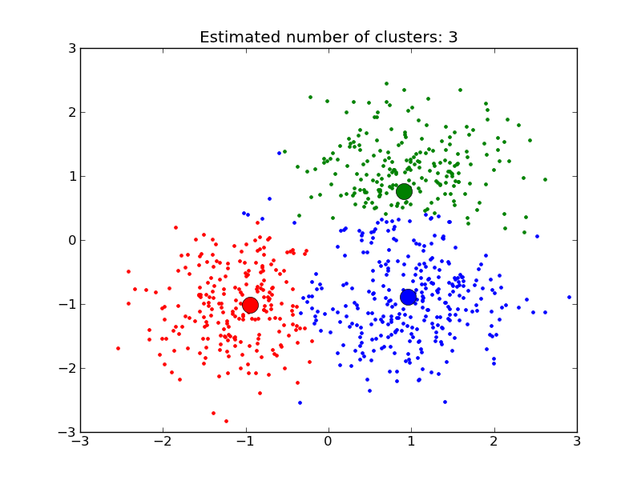
SemanticoAI
Ontologies
DB
RDF/XML
Ontology
Embeddings
Segment
By
Entities
Semantico
Encoder
Entities
Entities’

Slide 21
Retrieval Augmented Generation (RAG)
RAG
Entity N
SemanticoAI
Embedding
Entity 1
Get
TOP-K
nearest entities
Onto
Builder
Entity 2
Suggested
Entities
Entity K

Slide 22
OVERVIEW
SOLVED:
1-OntoBuilder generates RDF/XML coherent to the provided task with the support of the PlanSage context generator.
2-OntoMapper generates valid RML content validated by the KGEN with the use of morph-KG.
3-Testing using toy Kaggle datasets has been performed.
4-OntoBuilder now generates entity suggestions based on task descriptions to improve entity semantics.
5-SemanticoAI enhances entity descriptions for more accurate embedding space generation.
TODO:
1-Retrieval Augmented Generation (RAG) strategy still under development.
GITHUB:
1-Main branch updated to latest OntoGenix v-0.1.4.
2-Docker file created.
3-README updated.
4-Testing in progress.
5-GUI in progress.
PAPER:
1-Overleaf project created and tasks assigned. ONPROGRESS.
KGEN
Tripplets
RML
Preprocessing
RAG
TASK
Ontology Generator
Entity N
RDF/XML
SemanticoAI

