Slide 1

ONTOGENIX v-0.1.4
KGEN
Tripplets
RML
Preprocessing
RAG
TASK
Ontology Generator
Entity N
RDF/XML
SemanticoAI

Slide 2
ONTOGENIX v-0.1.4
Tripplets
CSV
CHUNK
CSV’
KGEN
Preprocessing
TASK
Kgraph-Generator
Onto
Builder
Plan
Sage
RDF/XML
TASK:Context
Onto
Mapper
RML
Ontology Generator
Feedback: ERROR

Slide 3
OntoBuilder
Instructions
To generate the base ontology
TASK:Context
CSV’
Onto
Builder
RDF/XML
Rationale + RDF/XML
Instructions
to improve a specific entity from the ontology
TASK
Entity
Onto
Builder
Improved
Entity

Slide 4
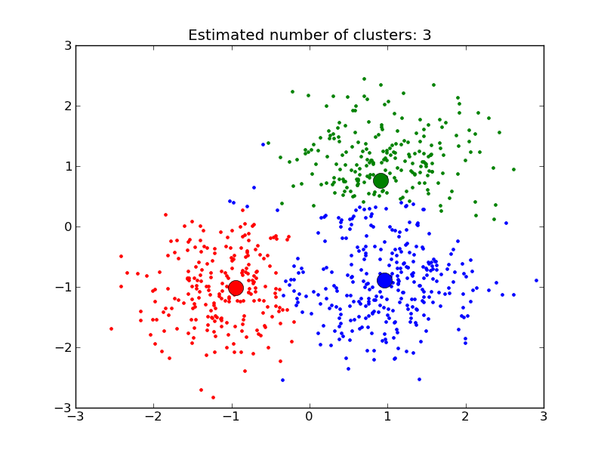
SemanticoAI
Ontologies
DB
RDF/XML
Ontology
Embeddings
Segment
By
Entities
Semantico
Encoder
Entities
Entities’

Slide 5
Retrieval Augmented Generation (RAG)
RAG
Entity N
SemanticoAI
Embedding
Entity 1
Get
TOP-K
nearest entities
Onto
Builder
Entity 2
Suggested
Entities
Entity K

Slide 6
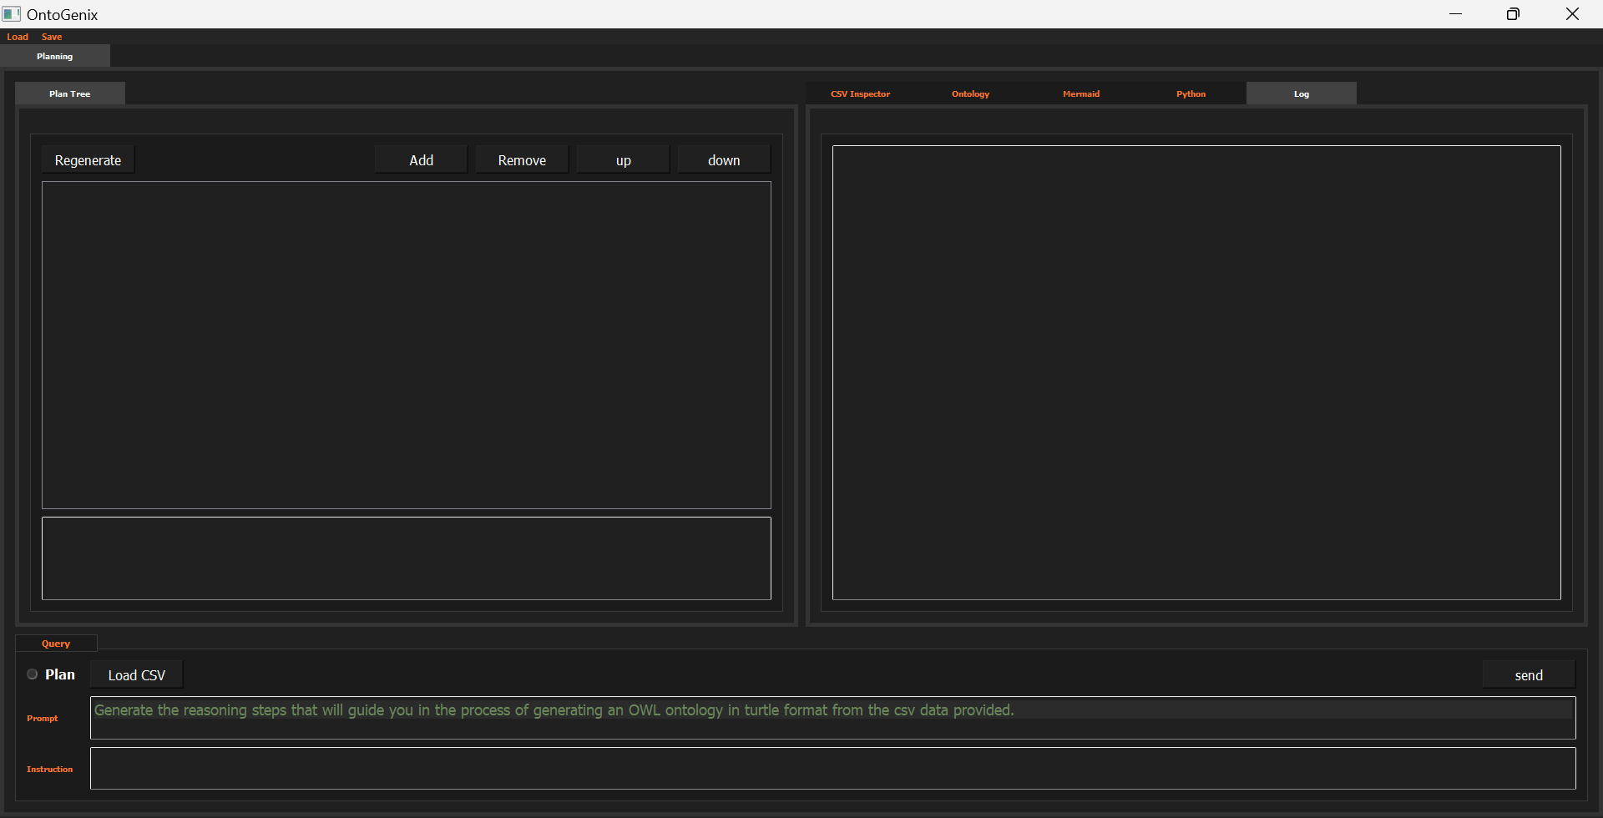
OntoGenix - GUI

Slide 7
Comparative Analysis:
BigBasket products dataset:
Ontology 1 was performed with the previous ontogenix versión 0.1.3.
Ontology 1 has been performed with the current ontogenix versión 0.1.4.
1. Annotations: - Ontology 1 Has minimal annotations, primarily focusing on defining the structure. - Ontology 2 Contains richer annotations, including comments, labels, descriptions, and alternative labels. This provides more context and clarity about the ontology's elements. 2. Restrictions: - Ontology 1 Does not have cardinality restrictions on properties. - Ontology 2 Introduces cardinality restrictions on properties, ensuring that certain properties have specific numbers of values. For example, the sales_product class has a cardinality restriction of 1 for the BrandName property. 3. Equivalence: - Ontology 1 Does not define equivalent properties. - Ontology 2 Defines equivalent properties, linking the ontology's properties to those from the schema.org vocabulary. This enhances interoperability and understanding.

Slide 8
Comparative Analysis:
4. Metadata: - Ontology 1 Lacks metadata about the ontology's creation and modification. - Ontology 2 Contains metadata, such as creator and modification date, providing more information about the ontology's development and updates. 5. Granularity: - Ontology 1 Has a more general structure with broader classes and properties. - Ontology 2 Offers a more granular approach, with detailed classes and properties, and introduces more specific restrictions.
Conclusion: - Ontology 1 seems to be a more basic representation, focusing primarily on the structure without much emphasis on annotations, restrictions, or metadata. - Ontology 2 appears to be more refined and detailed. The human touch is evident in the richer annotations, clearer definitions, and the introduction of cardinality restrictions and equivalent properties. In summary, while both ontologies represent the same structured data, the second ontology provides a more comprehensive, detailed, and user-friendly representation.

Slide 9
OVERVIEW
SOLVED:
1-OntoBuilder generates RDF/XML coherent to the provided task with the support of the PlanSage context generator.
2-OntoMapper generates valid RML content validated by the KGEN with the use of morph-KG.
3-Testing using toy Kaggle datasets has been performed.
4-OntoBuilder now generates entity suggestions based on task descriptions to improve entity semantics.
5-SemanticoAI enhances entity descriptions for more accurate embedding space generation.
TODO:
1-Retrieval Augmented Generation (RAG) strategy still under development.
GITHUB:
1-Main branch updated to latest OntoGenix v-0.1.4.
2-Docker file created.
3-README updated.
4-Testing in progress.
5-GUI in progress.
PAPER:
1-Overleaf project created and tasks assigned. ONPROGRESS.
KGEN
Tripplets
RML
Preprocessing
RAG
TASK
Ontology Generator
Entity N
RDF/XML
SemanticoAI

Slide 10

INPUT
OUTPUT
CSV
KGEN
Tripplets
Preprocessing
Statistical
Description
+
FAIR URI
OUTPUT
RML
Error
Feedback
DATA PROCESSING
Self-Repairing
Onto
Mapper
Actions
History
Assyst
Bot
MAPPING
Task
Mapp
ACTIONS MANAGER
SCHEMA DEFINITION
Help
Prompt
Crafter
Plan
Sage
OUTPUT
TURTLE
prompt
High Level
Structure
Description
prompt’’
prompt’
Onto
Builder
Entity N
GUI:User Interaction
ONTOLOGY

Slide 11

Statistical
Description
Prompt
Crafter
prompt’
Plan
Sage
High Level
Structure
Description
Function
Caller
RML
prompt
Onto
Mapper
Error
KGEN
Tripplets
state
Assystant
ChatBot
Onto
Builder
Turtle
help

