Slide 1

Development of the CFIHOS ontology
Francisco Abad Navarro
Jesualdo Tomás Fernández Breis, PhD
Alexander Garcia Castro, PhD
Andreas Neumann

Slide 2
The Ecosystem of Industry Standards
Asset Management
Identification & Classification
Equipment & Data Model
Maintenance & Reliability
ISO 55000 series
PAS 55
ISO19650
GS1
IEC 81346 (RDS)
KKS, RDS-PP
ECLASS
UNSPSC
ISO 15926
CFIHOS
ISO 8000
IEC 61987
ISO 13584
IEC 62714
ISO 14224
IEC 60300
ASME BPVC
Industry-specific technical
DNV
IEEE

Slide 3
The Ecosystem of Industry Standards
Asset Management
Identification & Classification
Equipment & Data Model
Maintenance & Reliability
ISO 55000 series
PAS 55
ISO19650
GS1
IEC 81346 (RDS)
KKS, RDS-PP
ECLASS
UNSPSC
ISO 15926
CFIHOS
ISO 8000
IEC 61987
ISO 13584
IEC 62714
ISO 14224
IEC 60300
ASME BPVC
Industry-specific technical
DNV
IEEE

Slide 4

A Siemens Energy Centrifugal Pump
Notes:
The goal of this slide is to set up the stage describing the current situation with the tool data models/ontologies. Main features, main problems

Slide 5
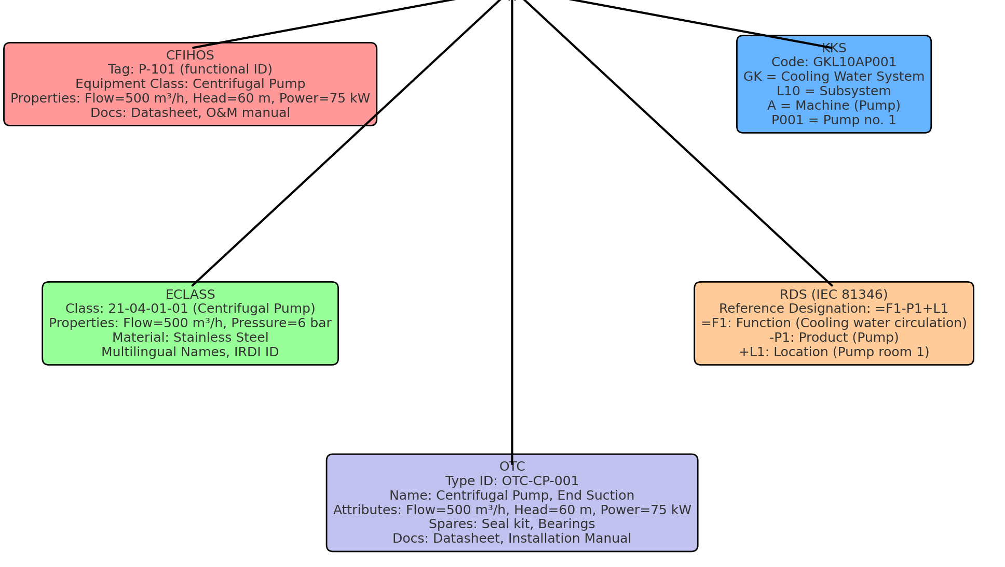
A Siemens Energy Centrifugal Pump
Different SE departments and customers use different standards
Need for data interoperability
Notes:
The goal of this slide is to set up the stage describing the current situation with the tool data models/ontologies. Main features, main problems

Slide 6
Common aspects of the standards
 | Product | Classification | Function | Location | Properties
CFIHOS |  | Hierarchy
KKS |  | Components
ECLASS |  | Hierarchy
RDS |  | Hierarchy
OTC |  | Hierarchy | Often
Notes:
The goal of this slide is to set up the stage describing the current situation with the tool data models/ontologies. Main features, main problems

Slide 7
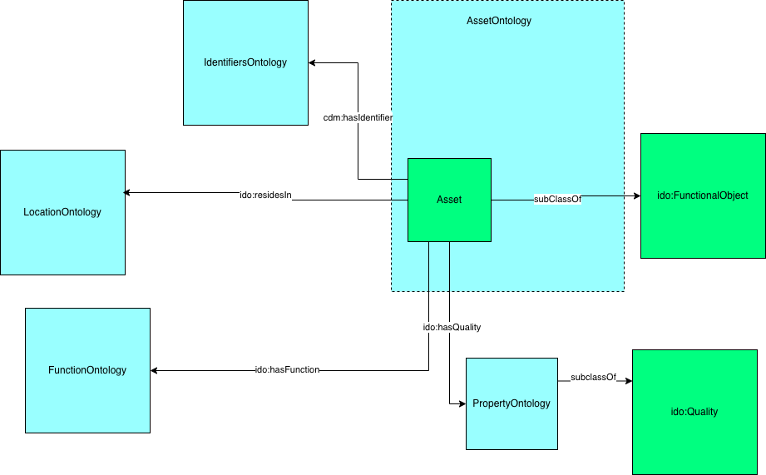
Towards a “common language”
Notes:
The goal of this slide is to set up the stage describing the current situation with the tool data models/ontologies. Main features, main problems

Slide 8
Common aspects of the standards
 | Product | Classification | Function | Location | Properties
CFIHOS |  | Hierarchy
KKS |  | Components
ECLASS |  | Hierarchy
RDS |  | Hierarchy
OTC |  | Hierarchy | Often
Notes:
The goal of this slide is to set up the stage describing the current situation with the tool data models/ontologies. Main features, main problems

Slide 9
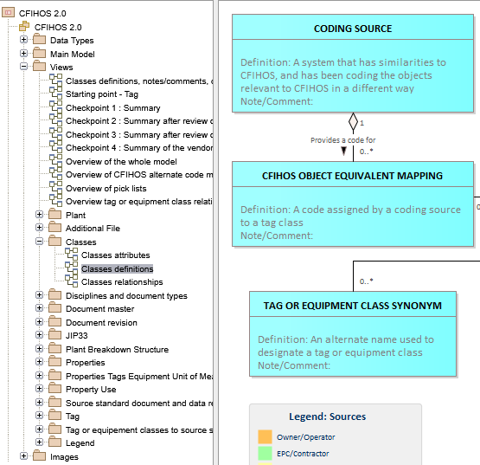
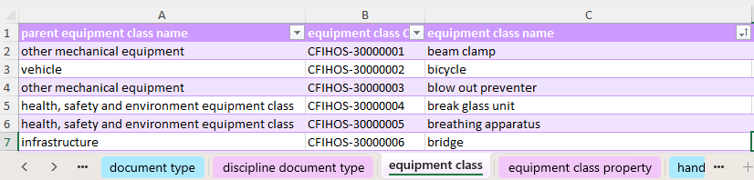
CFIHOS distribution Version 2.0 October 2024
CFIHOS is a specification, not an implementation
CFIHOS data model can be inspected through an HTML explorer
CFIHOS reference data library is distributed as tables in Excel format
Notes:
This is the competency question driving the presentation

Slide 10


Generation of the CFIHOS ontology
A translation process was developed to generate an OWL ontology by using the CFIHOS excel as input.
Processing made by sheet in the source file
The script is available at https://github.com/tecnomod-um/cfihos
Notes:
This is the competency question driving the presentation

Slide 11
CFIHOS ontology modeling principles
Alignment with the CFIHOS specification and principles
Alignment with the “common language”
Alignment with the Industrial Data Ontology (IDO)
Alignment of classes with IDO classes
Representation of properties using IDO modeling patterns
Notes:
This is the competency question driving the presentation

Slide 12
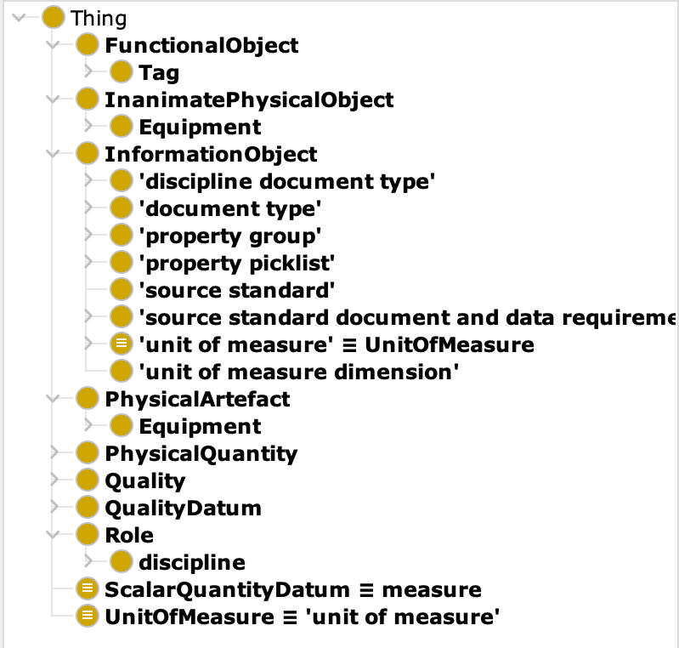
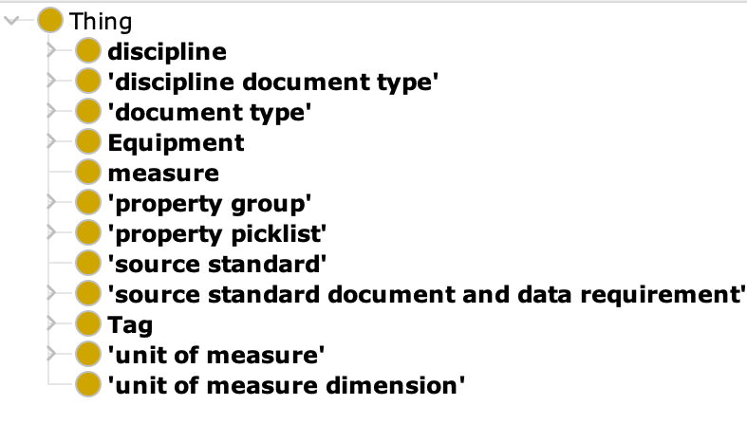
Overview of the current CFIHOS ontology
The current version has >6,200 classes, and >1,400 properties and approx. 5,000 individuals.
URIs of classes and properties based on CFIHOS identifiers
Names and descriptions of classes and properties from
the RDL Master object
https://github.com/tecnomod-um/cfihos
Notes:
This is the competency question driving the presentation

Slide 13
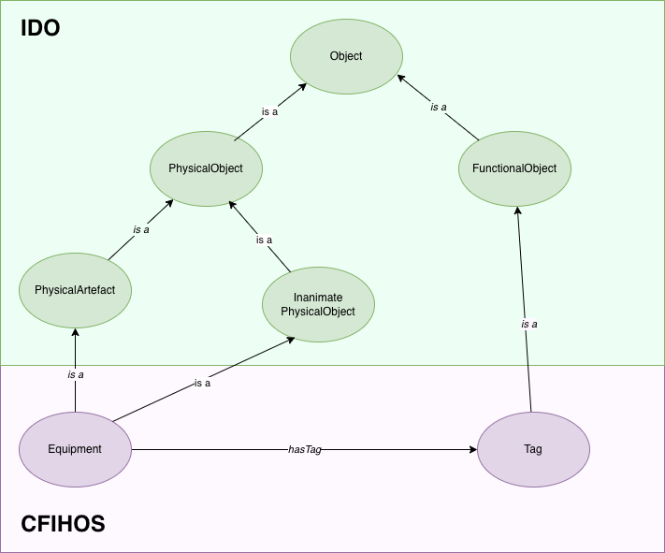
Linking CFIHOS classes to the IDO
The Industrial Data Ontology (IDO) is a “top-level” ontology for industrial data terminology that defines generic terms for things that exist in more than one industrial domain.
Representing CFIHOS by extending IDO benefits the interoperability
The main classes of the CFIHOS ontology have been linked to the Industrial Data Ontology
Notes:
This is the competency question driving the presentation

Slide 14
Linking CFIHOS classes to the IDO
IDO Class
Notes:
This is the competency question driving the presentation

Slide 15
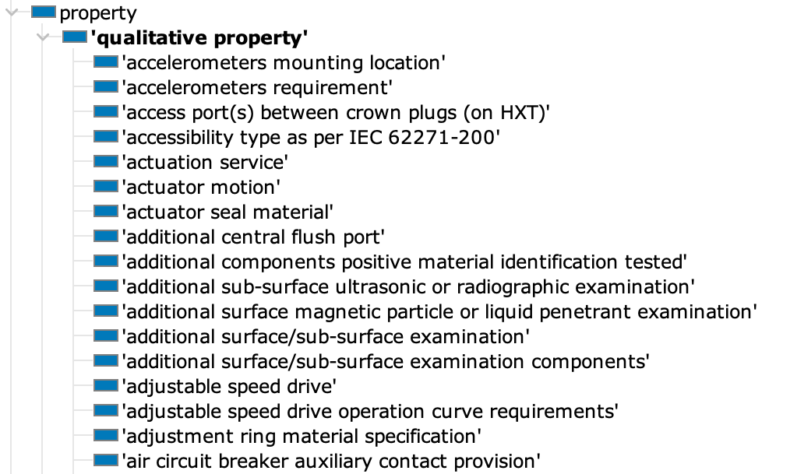
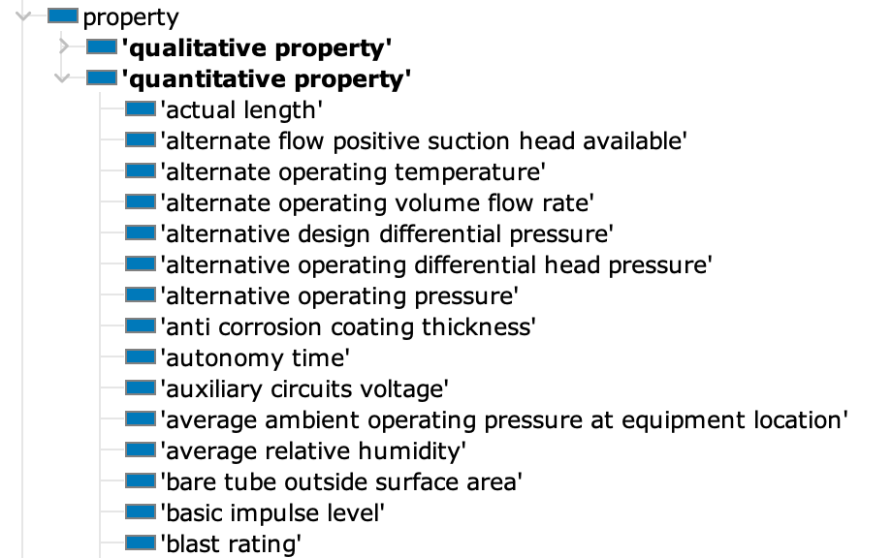
Modeling properties
Notes:
This is the competency question driving the presentation

Slide 16
Modeling properties
Classification of properties
The property has a dimension assigned in the CFIHOS standard ➔ Quantitative
The property has a picklist assigned in the CFIHOS standard ➔ Qualitative
If the property does not have dimension nor picklist
Quantitative if the data type is “number”
Qualitative in other case
Notes:
This is the competency question driving the presentation

Slide 17
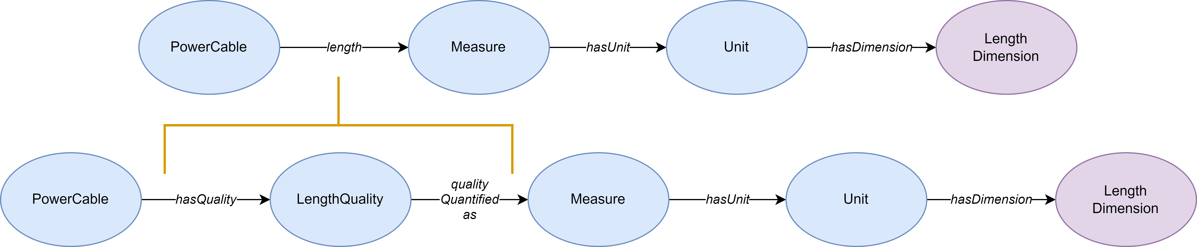
IDO-based Property modeling
IDO does not use object properties for qualities but classes
Quality classes were created from object properties and axioms were redefined in these terms
Notes:
This is the competency question driving the presentation

Slide 18
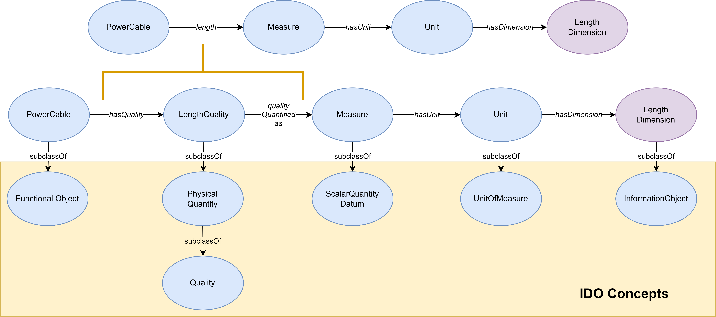
IDO-based Property modeling
The qualities are classified according to IDO
Notes:
This is the competency question driving the presentation

Slide 19
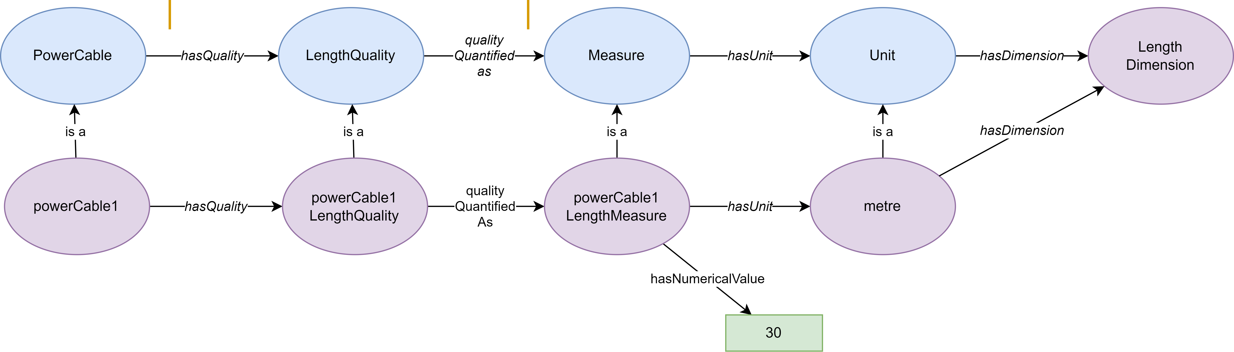
First example
My powerCable 1 has a length of 30 m
Notes:
This is the competency question driving the presentation

Slide 20
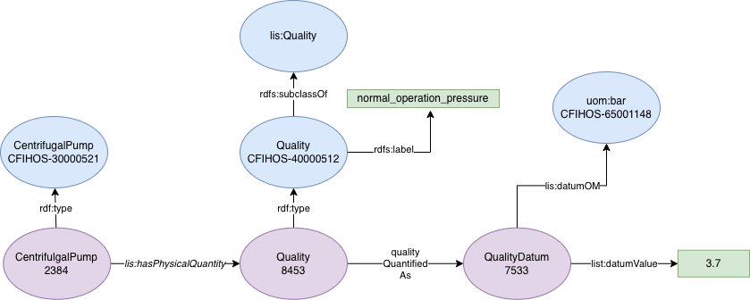
Second example
My centrifugal pump 2384 has a normal operating pressure of 3.7 bar
Notes:
This is the competency question driving the presentation

Slide 21
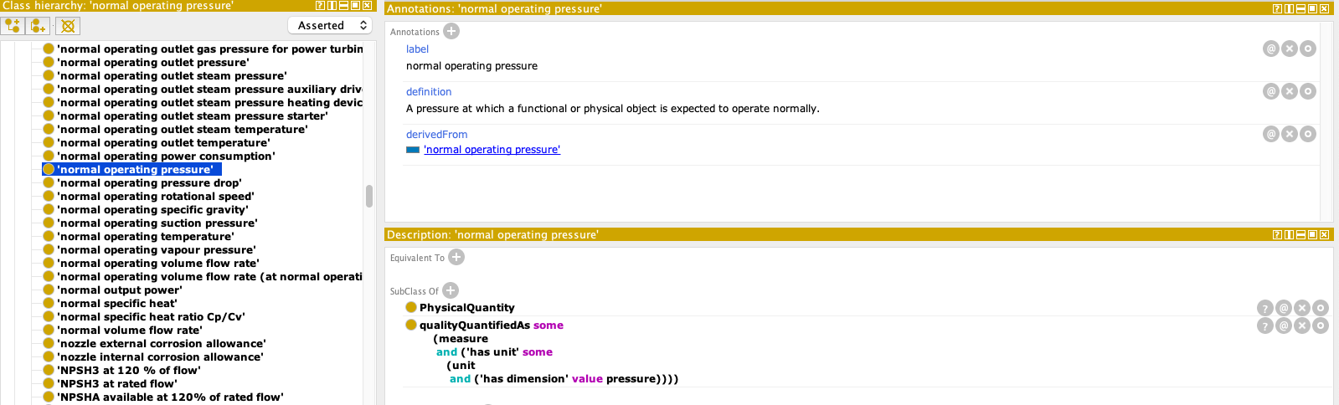
Shortcuts: IDO expressions - CFIHOS properties
Each quality in the CFIHOS ontology is annotated with the object property from which it derives
Notes:
This is the competency question driving the presentation

Slide 22
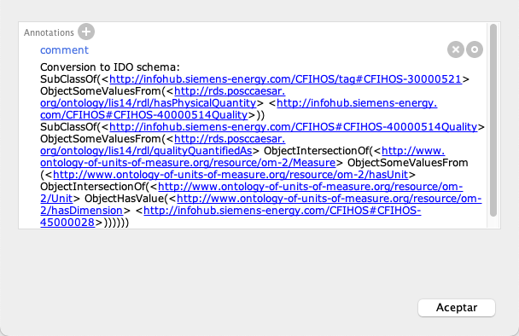
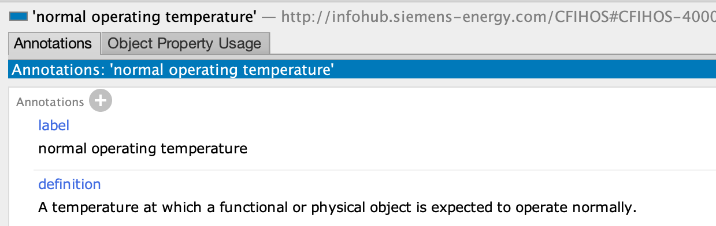
Object Properties ⇔ IDO expressions
Notes:
This is the competency question driving the presentation

Slide 23
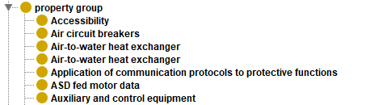
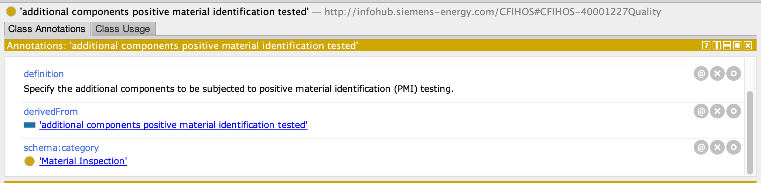
Other modeling aspects: property groups
Property groups were modelled as classes
Use of the annotation property schema:category to link a property with its property group
Notes:
This is the competency question driving the presentation

Slide 24
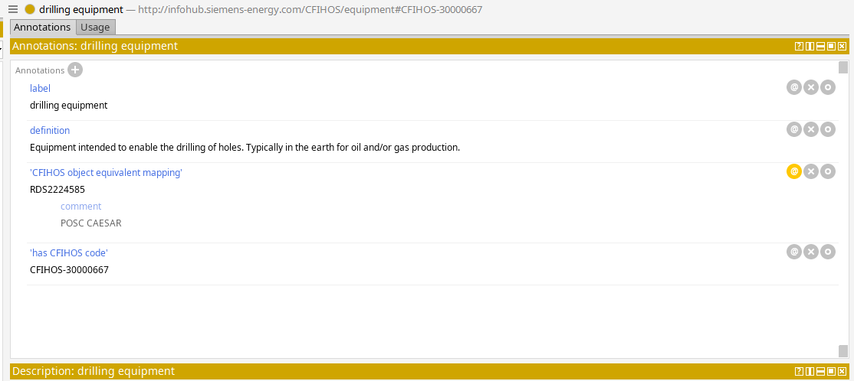
Other modelling aspects: mappings to other standards
Use of annotation property
Notes:
This is the competency question driving the presentation

Slide 25

Testing the CFIHOS ontology
The ontology was tested by using a set of 15 competency questions (CQ).
These CQs were answered by querying the ontology through SPARQL queries.
Notes:
This is the competency question driving the presentation

Slide 26
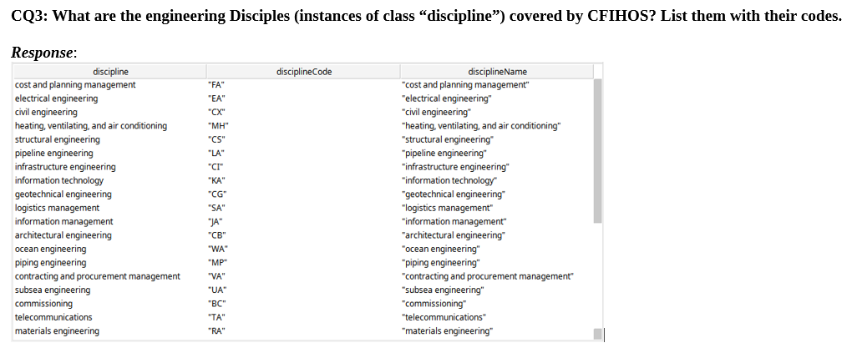
Testing the CFIHOS ontology
Notes:
This is the competency question driving the presentation

Slide 27
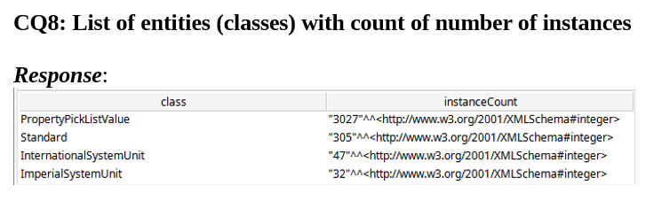
Testing the CFIHOS ontology
Notes:
This is the competency question driving the presentation

Slide 28
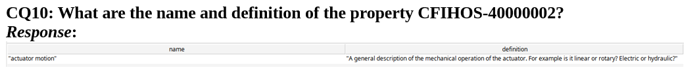
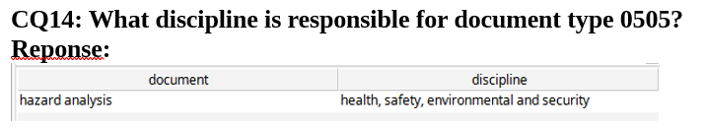
Testing the CFIHOS ontology
Notes:
This is the competency question driving the presentation

Slide 29
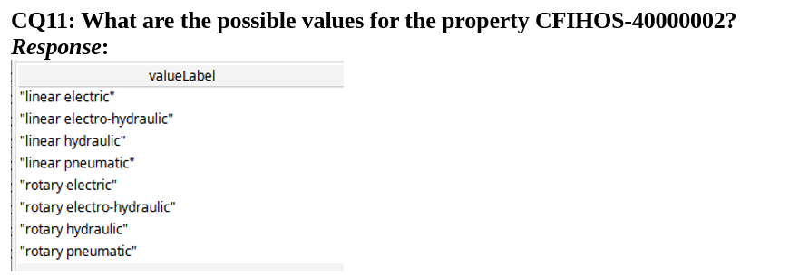
Testing the CFIHOS ontology
Notes:
This is the competency question driving the presentation

Slide 30
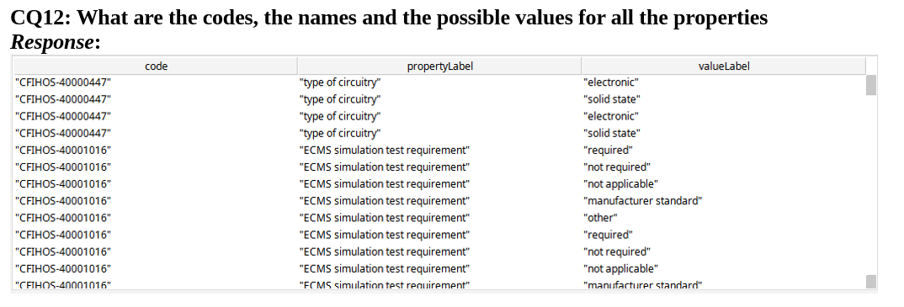
Testing the CFIHOS ontology
Notes:
This is the competency question driving the presentation

Slide 31
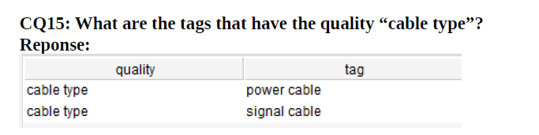
Testing the CFIHOS ontology
Notes:
This is the competency question driving the presentation

Slide 32
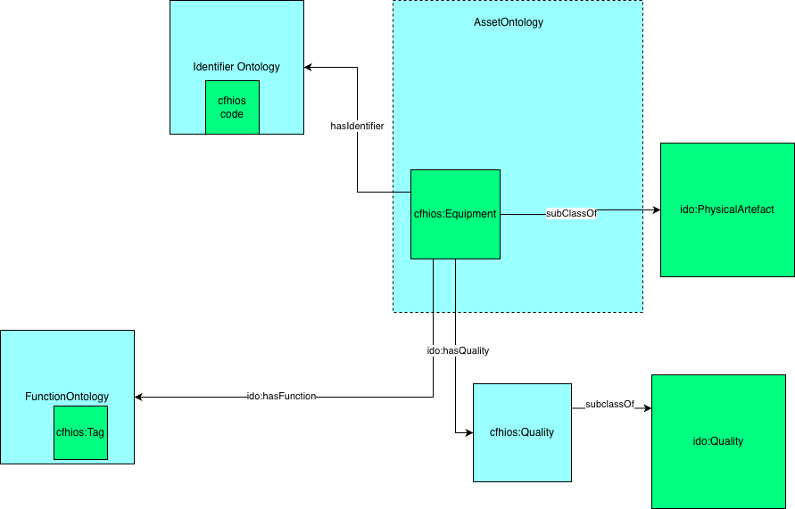
The common language applied to CFIHOS
Notes:
This is the competency question driving the presentation

Slide 33
Final remarks
Development of a CFIHOS ontology based on the IDO
Need for validation from the CFIHOS community and testing in real scenarios
Need to clarification: Tag vs Equipment
Use of a modelling pattern that could be applied to other standards to promote data interoperability
Notes:
This is the competency question driving the presentation

Slide 34
Development of the CFIHOS ontology
Francisco Abad Navarro
Jesualdo Tomás Fernández Breis, PhD
Alexander Garcia Castro, PhD
Andreas Neumann

