Slide 1



Department of Computer Science Engineering & Allied Specialized Branches Presents International Conference on Recent Trends in Intelligent Computing and Communication (ICRTICC- 2025)
Paper Id:395
IoT-Based Smart Electronic Voting Machine for Candidate Selection Using Fingerprint
Presented by
Brijesh Nishad
B.Tech 4th Year
GNIOT Engineering Institute
20th – 21st February 2025

Slide 2
CONTENTS
Introduction
Literature Survey
Problem Statement
Proposed Model
Methodology
Results & Discussion
Conclusion & Future Work

Slide 3
Introduction
This document outlines the design, implementation, and setup of an election voting machine that includes fingerprint authentication, candidate selection, and real-time vote monitoring through a web interface built with React. The hardware components consist of a fingerprint scanner, ESP32 microcontroller, and Arduino, while the software architecture allows for real-time updates
Background : The significance of secure voting systems cannot be overstated in today’s democratic processes. This project aims to enhance the security and efficiency of elections.
Motivation : The motivation behind this project is to address vulnerabilities in traditional voting systems and ensure that elections are conducted fairly and transparently

Slide 4
Literature Survey
Electronic voting has revolutionized the way electoral processes are conducted from the traditional paper ballot to the more modern systems. Some of the traditional EVMs have led to several benefits like less dependence on paper, quick counting of votes, and reduced human error. There are challenges, however. Issues such as tampering, voter impersonation, and the absence of real-time data monitoring have impeded electoral integrity and transparency. These issues challenge researchers to seek alternative solutions overcoming these limitations while improving the overall efficiency of voting systems.
Besides technical and financial challenges, public perception and acceptance of these systems also play an important role in the success of an IoT-based voting system.

Slide 5
Problem Statement
Electronic Voting Machines (EVMs) have streamlined the voting process, they still face several challenges, including:
Voter Authentication and Security: Ensuring the authenticity of voters and safeguarding the election process from identity theft, fraud, or vote manipulation remains a critical issue.
Slow Results: Manual vote tallying or even the automated tallying of votes via existing EVMs can take hours or even days, leading to delays in announcing results, which can undermine public trust.
Lack of Transparency: In many cases, voters cannot track or verify their vote, resulting in a lack of transparency and reduced confidence in the electoral system.
Vulnerability to Tampering: Traditional EVMs, while more secure than paper ballots, can still be vulnerable to physical tampering, hacking, or technical malfunctions, which could impact the accuracy of election results.
Remote Monitoring and Maintenance Issues: Election officials often struggle to monitor EVMs in real-time, making it difficult to quickly detect faults, errors, or malicious activities during the voting process.

Slide 6
Proposed Model
Voting Process
Registration
Authentication
Granted
Initiate
Voting
Collection
Store-Server
Admin Portal

Slide 7
IoT-based Smart EVM System consists of the following key components:
Voting Machine (EVM): A touch-screen or button-based interface for voters to select their candidates.
Biometric Authentication Unit: Fingerprint/Face recognition sensors to verify voter identity.
IoT Connectivity Module: A secure network for real-time data transmission (Wi-Fi, GSM, or LTE).
Centralized Server: A cloud-based server for real-time data aggregation and processing of votes.
Blockchain Ledger: Used for storing votes in a secure, tamper-proof manner.
Voter ID Authentication: Smart cards or OTP sent to mobile phones for authentication.

Slide 8
Methodology
IoT-based Electronic Voting Machine (EVM) for candidate selection involves several stages: design, implementation, testing, and evaluation. Each stage incorporates the use of Internet of Things (IoT) technologies to enhance the security, transparency, and efficiency of the voting process.
System Architecture .
Hardware Components.
Software Components.
Process.
EVM Control Portal.
Security Features
Challenges and Considerations

Slide 9
System Architecture
Software Components The software stack includes:
Arduino IDE for programming the fingerprint scanner and candidate selection.
React.js for real-time display of voting results.
Hardware Components The election voting machine utilizes the following components:
Fingerprint Scanner - Used for voter authentication.
ESP32 - Sends data to a real-time web server for vote tracking.

Slide 10
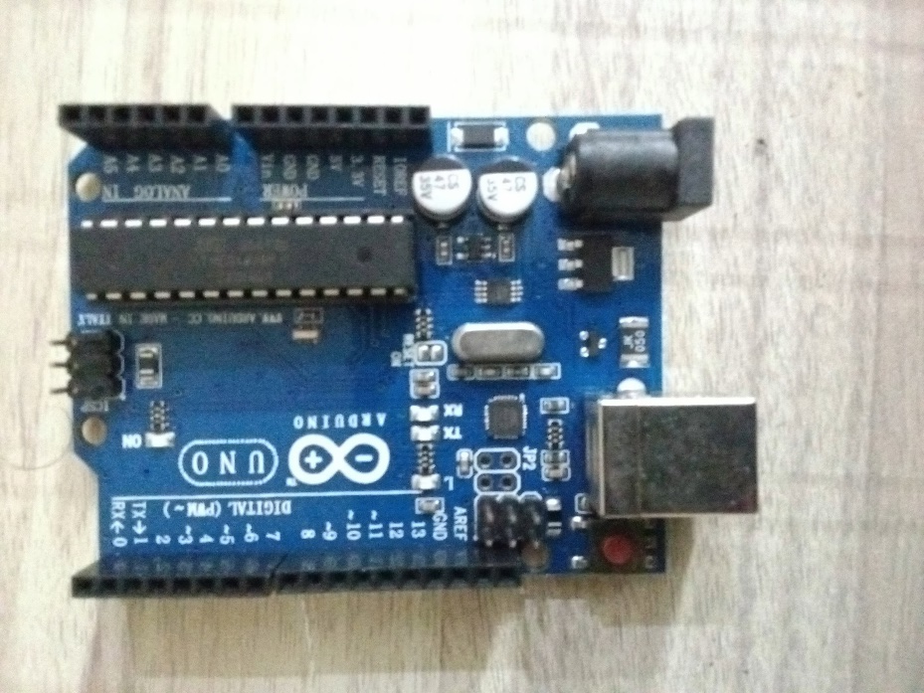
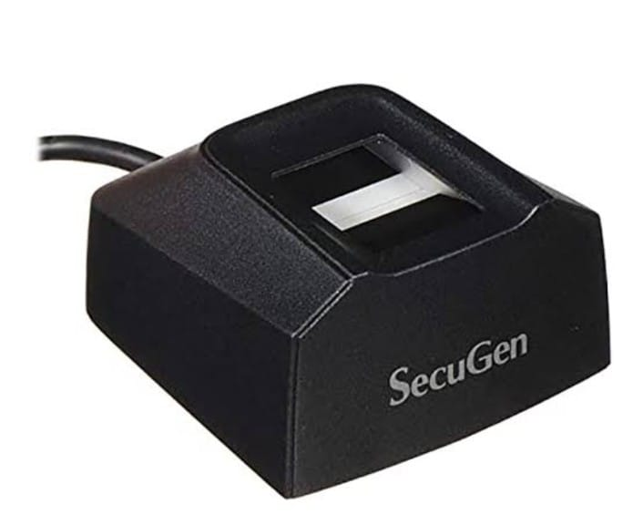
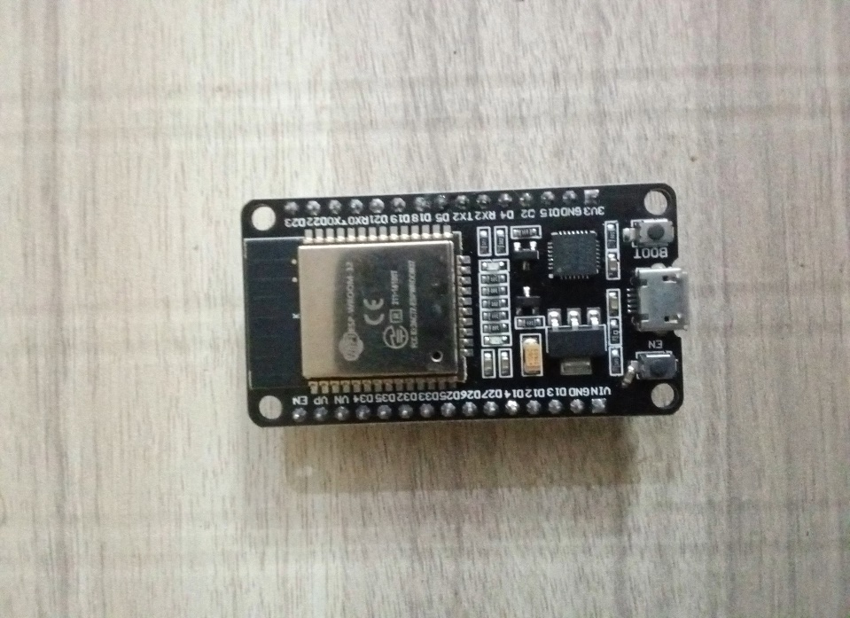
Hardware Components
Arduino Uno
ESP32
Fingerprint device

Slide 11
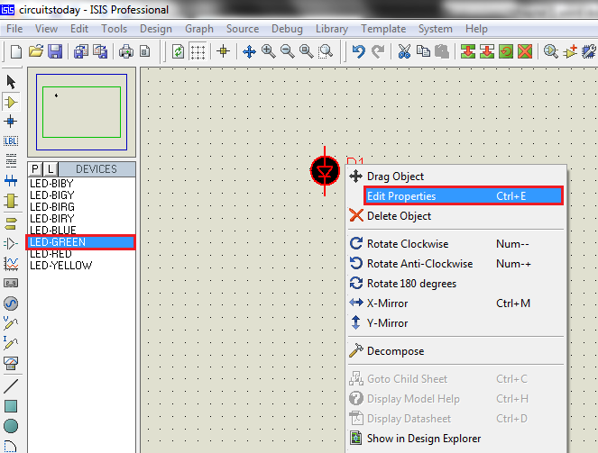
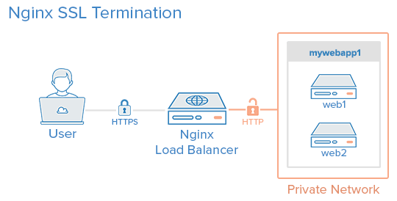
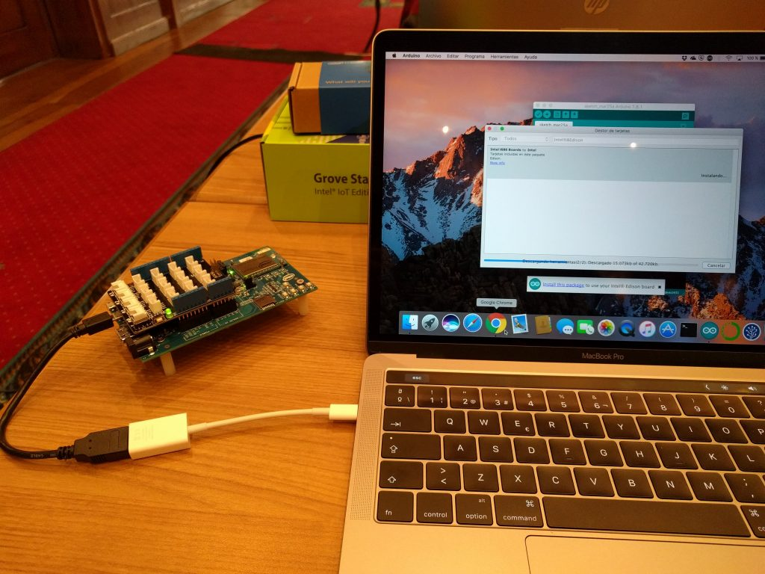
Software Components
Proteus Software
Web
Server
Arduino
IDE

Slide 12
Results & Discussion
B. Security Analysis
The system was subjected to penetration testing to evaluate its resilience against potential cyberattacks. The use of end-to-end encryption and secure authentication protocols effectively prevented unauthorized access. However, simulated tests highlighted areas where additional layers of security, such as machine learning-based intrusion detection systems, could further enhance robustness.
C. User Feedback
Election officials and mock voters participated in usability testing to assess the system's user-friendliness and acceptance.
The IoT-based Smart EVM demonstrates significant improvements over traditional voting systems in terms of security, transparency, and efficiency. The following sections outline the key findings and their implications.
A. System Performance
The proposed Smart EVM was tested in a simulated environment to evaluate its performance. Key metrics such as voting time per voter, biometric authentication accuracy, and data transmission speed were measured.

Slide 13
Conclusion & Future Work
The IoT-based Smart Electronic Voting Machine (EVM) is a groundbreaking innovation aimed at modernizing electoral systems to address the limitations of traditional voting methods. By integrating advanced technologies such as IoT, biometric authentication, real-time data transmission, and cloud-based monitoring, the proposed system enhances the security, efficiency, and transparency of elections. This approach ensures that every vote is accurately recorded and counted while reducing the possibility of human error or tampering, thereby fostering trust among voters and stakeholders.
One of the most critical aspects of this system is its ability to provide real-time monitoring and reporting, which not only reduces the time required for vote counting but also allows election officials to detect and address anomalies promptly. The incorporation of biometric authentication further strengthens the system by ensuring that only registered voters can participate, thus eliminating concerns related to impersonation or multiple voting attempts. Additionally, the user-friendly interface and accessibility features make the system inclusive, allowing voters from all demographics, including those with disabilities, to participate seamlessly.

