Slide 1
Real Time Tracking System for Perishable Items
Revolutionising food distribution to minimise waste and maximize freshness in food manufacturing company.
-HCL Technologies Limited

Slide 2
Problem Statement
A food manufacturing and distribution company produces perishable items that expire within 1 or 2 days. These items are highly popular and quickly sold in some stores but sell slowly in others stores. Due to lack of real time tracking by the time they identify unsold items and try to transfer them to high demand stores, the items have already expired leading to loss and waste, so we must design a high scalable real time tracking system to prevent the problems.

Slide 3







STAGE 1
Solution Architecture: Core Components
IoT Devices
Cloud Server
Real-time stock level and shelf-life data collection.
Centralised, scalable data storage and processing.
Inventory System
ML Model
Monitors stock, expiry dates, and location analytics.
Predicts future demand patterns based on historical data.
Admin Dashboard
Alert System
Provides alerts, insights, and actionable recommendations.
Suggests optimal actions for inventory balancing.

Slide 4




STAGE 2
High-Level System Design
Real-time Inventory Update
Cloud Data Integration
Smart shelves and barcode scanners continuously update stock data.
Data is securely transmitted to a central cloud-based system.
Demand Pattern Analysis
Optimisation & Alerts
Machine Learning model analyses consumer demand and trends.
System flags discrepancies and suggests immediate actions to admins.

Slide 5
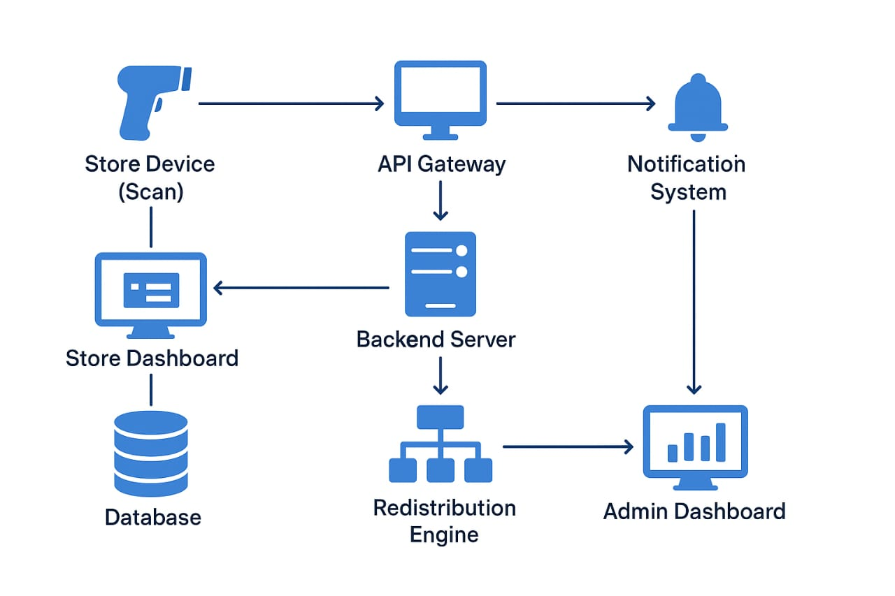

Slide 6
STAGE 3
Detailed Operational Flow: Minimising Waste
Our system ensures proactive management of perishable goods from arrival to sale.
Proactive Monitoring
Item Arrival & Data Capture
System continuously monitors shelf life and predicts store-specific demand.
Perishable goods arrive, and inventory data is instantly sent to the central system.
Last-Mile Intervention
Intelligent Redistribution
If no transfer is feasible, automated discounts are applied, and local customers are notified for quick sales.
If an item is unlikely to sell, system identifies high-demand stores, triggers transfers, and tracks delivery.

Slide 7
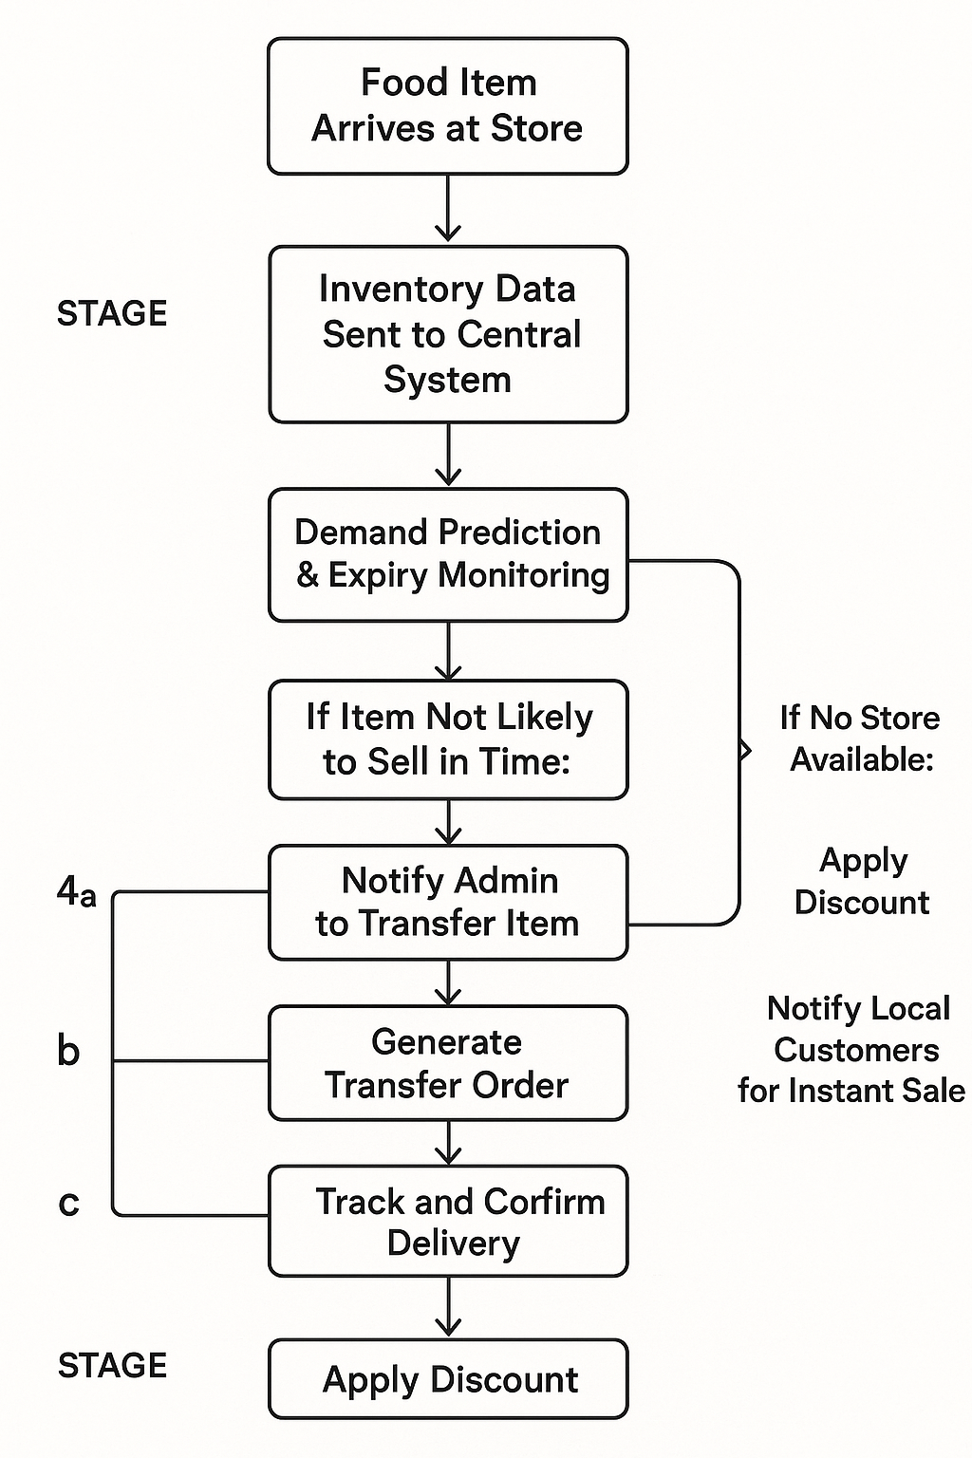
FLOW CHART

Slide 8
The Unexpected Challenge
A recent power outage at a major distribution hub delayed deliveries, highlighting critical vulnerabilities.
"Sudden power outage at major hub delayed distribution by 12 hours. Spoilage complaints reported across multiple regions."
This scenario demands an immediate enhancement of our real-time tracking and emergency response capabilities.

Slide 9
New Requirements: Enhancing Resilience
To mitigate future disruptions, we need to upgrade our system with advanced features.
Ultra-Real-Time Tracking
1
Monitor delivery temperature and precise shelf life during transit.
Preventive Risk Alerts
2
Automated alerts for potential delay risks and spoilage.
Faster Redistribution Decisions
3
Accelerated data processing for immediate action.
Emergency Customer Notifications
4
Instant alerts for flash discounts and alternative pick-up options.

Slide 10
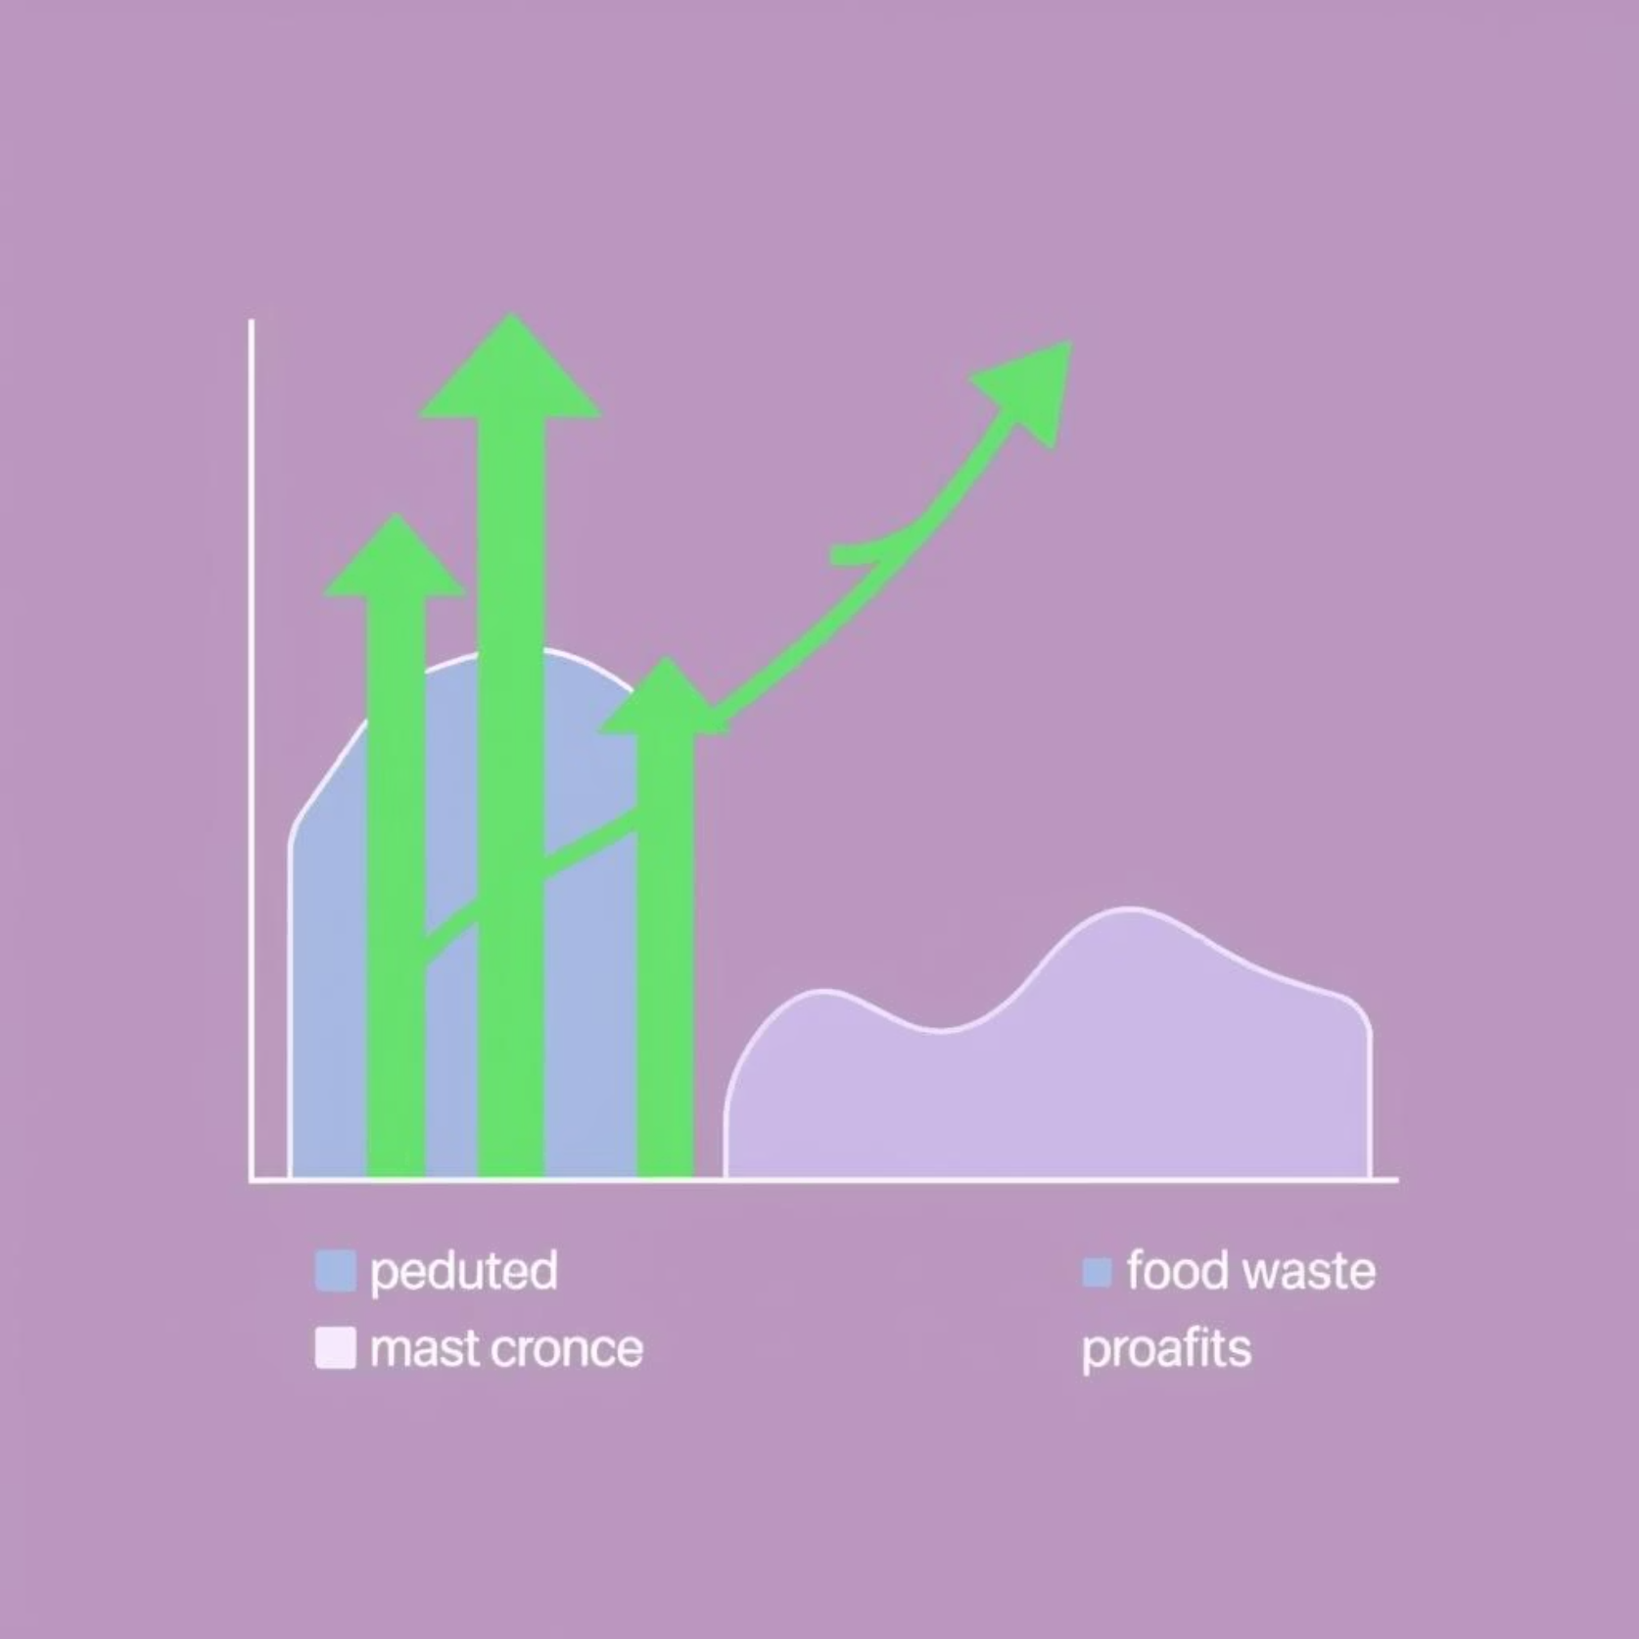
Key Outcomes: A Sustainable Future
Reduced Spoilage: Significantly decrease food waste.
Real-time Visibility: Complete stock transparency for decision-makers.
Improved Availability: Ensuring high-demand stores are always stocked.
Financial & Environmental Savings: Boost profitability and sustainability.

