Slide 1
Part 1: Regression
Predicting S&P 500 Stock Closing Prices
Dataset: S&P 500 Stocks (Kaggle)

Slide 2
Dataset
- Source: S&P 500 Stocks (Kaggle) -- daily OHLCV data
- Top 50 companies by market cap, 2018-present (~60K rows)
- Target: Close (daily closing price)
- Merged with company fundamentals (sector, market cap, EBITDA)
- 16 engineered features: lags, rolling averages, volume change

Slide 3
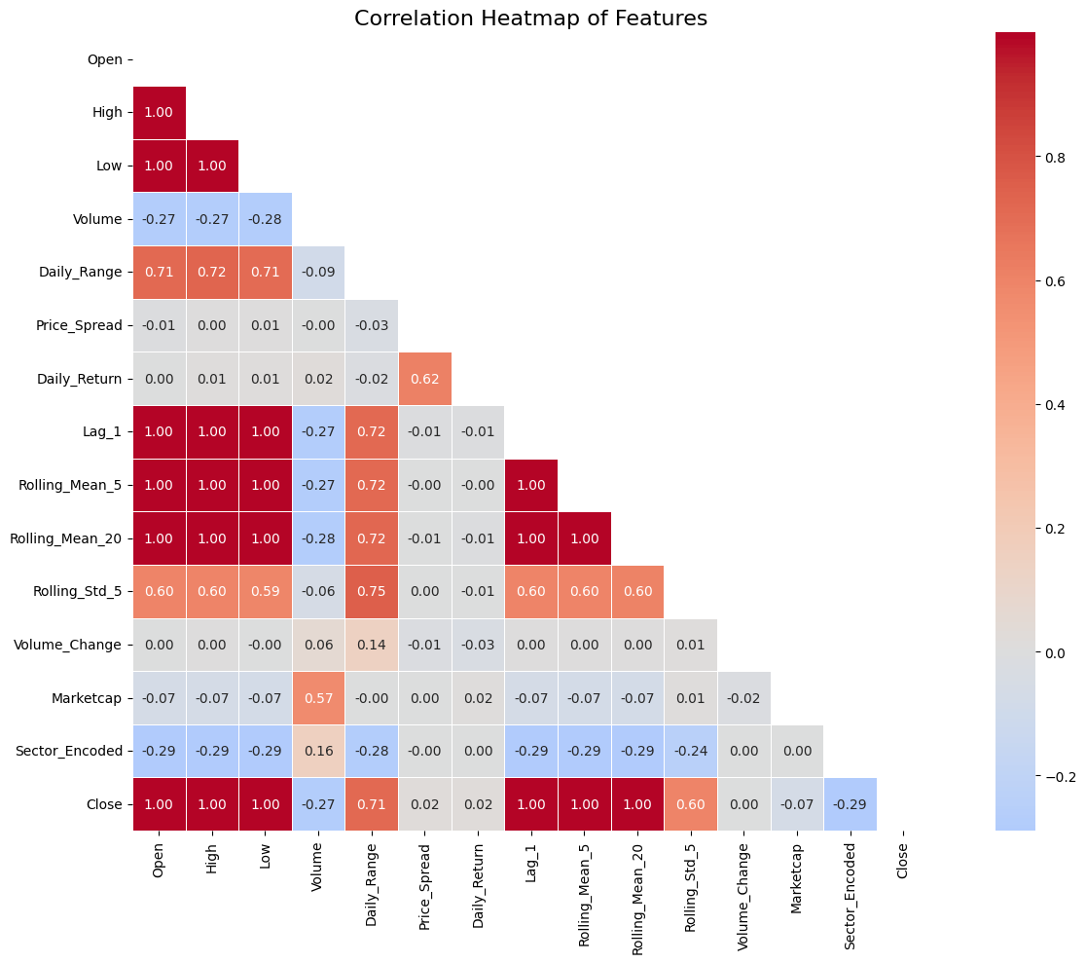
Feature Correlation
Strong linear relationships between Close and Open/High/Low

Slide 4
Models Trained
- Linear Regression (baseline)
- Lasso Regression (L1)
- Ridge Regression (L2)
- SVR (StandardScaler pipeline, RBF kernel)
- Decision Tree (max_depth=15)
- Random Forest (n_estimators=100, max_depth=20)
- Neural Network (Keras, 3 hidden layers, StandardScaler)

Slide 5
Hyperparameter Tuning
- Model tuned: Random Forest via GridSearchCV (3-fold CV)
- Parameters: n_estimators [100,200,300], max_depth [10,20,30], min_samples_split [2,5,10]
- Best: n_estimators=300, max_depth=30, min_samples_split=2
- Improvement: RMSE 1.0295 -> 1.0256 (0.37%)

Slide 6
Results
Model | RMSE | MAE | R2
Ridge | 0.0001 | 0.0000 | 1.0000
Lasso | 0.0297 | 0.0172 | 1.0000
Neural Network | 0.8693 | 0.6073 | 0.9999
Random Forest (Tuned) | 1.0256 | 0.5203 | 0.9999
Decision Tree | 1.4913 | 0.7512 | 0.9998
Linear Regression | 2.4065 | 1.4050 | 0.9995
SVR | 10.3737 | 0.6864 | 0.9914

Slide 7
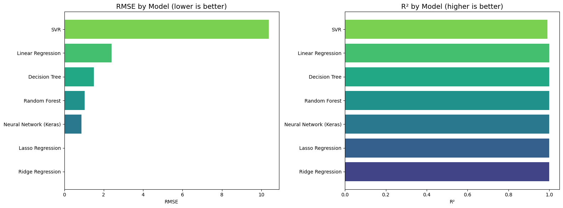
Model Comparison
RMSE and R2 comparison across all models

Slide 8
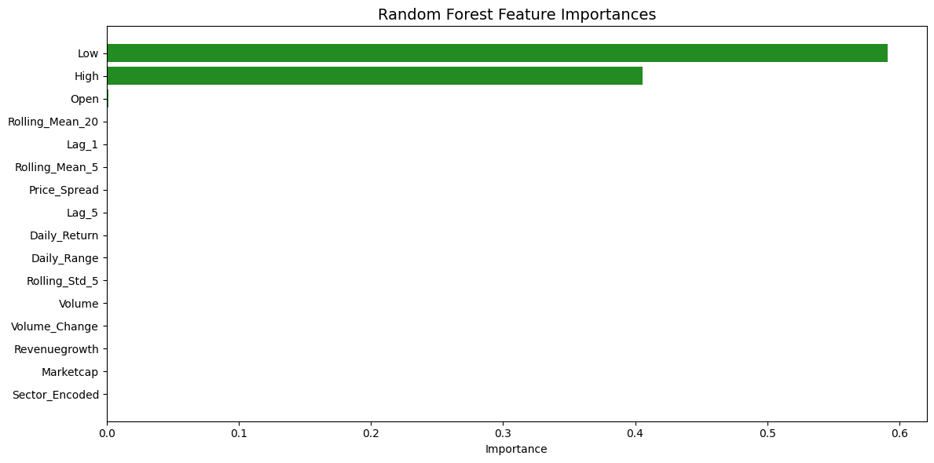
Feature Importances (Random Forest)
Low (59.1%) and High (40.6%) dominate

Slide 9
Key Findings
- All models achieved R2 > 0.99
- Lasso reduced features from 16 to 7 (only price features survived)
- Close is almost entirely determined by same-day OHLC features
- GridSearchCV gave modest improvement -- default RF was near-optimal

Slide 10
Conclusion
- Recommended model: Ridge Regression
- Lowest RMSE (0.0001) and perfect R2 (1.0000)
- L2 regularization handles multicollinearity among correlated price features
- For forecasting future prices (no same-day data), tree-based models would likely outperform

