Slide 1
Part 2: Classification
Predicting S&P 500 Stock Price Direction
Dataset: S&P 500 Stocks (Kaggle)

Slide 2
Dataset
- Same S&P 500 subset (top 50 companies, 2018-present)
- Target: binary -- 1 (UP) if next-day close > today, 0 (DOWN)
- Class balance: ~52% UP, ~48% DOWN
- 13 technical indicator features: RSI, SMA ratio, momentum, volatility
- F1 Score as primary metric

Slide 3
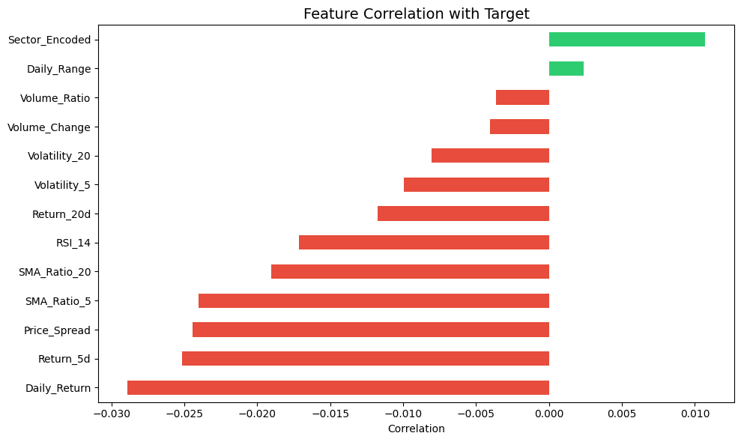
Feature Correlation with Target
Weak correlations reflect randomness of daily price movements

Slide 4
Models Trained
- Logistic Regression (max_iter=1000)
- SVC (StandardScaler pipeline, RBF kernel)
- Decision Tree (max_depth=10)
- Random Forest (n_estimators=200, max_depth=15)
- Neural Network (Keras, 3 layers, sigmoid output, StandardScaler)

Slide 5
Hyperparameter Tuning
- Model tuned: Random Forest Classifier via GridSearchCV (3-fold, scoring=f1)
- Parameters: n_estimators [100,200,300], max_depth [10,15,20,None], min_samples_split [2,5,10]
- Best: n_estimators=300, max_depth=10, min_samples_split=10
- Improvement: F1 0.6638 -> 0.6778

Slide 6
Results (sorted by F1 Score)
Model | Accuracy | F1 | Precision | Recall
Logistic Regression | 0.5277 | 0.6829 | 0.5288 | 0.9636
Random Forest (Tuned) | 0.5355 | 0.6778 | 0.5346 | 0.9259
SVC | 0.5284 | 0.6730 | 0.5307 | 0.9196
Decision Tree | 0.5293 | 0.6689 | 0.5320 | 0.9009
Neural Network | 0.5181 | 0.5730 | 0.5382 | 0.6126

Slide 7
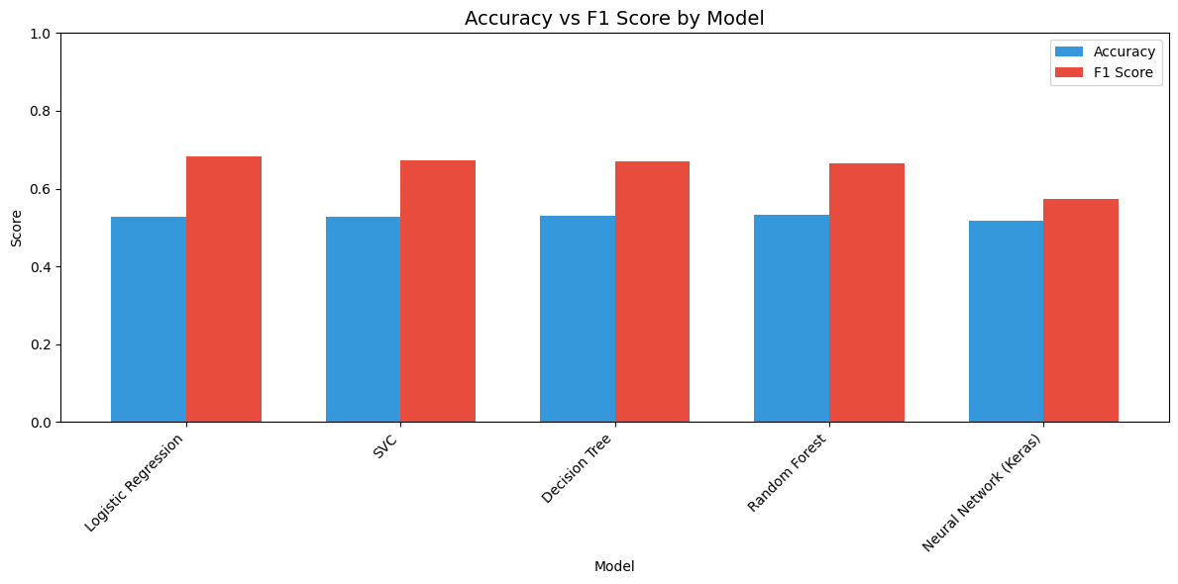
Accuracy vs F1 Score

Slide 8
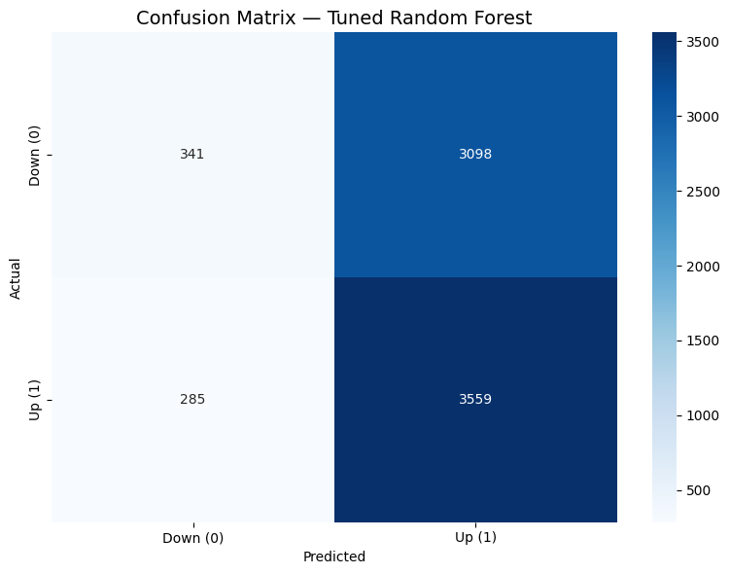
Confusion Matrix (Tuned RF)
Slight bias toward predicting UP

Slide 9
Key Findings & Conclusion
- All models ~53% accuracy -- only slightly above random (50%)
- Logistic Regression: best F1 (0.6829), very high recall (0.9636)
- Daily stock direction is essentially a random walk with slight upward drift
- Complex models did not outperform logistic baseline
- Recommended: Logistic Regression

