Slide 1
Part 3: Time Series
Forecasting the S&P 500 Index
Dataset: S&P 500 Stocks (Kaggle)

Slide 2
Dataset
- S&P 500 index daily values (Dec 2014 - Dec 2024)
- 2,517 data points with genuine daily time index
- Target: S&P 500 index value (continuous, sequential)
- Chronological 80/20 split -- no shuffling

Slide 3
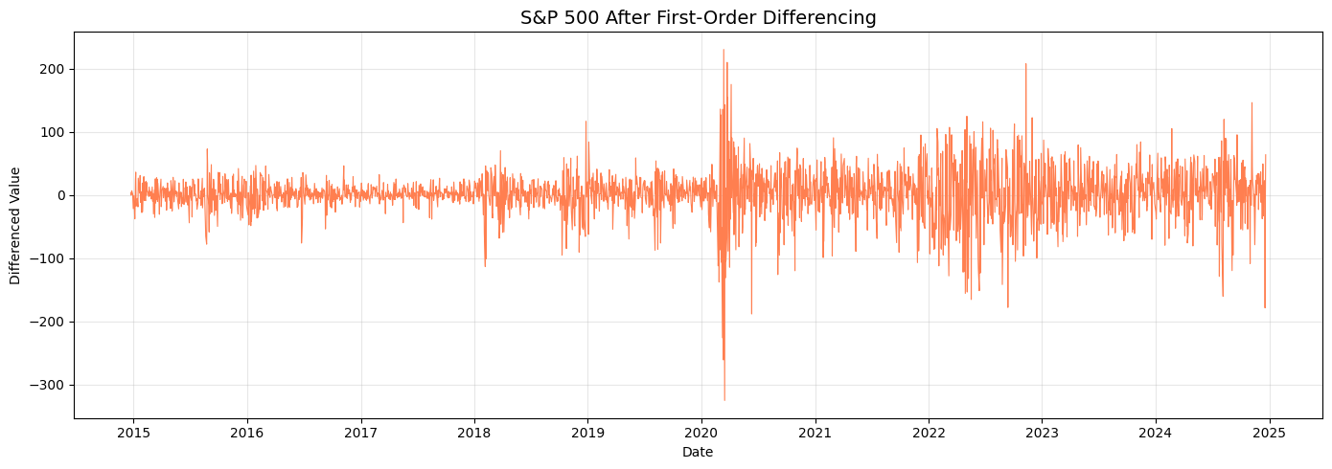
Stationarity Analysis
- ADF test on raw series: statistic=0.545, p=0.986 -- not stationary
- After first-order differencing: statistic=-15.941, p~0.0 -- stationary
- Volatility clusters visible (e.g., 2020 COVID crash)

Slide 4
Methods
- ARIMA: manual grid search over (p,d,q), best = ARIMA(2,1,2), AIC=20,119
- Random Forest: 9 lag/rolling features (lag_1 to lag_7, rolling mean/std)
- Pipeline: StandardScaler -> Random Forest
- GridSearchCV with TimeSeriesSplit (3 splits)
- Best RF params: n_estimators=200, max_depth=20, min_samples_split=2

Slide 5
Results
Method | MAE | RMSE | Type
Random Forest | 352.39 | 544.17 | ML
Random Forest (Tuned) | 352.39 | 544.17 | ML
ARIMA(2,1,2) | 1012.39 | 1202.29 | Classical

Slide 6
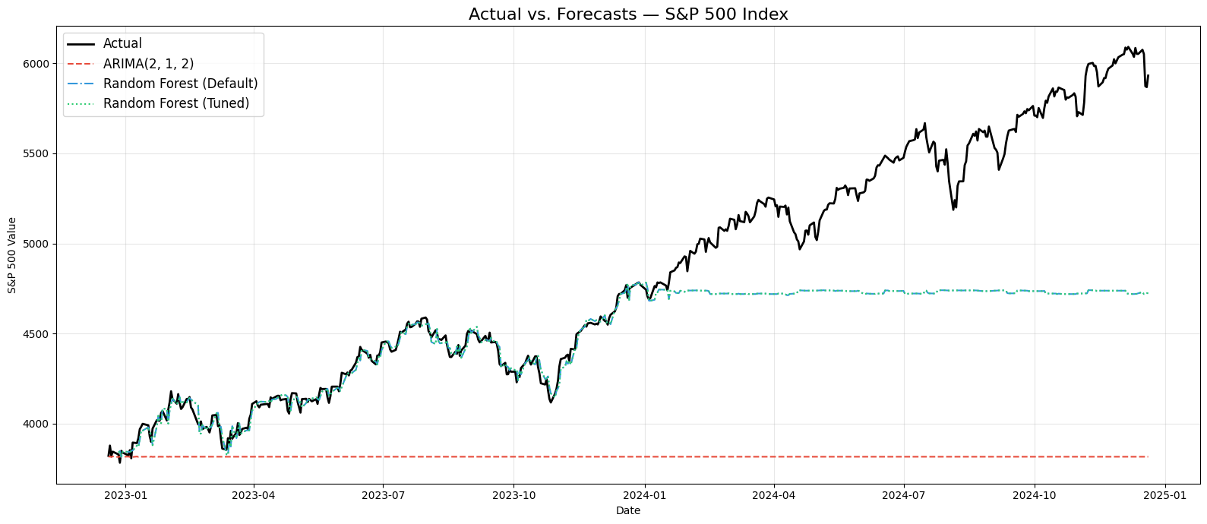
Actual vs Forecasts
Random Forest tracks actual values closely; ARIMA diverges

Slide 7
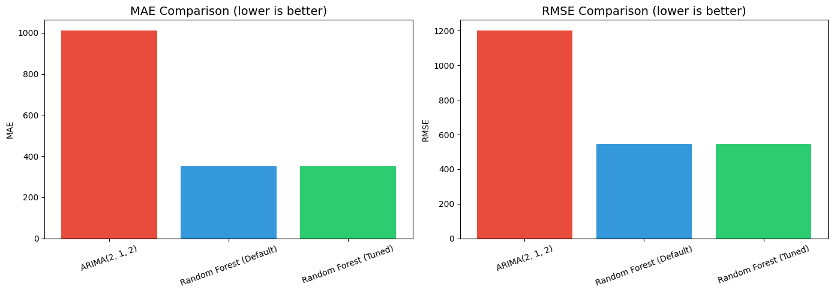
MAE and RMSE Comparison

Slide 8
Key Findings
- Random Forest outperformed ARIMA -- 55% RMSE improvement
- ARIMA degrades over long horizons (projects flat trend)
- RF with lag features captures upward trajectory
- Tuned RF matched default -- parameters were already near-optimal

Slide 9
Conclusion
- Recommended: Random Forest with Lag Features
- RMSE improvement: 1202 -> 544 (55% better than ARIMA)
- ARIMA remains valuable for short-term (1-5 step) forecasts
- Combining both approaches could yield best practical results

