Slide 1
Part 4: Clustering
Grouping S&P 500 Companies
Dataset: S&P 500 Stocks (Kaggle)

Slide 2
Dataset
- 11 numeric features: return, volatility, volume, market cap, EBITDA, etc.
- Fully unsupervised -- no target variable
- Combined daily stock aggregates with company fundamentals
- StandardScaler applied before all clustering algorithms
- PCA (2D) for visualization; clustering on full 11 features

Slide 3
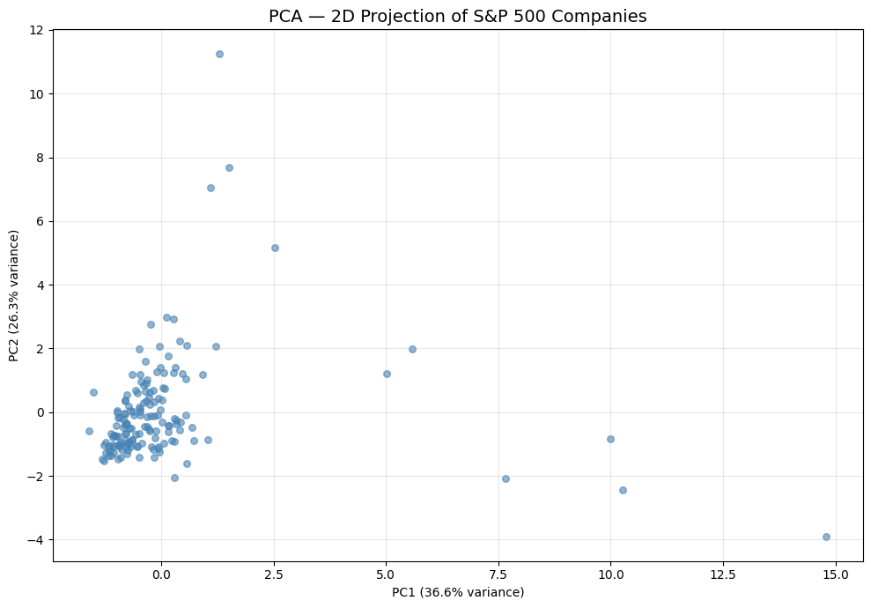
PCA Projection
Mega-cap tech companies clearly separated from the main cluster

Slide 4
Algorithms
- K-Means: tested k=2 to 10, Elbow Method + Silhouette Scores
- DBSCAN: varied eps (0.5-5.0), min_samples (3,5,7,10)
- Agglomerative: 3 linkage methods (ward, complete, average) x k=2 to 5
- Selected best by Silhouette Score

Slide 5
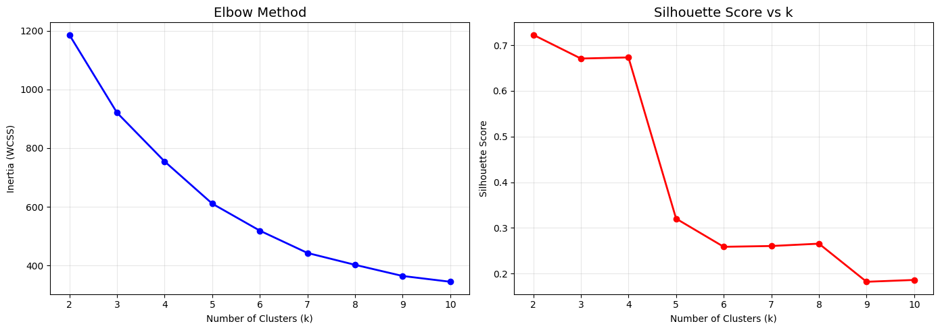
K-Means: Elbow and Silhouette
Both indicate k=2 as optimal

Slide 6
Clustering Comparison
Algorithm | Clusters | Silhouette | Observation
K-Means | 2 | 0.7226 | Clean separation
DBSCAN | 6 | 0.3622 | 131 noise points
Agglomerative | 2 | 0.8072 | Average linkage, best score

Slide 7
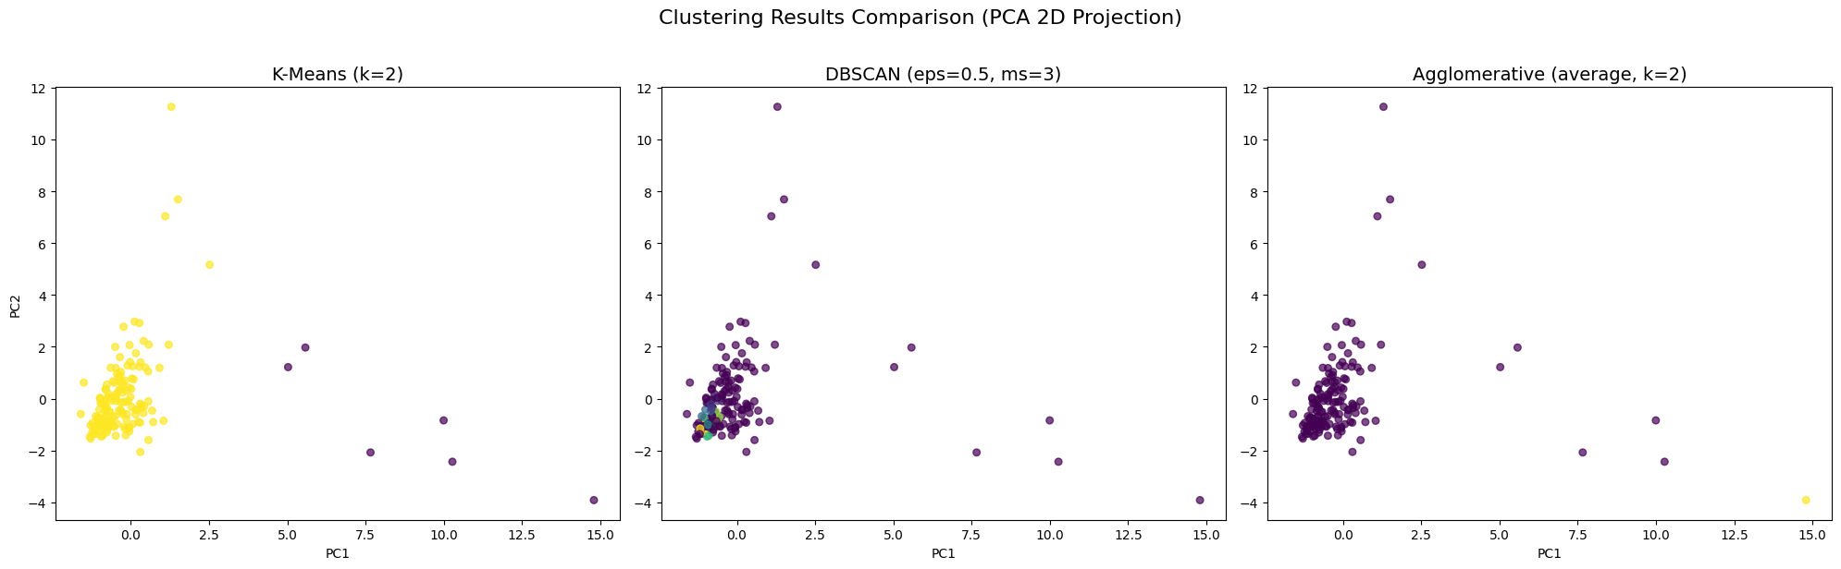
All Clustering Results
K-Means and Agglomerative produce similar 2-cluster solutions

Slide 8
Key Findings
- Natural 2-cluster split: mega-cap tech vs. rest of S&P 500
- Driven by Market Cap, EBITDA, and Index Weight
- DBSCAN identified 131 noise points (26% of companies)
- Dendrogram reveals hierarchical sub-group structures
- Average linkage with k=2 gave highest Silhouette (0.807)

Slide 9
Conclusion
- Recommended: Agglomerative Clustering (Average Linkage)
- Highest Silhouette Score (0.8072), cleanest 2-cluster solution
- Hierarchical structure provides dendrogram for sub-group analysis
- 2-cluster solution useful for portfolio diversification
- Finer clustering (k=3-5) could separate growth vs. value vs. defensive

