Slide 1
Covid-19 Impact Report New
Estimates of Covid-19 Impact for Singapore Biometix

Slide 2
Introduction

Slide 3
In the morning
Eat eggs
Drink coffee
ted@biometix.com
Estimates of Covid-19 Impact for Singapore

Slide 4
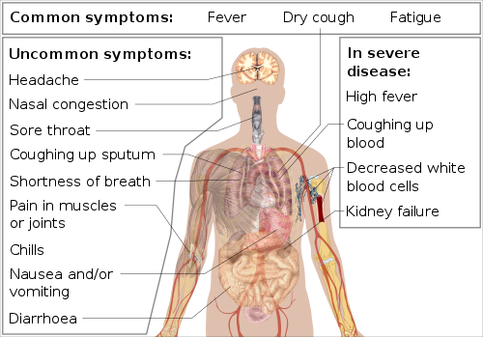
Symptoms
symptoms

Slide 5
PS test
test

Slide 6
Details

Slide 7
corona virus
EPS

Slide 8
This slide has columns
Eat eggs
Drink coffee
symptoms

Slide 9
In the evening
Eat spaghetti
Drink wine

Slide 10
Conclusion

Slide 11
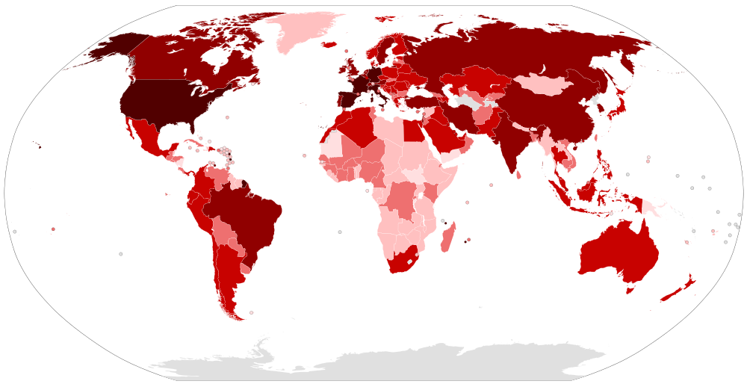
map

Slide 12
Deaths By Region

Slide 13
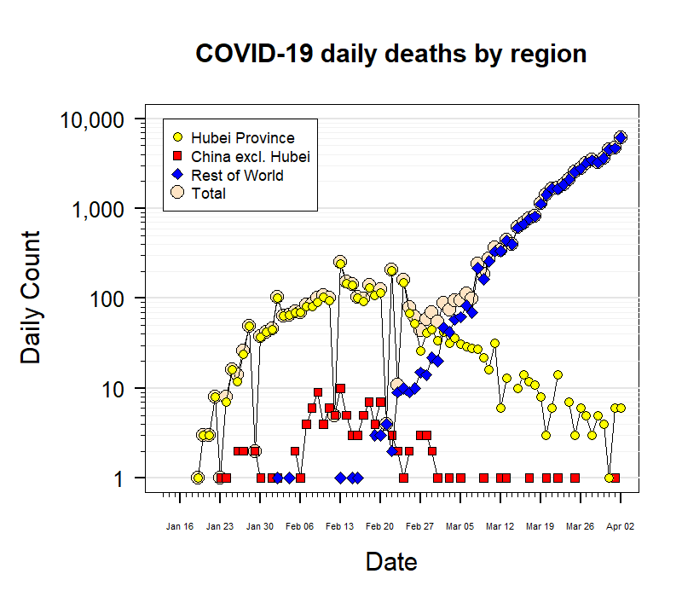
corona

Slide 14
News

Slide 15
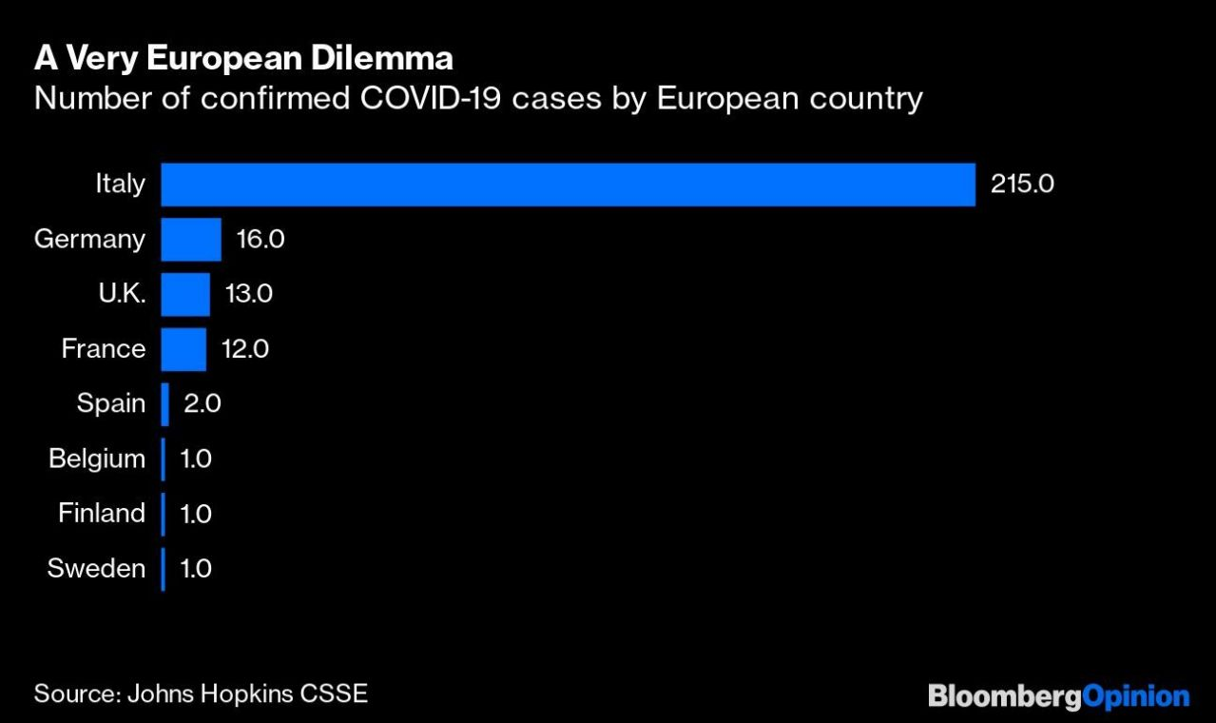
Salvini and Le Pen Don’t Have a Coronavirus Cure
(Bloomberg Opinion) – The surge in confirmed cases of the Covid-19 coronavirus in Italy has thrown up a classic dilemma for the European Union: How to protect unity between 27 member states when domestic political pressures call for national, beggar-thy-neig… [+5492 chars] link
Warren introduces bill to transfer funding from border wall to efforts to combat coronavirus (Martin Finucane) link
Blockchain as a Tool to Combat Coronavirus (Cointelegraph By Cointelegraph Consulting) link
Coronavirus: What are the symptoms? Can I get it from food? What about kissing? (MANDY TE) link
Coronavirus: Avoid crowded places, says Health Minister Harsh Vardhan (BusinessToday.In) link
Cleary Gottlieb Discusses the Coronavirus – Force Majeure or Frustration? (Jonathan Kelly, Jeffrey A. Rosenthal and Delphine Michot) link
Man ‘hacks airline computer system to book free business class flights worth €18,000’ (Helen Coffey, Helen Coffey) link
Salvini and Le Pen Don’t Have a Coronavirus Cure

Slide 16

First Edition: February 21, 2020
S.Korea Coronavirus Cases Go Exponential As New Infections Soar By 70%; 10 Towns In Northern Italy Put On Lockdown (Steve Watson) link
‘Ghost town’: What it’s like to be on holiday in northern Italy amid coronavirus shut down (Julia Buckley, Julia Buckley) link
With coronavirus, North Korea’s isolation is a possible buffer but also a worry (Simon Denyer) link
First Edition: February 21, 2020

