Slide 1
Kubernetes(RBAC)
Written by Ted.Jung
jongnag@gmail.com

Slide 2
Objects
Role
ClusterRole
ServiceAccount
Rolebinding
Clusterrolebinding
Secret
Token

Slide 3
Objects (Dashboard perspective)
RBAC
Cluster
scope
non cluster
scope
nodes
roles
Kubernetes Dashboard

Slide 4
Use case
Kubernetes API is the best example of usecases
Components
RBAC
client
API
Secret
access should be limited

Slide 5
Secret
to hold sensitive information
such as passwords,
OAuth tokens,
ssh keys
Secret
injected
PoD
such as passwords,
OAuth tokens,
ssh keys
Secret
injected
Image
Use-case (access to MySQL from Pod)
PoD
MySQL
Secret
such as passwords,
OAuth tokens,
ssh keys
userid/passwd
“admin”/”password”
“AABta4=“/”NXAImmn9N” (base64)
$ kubectl create secret generic db-user-pass --from-file=./username.txt --from-file=./password.txt
secret "db-user-pass" created

Slide 6
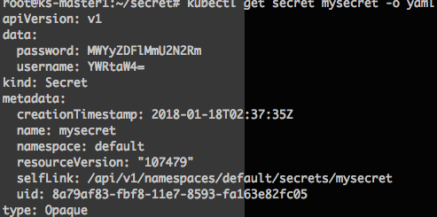
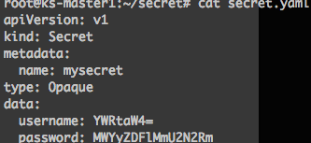
Secret
How to create secret?
What kind of options to create secrets?
Docker-registry | Create a secret for use with a Docker registry
generic | Create a secret from a local file, directory or literal value
tls | Create a TLS secret

Slide 7
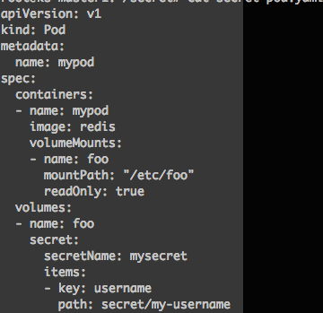
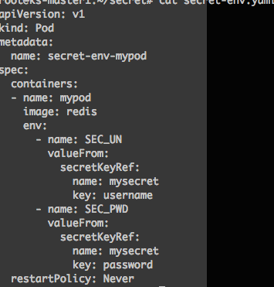
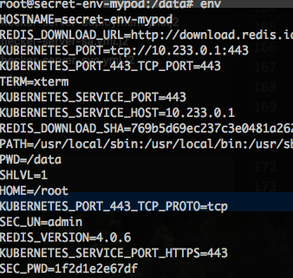
Secret
How to use?
such as passwords,
OAuth tokens,
ssh keys
share
PoD
Secret
PoD
PoD
PoD
Using secrets as files from a pod
Using secrets as Environment
PoD
/etc/foo/secret/my-username

Slide 8
Role
namespace
namespaces
Role
ClusterRole
rules = permissions
rules = permissions
apiGroups
apiGroups
resources
resources
verbs
verbs

Slide 9
Bindings(Role, ClusterRole)
A role binding grants the permissions defined in a role to a user or set of users
Subjects
(role)Reference
binding
users,
groups,
service accounts
rules

Slide 10
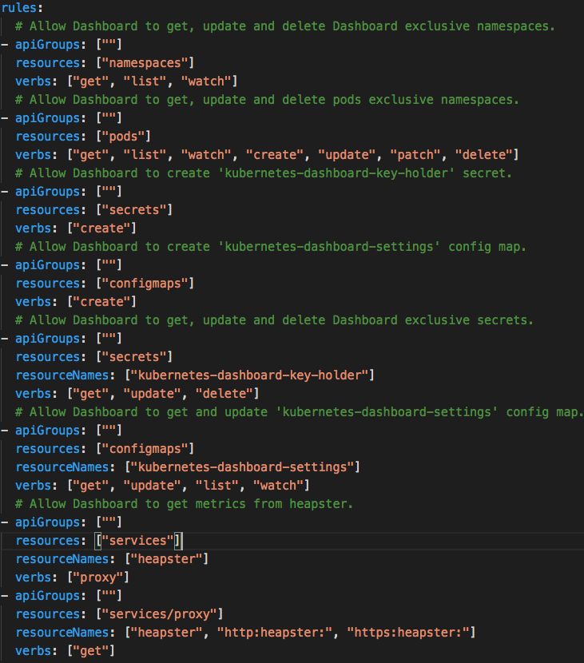
Example of Rules

Slide 11
RBAC (Dashboard)
namespace
Action:create
Process: link serviceaccount to role
subjects
RoleBinding
roleRef
Deployment
ServiceAccount (user)
Role
Service
Secret
rules
Token
User -> [system]:[serviceaccount]:[namespace]:[serviceaccount]
Notes:
Secret purpose: allows for more control over how it is used, and reduces the risk of accidental exposure

