Slide 1
Kubernetes Storage
Written by Ted.J
jongnag@gmail.com

Slide 2
Kinds of Kubernetes & Relationship between them
Service
Pod
Ingress
Controller
Ingress
rule set
Endpoints
Ingress
Controller
Kubernetes API
monitoring
Ingress
(rule set)
Endpoints
NetworkPolicy
rules
Developers
switching between clusters by context
Limits
Region-asia1
(Resource, cpu/mem)
Cluster
Namespace
Pod
Cluster
Namespace
Service
Pod
Headless service
Container
StatefulSet
Federation
ClusterIP (internal)
--------------------------
Nodeport
Loadbalancer
ExternalName
Port proxy
Container
Cluster
(=context))
CPU
Cluster
(=context))
1:N
N:M
1:N
CPU
Region-asia2
1:N
GPU
(applications on stateful)
GPU
Mem
Mem
Ordinal index
Stable NetworkID
Stable Storage
Cluster
TLS(Certificate signing Request)
ConfigMap
Horizontal pod Autoscaler
(cpu,mem,custom)
stateless
sync controller by
federation controller manager
demonset
secret
configmap
Deployment
Persistent
VolumeClaim
(Size,Mode)
Rollout & Rollback
Update image
Replicaset
Scaling a deployment
Pause & Resuming
* pod updating
ReplicaSets
Certificate
Signing
Requests
stateless
StorageClass
kubeadm join with token
-provisioner
Ceph/Gluster/AWS/
Ccloud/NFS/iSCSI
-parameter
(size, access mode)
(No NS)
Replication
Controller
Persistent
Volume
(No NS)
kubernetes
package
CoreDNS
Secret
Service
Account
Service
Account
Operator
ThirdPartyResources
Node
(Node selector)
Helm
DNS entry
Token
(kubeadm –ttl=0)
RBAC
ClusterRole
ClusterRole
Binding
Role
Binding
Role
DaemonSet
KubeDNS
rules
rules
service-name.namespace-name.svc.cluster.local
namespace or all namespaces
the same namespace
Job
Notes:
In Kubernetes, a controller is a control loop that watches the shared state of the cluster through the apiserver and makes changes attempting to move the current state towards the desired state

Slide 3
What does PV/PVC/StorageClasses provides?
Store data persistently
Data share between containers
Build stateful application (Apps, R-DB, KV-Store)
Notes:
In Kubernetes, a controller is a control loop that watches the shared state of the cluster through the apiserver and makes changes attempting to move the current state towards the desired state

Slide 4
K8S Storage
How does storage be provided into container?
It is nothing but an abstracted layer in which storage classes(plugin) is enabled
Kinds
PV
(persistent volume)
PVC
(persistent volume claim)
DVP
(dynamic volume provisioning)
Notes:
In Kubernetes, a controller is a control loop that watches the shared state of the cluster through the apiserver and makes changes attempting to move the current state towards the desired state

Slide 5
What is PV & PVC?
PV
a piece of storage in the cluster that has been provisioned by an administrator
have a lifecycle independent of any individual pod that uses the PV
storage resource
PVC
a request for storage by a user
It is similar to a pod
can be mounted once read/write or many times read-only
request
pod | pvc
cpu, memory | size, access mode

Slide 6
How it works?
App owner / plan to launch a service based on container / volume is used to store data
Kubernetes (API)
PV
PVC
PV
PVC
resource
request
resource
request
storage
provider
AWS
GCE
CEPH
Gluster
Portworx
etc
storageclasses
storageclasses
Storage #1
Storage #2
Notes:
for dynamic storage option? => API should be run with an option “–admission-control=DefaultStorageClass”

Slide 7
What criterias to map pv for selecting?
Capacity
Access Mode
ReadWriteOnce – the volume can be mounted as read-write by a single node
ReadOnlyMany – the volume can be mounted read-only by many nodes
ReadWriteMany – the volume can be mounted as read-write by many nodes

Slide 8
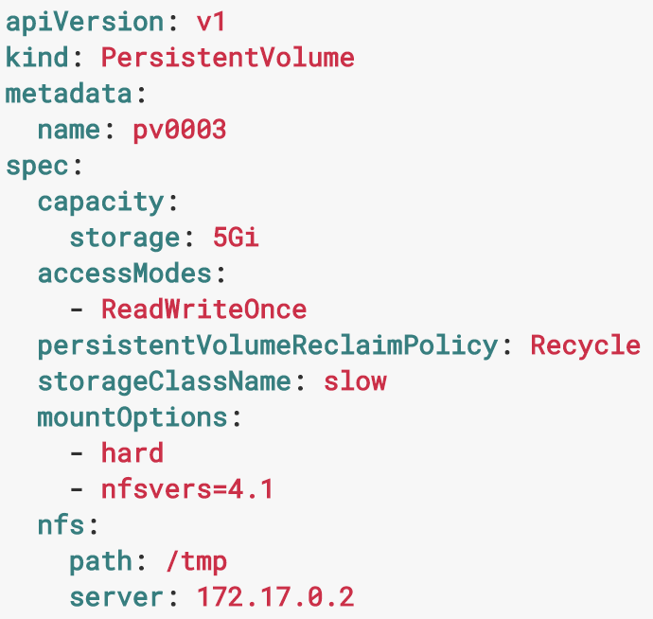
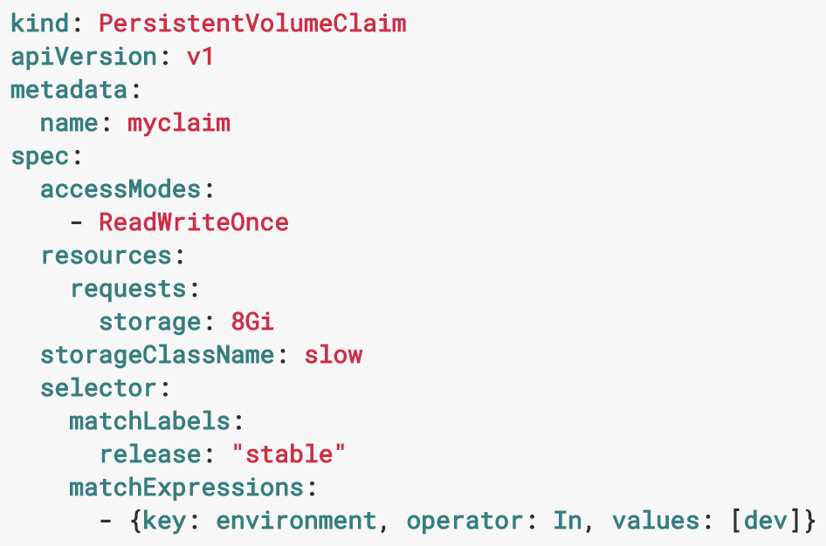
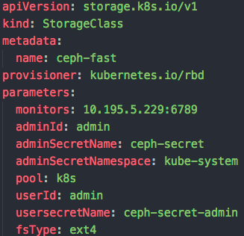
Expression
PV
PVC
StorageClasses

Slide 9
Lifecycle of Volume
Provisioning
Binding
Using
Reclaim
PVC delete
Static
A
retaining
M
pvc
pv
recycling
Dynamic
watching
deleting
pv existed
attache or wait
no available pv
create & attache
Notes:
In Kubernetes, a controller is a control loop that watches the shared state of the cluster through the apiserver and makes changes attempting to move the current state towards the desired state

Slide 10
What kinds of storage are supported for K8S?
NFS
iSCSI
Local
Public
glusterfs
ceph (rbd)
host
downwardAPI
emptyDir
aws, gce,a zure
Notes:
In Kubernetes, a controller is a control loop that watches the shared state of the cluster through the apiserver and makes changes attempting to move the current state towards the desired state

Slide 11
How it works?
K8S Installation
1) Installation of ceph-common package
2) create a secret by kubectl using admin key from ceph
master
worker1
worker2
worker3
Containers
container (pvc, 10G, RW)
container
PVC
vol(10G)
claim
PV
vol(20G)
vol(5G)
vol(10G)
POOL
image
image
…
mon
node1
node2
node3
node4
node5
Ceph Installation
. access natively by app
. access to device by rbd map

Slide 12
How it works? (use case)
Kubernetes
host ‘A’
hsot ‘B’
host ‘C’
container
directory~
container
mount~
/dev/vdb
direct writing by app
Ceph
POOL
POOL
POOL
image
image
…
…
image
image
POOL

Slide 13
Demo (steps)
create
a single
container
return
container
1
4
Kubernetes
(storage classes)
create a type ‘secret’
in K8S with key ‘client.admin’ of Ceph
# secure connection
between k8s and ceph
volumeclaim
(*dynamic)
2
attach volume
into container
2’
3
0
pre-built (static)
Ceph
(rbd)

Slide 14
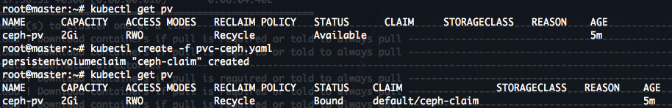
Demo (result)

Slide 15
Picture
Kubernetes Cluster
(Type-1: general application)
Kubernetes Cluster
(Type-2: general application)
Kubernetes Cluster
(Type-3: High speed application)
Worker
Worker
Local Storage
Local Storage
SSD
SATA
Shared storage
Shared storage
SSD
SATA
PCI Express

