Slide 1
ORAL PRESENTATION
COMP20008 Elements of Data Processing
Group members:
Ngoc Thanh Van Tran ID: 980818
Edward Marozzi ID: 910193

Slide 2
Outline and corresponding questions:
Pre-processing tasks
1
Designing classifier & Methodology
2
3
4
Performance & Limitations
5
6
Improvement & Alternatives
7

Slide 3
1
Pre-processing tasks:
Median
1) Impute missing values
Mean
Mean centering
2) Scale features
Standardisation
Notes:
Missing values imputation: to avoid inaccuracy during predictions
>> Unsure of if there is a pattern to the missing values, so we can’t just delete them. The median imputation method is more suitable as it is not unaffected by skewed data as much as the mean imputation method.
Scaling features: to help plotting visuals, and make the numbers smaller and easier to compute.
>> We successfully did both and went with mean centring as per the assignment instructions.

Slide 4
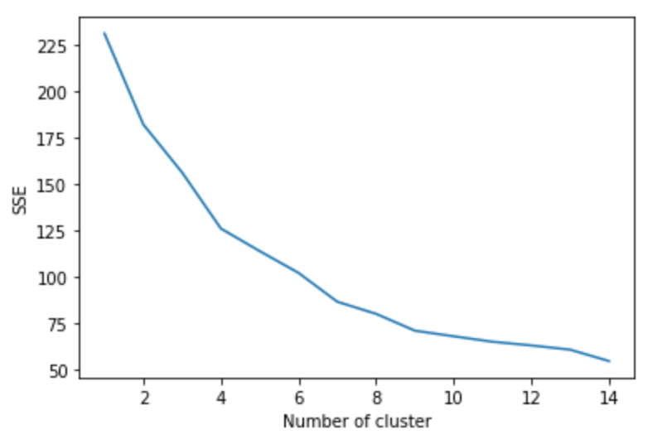
2
Different classification algorithms:
k-NN
Algorithm | k = 5 | k = 10 | Decision tree
Accuracy on the test data (based on the first 8 features) | 66.14% | 69.06% | 63.68%
Notes:
Decision Tree builds a binary search tree that, by traversing the tree, will be able to find the type of the predicting record. It works with numeric features better because tiny adjustments in numbers can be done much easier than string-based features. -> very low accuracy
k-NN is a pattern recognition algorithm that computes the Euclidean distance to the n nearest neighbours to find x nearest records near the predicting record, then decide which type the predicting record is based on the nearest neighbours.
-> suitable because it is easy to compute the distance between records and is computationally low complexity as compared with more complex classifier algorithms i.e neuron network.
Plot -> knn-6 was an ideal number of clusters
and finally in practice knn = 2 was best for our random state, this changes with different random states, and our program will dynamically adjust to give the best accuracy.

Slide 5
3
4
Classifier methodology and parameters manipulation:
Interaction term pairs
(New features are products of each pair of initial features)
Feature Engineering
Clustering labels
(Applying k-means clustering to create an extra cluster label feature)
k-NN classification
Notes:
Generate new features then our program iterates through all combinations of k nearest neighbours and calculates the mutual information for all n features, then adds the accuracy score to a list and sorts the list by highest accuracy. In this way we ensure that our classifier finds the best value for the number of nearest neighbours to take and the attributes with the highest MI and thus the highest classifier accuracy

Slide 6

5
Performance:
Both gives accuracy of 70.71% with:
Top number of features to select: 14
Number of nearest neighbours: 2
Notes:
As they got the same accuracy, it suggests that engineering new features didn’t really increase accuracy in this random state and it was in fact changing the top n features, and num of knn.

Slide 7
6
Generalization & Limitation:
Highly generalised: Our classifier will always improve or maintain accuracy as it takes a brute force approach to the problem by testing all possible combinations of
k in k-nn and n in top-n neighbours. Then the classifier outputs the two parameters that produced the highest accuracy.
Limitation: Performance is the biggest issue, by testing all possible combinations the classifier is computationally complex.
Currently sensitive to random state changes.
Notes:
K-NN is highly generalised since there is no training required at the start. ???
Scalability: It needs to calculate the distance of all records with the predicting record, if there are a lot of trained data, the performance will be slow, we had to limit the maximum iterations to 15 of k and n so that the program runs fast enough.
We also wanted to re run with multiple random states and take the mode of the k and n parameters for the best results but perfmace limites us

Slide 8
7
Improvement & Alternatives:
Performance is the main area that our classifier needs improvement on. Faster performance would mean we could iterate over a few random states to find the mode of our k and n parameters.
This would reduce the sensitivity to different random states and find a more accurate model of the data overall.
To improve performance we likely would have to re-write the knn classifier built into sk-learn and tailor it to our data for faster performance.
Notes:
KNN does not perform training when loading the train data, it simply store the data in the classifier. Therefore all computational power is needed during prediction.
We could make the program faster instead of using a brute force method.
Rewrite sklearn – Might look like removing unnecessary safety checks ect.

