Slide 1
Predicting Rushing Yards in the NFL

Slide 2
Purpose
NFL teams are always looking to gain an advantage over other teams.
A model that predicts rushing yards could give teams key insights on how to improve their run game.
The NFL makes money because fans want to watch the game.
Announcers, casters, and commentators improve the viewing experience by giving insights to the viewers.
A model that predicts rushing yards could aid in this objective, especially by identifying plays or players that exceed the expectations of an accurate model

Slide 3
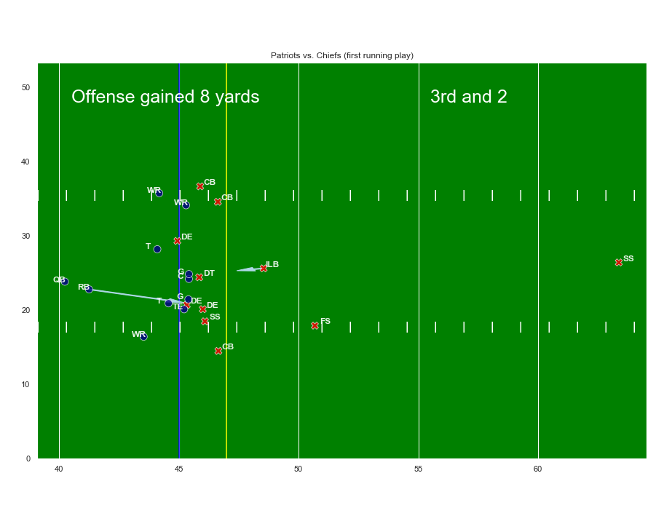
The Data
Snapshot at the time of handoff with over 400 features related to:
The game
Stadium, home team, week, etc.
The play
Current score, down, yard line, etc.
The players
(x,y) coordinates, speed, position, etc.
Single play reconstructed using some of the features available

Slide 4
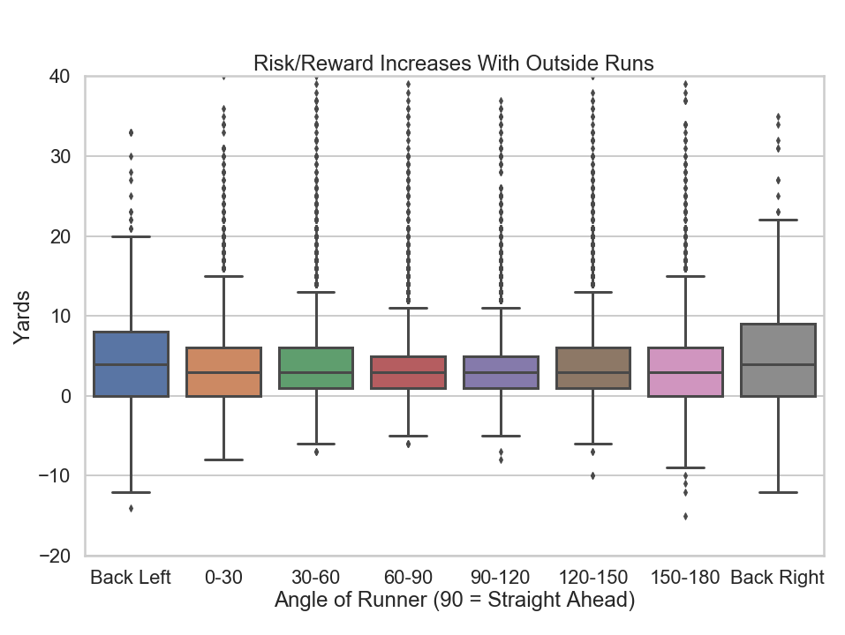
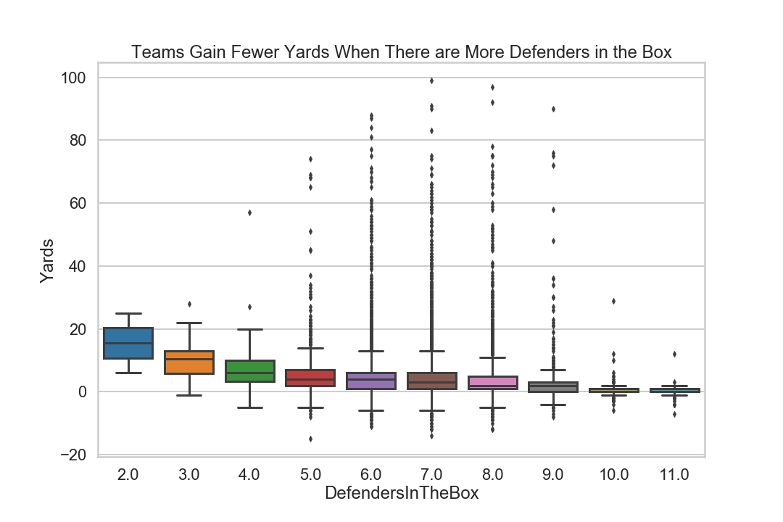
Exploration helps us identify features that might be useful in predicting yards

Slide 5
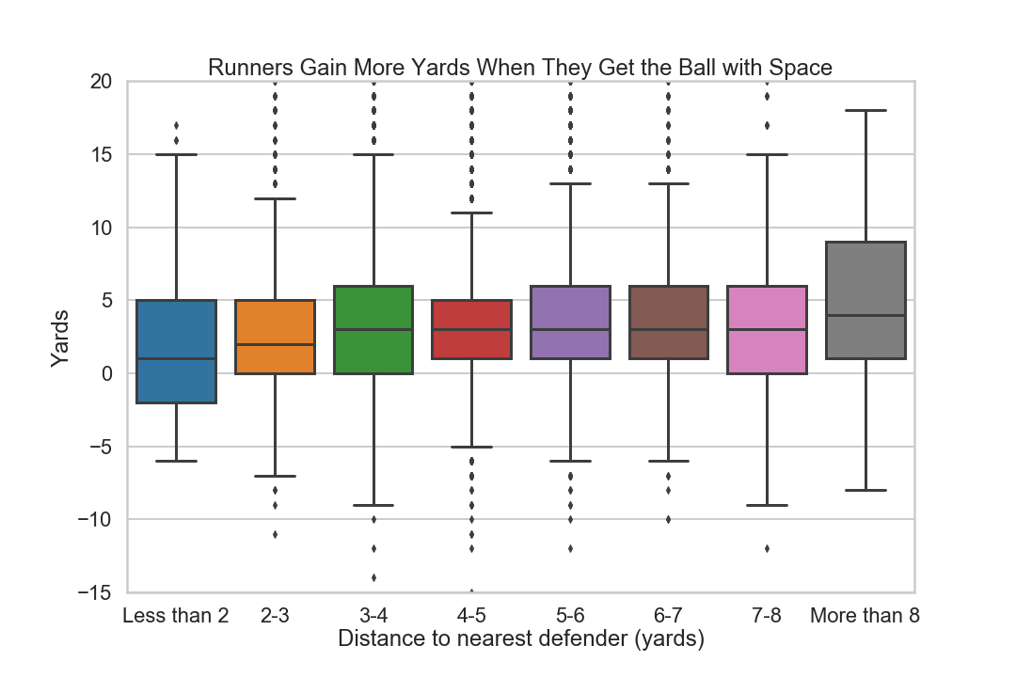
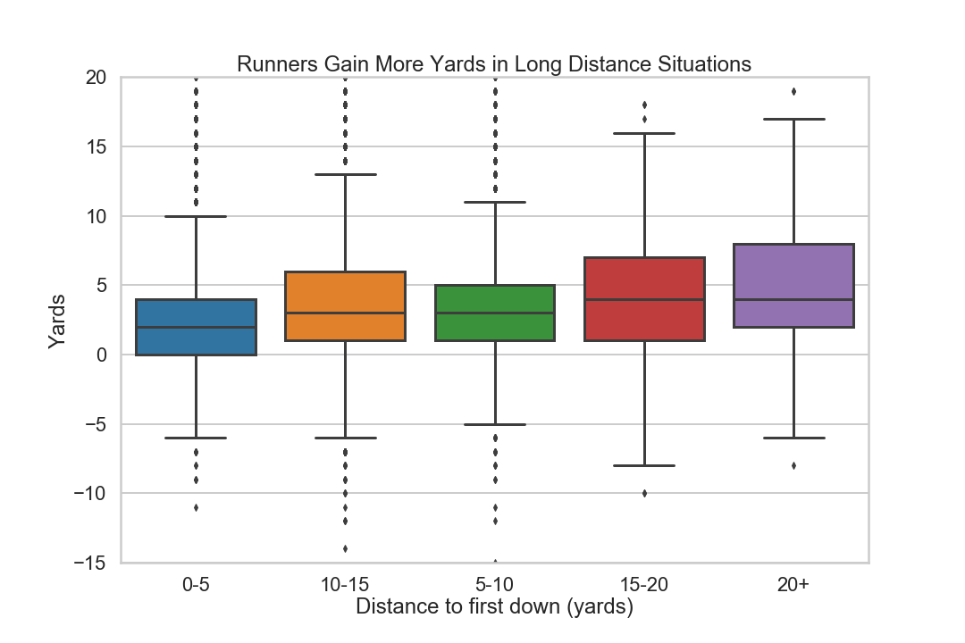
We can also use our knowledge of football to engineer some useful features

Slide 6
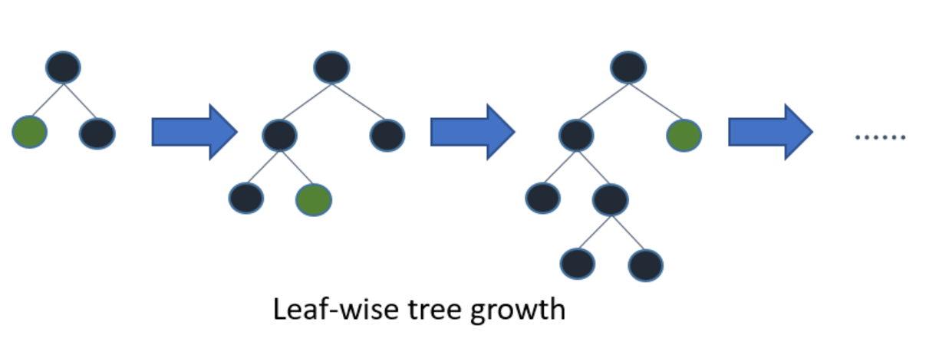
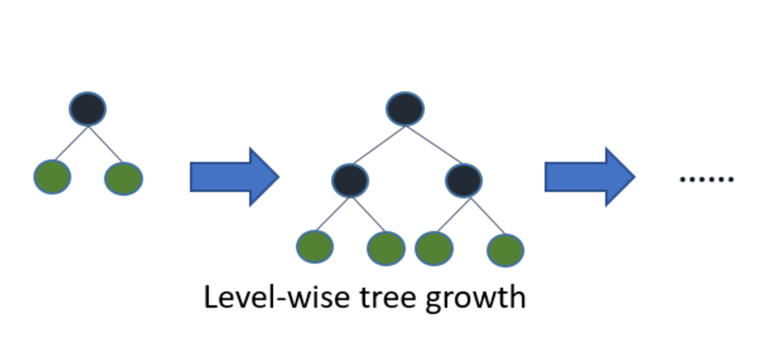
We use a Light Gradient Boosted Machine decision tree
Pros
More efficient than other boosting algorithms because it bins continuous variables to save memory
More accurate than other boosting algorithms because leaf-wise tree growth creates highly complex trees
Cons
Prone to overfitting due to the complexity of the trees mentioned above
Careful parameter tuning is needed to avoid overfitting

Slide 7
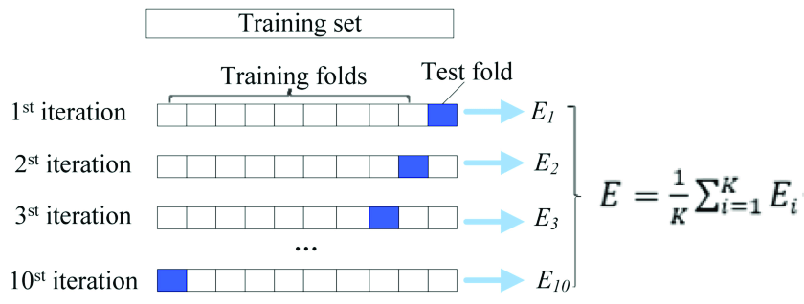
Parameter Tuning
I use 80% of the data for training and the remaining 20% for testing
I use 10-fold cross validation to tune 3 important parameters on the training data
Number of leaves per tree
Number of trees
Learning rate

Slide 8
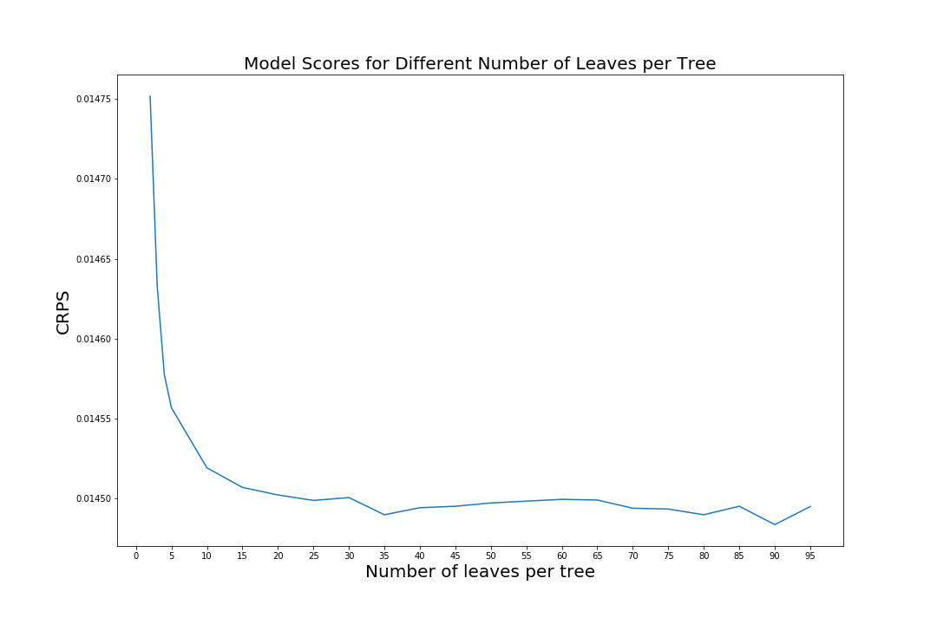
Parameter tuning
More leaves means the model takes longer to train.
Learning rate and number of trees were tuned together. The best model resulted from a learning rate of 0.01 with 400 trees.
For this application I choose the most accurate model because time is not a limiting factor
Good balance of speed and accuracy (0.0144899)
Most accurate model (0.0144837)

Slide 9
Final Workflow
Parameter tuning
Cross validation
Raw data
Training data
Fit
Trained Model
80%
Reshaped data
EDA
Predict
20%
Feature engineering
Test data
Compare
Predicted values
Model score
= 0.014782

Slide 10
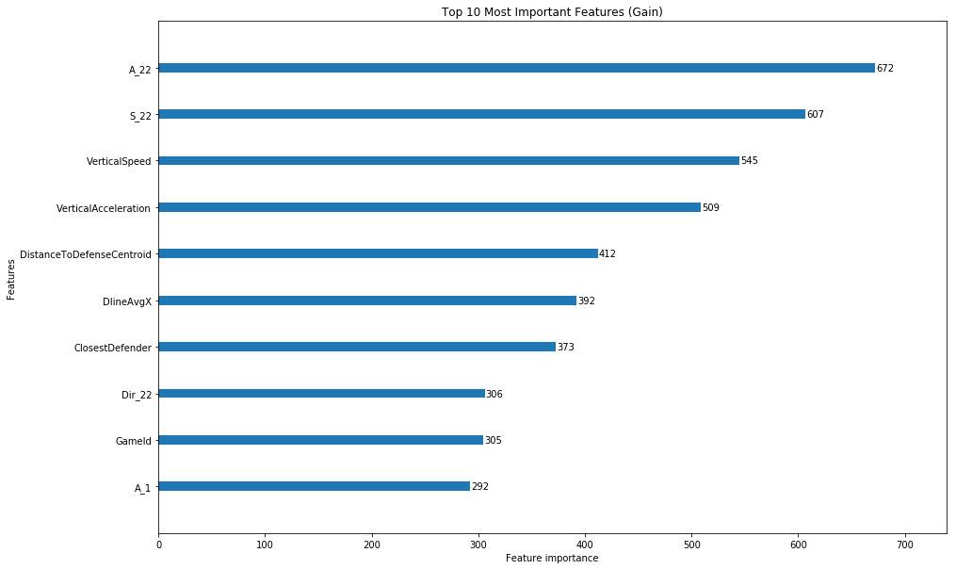
Most Important Features
Runner’s speed and acceleration
Vertical component
Runner’s distance to center of defense
Average position of defensive line relative to line of scrimmage
Runner’s distance to nearest defender
Direction of runner

Slide 11
Findings
Speed and acceleration of the runner are the most important factors
Particularly the vertical components
Spacing is also very important
More space = more yards
What does it mean?
Draw plays are less likely to be successful
Misdirection plays are likely to be successful

