Slide 1
Can we predict rushing yards in the NFL?

Slide 2
Next Gen Stats has partnered with the NFL to collect detailed data on every rushing play in the NFL for the last two years.
The data represents a snapshot in time at the moment the ball is handed to the runner.
Can we use this data to predict how many yards are gained on a particular play?

Slide 3
What does the data look like?
Play Information
Season
Week
YardLine
Quarter
GameClock
Down
Distance
Score
Offense/Defense formation
Temp/Humidity/Wind
Stadium
Player Information (for all 22 players)
(X,Y) coordinates
Speed/Acceleration
Orientation/Direction
Height/Weight
Age
Position (RB, QB, LB, etc.)
Jersey Number

Slide 4
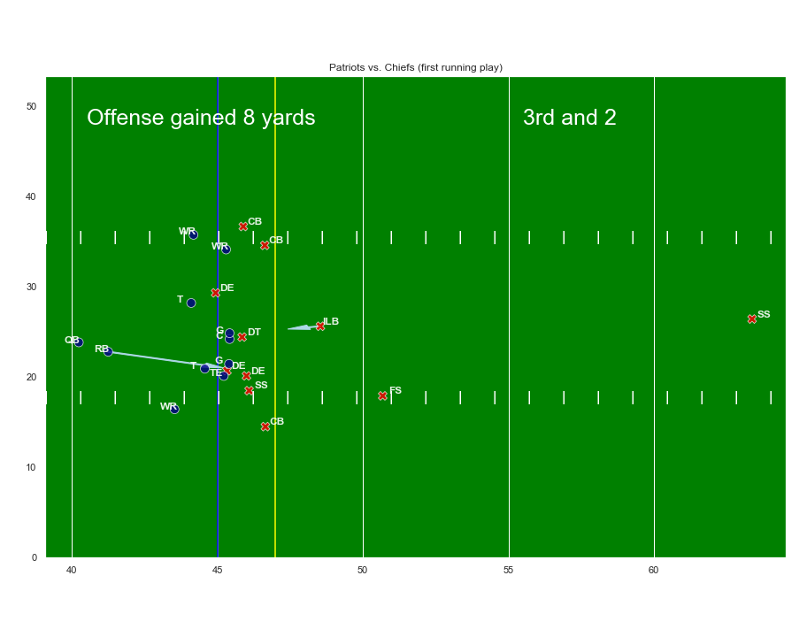
Let’s look at the data in context
Players location is determined by their (X,Y) coordinates.
The arrows represent the player’s direction, with the length proportional to his speed.
We can begin to imagine how this play might unfold.
There is a small hole on the right side in the direction the RB is headed
The ILB is unblocked and may run to meet the RB in the hole
Here is how the play actually unfolds: (https://youtu.be/zn1YUctg28Q?t=14)

Slide 5
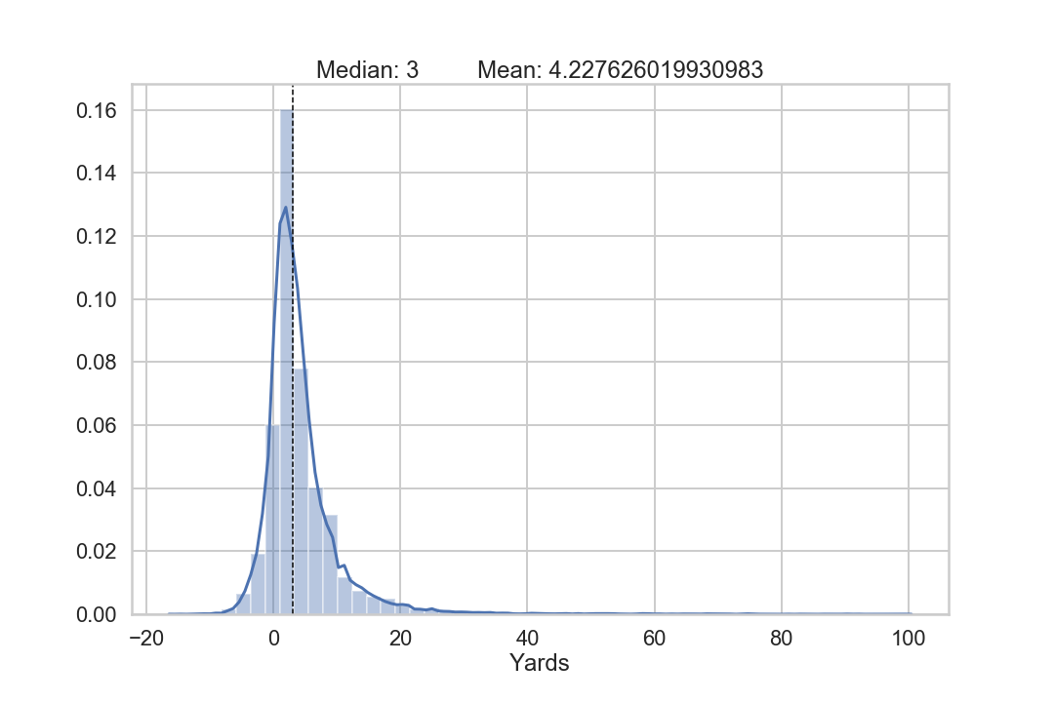
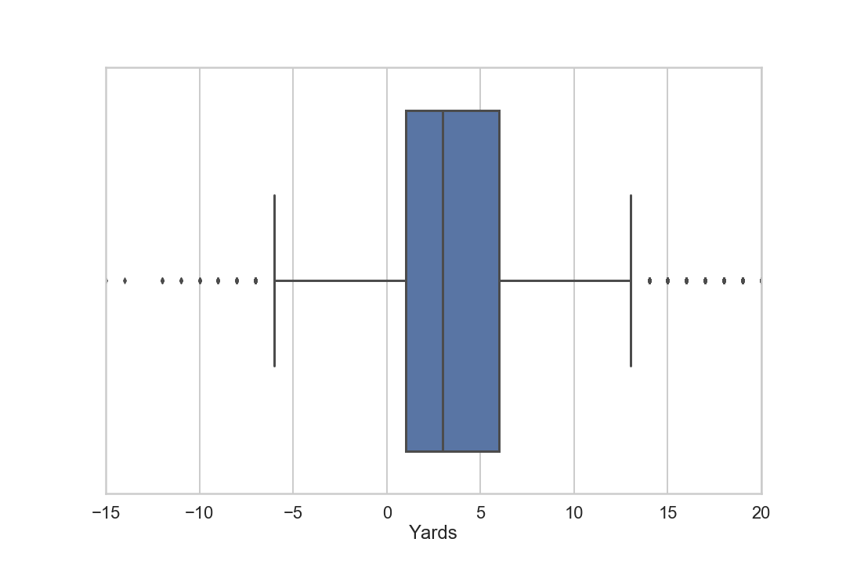
What kind of trends can we find across the entire dataset?
Yards is very positively skewed
Variance is quite low
The middle 50% of runs are between 1 and 6 yards

Slide 6
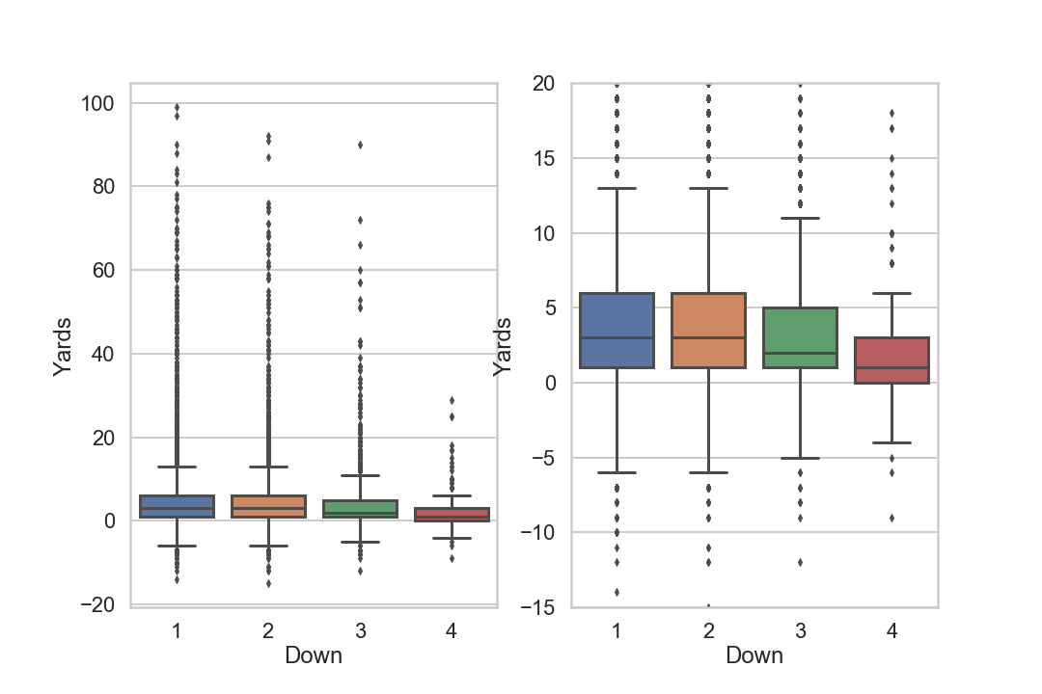
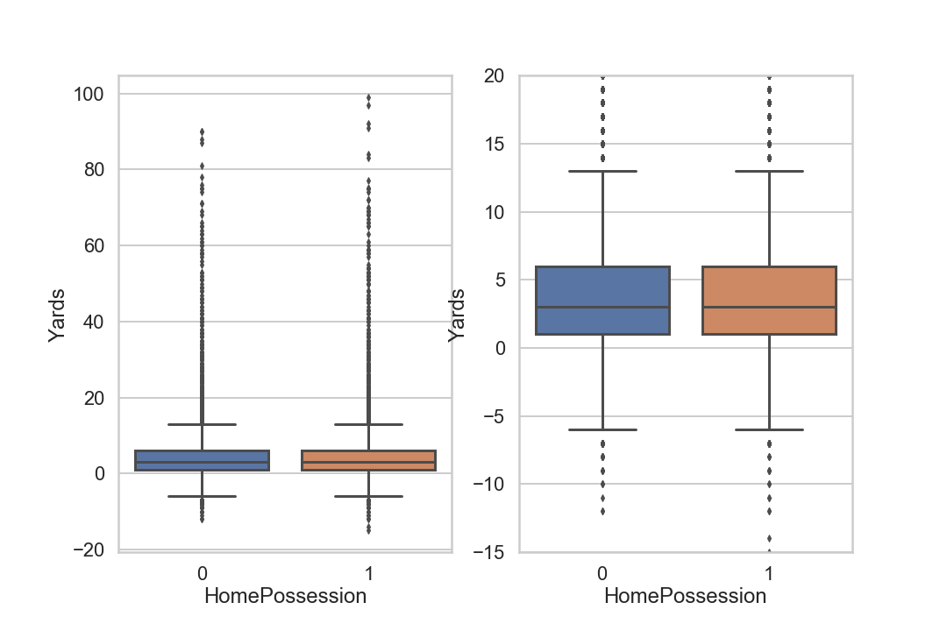
Some variables that might correlate with Yards
Less yards are gained on 3rd and 4th down
The variance decreases significantly on 4th down
There appears to be no difference between the Home and Away team

Slide 7
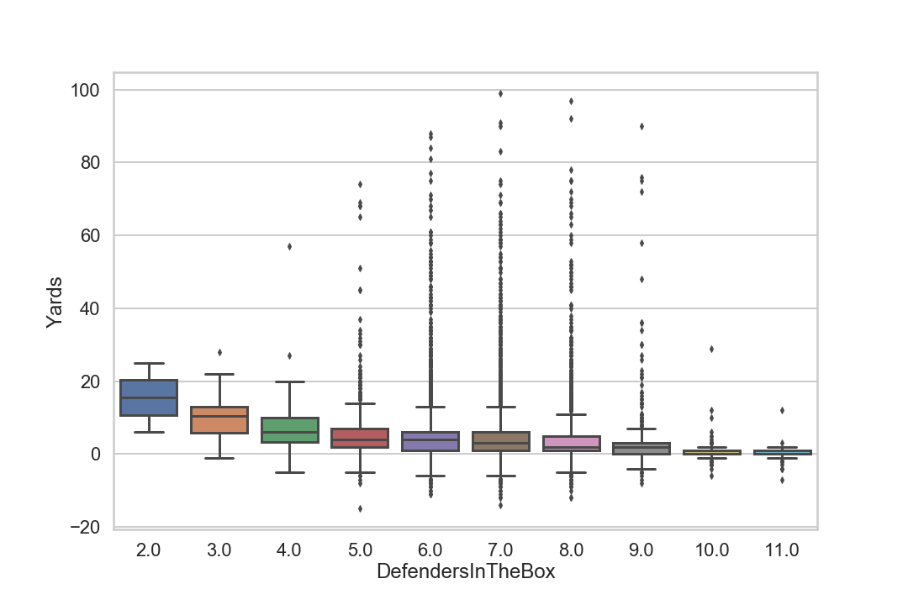
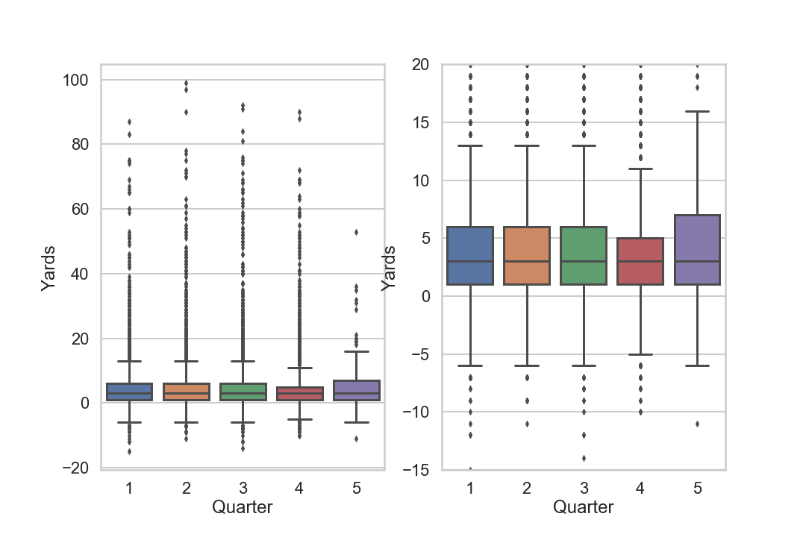
Some variables that might correlate with Yards
Teams gain fewer yards when there are more defenders in the box
Teams gain the same yards in each quarter, but there are fewer explosive plays in overtime

Slide 8
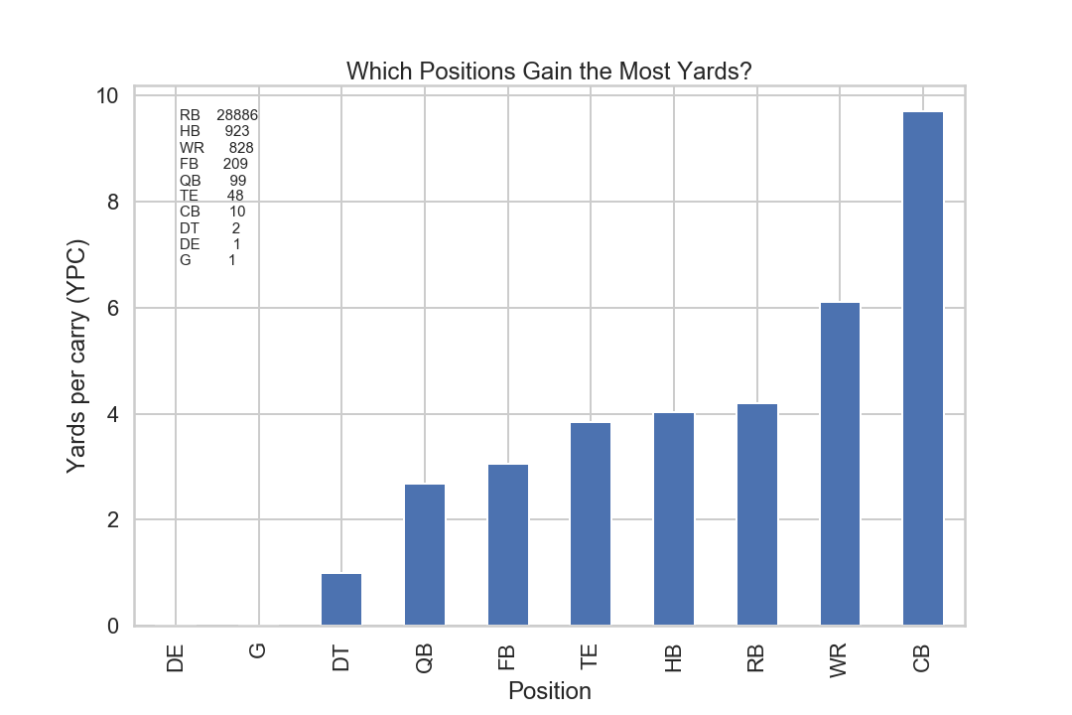
Running Backs get the vast majority of carries.
Cornerbacks gain the most yards per carry; however they only carried the ball 10 times in the last two years.
Wide Receivers get a significant amount of carries and also seem to gain significantly more yards than Running Backs.

Slide 9
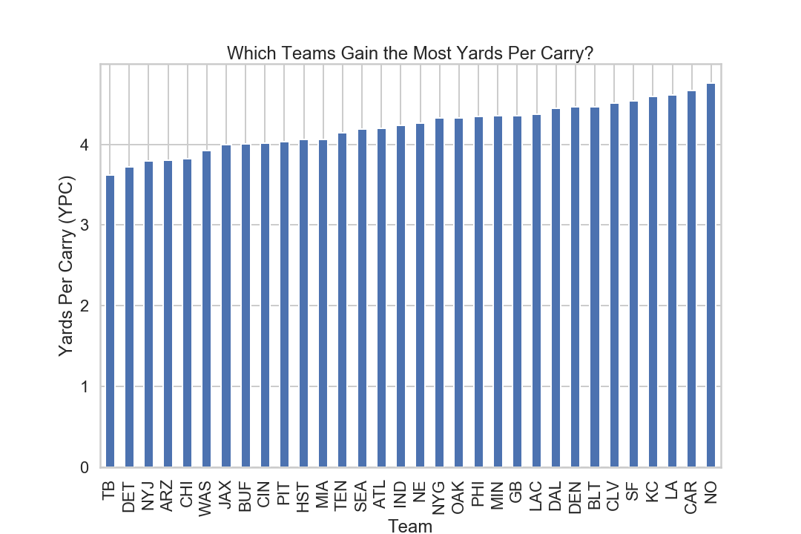
Over the last two years some teams gain more yards per carry than others

Slide 10
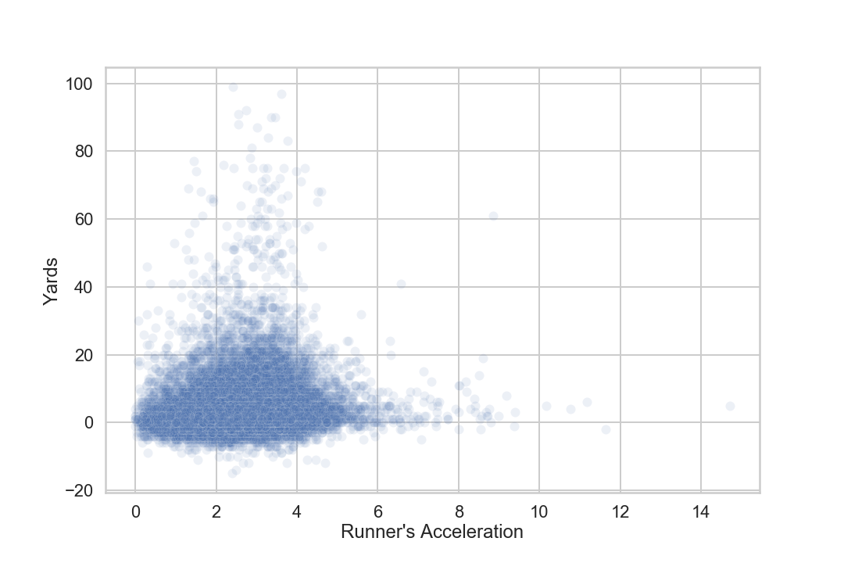
Runners with higher acceleration at the handoff gain more yards

Slide 11
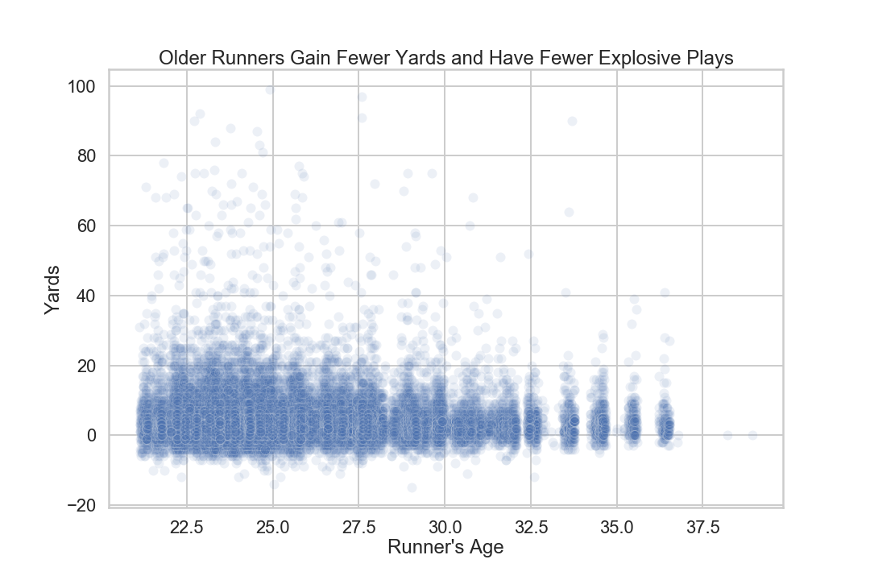

Slide 12
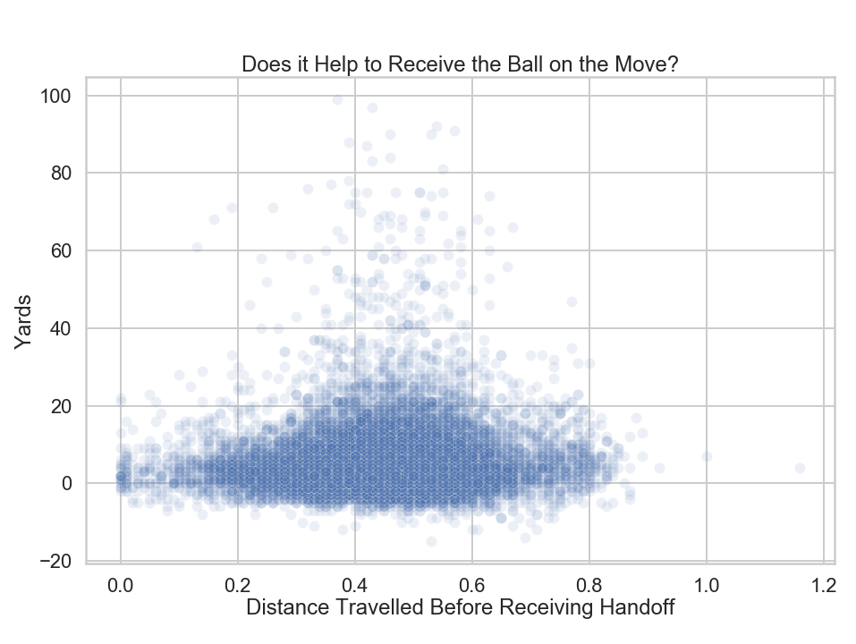
There seems to be a weak positive correlation between the distance travelled before receiving the handoff and yards gained.

Slide 13
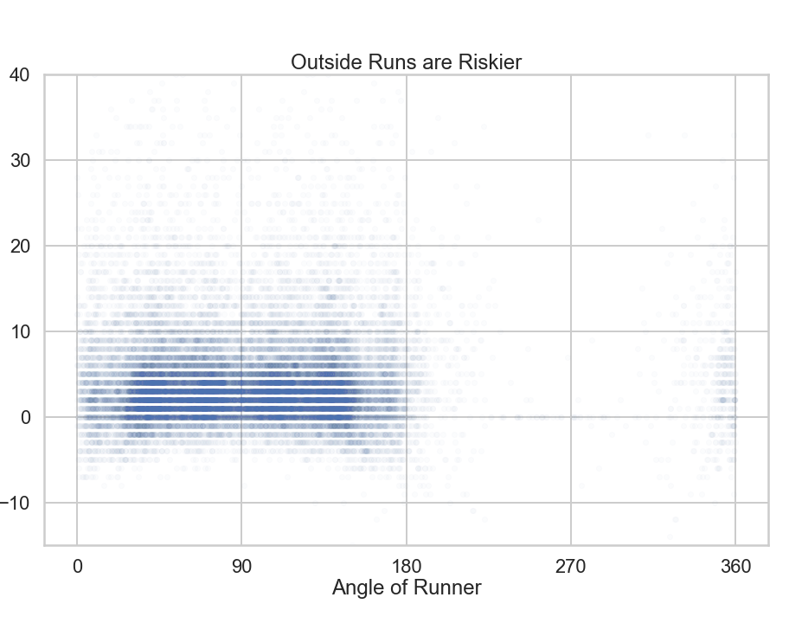
Angles:
90 = ‘straight up the gut’
0 = ‘completely horizontal, left’
180 = ‘completely horizontal, right’
180+ = ‘backwards’
Successful runs can come from any angle (0-180), but runs to the left and right have a greater risk of negative yards.

Slide 14
What sort of features can we engineer that will be useful when predicting yards?

Slide 15
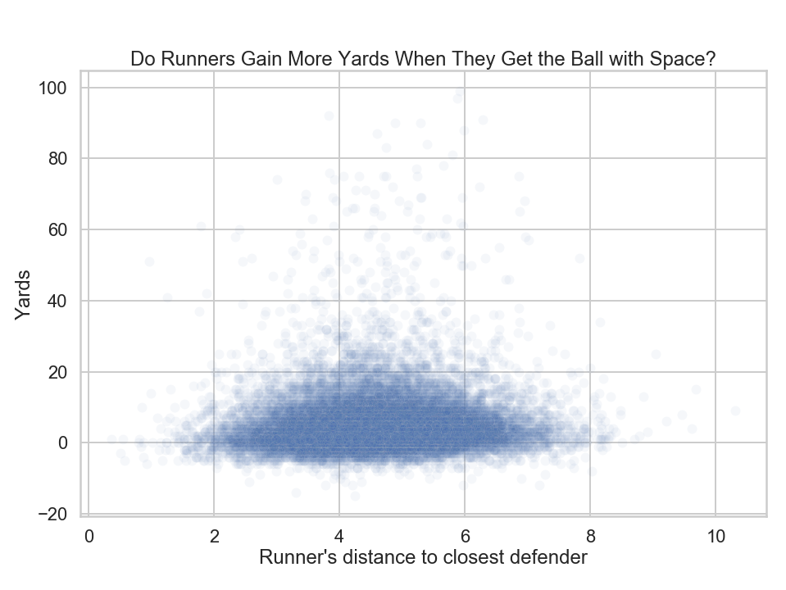
Using (X,Y) coordinates, the runner’s distance to the nearest defender is calculated.
It seems that the most yards are gained when the runner is 4-6 yards away from the nearest defender at handoff.

Slide 16
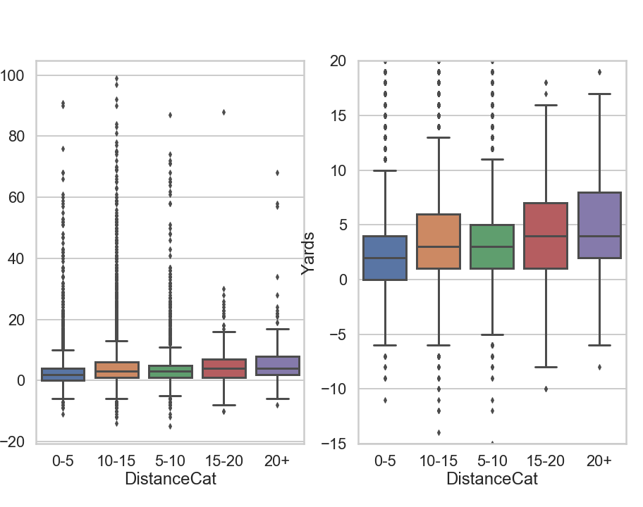
Do runners gain more yards when more are needed?
Teams run the ball less when there are many yards needed for a first down.
Because of this, however, defenses are less prepared for the run, so runs tend to get more yards in long distance situations.

Slide 17
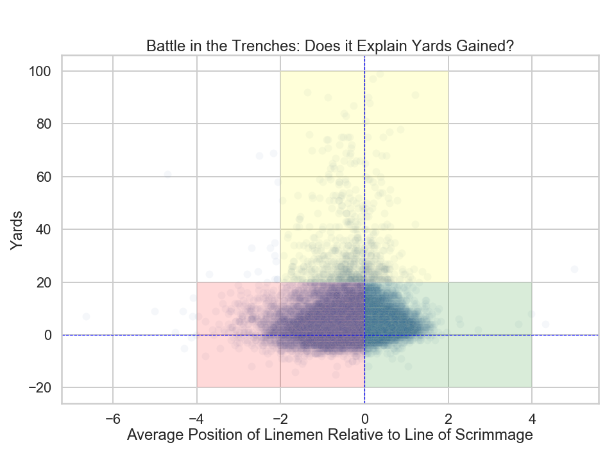
When the offensive line pushes the defensive line forward (green) there are fewer negative plays compared to when the defensive line pushes the offensive line backwards (red)
Surprisingly, explosive plays (yellow) happen more often when the offensive line gets pushed back. These may be cases

Slide 18
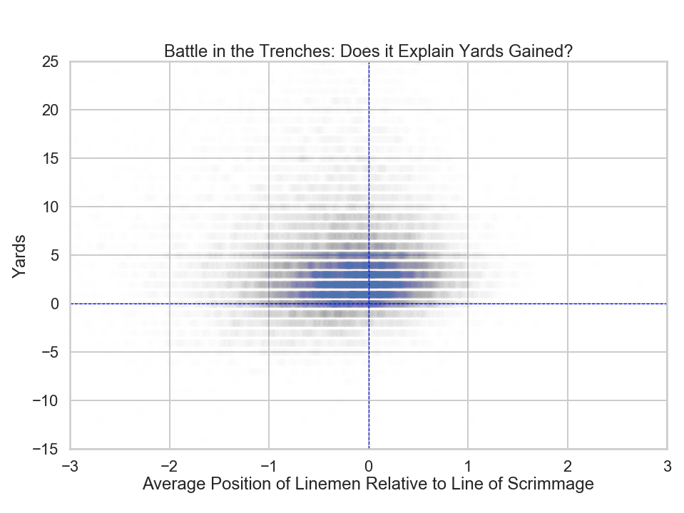
The same data but zoomed in and a lower alpha. You can see more clearly that there are fewer negative plays when the offensive line gets a push in the positive direction.

Slide 19
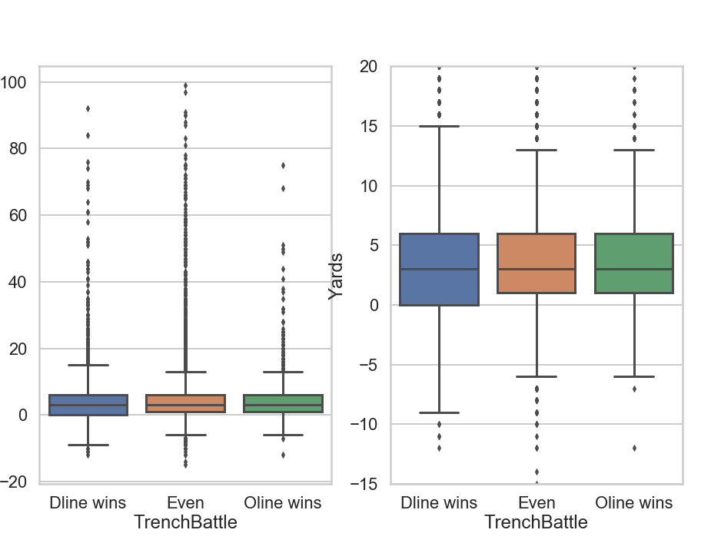
Same data as before
Although the median is the same for all groups, the variance is lower and the risk of a negative play is less when the Oline gets a push.

