Slide 1

MIS 581 Portfolio Project
Ted Tomes - 320283
Colorado State University Global
MIS581 Capstone: Business Intelligence and Data Analytics
Dr. Osama Morad
August 7, 2022

Slide 2
Introduction
What: Pet Food Orders Data from Kaggle
Why: Companies have seen a massive increase for online sales.
Notes:
For this critical thinking assignment, I will discuss my capstone project. I will be analyzing the pet food orders data from Kaggle. I have chosen this data set for my project because many companies have seen a massive increase for online sales. When COVID began online sales have increased drastically. According to Young (2022), “Ecommerce grew 14.2%.” With so many consumers ordering online now, I believe ordering data sets need to be analyzed for companies to fully understand what people are buying, and how to get them to visit their websites, and increase the time spent on websites.

Slide 3
Problem | Purpose
Goal: Increase Sales & Website Traffic
Questions to help achieve the goal:
What products are customers purchasing?
What products are customers not purchasing?
Is there a correlation between the pet food tier and time spent on website?
How are consumers signing up primarily?
Are there repeat customers not signed up for a subscription?
Notes:
The problem I am looking to solve is increasing sales and website traffic for the company.
The specific problems I would like to address with the data set are:
What products are customers purchasing?
What products are customers not purchasing?
Is there a correlation between the pet food tier and time spent on website?
How are consumers signing up primarily?
Are there repeat customers not signed up for a subscription?
According to Peek (2022), “Repeat customers tend to spend more money on your brand than new customers because they trust your business.”

Slide 4
Objectives
Drive more consumers to the website
Increase sales
Know what the customers are interested in buying
Notes:
The goals of the research are to drive more consumers to the website and to increase sales. Knowing what the customers are interested in will allow the company to expand their offerings based on the needs of the many. This doesn’t necessarily mean the company would have to decrease inventory, but this could allow the organization to buy additional inventory to save profits on bigger orders.

Slide 5
Overview of Study
________________
Research Questions
&
Hypothesis
Use pet food data and analyze the data to solve my problems
What brand of dry food are customers purchasing?
What brand of dry food are customers not purchasing?
Is there a correlation between pet food tier and time spent on website?
How are consumers signing up primarily?
Are there repeat customers not signed up for a subscription?
What is the pet life stage order for most pets? Is there a correlation with the number of orders?
Notes:
The overview of the study is to use the pet food data and analyze the data to solve my problems.
My research questions I would like to find answers for are:
1. What brand of dry food are customers purchasing?
2. What brand of dry food are customers not purchasing?
3. Is there a correlation between pet food tier and time spent on website?
4. How are consumers signing up primarily?
5. Are there repeat customers not signed up for a subscription?
6. What is the pet life stage order for most pets? Is there a correlation with number of orders?
The reason I want to use these questions for my analysis is that these will provide me a good sense of what the company needs to focus its sales on and where marketing efforts can be improved.

Slide 6
Hypothesis
H0: There are top favorite dry_food_brand_pre_tails customers prefer to purchase.
Ha: There are not top favorite dry_food_brand_pre_tails customers prefer to purchase.
H0: There is a correlation between pet_food_tier and total_minutes_on_website.
Ha: There is not a correlation between pet_food_tier and total_minutes_on_website.
Notes:
When it comes to choosing a research project, Betts (n.d) states, “Don’t just choose a topic randomly, focus on something that interests you. “I chose the pet food dataset because I love animals and feel like helping an organization that specializes in a pet product will make the research more enjoyable.
The first hypothesis I will use to test my questions are as follows:
H0: There are top favorite dry_food_brand_pre_tails customers prefer to purchase.
Ha: There are not top favorite dry_food_brand_pre_tails customers prefer to purchase.
This hypothesis will help me find the top and the least favorite brands of dog food. This will help me understand if marketing efforts can be spent on certain areas and eliminate any products customers really aren’t enjoying.
I will be able to run summary statistics on the pet food data to show me what people are buying and will be able to use box plots and histograms to show visuals of where the sales are coming from.
The second hypothesis I will use to test my questions are as follows:
H0: There is a correlation between pet_food_tier and total_minutes_on_website.
Ha: There is not a correlation between pet_food_tier and total_minutes_on_website.
This hypothesis will help me to see if this is there is a correlation on tier and website time spent. This will show me what correlations there are, and which correlation is having the biggest impact on the time spent on the website.
To test this hypothesis, I will use linear regression. I will be able to use time on website as the dependent variable, and pet food tier status as the independent variable. I can interchange the other variables to see if there is a better correlation that impacts time spent on website.

Slide 7
Hypothesis
H0: The majority of signup_promo is not Null & Default.
Ha: The majority of signup_promo is Null & Default.
H0: When total_minutes_on_website is increased the total_order_kcal is increased.
Ha: When total_minutes_on_website is increased the total_order_kcal is not increased.
Notes:
To answer questions 4 & 5 I will be able to use summary statistics and simply report what I find. This will allow me to see where marketing efforts can be spent further.
A hypothesis I can use for these questions are:
H0: The majority of signup_promo is not Null & Default.
Ha: The majority of signup_promo is Null & Default.
To answer question 6, I will be using summary statistics and regression to see of there is a correlation on the pet life stage at order variable and orders variable. I also want to see which stage has the most orders. This will allow me to see which category needs more of a focus on to increase business with that category.
For my portfolio project I plan on researching a couple of additional models that can help explain my data further. I would like to incorporate a forecasting model and logistic regression model in my final portfolio project.
One test I can use is an ANOVA test. According to Srivastava (2019), “Analysis of variance (ANOVA) is a statistical technique that is used to check if the means of two or more groups are significantly different from each other.” The hypothesis test for this is:
H0: When total_minutes_on_website is increased the total_order_kcal is increased.
Ha: When total_minutes_on_website is increased the total_order_kcal is not increased.
The ANOVA test will allow me to see if there are major differences that can be used to support a conclusion to help the organization to generate additional revenue.
For my hypothesis testing I will provide the p-value. According to glen (2022), “It’s good science to let people know if your study results are solid, or if they could have happened by chance. The usual way of doing this is to test your results with a p-value.”

Slide 8
Ethical Considerations
Protect Pet Health Data
Notes:
The only ethical consideration I can really see in the data is the health data of the pet. Health data for animals could become an issue if it was leaked to health insurance agencies. This data would need to be protected so there aren’t issues for the pet and/or owners involved. The dataset does a great job suppressing personal data. According to Cote (2021), “Ethical responsibility that comes with handling data is ensuring data subjects’ privacy. Even if a customer gives your company consent to collect, store, and analyze their personally identifiable information (PII), that doesn’t mean they want it publicly available.” Suppressing identifiable data for users that don’t need it for analysis is important. It limits who will have access to the data and help protect the individuals involved.

Slide 9
Literature Review
Effect of Live Chat on Traffic‐to‐Sales Conversion: Evidence from an Online Marketplace (sun et al 2021)
Being at the cutting edge of online shopping: Role of recommendations and discounts on privacy perceptions (Venkatesh et al 2021)
When empathy prevents negative reviewing behavior (Pera et al 2019)
Why strategy is key for successful social media sales (Lindsey-Mulikin & Norm Borin 2017)
17 Strategies for Increasing Your Online Sales (contributor 2021)
Notes:
Effect of Live Chat on Traffic‐to‐Sales Conversion: Evidence from an Online Marketplace (sun et al 2021)
This journal goes into detail on how including a live chat feature on a website increases consumer purchases. People need help with shopping and the study showed people will use the live chat 43% of the time. People use the email feature about half has much of the live chat feature. According to sun et al (2021), “On average, by fully using live chat, the conversion rate increases by 9%”
Being at the cutting edge of online shopping: Role of recommendations and discounts on privacy perceptions (Venkatesh et al 2021)
This journal talks about using recommendations and discounts to increase online sales. Consumers are still concerned about their privacy when making purchases online, but to combat these concerns the recommendation is to increase sales by increasing the sales on each purchase by making recommendations and/or offer discounts on the products. Discounts could include buying more to receive a percentage off the entire order. People are more likely to follow through with a purchase when they trust the site and when recommendations are explained and come with a discount. Recommendations and discounts are considered interventions to get the purchaser to buy when they may not trust the site just yet.
When empathy prevents negative reviewing behavior (Pera et al 2019)
This journal article talks about how negative reviews can be avoided by showing empathy to consumers when issues arise. Customers are less likely to leave a negative review if customer service takes care of them. This leads to a positive bias when it comes to positive reviews. If a customer doesn’t leave any review, it doesn’t mean that the person had a good experience with the organization. Not leaving a review if it was going to be a bad review ends up helping the organization. It builds trust for other buyers because they will only see mostly positive reviews.
Why strategy is key for successful social media sales (Lindsey-Mulikin & Norm Borin 2017)
This article talks about how a business can increase revenue on their website by utilizing social media. Purchases from social media outlets have increased immensely over the last couple of years. Referrals on social networking sites are increasing sales longer than just using traditional marketing efforts. Marketing through social media can quickly show consumers most likely to buy your product and link them right to the site to make a purchase. The biggest part about using this marketing style is that they can like and save specific products for later purchases. Because they did this their followers can also see what that person was interested in. This increases sales and trust for the brand without spending additional money based on the actions the one customer did. Using social media marketing and pushing to increase sales online will allow a company to generate more profits because they will not need to store these items and ship the directly to retail stores. Not having to transport goods or hire additional employees in retail stores helps cut cost for the organization.
17 Strategies for Increasing Your Online Sales (contributor 2021)
This article breaks it down by 17 key strategies for increasing online sales as the title suggests. The key strategies discussed are:
Understand your target audience
Analyze what people are interested in buying. This is different than brick and mortar stores because workers can ask fact-finding questions in person, but you cannot do that online.
Use analytics to learn how customers find your store
Knowing how your customers find your online store allows you to use your marketing budget better.
Find your unique selling proposition
Make your presence known. Give people a reason to want to shop from your site.
Simplify customer experience
Customers want an easy shopping experience. Make it simple for them to buy from your site.
Focus on customer service
Have a FAQ page available and be quick when it comes to customer contacts. Customers are more likely to buy when they feel like they are receiving good customer service.
Provide a chat feature on your website
Use virtual agent technology that can answer key questions quickly.
Create a simple checkout process
Make the purchase easy.
Select the right eCommerce platform for your needs
Don't forget SEO
People find online shops by searches. Make sure you use key words that can help people find the online store.
Create content
Write content often based on what you sell. This will help direct people to your site because of the content people are able to view.
Put customer reviews on product pages
Customers will feel appreciated that you recognized their review and people reading the reviews will feel more confident in buying your product.
Use responsive design
25% customers purchase from their smartphone. Make sure your website will automatically format for a phone version to best accommodate these customers.
Showcase your products with high-quality photos
People are more likely to return a product if the product looks different in person.
Connect with customers through email marketing
Use a platform that collects email addresses for marketing purposes.
Keep shipping costs as low as possible
People are more likely to purchase from your store if they get free shipping or may not buy from your site at all if shipping is too high.
Be active on social media
Social media helps more people discover your brand.
Connect your online store to social media accounts
Connecting your online store to your social media accounts allows people to purchase things that they like straight from your social media posts.

Slide 10
Literature Review
How to Increase Online Sales – 10 Most Effective Strategies to Sell Online (Nguyen 2021)
The Only 3 Ways to Increase Sales (Laja 2021)
Exploratory examination of factors affecting online sales. (Ranganathan & Gandon 2002)
Notes:
How to Increase Online Sales – 10 Most Effective Strategies to Sell Online (Nguyen 2021)
#1 Upsell & Cross-sell relevant products
Showcase products that may cost more and products that are typically purchased together.
#2 Use personalized product recommendation to unveil product discovery
Product recommendations tailored to the customer will increase the overall sale and increase the likelihood of the customer making a purchase.
#3 Increase social proof with product reviews or recent-sales notifications
People are more likely to trust a seller based on their reviews.
#4 Run affiliate marketing with influencers in your niche
Bloggers and other influences can incorporate your website within their posts that can help drive traffic to your website.
#5 Add a countdown timer to create a sense of urgency
People don’t want to miss out on a deal. They are more likely to buy now versus going to other websites if they feel it is more urgent to buy now.
#6 Limit stock availability to create a sense of scarcity
This too helps drive urgency. People don’t want to miss out on something, and if they think there’s limited stock available, they’re more likely to buy now.
#7 Start a Loyalty Program That Keeps Customers Coming Back
Customers are likely to be repeat customers when they get something in return.
#8 Use gamification to increase AOV
When someone adds something to the cart, they can receive a discount by buying more from the site. You will increase your average order value by doing this because people will feel the need to add additional products to their cart to get the deal.
#9 Send personalized re-engagement newsletters
You can use determine if someone has not ordered from your site in a while based on their email address, or other contact information. Send the a personalized newsletter to get them engaged again.
#10 Optimize mobile web for better mobile conversion
Make sure your website can convert to be mobile.
The Only 3 Ways to Increase Sales (Laja 2021)
Increase the number of customers
This is the most expensive part of sales. Here you use marketing efforts that are free, but can also have costs associated to increase customers.
Increase the average order size
Increasing the average order size involves upsells, cross sell, and taking advantage of product suggestions based on buying patterns. An example of this is recommending a tie when someone is buying a suit.
3. Increase the number of repeat purchases
It’s cheaper and more cost effective to sell to current customers. You’ll want to incentivize people to return to you and not just shop based on price. Customers love loyalty programs and discounts for returning with a short time.
Exploratory examination of factors affecting online sales. (Ranganathan & Gandon 2002)
This project ran a regression analysis on 4 key variables that affected online sales. The figure shows us that frequent content updates, high privacy standards and information of the company is what’s highly important to buyers. Knowing this information, we could want to make sure our online website incorporates good content, and security for our customer’s purchases so they can have peace of mind. See figure 1 below for the regression analysis.

Slide 11
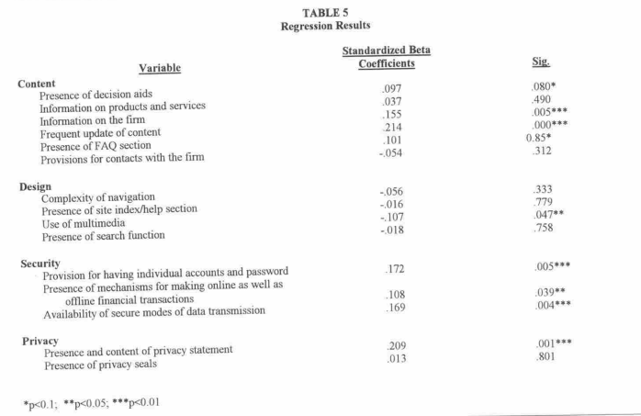
Regression Results
________________
Online Store
Variable Importance
Notes:
For this critical thinking assignment, I will discuss my capstone project. I will be analyzing the pet food orders data from Kaggle. I have chosen this data set for my project because many companies have seen a massive increase for online sales. When COVID began online sales have increased drastically. According to Young (2022), “Ecommerce grew 14.2%.” With so many consumers ordering online now, I believe ordering data sets need to be analyzed for companies to fully understand what people are buying, and how to get them to visit their websites, and increase the time spent on websites.

Slide 12
My problem regarding my research
Key Similarities
Customer Service is high importance
Create a sense of urgency to make a purchase
Create a long-term customer base
Notes:
My problem of increasing online sales and web traffic relates to my research because the research shows key similarities that stood out with each article. Customer service is of high importance. People want to feel like they matter to the company and are not just another number. They can give their business to anyone but chose that specific store to buy from. Increase revenue by tapping into current clients through upsell and cross sales. It’s easier and cheaper to sell to current clients than it is to sell to someone new. Create a sense of urgency so customers don’t want to keep shopping around. And lastly, find a way to create a long-term customers that will make repeat purchases. This can be done by having a rewards program, or another way to show them that you appreciate their business and returning. Other research can benefit from my research because it combines multiple sources into one research. This will make it easier for someone to understand best ways to increase sales for their organization. They will be able to see the similarities between the different articles and be able to adapt these for their own organization or research project.

Slide 13
Research Design & Methodology
Description of the Dataset
Notes:
Description of the dataset
For my portfolio project I am using the pet food customer order dataset. I decided to use this dataset because I believe it will allow me to use analytics tools to help improve the organization in numerous ways. The dataset itself has a total of 36 variables. I’m sure I won’t need to use all the variables, but I believe there is enough data to support decisions the organization can use to better itself. See Figure 2 below for the variables being used.

Slide 14
Analysis Tools
SAS OnDemand
SAS Enterprise Miner
R Studio
Notes:
Tools I’m using to complete analysis on the data set
I will be using SAS OnDemand, SAS Enterprise Miner, and R.
I like the SAS products. They make analytics easy. Both programs make it simple to create models and analyze the data. SAS OnDemand does a great job at summarizing the datasets and creating visuals. I like SAS Enterprise Miner because it allows to visually see the connections with the drop and drag features it has. Using these tools I can create a regression model, forecast model, summary statistics, view the ANOVA table, and overall test my hypothesis for the organization.

Slide 15
Analysis Tools
SAS OnDemand
SAS Enterprise Miner
R Studio

Slide 16
Variable Types & Description
Notes:
Variable Types
My dataset has all variable types being used. My dataset has categorical, ordinal, scaler, and binary variables. See figure 3 below for the variable description of the variables I’m using. Braun (2019) states, “Scalar variables (or measurement or continuous variables or numerous other possible monikers most of which mean the same thing)—such as height, weight, the number of floors in a building, the number of patients in a hospital at a given time—are objects you can measure or count.”
Bevans (2022) gives us the definition of ordinal variables as “Groups that are ranked in a specific order.”

Slide 17
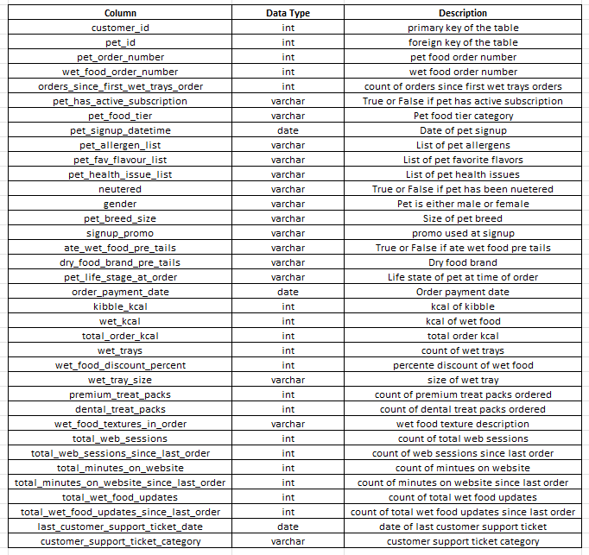
Data Dictionary
Notes:
Data dictionary of the pet food order dataset
Kononow (2018) states, “Data dictionary is a table with data elements (columns) as rows and their attributes as columns. Specific attributes vary depending on the purpose of the data dictionary.” It is also known as metadata. Figure 4 below will show the data dictionary of the pet food order dataset.

Slide 18
Methods
______________
Limitations
Quantitative Research
Linear Regression & Logistic Regression
Summary Statistics
Histogram, Boxplots & Line Charts
Limitations
No qualitative reserach
Data is from one source
Notes:
Methods
I will primarily be using quantitative research methods with my data set. According to Wienclaw (2021), “Quantitative Research is Scientific research in which observations are measured and expressed in numerical form, such as in physical dimensions or on rating scales.”
My methodology is primary quantitative because it deals with a great amount of numerical data from purchases. I plan on utilizing Linear Regression and Logistic Regression.
Bernardo (2022) tells us that “Linear Regression, and Logistic Regression are good predictive models every beginner should learn.” I like these models because they are simple to use and so I plan on using these with my dataset. The linear regression models will be able to tell me if there is a correlation within the dataset and give me the best results based on the independent and dependent variables. I will be able to utilize Logistic regression with my binary data. Additional plans to analyze the data within the dataset are to create forecast model, summary statistics. As I go further along on the project, I’m sure I will discover additional models I would like to use with the data. I plan on using the dataset to create visuals of histograms, boxplots, and line charts.
Limitations
Limitations in my project are that it does not include qualitative research.
According to Buthcer (2022), “Speech is a primary data source in qualitative research, with an expectation that the subject must have a voice.” My project is only about data and does not include interviews or surveys. We will solely be providing our conclusion based on purchases.
Another limitation of this research is that I’m limited on the data available for this specific project. The data I’m using is only for pet food products purchases with one online source. If I used a larger company’s data, it may be more robust allowing to have a better grasp of what people truly want to purchase from a pet store online.

Slide 19
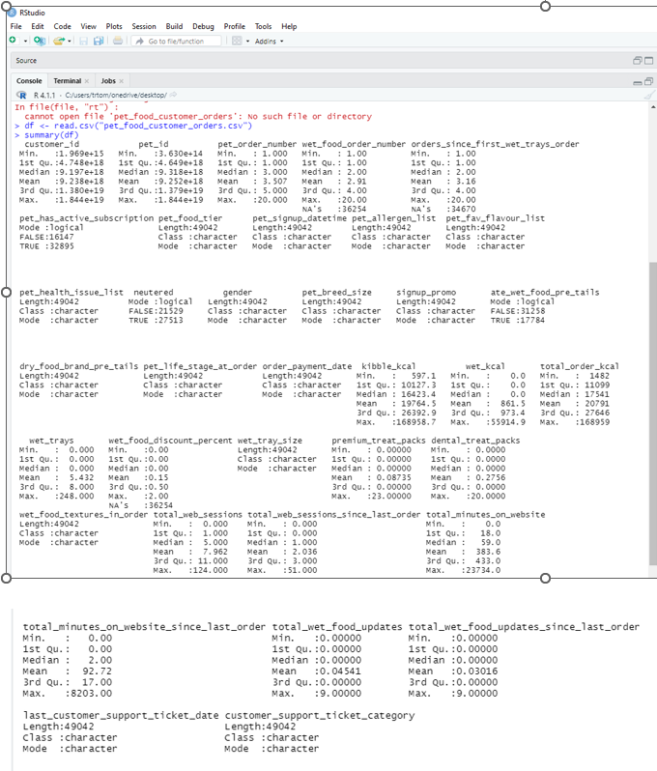
Findings
Notes:
Findings
I used R to show me the summary statistics of the pet_food_customer_orders. See figure 5 below of the summary statistics output in R.

Slide 20
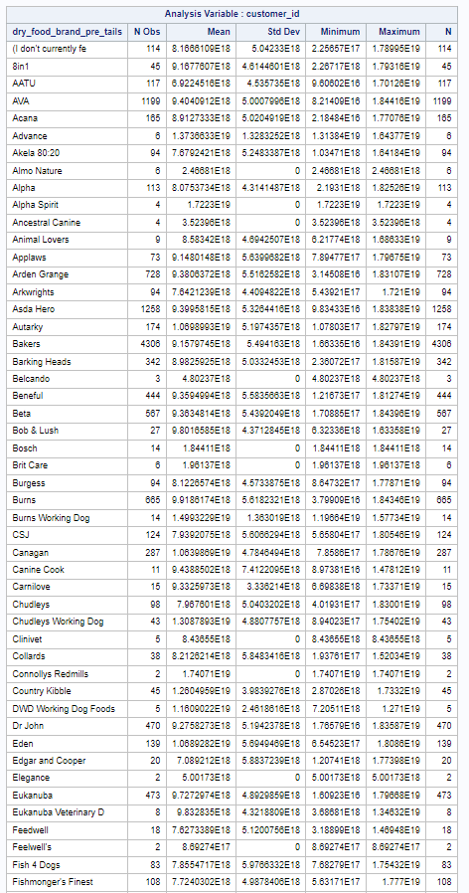
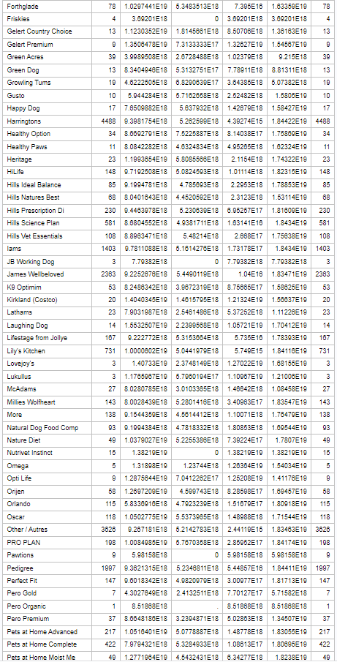
Findings
________________
Summary Statistics of dry_food_brand_pre_tails
Notes:
For the first hypothesis we can accept the null hypothesis.
H0: There are top favorite dry_food_brand_pre_tails customers prefer to purchase.
Figure 6 below shows the summary statistics of dry_food_brand_pre_tails. The top three favorite brands are Harringtons (4488), Bakers (4306) and James Wellbeloved (2363).

Slide 21
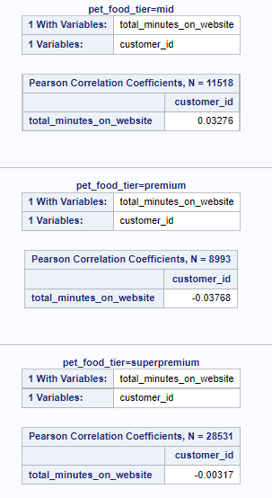
Findings
pet_food_tier correlated with total_minutes_on_website
Notes:
For the second hypothesis we can accept the null hypothesis. Figure 7 below will show that the pet food mid-tier spent the most time on the website.
H0: There is a correlation between pet_food_tier and total_minutes_on_website.

Slide 22
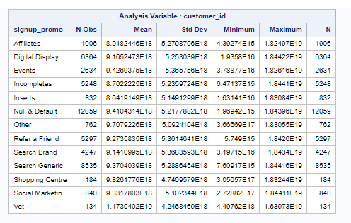
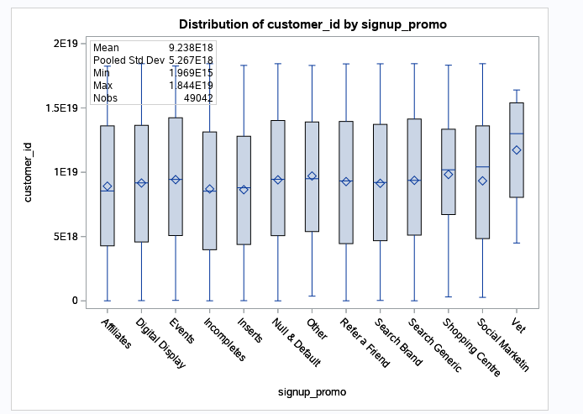
Findings
Customer_ID signup Promo Summary
Notes:
For the third hypothesis we reject the null hypothesis. See Figure 8 below supporting that the majority of sigup_promo is Null & Default.
Ha: The majority of signup_promo is Null & Default.

Slide 23
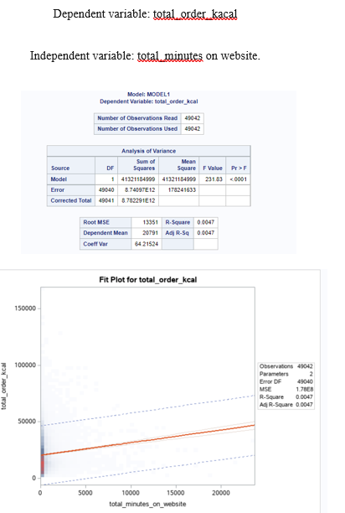
Findings
Linear Regression Model
Notes:
For the fourth hypothesis we can accept the null hypothesis.
H0: When total_minutes_on_website is increased the total_order_kcal is increased.
The p-value of the linear regression model is below .05. This tells me the model is a good model. The R square being .0047 shows me we can’t really use this data to support that the total_order_kcal is truly being affected by total_minutes_on_website.

Slide 24
Conclusion
____________
Recommendations
Conclusion
Customers & Promo Codes
Customers have a favorite
There is a correlation with total order kcal & the amount of time being spent on the website
    Recommendations
Increase social media marketing
Include promo code
Include profits on data
Offer recommendations
Create a blog or partner with additional vets
Implement a chat feature
Notes:
Conclusion
Most customers are not using a promo code when signing up for pet food. This tells me there is a lot of room to increase marketing efforts.
Customers have a favorite brand of dog food pre tails.
There is a correlation with total order kcal and the amount of time being spent on the website.
Based on the current data it is not a strong correlation. More data is needed to fully understand if increasing time on website will increase the overall number of purchases for a customer.
Recommendations
I recommend increasing using social media platforms for marketing efforts. When using these platforms, I suggest including a promo code to identify if this is increasing the customer order count. I recommend including profits per customer with the data set. This will help the team understanding which promos are having the best increase in profits for the organization. I recommend on including recommendations to customers to increase overall profit per sale. If a customer purchases the recommended product there should be a column that states if the customer purchased that product based on a recommendation. This column can be used to increase sales by better understanding what customers are most likely to purchase based on the recommendation. Another recommendation I would make is to create a blog and partner with additional vets. Having a blog with that imbeds a direct link to the dog food website will increase sales. The reason why I am recommending this is that a lot of people found the website by a generic search of the pet food. Having a blog will boost the organizations search results. Increasing vet partnerships will make the company more reliable and is one of our biggest opportunities for promos. I am recommending adding a chat feature to the website. This can be AI driven to help customers with purchases, but, if need be, customer can talk to a live person. This feature will increase the likelihood of a customer making a purchase and give the customer additional support if needed.

Slide 25
References
Bernardo, I. (2022, April 11). 6 predictive models models every beginner data scientist should master. Medium. Retrieved June 25, 2022, from https://towardsdatascience.com/6-predictive-models-models-every-beginner-data-scientist-should-master-7a37ec8da76d
Betts, J. (n.d.). How to write a strong hypothesis in 6 simple steps. Grammar. Retrieved July 3, 2022, from https://grammar.yourdictionary.com/for-students-and-parents/how-create-hypothesis.html
Bevans, R. (2022, May 4). Types of variables in research: Definitions & examples. Scribbr. Retrieved June 25, 2022, from https://www.scribbr.com/methodology/types-of-variables/#:~:text=There%20are%20three%20types%20of,%2C%20nominal%2C%20and%20ordinal%20variables.
Braun, S. (2019, February 13). Variable Types. Retrieved June 25, 2022, from https://education.arcus.chop.edu/variable-types/
Butcher, M. (2022). Qualitative research methods I: Emotionally engaged approaches to working with vulnerable participants. Progress in Human Geography, 46(3), 907–914. https://doi.org/10.1177/03091325221083212
Contributor, S. (2021, March 5). Square Brandvoice: 17 strategies for increasing your online sales. Forbes. Retrieved July 10, 2022, from https://www.forbes.com/sites/square/2020/11/13/17-strategies-for-increasing-your-online-sales/?sh=6e67082168c4
Cote, C. (2021, March 16). 5 principles of data ethics for business. Business Insights Blog. Retrieved July 3, 2022, from https://online.hbs.edu/blog/post/data-ethics
Glen, S. (2022, June 25). Hypothesis testing. Statistics How To. Retrieved July 3, 2022, from https://www.statisticshowto.com/probability-and-statistics/hypothesis-testing/
Kononow, P. (2018, October 1). What is Data Dictionary - Data Terminology. Dataedo. Retrieved June 26, 2022, from https://dataedo.com/kb/data-glossary/what-is-data-dictionary
Laja, P. (2021, April 5). The only 3 ways to increase sales. CXL. Retrieved July 10, 2022, from https://cxl.com/blog/3-ways-to-increase-online-sales/
Lindsey-Mullikin, J., & Borin, N. (2017). Why strategy is key for successful social media sales. Business Horizons, 60(4), 473–482. https://doi.org/10.1016/j.bushor.2017.03.005
Nguyen, A. (2021, June 17). How to boost sales by selling to existing customers. Beeketing Blog. Retrieved July 10, 2022, from https://beeketing.com/blog/how-to-increase-online-sales-effective-strategies/

Slide 26
References
Peek, S. (2022, April 13). How to build customer loyalty in 7 steps. Business News Daily. Retrieved June 19, 2022, from https://www.businessnewsdaily.com/16017-build-customer-loyalty.html
Pera, R., Viglia, G., Grazzini, L., & Dalli, D. (2019). When empathy prevents negative reviewing behavior. Annals of Tourism Research, 75, 265–278. https://doi.org/10.1016/j.annals.2019.01.005
Ranganathan, C., & Grandon, E. (2002). An exploratory examination of factors affecting online sales. Journal of Computer Information Systems, 42(3), 87-93.
Srivastava, A. (2019, July 21). Types of statistical tests. Medium. Retrieved July 3, 2022, from https://medium.com/@anushka.da3/types-of-statistical-tests-b8ceb90e13b3
Sun, H., Chen, J., & Fan, M. (2021). Effect of Live Chat on Traffic‐to‐Sales Conversion: Evidence from an Online Marketplace. Production & Operations Management, 30(5), 1201–1219. https://doi.org/10.1111/poms.13320
Venkatesh, V., Hoehle, H., Aloysius, J. A., & Nikkhah, H. R. (2021). Being at the cutting edge of online shopping: Role of recommendations and discounts on privacy perceptions. Computers in Human Behavior, 121. https://doi.org/10.1016/j.chb.2021.106785
Wienclaw, R. A. (2021). Quantitative and Qualitative Analysis. Salem Press Encyclopedia.
Young, J. (2022, February 21). US ecommerce grows 14.2% in 2021. Digital Commerce 360. Retrieved June 19, 2022, from https://www.digitalcommerce360.com/article/us-ecommerce-sales/

