Slide 1
Never Underestimate OLS and Intuition
Ted Dogan
Mikolaj Wilk

Slide 2
Models & Feature Engineering & Feature Selection
OLS
FGLS
Ridge
Lasso
Randomforest
Xgboost
Checked OLS assumptions
Created new variables
Age of Garage Year Built
Age of Year Sold
Age of Year Built
Age of Year Remodeled
Checked interaction terms
Missing values fixed: knn and mean value imputation by neighborhood
Correlation based
Coefficient based
P value, t-stat
Lasso and Ridge
Tree based
Intuition (subject knowledge)

Slide 3
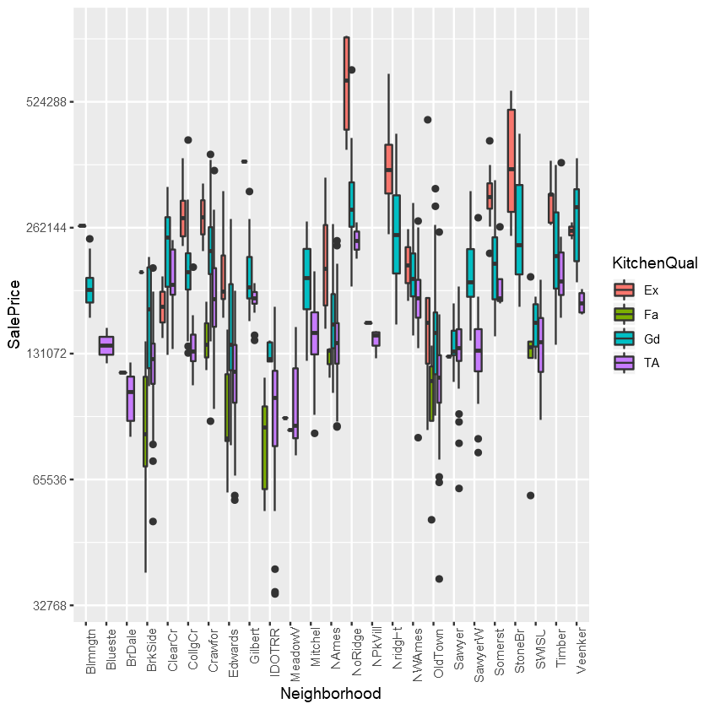

Slide 4
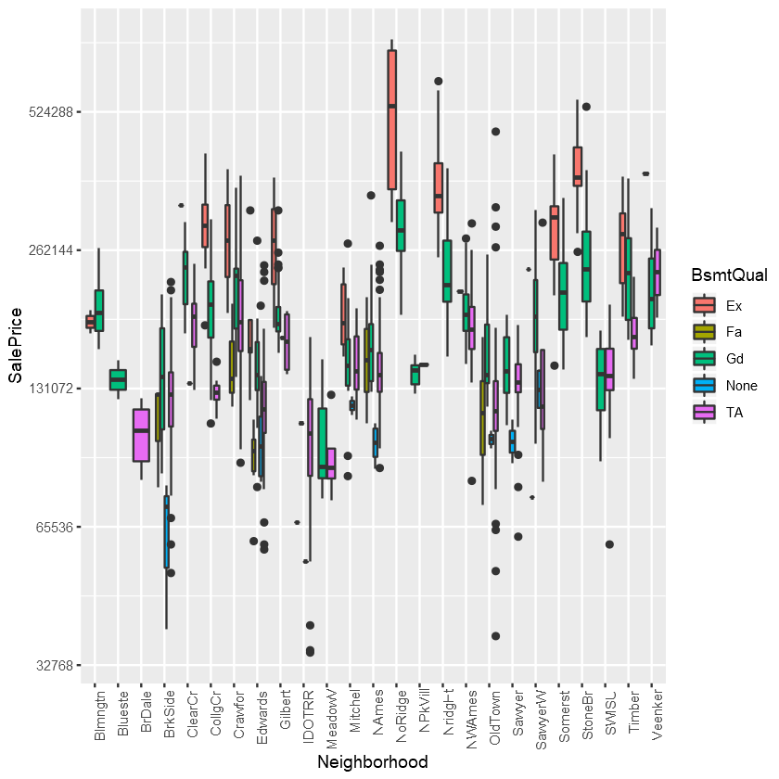

Slide 5
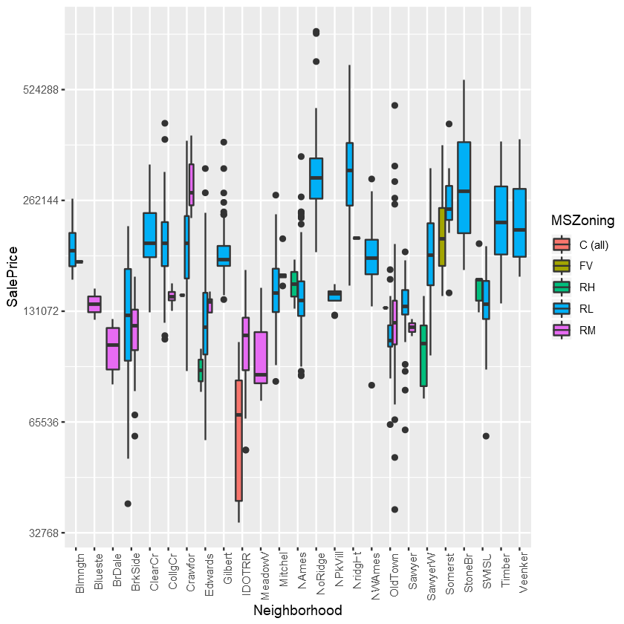

Slide 6
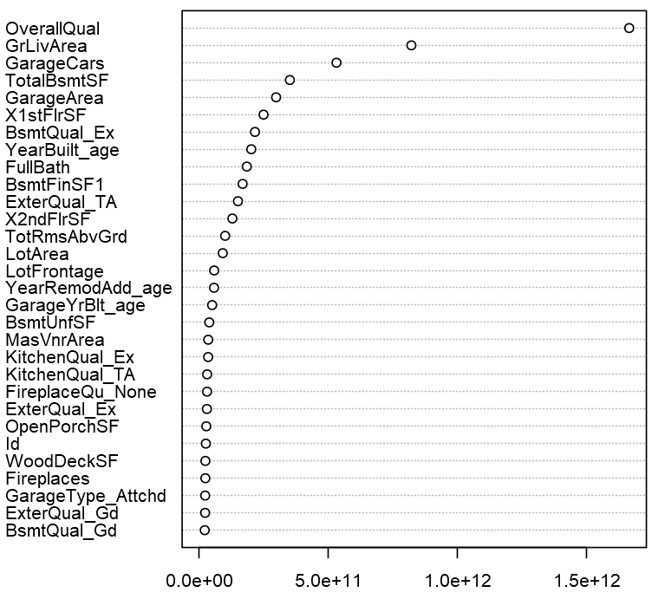
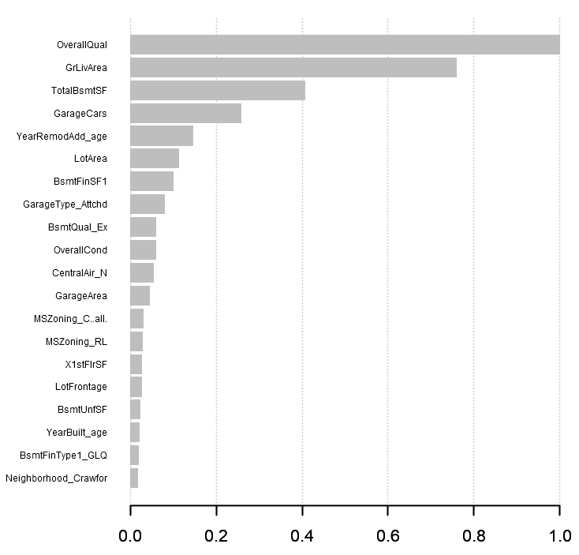
Feature Importance
randomforest
xgboost
Intuition
Neighborhood
Overall Quality
Living Area sqft
Basement Quality
Year Remodeled
Roof Material
House Style
Kitchen Quality

Slide 7
Results
# of Variables | Model | Train RMSE | Test RMSE
3 | Intuition | .167 | .172
5 | Intuition2 | .156 | .159
7 | Intuition3 | .141 | .174
25 | stepAIC OLS | .115 | .135
28 | stepwise OLS | .110 | .133
27 | Intuition + stepAIC + FGLS | .101 | .121
21 | Randomforest | .134 | .169
23 | Lasso | .141 | .125
All | Ridge | .139 | .123
All-38 | Xgboost + CV | .008 | .141

Slide 8
Final
Interpretable
Transferable to a comparable city
Log(Sale Price) ~
Neighborhood + Overall Quality + log(Above Ground Living Area Square Feet ) + Basement Quality + Year Remodeled
satisfies OLS assumptions
Intuition 5 variable model Interpretation
Holding all else constant, on average, at significance level of 1%, being in Stone Bridge Neighborhood in Ames Iowa, compared to the other neighborhoods, will have 21% higher sale price.
Holding all else constant, on average, at significance level of 1%, unit change in overall quality of a house in Ames Iowa will increase sale price by 8.6%.
84.4% of variation in sale price is explained by the intuitive based 5 variable model.

