Slide 1
Kickstarter Projects Analysis
Tuncay Dogan

Slide 2

Explore
https://www.kaggle.com/kemical/kickstarter-projects/version/7
378661 observations and 25 variables
15 main and 159 sub-categories
14 currencies
23 Countries
Additional columns created
Excess pledge
Most backed
Timestamp break-down
Total days
States of the project: success, fail, canceled, live, suspended, undefined

Slide 3
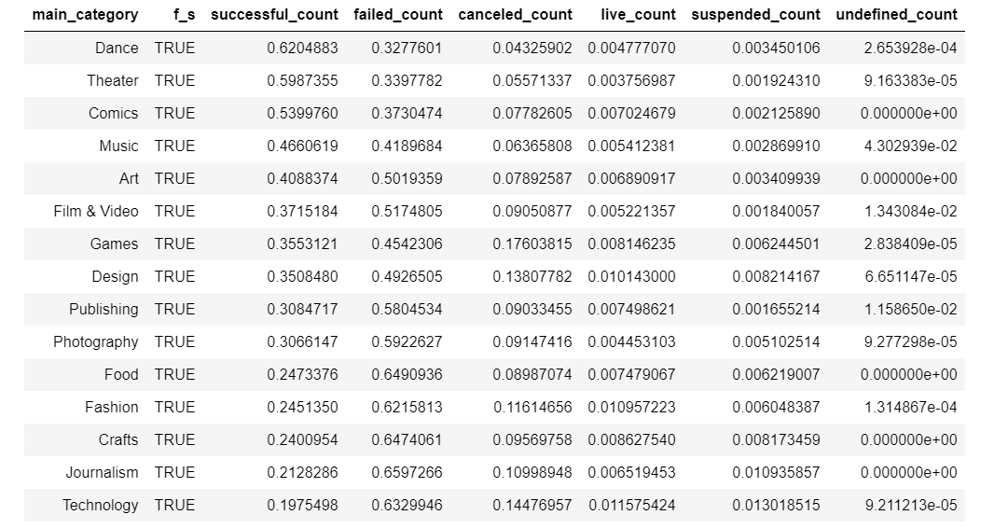
Excess pledge by main cetegory

Slide 4
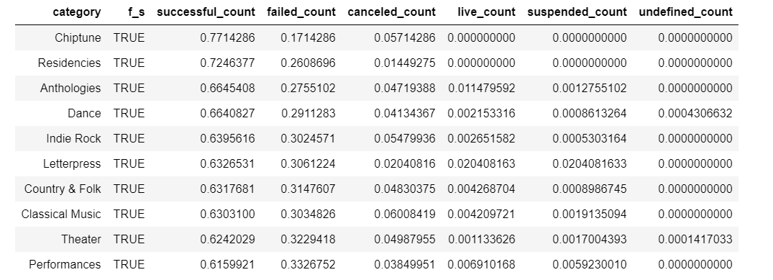
Excess pledge by sub-category

Slide 5
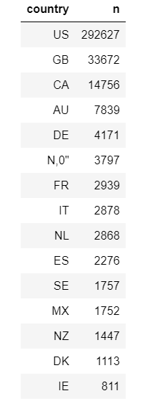
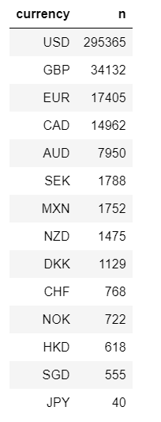
Country and Currency

Slide 6

Visual
Excess pledge by category
Excess pledge by sub-category
Launch by month
Launch by weekday
Wordcloud

Slide 7
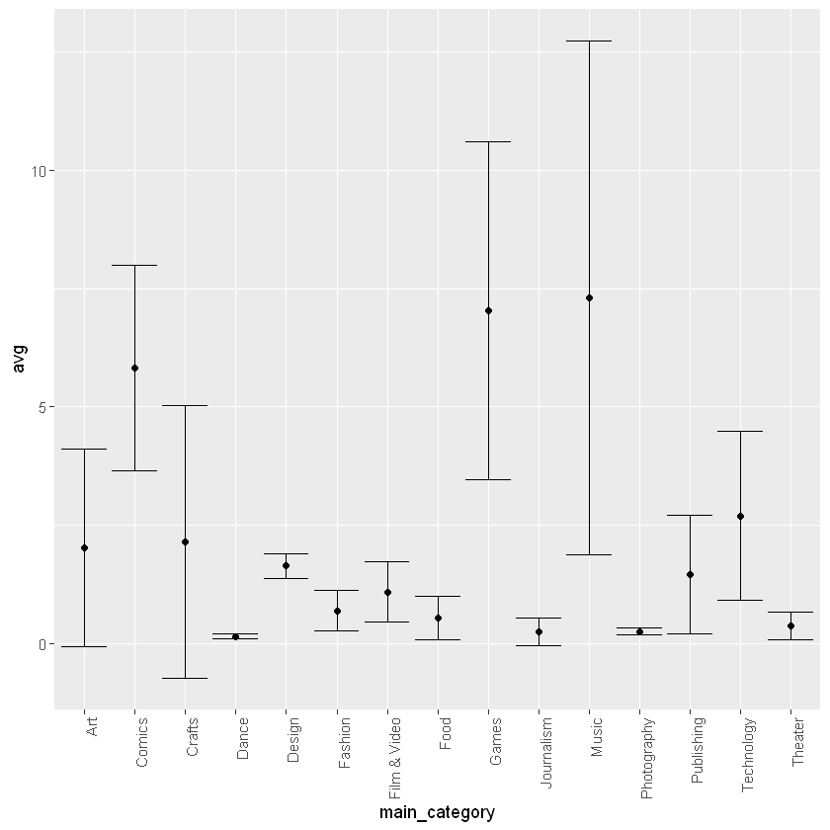
Categories by average excess funding

Slide 8
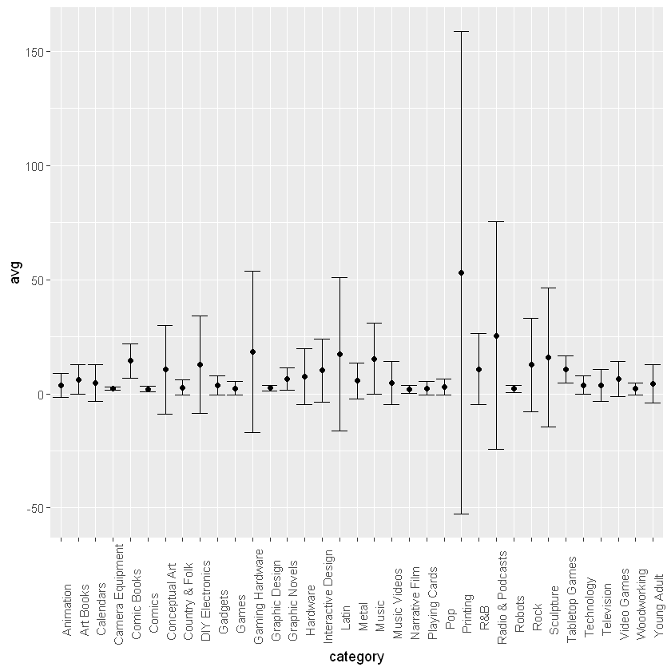
Sub-Categories by average excess funding

Slide 9
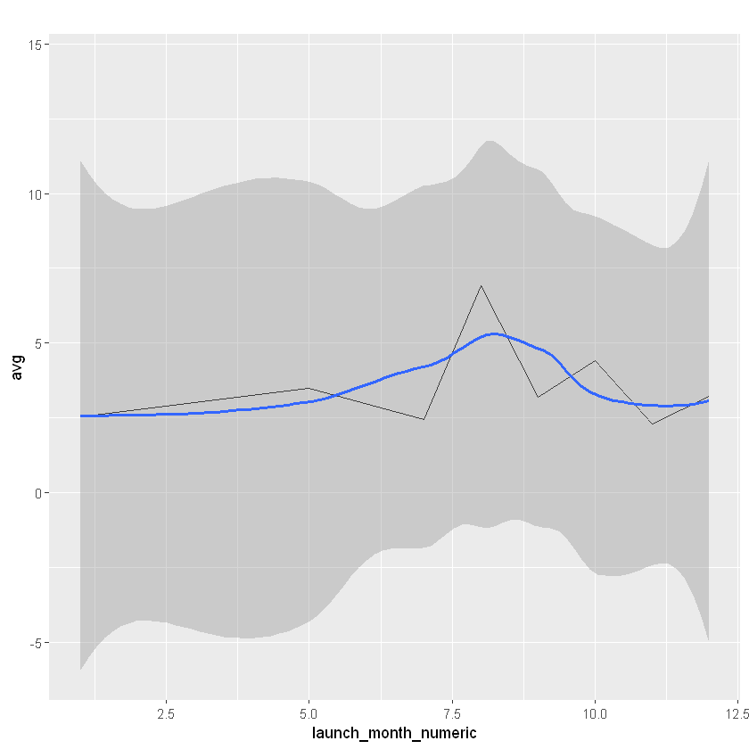
Excess funding by month

Slide 10
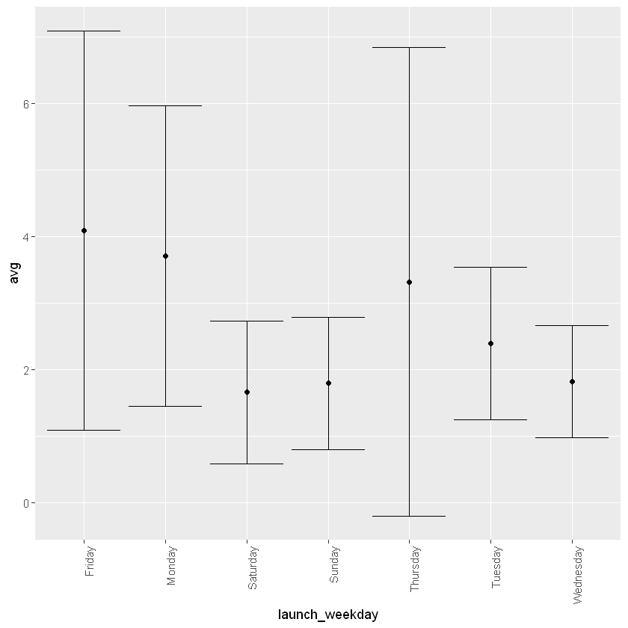
Excess funding by weekday

Slide 11
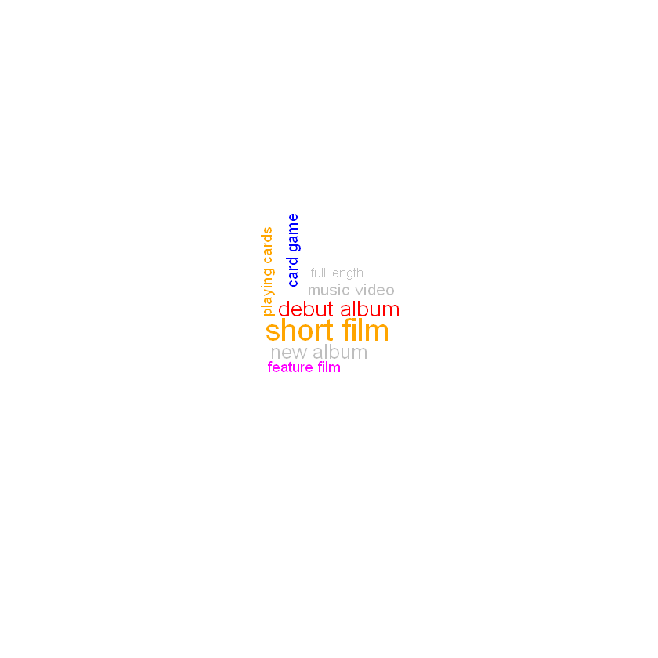

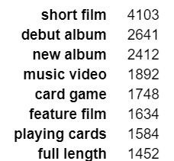
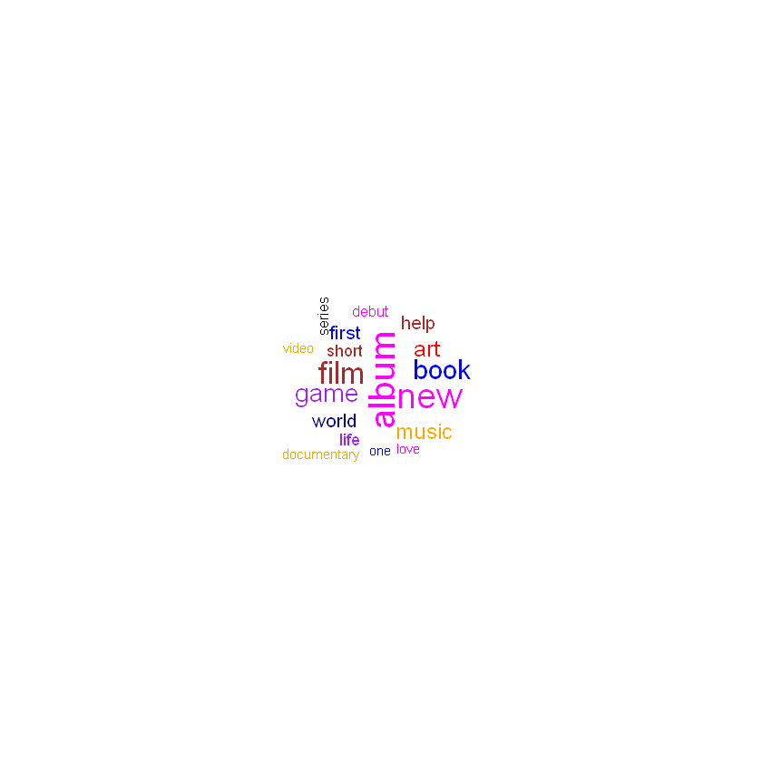
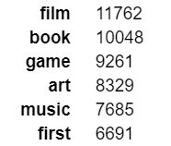
WordCloud

Slide 12
Predict
Predicting only
Either success or not
Logistic Regression
84% accuracy
RandomForest
85% accuracy
Wordcloud
30% accuracy
Adding detailed descriptions could improve the accuracy

Slide 13
Conclusion
Monday or Friday in August
Use the words “album” “film” “new” “book” “game”
Ask for a small amount
Chance of succeeding is at about 85%
Games, Dance&Music, Comics, Printing, Radio&Podcasts, Art&Design

