Slide 1

Unicode
Ted

Slide 2
Unicode
Universal Coded Character Set (UCS)

Slide 3
Unicode
An international encoding standard for use with different languages and scripts, by which each letter, digit, or symbol is assigned a unique numeric value that applies across different platforms and programs.

Slide 4
Before Unicode
There were hundreds of different systems, called character encoding, for assigning these numbers. However it could not contain enough characters to cover all the language.

Slide 5
ASCII
American Standard Code for Information Interchange became the first widespread encoding scheme. However, it’s limited to only 128character definitions. This is fine for the most common English characters, numbers, and punctuation, but is a bit limiting for the rest of the world.

Slide 6
After Unicode
The Unicode Standard has been adopted by all modern software providers and now allows data to be transported through many different platforms, devices and applications without corruption.

Slide 7
Unicode
Unicode provides a single character set that covers the languages of the world, and a small number of machine-friendly encoding forms and schemes to fit the needs of existing applications and protocols. It is designed for best interoperability with both ASCII and ISO-8859-1, the most widely used character sets, to make it easier for Unicode to be used in applications and protocols.

Slide 8
Implement
The standard has been implemented in many technologies, including modern operating system, XML, Java and other programming languages.

Slide 9
UTF
Unicode Transformation Unit.
The Unicode standard defines UTF-8, UTF-16, and UTF-32, and several other encodings are in use.

Slide 10
UTF-8
Only uses one byte (8 bits) to encode English characters. It can use a sequence of bytes to encode other characters. UTF-8 is widely used in email systems and on the internet.

Slide 11
UTF-16
Uses two bytes (16 bits) to encode the most commonly used characters. If needed, the additional characters can be represented by a pair of 16-bit numbers.

Slide 12
UTF-32
Uses four bytes (32 bits) to encode the characters. It became apparent that as the Unicode standard grew, a 16-bit number is too small to represent all the characters. UTF-32 is capable of representing every Unicode character as one number.

Slide 13
Origin
Unicode takes the role of providing a unique code point - a number, not a glyph. Unicode leaves the visual rendering (size, shape, font, or style) to other software, such as web browser or word processor.

Slide 14
Goals
1. To create a universal standard that covered all writing systems.
2. To use an efficient encoding that avoided mechanisms such as code page switching, shift-sequences and special states.
3. To use a uniform encoding width in which each character was encoded as a 16-bit value.
4. To create an unambiguous encoding in which any given 16-bit value always represented the same character regardless of where it occurred in the data.

Slide 15
Code Points
A code point is the value that a character is given in the Unicode standard. The values according to Unicode are written as hexadecimal numbers and have a prefix of U+.
A is U+0041, a is U+0061, 1 is U+0031, # is U+0023

Slide 16
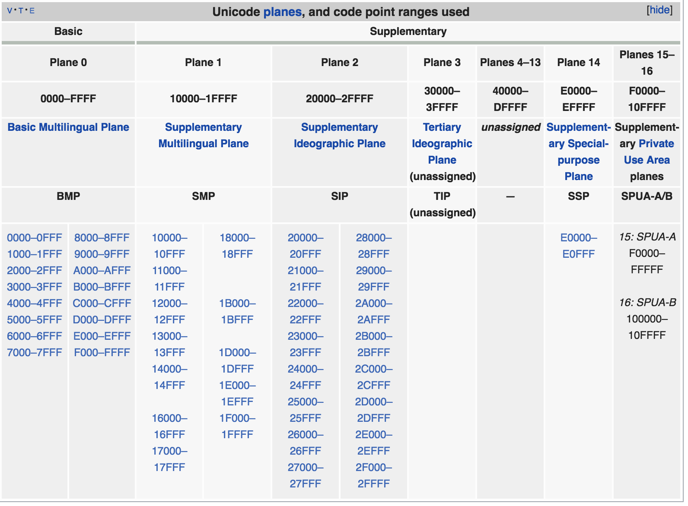
Code Units
The encoding schemes are made up of code units, which are used to provide an index for where a character is positioned on a plane. The Unicode codespace is divided into seventeen planes, numbered 0 to 16:

Slide 17
General Category
Each code point has a single General Category property. The major categories are denoted: Letter, Mark, Number, Punctuation, Symbol, Separator and Other. Within these categories, there are subdivisions. In most cases other properties must be used to sufficiently specify the characteristics of a code point.

Slide 18
History
The origins of Unicode date to 1987, when Joe Becker, Lee Collins and Mark Davis started investigating the practicalities of creating a universal character set. Peter Fenwick and Dave Opstad, Joe Becker published a draft proposal for an "international/multilingual text character encoding system in August 1988.

Slide 19
Unicode 11.0
Contains a repertoire of 137,439 characters covering 146 modern and historic scripts, as well as multiple symbol sets and emoji.

Slide 20
Unicode Consortium
The Unicode Consortium is a nonprofit organization that coordinates Unicode's development. Full members include most of the main computer software and hardware companies with any interest in text-processing standards, including Adobe, Apple, Google, IBM, Microsoft, and Oracle Corporation.
The Consortium’s goal is replacing existing character encoding schemes with Unicode and its standard Unicode Transformation Format (UTF) schemes.

Slide 21
THE END

