Slide 1
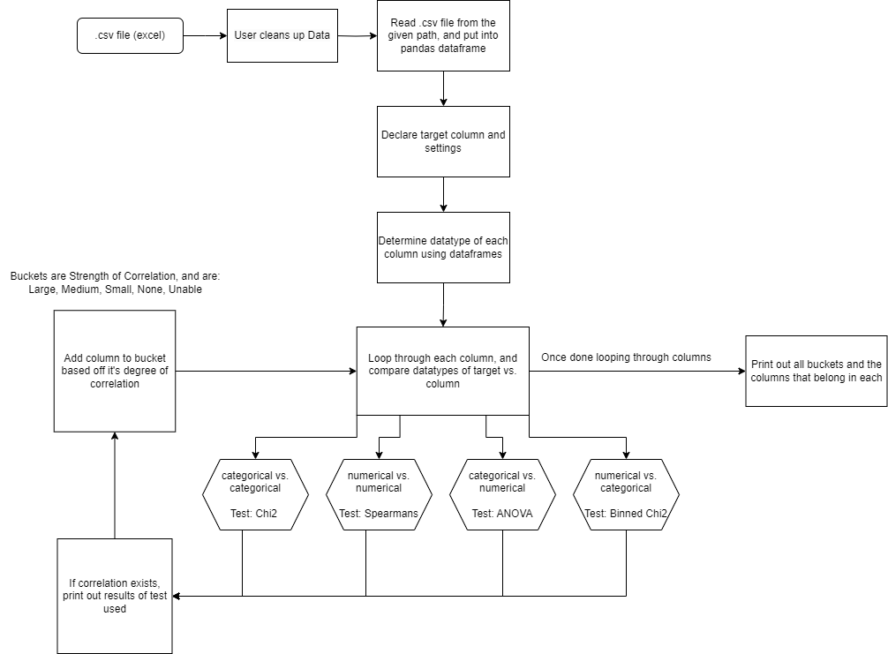


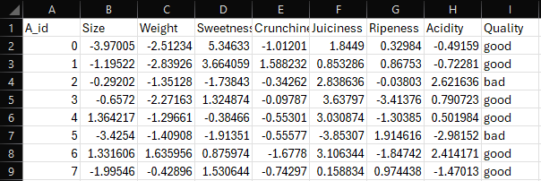
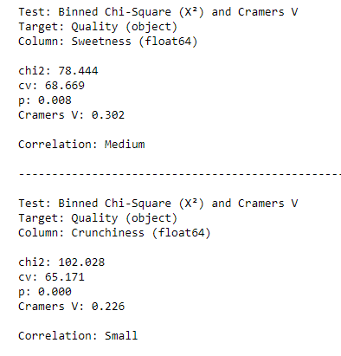


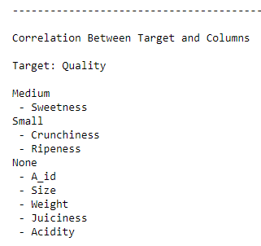




Automated Correlation Analysis
Overview
Motivation
Design Diagram
User inputs data and the column they want to analyze
Calculates correlations between a target column and all other columns in the data
Tools don’t exist to automatically find correlation between variables given input data
Allows for correlation analysis without extensive statistical experience from the user
Available tools do not have the ability to determine which tests should be used based on the datatype of each column
Why Correlation?
Correlation is useful because it quantifies the degree to which two variables are related. Understanding correlation helps in predicting one variable from another, identifying trends, guide decision making, and making inferences.
Examples: Find out which variables impact sales the most, which variables determine to apple quality, which lifestyle factors impact cardiovascular disease, etc.
Implementation
Created in a Python Jupyter Notebook, Statistics performed using SciPy and NumPy functions
Data inputted by user through .csv file path, data is stored in pandas dataframe
Correlation is categorized by comparing the results of correlation tests to the accepted cutoffs for each type of test, with these cutoffs being established by the statistical community
Given the datatypes that my program identifies, the correct correlation tests are used
Tests of Correlation Used: Chi^2, Spearman's, ANOVA, Binned Chi^2
My program determines the strength of this correlation, since some correlation tests can only tell if correlation exists
Tests of Correlation Strength Used: Cramér's V, Eta-Squared
Future Work
Technologies
Integrate with a visualization tool for dynamically generated visualizations
Support computing correlation between existing data and aggregated data values
More extensive research and testing to better understand strengths and limitations of my approach over large data
Developing (graphical) user interface (GUI), e.g., using webapp
Example Scenario
Example data about Apple Quality, this data has ratings of an apple’s attributes. My program will take in a target column (Quality) and then determine correlation between the target and all other columns
Ted Cordonnier
Computer Science 2024
Advisor: Prof. Seokki Lee
Outputs Results of Tests, mainly for Advanced Users
Outputs all the column names and which degree of correlation they fall into

