Slide 1
Senior Design Spring Presentation
Author: Ted Cordonnier

Slide 2
Team
Project Name: Automated Correlation Analysis
Individual Project by Ted Cordonnier
5th Year Computer Science Major, Graduating Spring 2024
Team: LOL
Email: cordontd@mail.uc.edu
Advisor: Seokki Lee

Slide 3
Goals
Find Correlation between target column and all other columns in a .csv file
Automates statistical tests of correlation as well as allows any analyst to find strength of association between all types of variables
All without extensive statistical experience from the user

Slide 4
Intellectual Merits
Myself and my advisor Seokki Lee were not able to think of or find tools that are able to automatically find correlation between variables given a .csv file input.
Tools do exist (IBM SPSS, minitab) that allow users to run different statistical tests on a given set of data. However, it requires that the user has a solid foundation on statistics.
Available tools do not have the ability to do do all these tests automatically
Available tools do not have the ability to determine which test should be used based on the datatype of each column.
Given the datatype that my program identifies, the correct correlation method is used
Some correlation tests only identify if there is correlation and can’t say anything about its strength. My program uses further tests to determine the strength of this correlation, something that I have not seen other programs do

Slide 5
Broader Impacts
Correlation is useful because it quantifies the degree to which two variables are related. Understanding correlation helps in predicting one variable from another, identifying trends, and making inferences.
Correlation is a fundamental statistical tool that enables data analysts to draw insights from data as well as guide decision-making.
Examples: Find out which variables impact sales the most, which variables determine to apple quality, which lifestyle factors impact cardiovascular disease, etc.
My program allows a user without extensive statistical experience to be able to calculate correlation from the target they want to analyze to their entire .csv file.

Slide 6
Design Specifications
Program was created inside of a Jupyter Notebook
Input: .csv file
Output: Strength of correlation between target and all other columns
Takes the .csv file and puts it into a Pandas dataframe. Dataframe automatically determines the datatype of each column.
Loop through each column and run one of 4 correlation tests depending on the datatypes of the target vs. column.

Slide 7
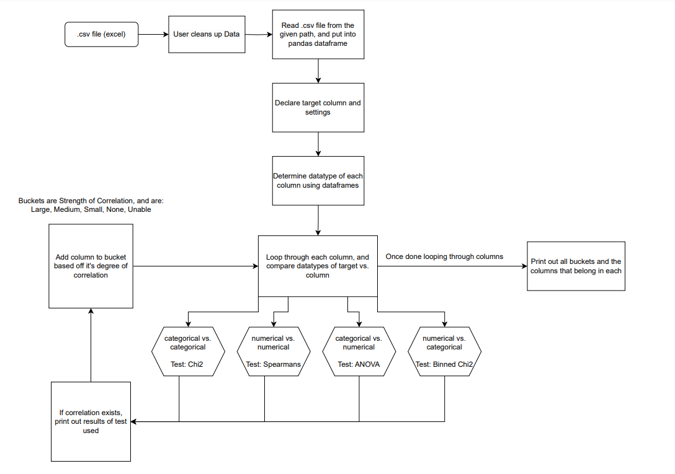
Design Specifications

Slide 8




Technologies
Jupyter Notebook
Python Data Science Workspace
Git
Version Control
Data Handling and Analysis Libraries
NumPy, Pandas Dataframes
Handling data from the .csv
Statistical Analysis Libraries
SciPy, Statsmodels
Running the tests for correlation and strength of correlation

Slide 9
Milestones
1/15: Project plan, environment setup, data collection
1/22: Initial data analysis report outlining which types of .csv should be used
1/30: Research which tests should be used for each correlation datatypes
2/15: Prototype for functions for ANOVA, chi-square, and correlation tests integrated into the project.
2/25: Initial analysis of correlation results, keep working on tests
2/30: Ensure correlation results are correct with IBM SPSS
3/25: Complete final presentation, poster, deliverables, etc.
4/14: Final project presentation at Expo, collection of feedback, documentation of lessons learned, and discussion of potential future work

Slide 10
Results
Achieved all milestones
Currently have a working Correlation Analysis Program
Demo will consist of showing the execution of the program live with 3 datasets I have picked
There are things that could be added in the future, but with time constraints, this is the place that I have decided to stop at
I am happy with how things turned out and believe that my program demonstrates the research and implementation of Computer Science/Statistics

Slide 11
Challenges
Project direction changed somewhat sharply right before the end of the Fall Semester
My advisor and I believed that this was the correct choice and would lead to a more meaningful project
Lots of research had to be done on statistics, correlation, etc., since I did not have an extensive background
I was able to learn a considerable amount from resources around the internet.
There was a shockingly low number of resources on programs to calculate correlation. I learned there are many formulas for calculating correlation
I found out that the method and formula used depends on the datatypes of the variables being analyzed

