Slide 1
Senior Design Fall Presentation
Author: Ted Cordonnier

Slide 2
Team
Project Name: Automated Correlation Analysis
Individual Project by Ted Cordonnier
5th Year Computer Science Major, Graduating Spring 2024
Team: LOL
Email: cordontd@mail.uc.edu
Advisor: Seokki Lee

Slide 3
Goals
Find Correlation between target column and all other columns in a .csv file
Automates statistical tests of correlation as well as allows any analyst to find association between all types of variables
All without extensive statistical experience from the user

Slide 4
Intellectual Merits
Myself and my advisor Seokki Lee were not able to think of or find tools that are able to automatically find correlation between variables given a .csv file input.
Tools do exist (IBM SPSS, minitab) that allow users to run different statistical tests on a given set of data. However, it requires that the user has a solid foundation on statistics.

Slide 5
Project Overview
Project Topic Area: Analyzing, visualizing and making predictions on data. Data will be from the publicly available Cincinnati Crime data from the past 10 years. I will clean up this data and put it into a SQL database and table. This data can then be analyzed in different ways to figure out new insights. I will then use the program mapbox to create a heatmap of this data, multiple maps or tables can be made based on needs. I want to ensure that the average observer of this project can see and gain value from what I create. AI/ML is also a consideration to be used on the data in order to make predictions of crimes for example. Mapbox or Google Maps Platform will be used.

Slide 6
User Stories
As a concerned citizen, I want to view a map of recent crime incidents in my neighborhood, so that I can stay informed about safety in my area.
As a resident of Cincinnati or someone looking to move here, I want to understand the areas of this city that have less occurrences of crime, so that I can make an informed decision on where to move.
As a politician or in police leadership, I want to understand where crime usually takes place, so that I can better make laws and distribute resources accordingly to the areas that need it most.
As a researcher, I want to extract data on specific crime types over a period of time, so that I can conduct in-depth analysis and contribute to academic studies on crime prevention.

Slide 7
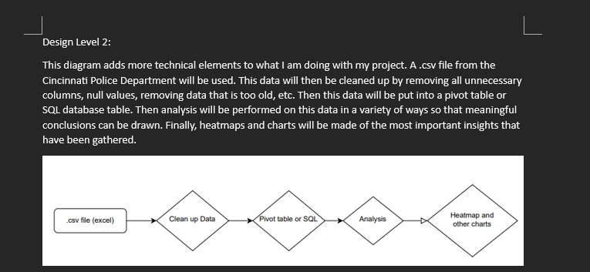
Design Diagrams

Slide 8
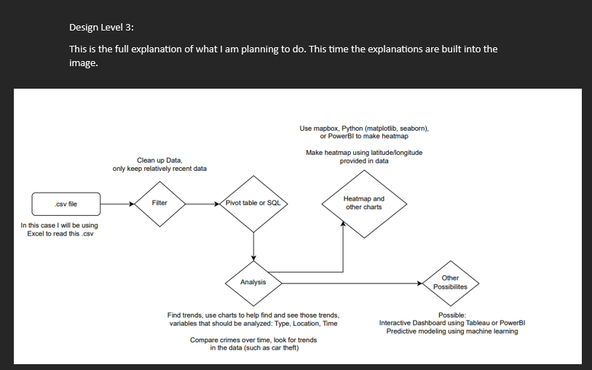
Design Diagrams

Slide 9
Project Constraints
Economic constraints will not be a problem because my project will not require any funding and is using online data that is free and provided by the City of Cincinnati. The software that I use will be free, either being mapbox or google mapping for developers.
For public relation, my assignment has an impact on because the audience will be shown analysis of crime data which will likely give them new beliefs or reinforce beliefs that they have about different areas around Cincinnati and their crime reputation, how good the area is, etc. That is part of the point of the project, to change public reputation about certain areas by giving them data that can inform them on each area.
For legal constraints I am pretty sure that the data that I am going to use can be freely used and given by the city of Cincinnati, but I will have to make sure that this is the case.
For ethical constraints with this project, it's crucial to strike the right balance in how we present our findings. I need to ensure that our heatmap provides a clear picture without unintentionally stigmatizing any particular area. Also, we've got to be careful to anonymize specific incidents and personal details to maintain trust and respect for privacy.

Slide 10
Review of Project Progress
Progress on the project has been mainly the administrative tasks that I have been assigned, such as the design diagrams, constraints, etc.
These are required steps in the Senior Design class that I have taken in order to get organized with what I am going to create for my Senior Design project
Once I figure a few more things out and get an advisor, walk them through the final decisions that I have to make on exactly what I want to do, I can begin to do more of the project work

Slide 11
Expectations by End of Term
By the end of the term, I expect to gain more proficiency in analyzing and manipulating data
Understanding more how to create heatmaps, charts, etc.
Turning data into valuable insights for my target audience

Slide 12
Expected Demo at Expo
Showing the observers my project, a very informative and useful heatmap as well as other charts that describe the data clearly
Answer any questions that come to their minds about my findings
Explain the process and reasoning that I took for going about the project in the way that I did
I expect to nail down the idea that anyone should be able to look at my project and gain valuable insights from it

