Slide 1

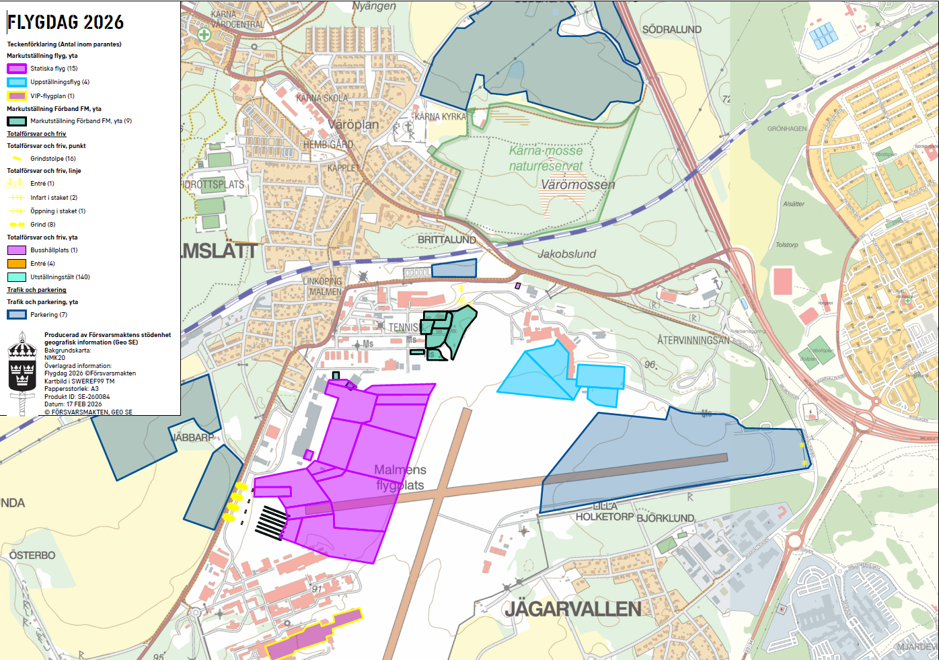
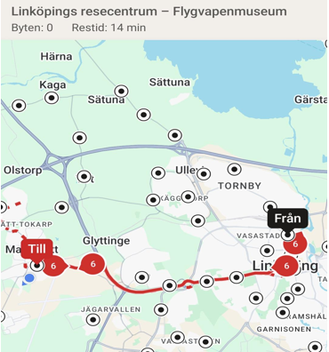

Overwiew for Friday 21st august
Map over Malmen Air Force Base Area, our parking area for Friday and entrance to spotters´ area
From LINKÖPING Railway Station:
Bus number 6 to bus stop ”Flygvapenmuseum”. (14 minutes)
Ticket from app ”Östgötatrafiken” (see below) – single adault price = 35 sek
(alternative is Bus number 3 with stop in RYD = 2.3km/30min walk)
From E4 (West of LINKÖPING) to LAGERLUNDA parking area:
(Your gps map will direct you from south east - E4/MANTORP to VIKINGSTAD)
Vehicles coming from VIKINGSTAD to LAGERLUNDA = read signs,
approx. 5.5 km/5 min by car (see next slide)
No vehicle access to the Air Base from North = Trafic junction TIFT (N:b 111) or East (Linköping City)!
P
MALMSLÄTT
Air Force Museum
Bus stop
RYD
Entrance
Bus stop
Main Guard
LINKÖPING CITY (5 KM)
P
Bus Line
Number 6
Parking Area
(farmers field)
Public Area
P
RYD
Trafic junction
P
Entrance
Spotters-
area
Vehicles from
Vikingstad

Slide 2
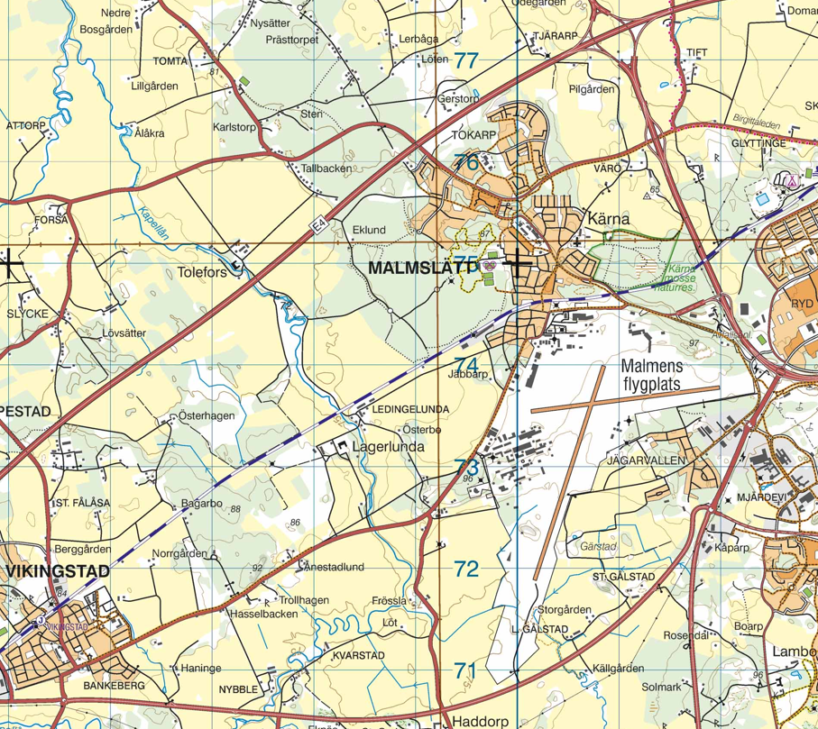
ROAD Overwiew for Friday 21st august
TIFT
Number 111
Parking Area
(farmers field)
X
X
From LINKÖPING
X
X
X
X
From MANTORP
X

