Slide 1


Katacoin live
Team 4

Slide 2
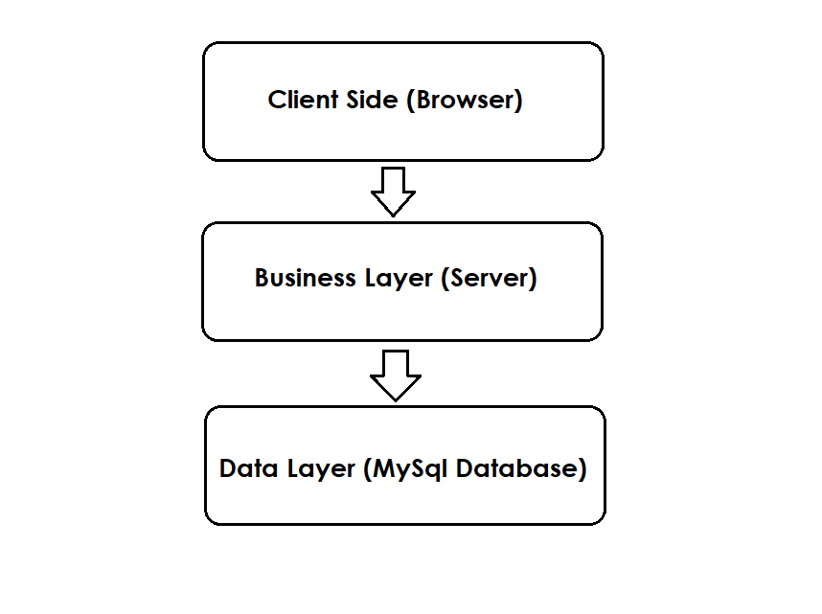




Frameworks and technologies
Locally hosted database: MySql
Business logic: SPRING
Front-end: React
Live data reloading: Socket.IO
Code written in Java & JavaScript

Slide 3
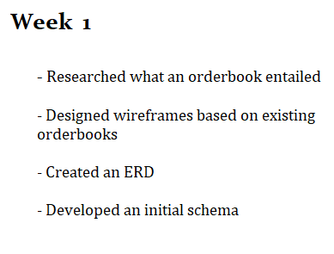
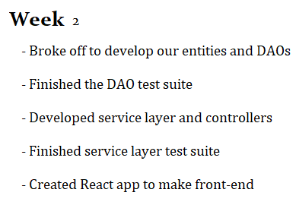
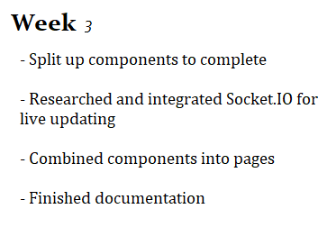
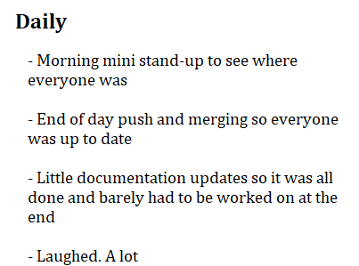
Process

Slide 4
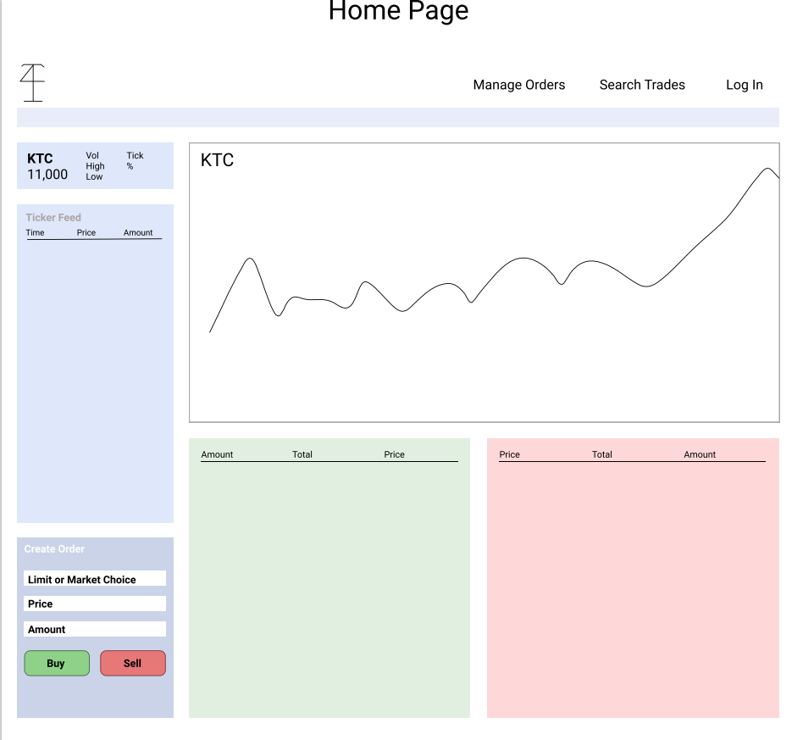
Wireframes
Designed with Figma
www.figma.com

Slide 5
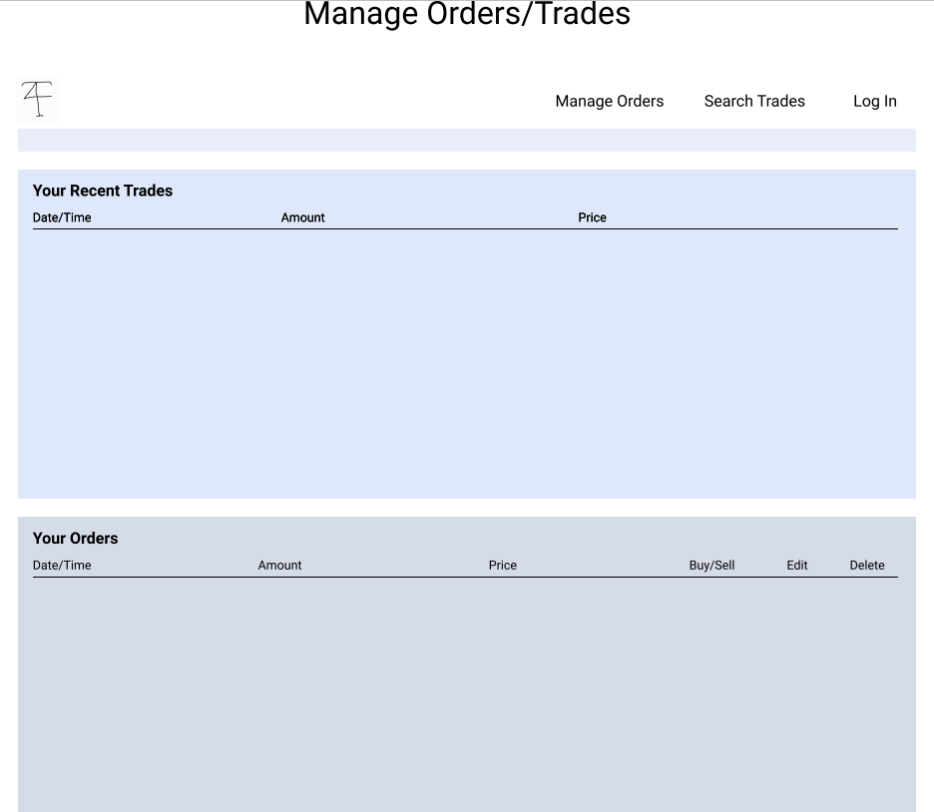
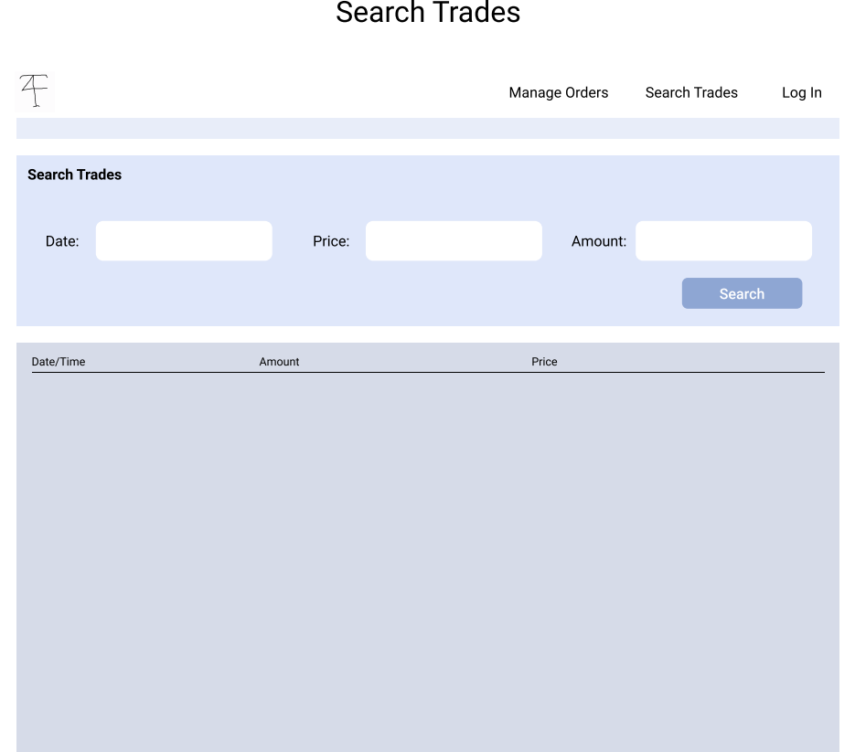

Slide 6
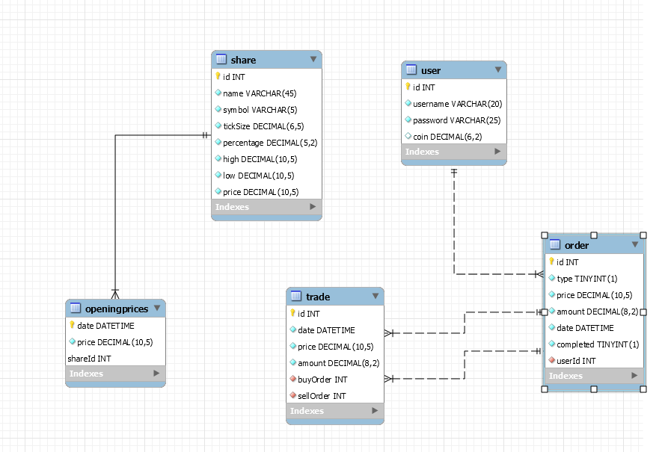
ERD

Slide 7
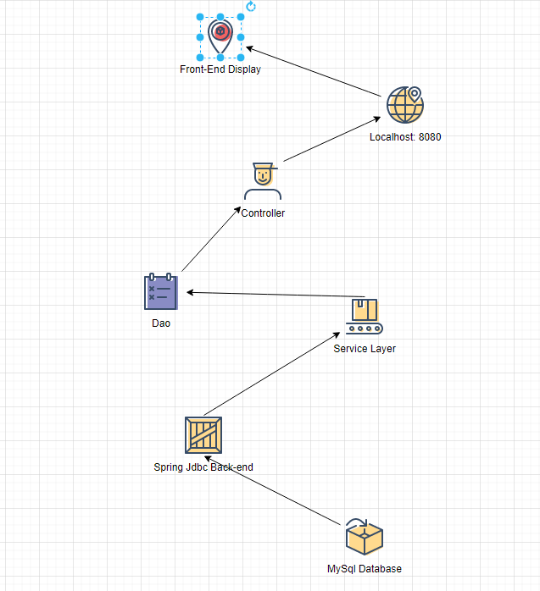
System Map
Designed with Draw.IO

Slide 8
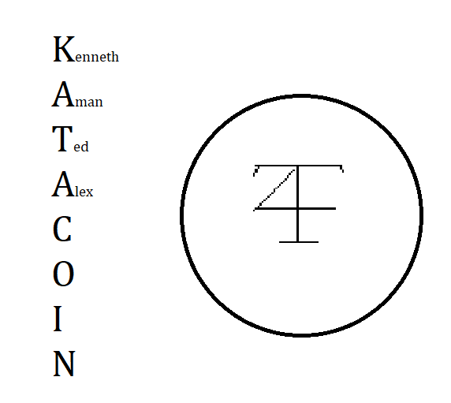
Enjoy the demo
By Team 4

