Slide 1

#2019-Machine Learning Termpj
Yes,Korea
201533645 배성재
201533661 이승수

Slide 2

Contents.
01
Bank Marketing
-Preprocessing:
-data discretization(Binning)
-feature engineering: feature selection
-Data Analysis
-Data Evaluation: WisePhropet
02
World Devlopment Indicator
-Preprocessing:
-data discretization(Binning)
-feature engineering:
-data filtering, feature creation, sampling
-Data Analysis

Slide 3
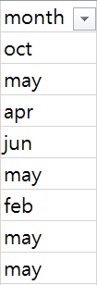
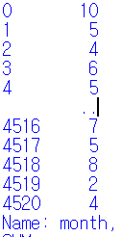
Part 1.Bank Marketing
1)Data Preprocessing
Data Inspection
Purpose: classify target variable(‘y’)
and look at which features matter to it.
‘month’ feature
Numeric features:
Age, balance, day, month, duration,
pdays, previous
Categorical features:
LabelEncoding
Job, martial, education, default, housing,
loan, Contact, poutcome
categorical
numeric

Slide 4
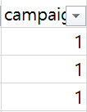
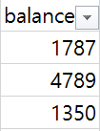
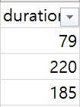
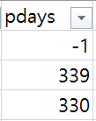

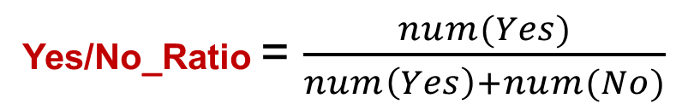
Part 1.Bank Marketing
1)Data Preprocessing
Data discretization
Feature Creation
Target feature ‘y’
Yes/No_Ratio = $\frac{num(Yes)}{num\left(Yes\right)+num(No)}$
Binning column data

Slide 5
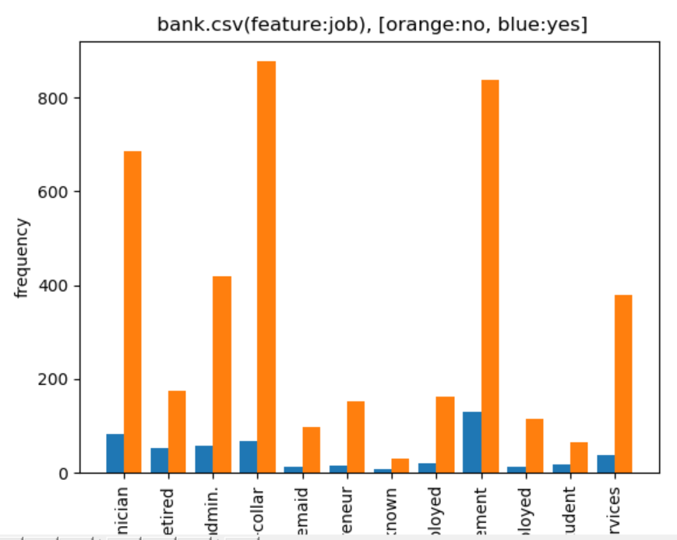
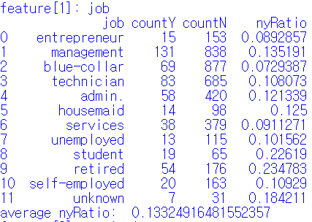
Part 1.Bank Marketing
1)Data Preprocessing
Feature Engineering
Yes/No_Ratio

Slide 6
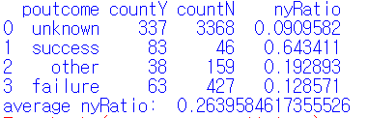
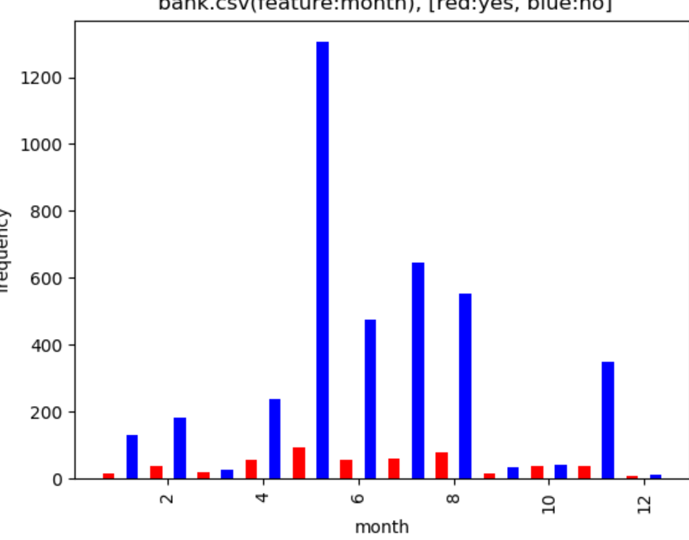
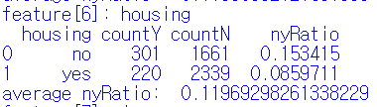
Part 1.Bank Marketing
1)Data Preprocessing
Feature name | Correlation with Yes/No_Ratio
Job | Student, retired, unknown
Poutcome | success
day | 6(June)
Duration | 700+,
Feature Engineering

Slide 7
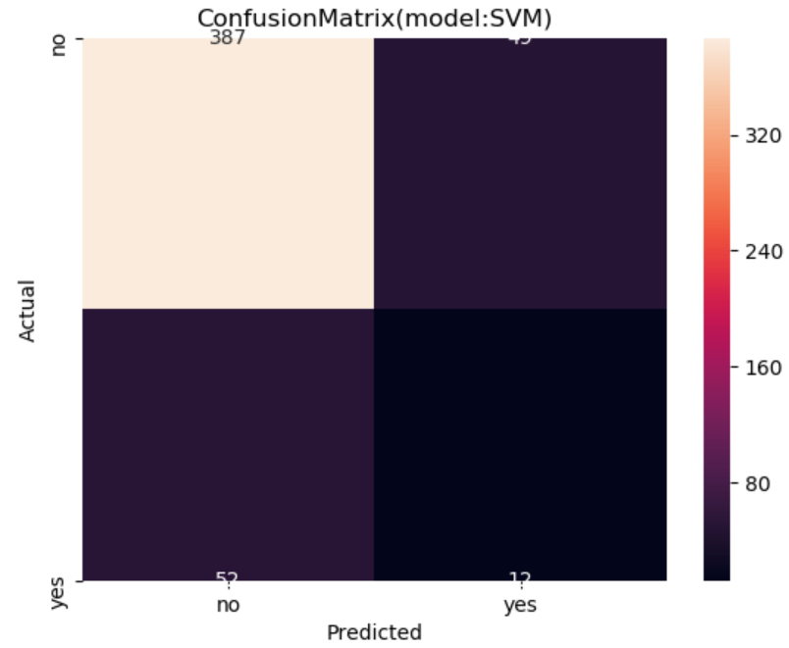


Part 1.Bank Marketing
2)Data Analysis
Classification Algorithms:
-Decision Tree Classification,
-Logistic Regression,
-SVM
FP=52 | TP=12
TN=387 | FN=45
Precision= 12/64
Recall= 12/57
K-fold=10
[Accuracy before feature engineering]
83%
[Accuracy after feature engineering]
87%
Notes:
정확도 작게는 0.5%에서 8%까지 개선

Slide 8
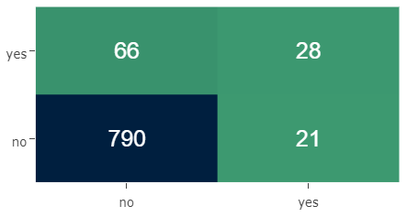
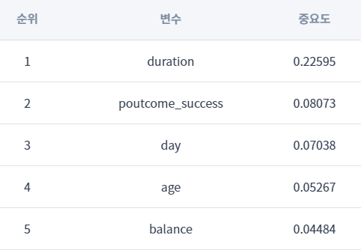
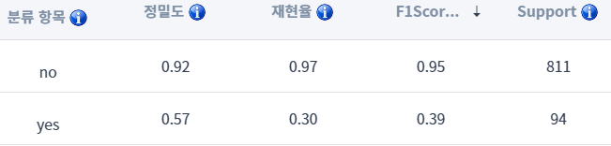

Part 1.Bank Marketing
3)Data Evaluation
Feature name | Correlation with Yes/No_Ratio
Job | Student, retired, unknown
Poutcome | success
day | 6(June)
Duration | 700+,
FP=52 | TP=12
TN=387 | FN=45

Slide 9
Part 2. World Devlopment Indicator
1)Data Preprocessing
Purpose: Finding Countries similar to Korean from 1960s to 2010s
Feature Selection: ‘Indicator Code’ into 5 Section
- Economic/Financial Section
- Infrastructure/Trade Section
- Agriculture/Environment/Health Section
- Welfare/Labor/Population Section
- Population Section

Slide 10
Part 2.World development Indicator
2)Data Preprocessing
Series.csv
Indicator Code(SeiresCode): BN.RES.INCL.CD
Section | Header of SeriesCode
Economic/Financial | Bank: (BN,BM,BG,BX), Financial: (FP,FS,FM,FR,FI,FD,FB), Debt(DT, DC)
Agriculture/Environment | Agriculture(AG), Environment(EA,EG,EN,ER,EP)
Social Protection | Social Protection(SE:education, SH:health, SP:population, SG,SI:poverty, SM:migration, SL:labor, ST:travel)
Trade/National Factors | National Factor(NY,NE,NV), Purchase(PX,PA),
Rest | MS,VC,CM,LP,GB,GC

Slide 11
Part 2.World development Indicator
2)Data Preprocessing
Series.csv
Indicator Code(SeiresCode): BN.RES.INCL.CD
Section | Header of SeriesCode
Economic/Financial | Bank: (BN,BM,BG,BX), Financial: (FP,FS,FM,FR,FI,FD,FB), Debt(DT, DC)
Agriculture/Environment | Agriculture(AG), Environment(EA,EG,EN,ER,EP)
Social Protection | Social Protection(SE:education, SH:health, SP:population, SG,SI:poverty, SM:migration, SL:labor, ST:travel)
Trade/National Factors | National Factor(NY,NE,NV), Purchase(PX,PA),
Rest | MS,VC,CM,LP,GB,GC

Slide 12
Part 2.World development Indicator
2)Data Preprocessing
Feaure Engineering
-feature discretization: Binning ‘years’ to ‘decades’
-feature creation: merge SeriesCodes into single meaning
Preprocessing():
Preprocessing type1
ex) SP.POP.TOTL
Preprocessing type2
ex) SP.POP.TOTL.FE.IN/SP.POP.TOTL.MA.IN
-> Female Ratio of total population
Preprocessing type3
ex) SP.POP.1564.TO/(SP.POP.0014.TO+SP.POP.65UP.TO)
-> Ratio of laborable number of total population

Slide 13
Part 2.World development Indicator
2)Data Preprocessing
Sectors of indicators
Sectors | Selected SeriesCode [Indicator Name]
Economic/Financial | DC.DAC.TOTL.CD [Net bilateral aid flows from DAC donors, Total (current US$)] FM.AST.DOMS.CN [Net domestic credit (current LCU)] NV.IND.MANF.ZS [Manufacturing, value added (% of GDP)] BX.KLT.DINV.WD.GD.ZS [Foreign direct investment, net inflows (% of GDP)]
Infrastructure/Trade | TX.VAL.FUEL.ZS.UN/TM.VAL.FUEL.ZS.UN TM.VAL.FUEL.ZS.UN [Fuel imports (% of merchandise imports)] TX.VAL.FUEL.ZS.UN [Fuel exports (% of merchandise exports)] TX.VAL.MANF.ZS.UN/TM.VAL.MRCH.CD.WT TM.VAL.MRCH.CD.WT [Merchandise imports (current US$)] TX.VAL.MANF.ZS.UN [Manufactures exports (% of merchandise exports)] IS.AIR.PSGR [Air transport, passengers carried] IT.CEL.SETS.P2 [Mobile cellular subscriptions (per 100 people)] IT.NET.USER.ZS [Individuals using the Internet (% of population)]

Slide 14
Part 2.World development Indicator
2)Data Preprocessing
Sectors of indicators
Section | Selected SeriesCode [Indicator Name]
Agriculture/ Environment / Health | AG.LND.AGRI.ZS [Agricultural land (% of land area)] AG.PRD.LVSK.XD [Livestock production index (2004-2006 = 100)] EN.ATM.CO2E.KT [CO2 emissions (kt)] EN.POP.DNST [Population density (people per sq. km of land area)]
Welfare/Labor /Population | SE.SEC.CUAT.LO.ZS [Educational attainment, at least completed lower secondary, population 25+, total (%) (cumulative)] SH.DTH.IMRT [Number of infant deaths] SL.UEM.TOTL.NE.ZS [Unemployment, total (% of total labor force) (national estimate)] SH.IMM.IDPT [Immunization, DPT (% of children ages 12-23 months)] SL.AGR.EMPL.ZS [Employment in agriculture (% of total employment) (modeled ILO estimate)] SL.GDP.PCAP.EM.KD [GDP per person employed (constant 2011 PPP $)] SH.XPD.CHEX.PC.CD [Current health expenditure per capita (current US$)]

Slide 15
Part 2.World development Indicator
2)Data Preprocessing
Sectors of indicators
Section | Selected SeriesCode [Indicator Name]
Population | SP.POP.TOTL [Population, total] SP.POP.TOTL.FE.IN/SP.POP.TOTL.MA.IN (female ratio) SP.POP.TOTL.FE.IN [Population, female] SP.POP.TOTL.MA.IN [Population, male] SP.POP.1564.TO/(SP.POP.0014.TO+SP.POP.65UP.TO) SP.POP.0014.TO [Population ages 0-14, total] SP.POP.1564.TO [Population ages 15-64, total] SP.POP.65UP.TO [Population ages 65 and above, total] SP.URB.TOTL.IN.ZS/SP.RUR.TOTL.ZS SP.RUR.TOTL.ZS [Rural population (% of total population)] SP.URB.TOTL.IN.ZS [Urban population (% of total population)]

Slide 16
Part 2.World development Indicator
1)Data Analysis
pseudo Code
For each_section:
for each_indicator_code
c1 = K-means
c2 = K-Medoid
c3 = DBSCAN
result = Ens(c1,c2)
Ens(result[])
Notes:
섹션을 구성하는 각각의 인디케이터 코드마다 년대별로
우리나라와 같이 구성된 클러스터를 확인하기 위해서 k-MEANS와 K-MEDOID를 사용 후 교차검증하였다.
전체 년도의 흐름에 대한 유사도를 판단하기 위해서는 DBSCAN을 사용했습니다.
결과적으로 각각의 섹션마다 년대별
가장 유사도가 높은 5개의 나라를 찾는것이 목표입니다.

Slide 17
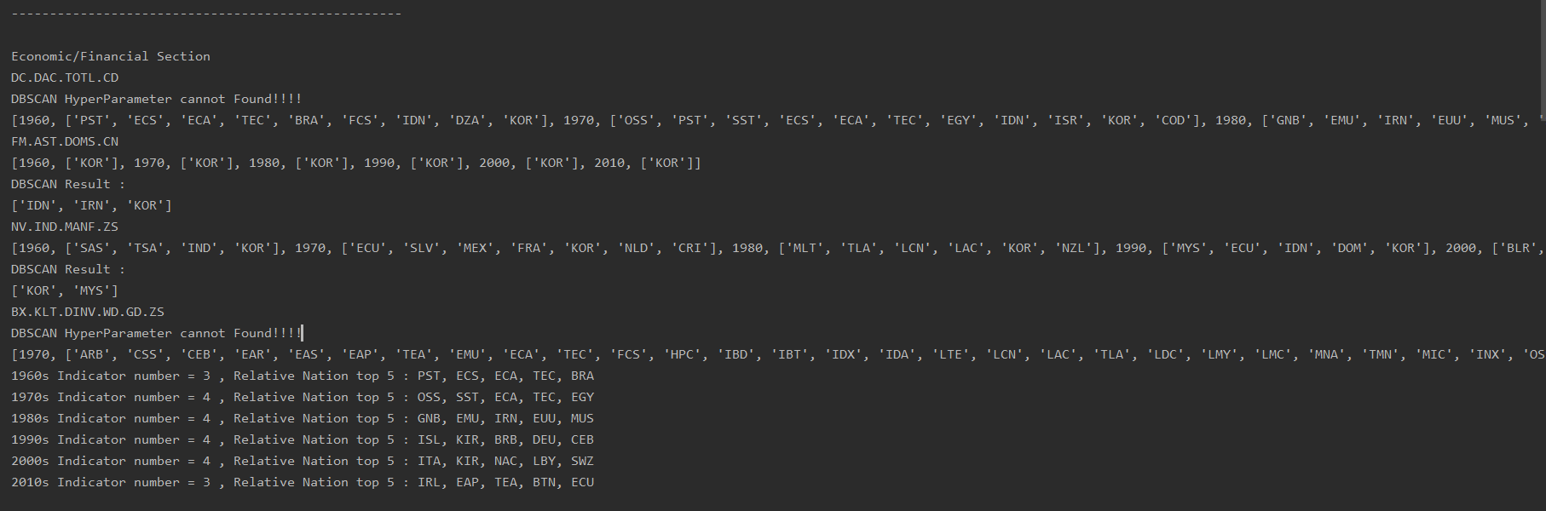
Part 2.World development Indicator
1)Data Analysis
Economy section

Slide 18
Part 2.World development Indicator
1)Data Analysis
Economy section
Years | Nations
1960’s | Pacific island small states, Brazil, Central Asia, Central Asia (excluding high income)
1970’s | Other small states, Small states, Central Asia (excluding high income), Egypt, Arab Rep.
1980’s | Guinea-Bissau, Iran, Islamic Rep, Mauritius
1990’s | Iceland, Kiribati, Barbados, Germany,
2000’s | Italy, Kiribati, North America, Eswatini,
2010’s | Ireland, East Asia & Pacific (IDA & IBRD countries)

Slide 19
Part 2.World development Indicator
1)Data Analysis
Infrastructure/Trade section
Years | Nations
1970’s | New Zealand , Arab World, Caribbean small states
1980’s | Central Europe and the Baltics, Heavily indebted poor countries (HIPC),
1990’s | South Asia, Middle East & North Africa (excluding high income),
2000’s | South Asia, India, Canada, France
2010’s | Small states, Germany, Japan

Slide 20
Part 2.World development Indicator
1)Data Analysis
Agriculture/Environment/Health section
Years | Nations
1960’s | Indonesia, Iraq, Ireland
1970’s | Brazil, Mauritius, Dominica
1980’s | Niger, Middle East & North Africa, Middle East & North Africa (excluding high income)
1990’s | Iceland, Antigua and Barbuda, Gabon
2000’s | Nauru, Iceland, Iraq, Israel
2010’s | Channel Islands, Aruba, Netherlands

Slide 21
Part 2.World development Indicator
1)Data Analysis
Welfare/Labor/Population section
Years | Nations
1960’s | Algeria, Morocco, Colombia
1970’s | Guinea, Ghana, Madagascar, Malawi
1980’s | Liberia, Ecuador, World, Central Europe and the Baltics
1990’s | East Asia & Pacific, East Asia & Pacific (excluding high income)
2000’s | Libya, Malaysia, Hungary, Czech Republic
2010’s | Czech Republic, Hungary, Japan

Slide 22
Part 2.World development Indicator
1)Data Analysis
Population section
Years | Nations
1960’s | Canada, Argentina, Egypt, Arab Rep
1970’s | Egypt, Arab Rep., Iran, Islamic Rep., Ethiopia, Canada
1980’s | Central Europe and the Baltics, France, Egypt, Arab Rep, Iran, Islamic Rep.
1990’s | Egypt, Arab Rep., Hong Kong SAR, China, Central Europe and the Baltics, Iran, Islamic Rep.
2000’s | Egypt, Arab Rep., Iran, Islamic Rep., Ethiopia, Italy, France
2010’s | Ghana, Nepal, Small states, Malaysia

Slide 23
-End-

