Slide 1

Matrix exponent
Using stable numeric algorithm
Teddy Lazebnik
$$e^{m}$$

Slide 2

Agenda
$$e^{m}$$
Motivation to solve matrix exponent
Definition of the problem
Known algorithm and the original Lanzos & Putzer algorithms
The improvement
Choose tree algorithm
Numerical results
Example of real world application
Notes:
This slide will describe what I am talking about in the presetetion

Slide 3
Motivation to solve matrix exponent
$$e^{m}$$
Matrix exponent can be found in many areas of applied mathematics, for example:
In control theory, A linear control system with continues time measurement described by O.D.E. When the system is presented as a combination of smaller systems it describes as a vector and the mathematical model describes such systems is a matrix exponent.
Other example can be the ability to convert continuous-time system into discrete-time state-space system.
Notes:
This slide gives 3 examples where Matrix exponent is used in applied mathematics in general to solve different things…

Slide 4
Motivation to solve matrix exponent
$$e^{m}$$
When looking on a robotic system mimics the walking process of a person we can describe the dynamics of the system by a discrete – continues function described by continues ODE of space, time when the “foot” of the robot is in the air and a shock functions when making a “step” on the ground.
To make sure the robot is not falling as a result of the noise in a real world system; one can use a control system to supervise the right operation of the robot. These systems use several sensors to retrieve the information but putting sensor and analyze it’s signal on all the needed parameters is costly and not efficient technic.
Notes:
This slide gives 3 examples where Matrix exponent is used in applied mathematics in general to solve different things…

Slide 5
Motivation to solve matrix exponent
$$e^{m}$$
Control system uses a part group of the sensors which satisfices the observable condition.
The observable condition stands for that we can retrieve the full system information based on the partial group.
The process of calculating the observer of a system uses matrix exponent. An unstable calculation of the matrix exponent bubbles to the calculation of the observer and decide the effectiveness of the control system.
Notes:
This slide gives 3 examples where Matrix exponent is used in applied mathematics in general to solve different things…

Slide 6
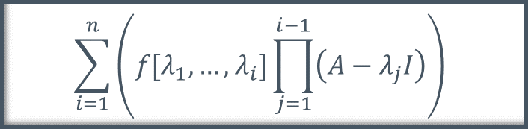






Matrix exponent Forms
$$A∈ℂ^{n×n}$$
$$e^{m}$$
Differential system
Interpolation
$$Y^{′}\left(t\right)=AY\left(t\right), Y\left(0\right)=1$$
$$\sum_{i=1}^{n}{\left(f[λ_{1},…,λ_{i}]\prod_{j=1}^{i−1}{\left(A−λ_{j}I\right)}\right)}$$
Cauchy integral
Padé approximation
$$\frac{1}{2πi}\int_{Γ}^{ }{\left(e^{z}{\left(zI−A\right)}^{−1}\right)dz}$$
$$p_{km}\left(A\right)q_{km}{\left(A\right)}^{−1}$$
Power series
Limit
$$I+A+\frac{A^{2}}{2!}+\frac{A^{3}}{3!}+…$$
$$\lim_{s→∞}{{\left(I+\frac{A}{s}\right)}^{s}}$$

Slide 7

Matrix exponent properties
$$e^{m}$$
$$e^{0}=I, e^{A}∗e^{−A}=I$$
$$e^{\left(A+B\right)}=e^{A}∗e^{B} ↔AB=BA$$
$$e^{QAQ^{−1}}=Qe^{A}Q^{−1}↔Q invertible$$
$$e^{(A^{T})}={\left(e^{A}\right)}^{T}$$
$$\det\left(e^{A}\right)=e^{tr\left(A\right)}$$

Slide 8



Definitions
$$A∈ℂ^{n×n}$$
$$e^{m}$$
$y$ is the analytical result
$y^{∗}$ is the approximation of the result
Absolute error: $\left|y−y^{∗}\right|$
Relative error:$\frac{\left|y−y^{∗}\right|}{\left|y\right|}$
Matrix condition:$μ=\left\|A\right\|\left\|A^{−1}\right\|.$ $A$ is “ill condition” if $μ≫1.$
Big O: $f,g$ are functions. If there are $c∈ℝ$ with $f≤c∗g$ then $f=O(g)$
Numerical stability: for given small $Δx, \left|f (x + Δx) − y^{∗}\right|$ is small

Slide 9
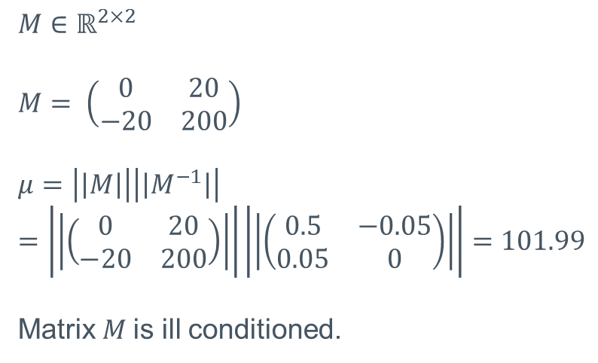
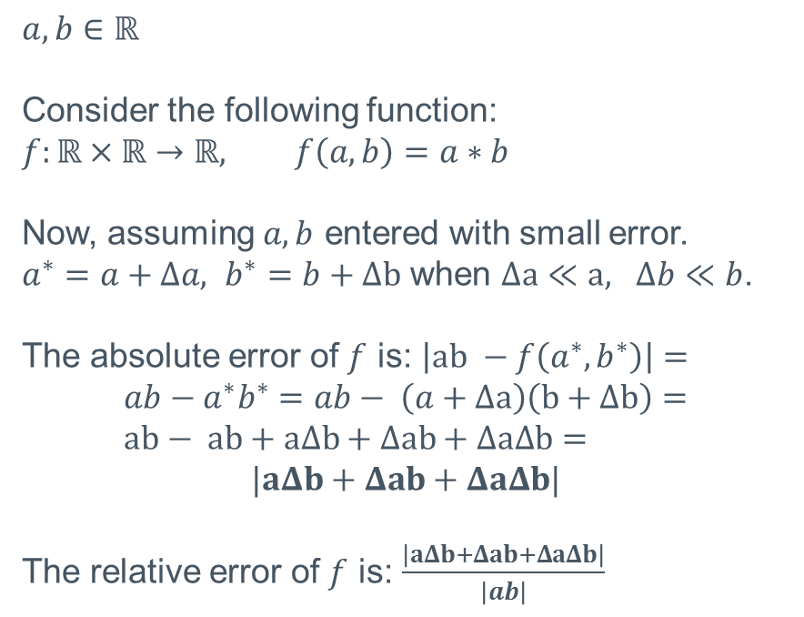
Definitions – examples
$$e^{m}$$
$$a,b∈ℝ$$
Consider the following function:
$$f:ℝ×ℝ→ℝ, f\left(a,b\right)=a∗b$$
Now, assuming $a,b$ entered with small error.
$a^{∗}=a+Δa, b^{∗}=b+Δb$ when $Δa≪a, Δb≪b$.
The absolute error of $f$ is: $\left|ab −f\left(a^{∗},b^{∗}\right)\right|=$ $$ab−a^{∗}b^{∗}=ab− \left(a+Δa\right)\left(b+Δb\right)= \\ ab− ab+aΔb+Δab+ΔaΔb=$$
$$|aΔb+Δab+ΔaΔb|$$
The relative error of $f$ is: $\frac{\left|aΔb+Δab+ΔaΔb\right|}{\left|ab\right|}$
$$M∈ℝ^{2×2}$$
$$M= \left(\begin{matrix}0 & 20 \\ −20 & 200\end{matrix}\right)$$
$$μ=\left|\left|M\right|\right|\left|\left|M^{−1}\right|\right|=\left|\left|\left(\begin{matrix}0 & 20 \\ −20 & 200\end{matrix}\right)\right|\right|\left|\left|\left(\begin{matrix}0.5 & −0.05 \\ 0.05 & 0\end{matrix}\right)\right|\right|=101.99$$
Matrix $M$is ill conditioned.

Slide 10
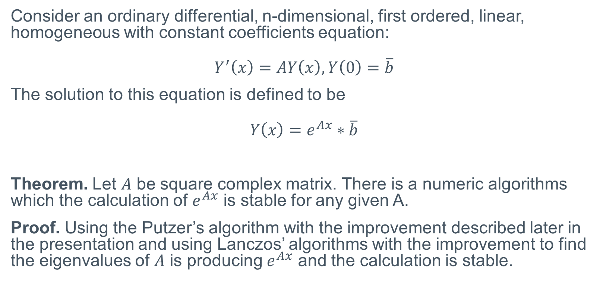
Problem’s definition
$$e^{m}$$
Consider an ordinary differential, n-dimensional, first ordered, linear, homogeneous with constant coefficients equation:
$$Y^{′}\left(x\right)=AY\left(x\right), Y\left(0\right)=\overline{b}$$
The solution to this equation is defined to be
$$Y\left(x\right)=e^{Ax}∗\overline{b}$$
Theorem. Let $A$ be square complex matrix. There is a numeric algorithms which the calculation of $e^{Ax}$ is stable for any given A.
Proof. Using the Putzer’s algorithm with the improvement described later in the presentation and using Lanczos’ algorithms with the improvement to find the eigenvalues of $A$ is producing $e^{Ax}$ and the calculation is stable.

Slide 11
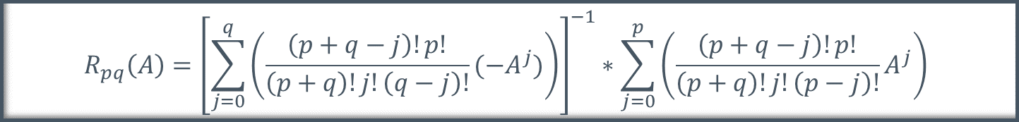

Known algorithms
$$e^{m}$$
P’ade approximation based method
$$R_{pq}\left(A\right)={\left[\sum_{j=0}^{q}{\left(\frac{\left(p+q−j\right)!p!}{\left(p+q\right)!j!\left(q−j\right)!}{(−A}^{j})\right)}\right]}^{−1}∗\sum_{j=0}^{p}{\left(\frac{\left(p+q−j\right)!p!}{\left(p+q\right)!j!\left(p−j\right)!}A^{j}\right)}$$
Cayley–Hamilton based method
$e^{At}=\sum_{j=0}^{n−1}{\left(a_{j}\left(t\right)A^{j}\right)}$ when $a_{j}\left(t\right)= \sum{\left(\frac{b_{kj}t^{k}}{k!}\right)} and$
$b_{kj}= \left\{\begin{aligned}\begin{matrix}δkj, k<n \\ c_{j}, k=n\end{matrix} \\ \begin{matrix}c_{0}b_{k−1,n−1}, k>n \& j=0 \\ c_{j}b_{k−1,n−1}+b_{k−1,j−1}, k>n \& j>0\end{matrix}\end{aligned}\right.$

Slide 12

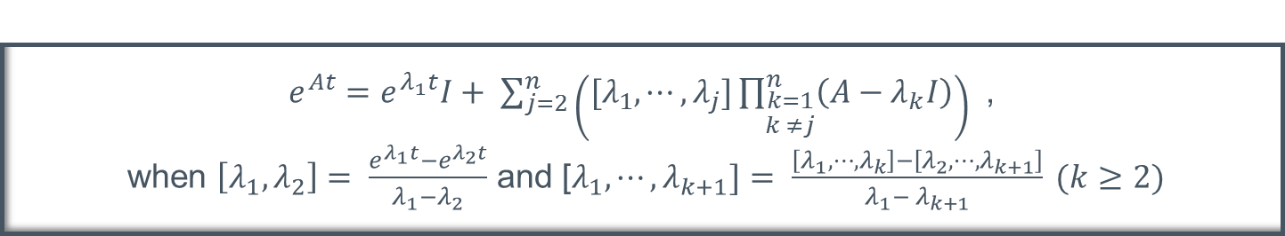
Known algorithms
$$e^{m}$$
Lagrange interpolation based method
$$e^{At}= \sum_{j=0}^{n−1}{\left(e^{λ_{j}t}\prod_{\begin{aligned}k=1 \\ k ≠j\end{aligned}}^{n}{\left(\frac{A−λ_{k}I}{λ_{j}−λ_{k}}\right)}\right) }$$
Newton interpolation based method
$e^{At}=e^{λ_{1}t}I+ \sum_{j=2}^{n}{\left([λ_{1},⋯,λ_{j}]\prod_{\begin{aligned}k=1 \\ k ≠j\end{aligned}}^{n}{\left(A−λ_{k}I\right)}\right) }$ , when $\left[λ_{1}, λ_{2}\right]= \frac{e^{λ_{1}t}−e^{λ_{2}t}}{λ_{1}−λ_{2}}$ and [$λ_{1},⋯,λ_{k+1}]= \frac{\left[λ_{1},⋯,λ_{k}\right]−\left[λ_{2},⋯,λ_{k+1}\right]}{λ_{1}− λ_{k+1}} (k≥2)$

Slide 13
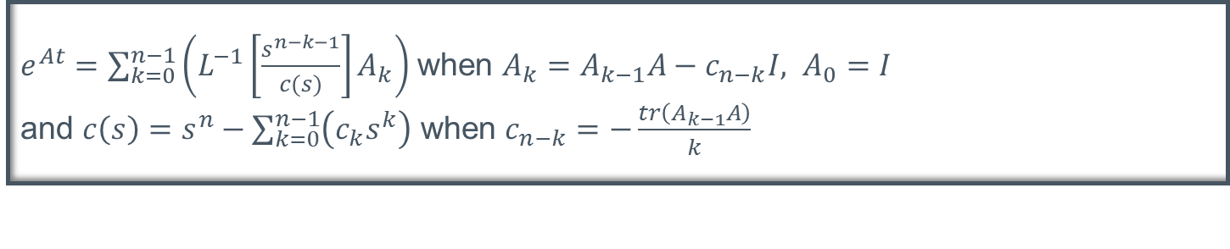
Known algorithms
$$e^{m}$$
Inverse Laplace transforms based method
$e^{At}=\sum_{k=0}^{n−1}{\left(L^{−1}\left[\frac{s^{n−k−1}}{c(s)}\right]A_{k}\right)}$ when $A_{k}=A_{k−1}A−c_{n−k}I, A_{0}=I$ and $c\left(s\right)=s^{n}−\sum_{k=0}^{n−1}{\left(c_{k}s^{k}\right)}$ when $c_{n−k}=−\frac{tr\left(A_{k−1}A\right)}{k}$
General purpose O.D.E. solver
This is not a specific algorithm. It’s based on the idea that calculate the result of the following equation with O.D.E solves algorithms will produce the right answer;

Slide 14
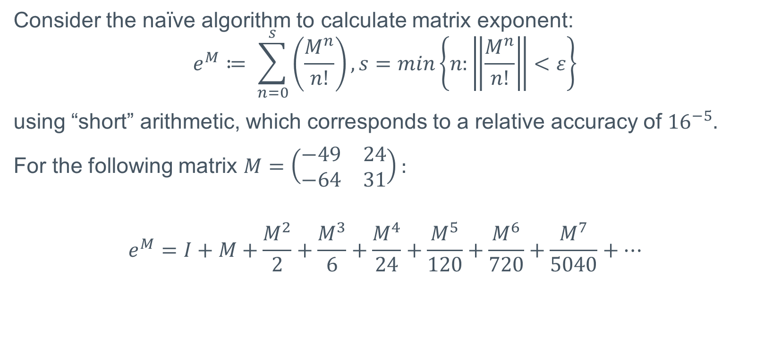
Unstable algorithm example
Consider the naïve algorithm to calculate matrix exponent:
$$e^{M}≔ \sum_{n=0}^{s}{\left(\frac{M^{n}}{n!}\right)}, s=min\left\{n:\left\|\frac{M^{n}}{n!}\right\|<ε\right\}$$
using “short” arithmetic, which corresponds to a relative accuracy of ${16}^{−5}.$
For the following matrix $M=\left(\begin{matrix}−49 & 24 \\ −64 & 31\end{matrix}\right):$
$$e^{M}=I+M+\frac{M^{2}}{2}+\frac{M^{3}}{6}+\frac{M^{4}}{24}+\frac{M^{5}}{120}+\frac{M^{6}}{720}+\frac{M^{7}}{5040}+…$$

Slide 15
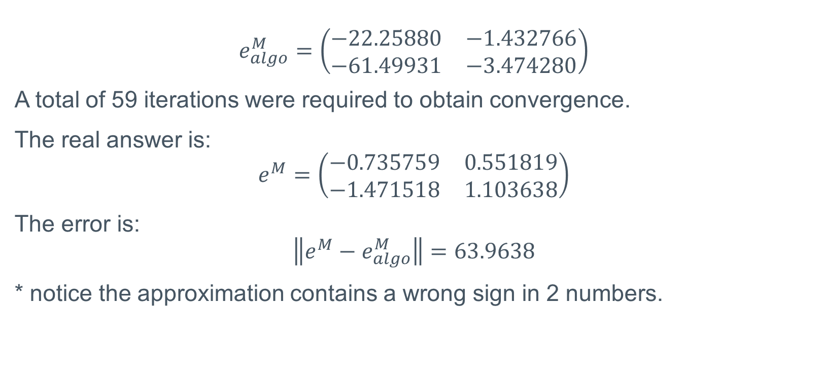
Unstable algorithm example
$$e_{algo}^{M}=\left(\begin{matrix}−22.25880 & −1.432766 \\ −61.49931 & −3.474280\end{matrix}\right)$$
A total of 59 iterations were required to obtain convergence.
The real answer is:
$$e^{M}=\left(\begin{matrix}−0.735759 & 0.551819 \\ −1.471518 & 1.103638\end{matrix}\right)$$
The error is:
$$\left\|e^{M}−e_{algo}^{M}\right\|=63.9638$$
* notice the approximation contains a wrong sign in 2 numbers.

Slide 16

Unstable algorithm example
When calculating the same matrix $M$ with the new algorithm the answer gained is:
$$e_{algo}^{M}=\left(\begin{matrix}−0.6925 & 0.5194 \\ −1.3850 & 1.0387\end{matrix}\right)$$
The error is:
$$\left\|e^{M}−e_{algo}^{M}\right\|=0.121$$

Slide 17
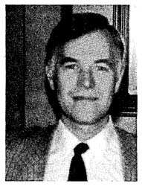
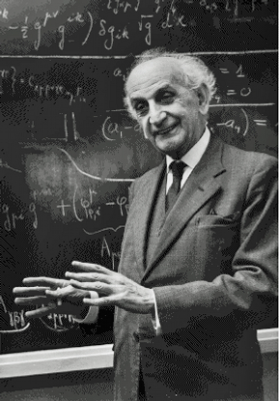
The original solution
$$e^{m}$$
E.J. Putzer lived in Germany at the 20th century, he was an engineer and published the “Avoiding the Jordan canonical form in the discussion of linear systems with constant coefficients”
Cornelius Lanczos lived in Hungary. Born at 1893 and died at 1974, he was a mathematician and physicist and work on many fields of applied mathematics.
E.J. Putzer
Cornelius Lanczos

Slide 18
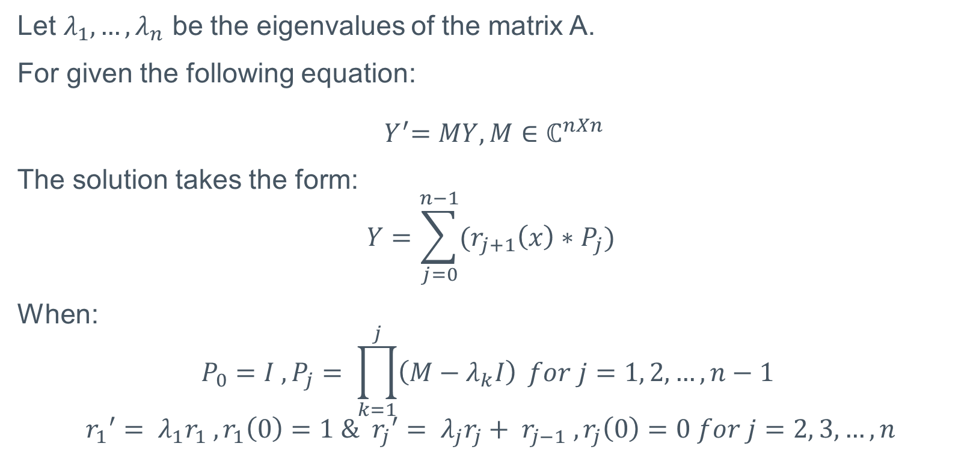
Putzer’s algorithm
$$e^{m}$$
Let $λ_{1},…,λ_{n}$ be the eigenvalues of the matrix A.
For given the following equation:
$${ Y}^{′}=MY, M∈ℂ^{nXn}$$
The solution takes the form:
$$Y=\sum_{j=0}^{n−1}{{(r}_{j+1}\left(x\right)∗P_{j})}$$
When:
$$P_{0}=I , P_{j}= \prod_{k=1}^{j}{\left(M−λ_{k}I\right)} for j=1, 2,…, n−1$$
$${r_{1}}^{′}= λ_{1}r_{1} , r_{1}\left(0\right)=1 \& {r_{j}}^{′}= λ_{j}r_{j}+ r_{j−1} , r_{j}\left(0\right)=0 for j=2, 3,…, n$$

Slide 19
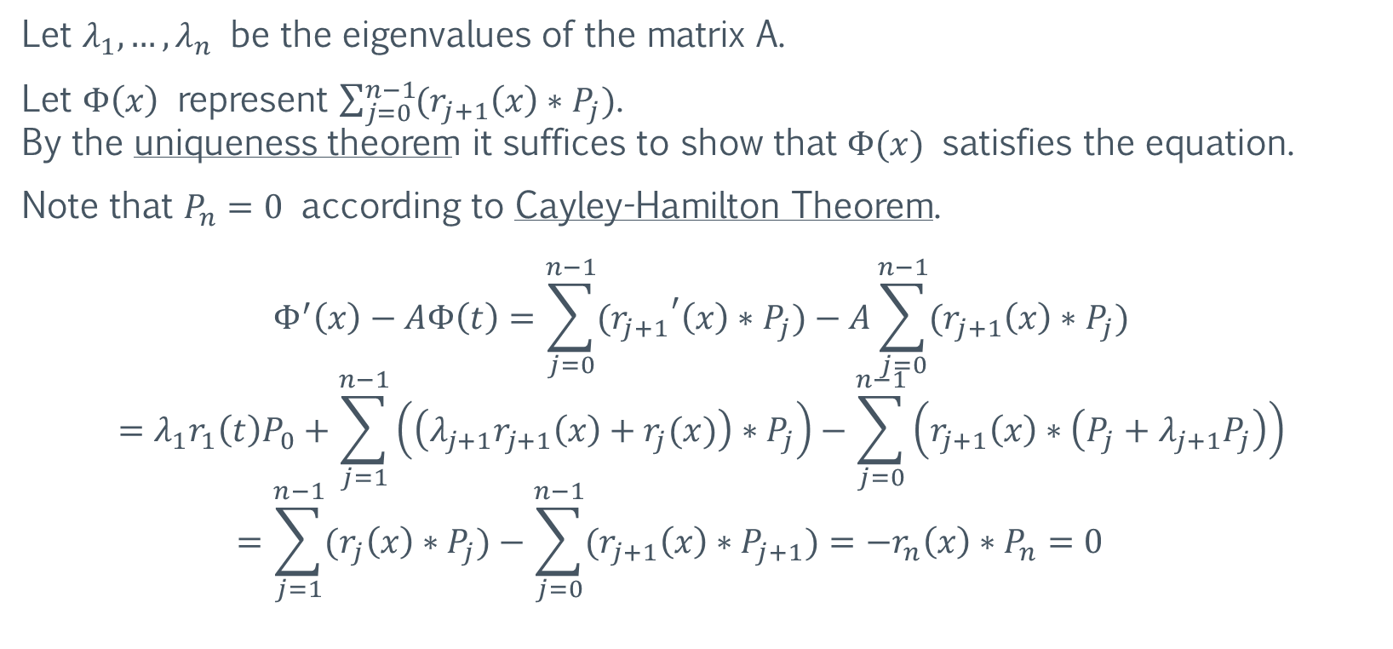

Putzer’s algorithm proof
$$e^{m}$$
Let $λ_{1},…,λ_{n}$ be the eigenvalues of the matrix A.
Let $Φ\left(x\right)$ represent $\sum_{j=0}^{n−1}{{(r}_{j+1}\left(x\right)∗P_{j})}$. By the uniqueness theorem it suffices to show that $Φ(x)$ satisfies the equation.
Note that $P_{n}=0$ according to Cayley-Hamilton Theorem.
$$Φ^{′}\left(x\right)−AΦ\left(t\right)=\sum_{j=0}^{n−1}{{(r_{j+1}}^{′}\left(x\right)∗P_{j})}−A\sum_{j=0}^{n−1}{{(r}_{j+1}\left(x\right)∗P_{j})}$$
$$=λ_{1}r_{1}\left(t\right)P_{0}+\sum_{j=1}^{n−1}{\left(\left({λ_{j+1}r}_{j+1}\left(x\right)+r_{j}(x)\right)∗P_{j}\right)−\sum_{j=0}^{n−1}{\left(r_{j+1}\left(x\right)∗\left(P_{j}+λ_{j+1}P_{j}\right)\right)}}$$
$$=\sum_{j=1}^{n−1}{{(r}_{j}\left(x\right)∗P_{j})}−\sum_{j=0}^{n−1}{{(r}_{j+1}\left(x\right)∗P_{j+1})}=−r_{n}\left(x\right)∗P_{n}=0$$
$$\text{Q}\text{.}\text{E}\text{.}\text{D}\text{.}$$

Slide 20
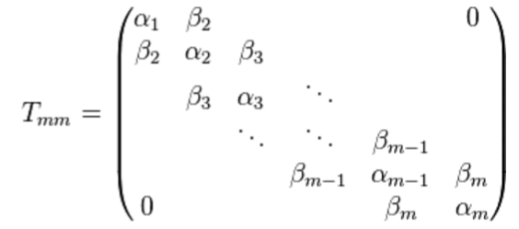
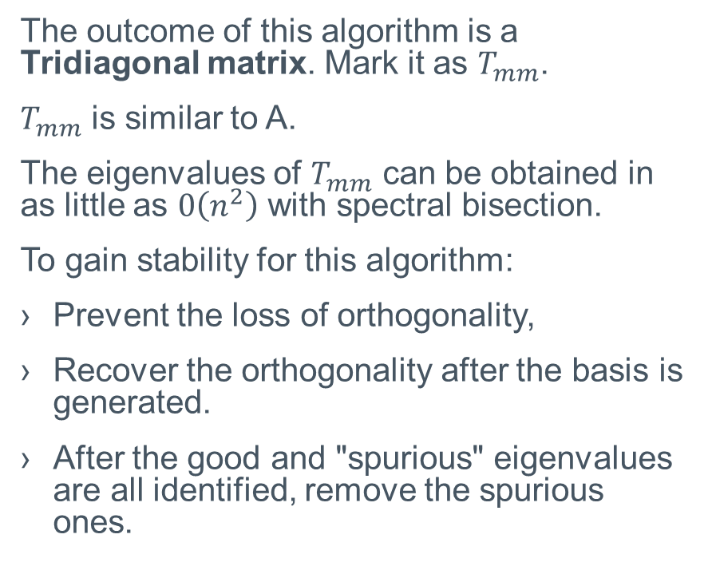

Lanczos’ algorithm
$$A∈ℂ^{n×n}$$
$$e^{m}$$
To gain the eigenvalue of $A$ run the following algorithm:
$v_{1}←random vector with norm 1$
$v_{0}←0$
$β_{1}←0$
For $j$ from $1$ to $m−1$ do:
$w_{j}^{′}←Av_{j}$
$α_{j}←w_{j}^{′}v_{j}$
$w_{j}←w_{j}^{′}−α_{j}v_{j}−β_{j}v_{j−1}$
$β_{j+1}←\left\|w_{j}\right\|$
$v_{j+1}←{w_{j}}/{β_{j+1}}$
$End$
$w_{m}←Av_{m}$
$α_{m}←w_{m}v_{m}$
Return
The outcome of this algorithm is a Tridiagonal matrix. Mark it as $T_{mm}$.
$T_{mm}$ is similar to A.
The eigenvalues of $T_{mm}$ can be obtained in as little as $0\left(n^{2}\right)$ with spectral bisection.
To gain stability for this algorithm:
Prevent the loss of orthogonality,
Recover the orthogonality after the basis is generated.
After the good and "spurious" eigenvalues are all identified, remove the spurious ones.

Slide 21
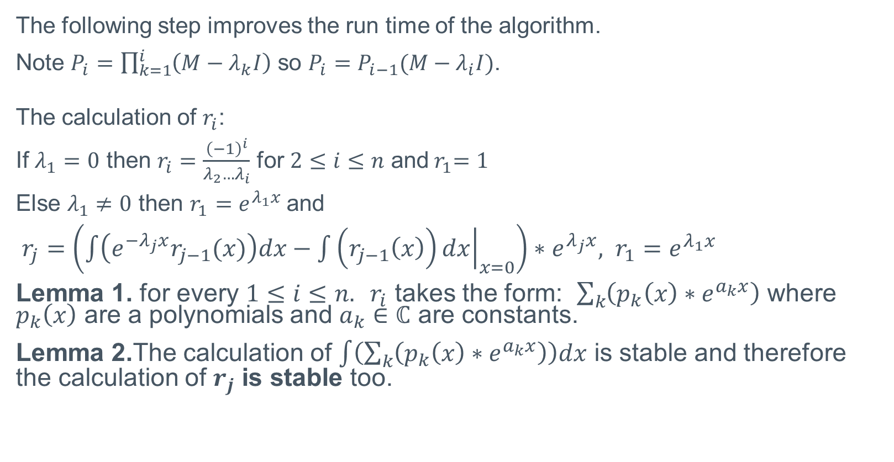
The Improvement
$$e^{m}$$
The following step improves the run time of the algorithm.
Note $P_{i}=\prod_{k=1}^{i}{\left(M−λ_{k}I\right)}$ so $P_{i}=P_{i−1}(M−λ_{i}I)$.
The calculation of $r_{i}$:
If $λ_{1}=0$ then $r_{i}=\frac{{\left(−1\right)}^{i}}{λ_{2}…λ_{i}}$ for $2≤i≤n$ and${ r}_{1}=1$
Else $λ_{1}≠0$ then $r_{1}=e^{λ_{1}x}$and
$r_{j}=\left(\int{\left(e^{−λ_{j}x}r_{j−1}(x)\right)dx−{\left.\int{\left(r_{j−1}\left(x\right)\right)dx}\right|}_{x=0}}\right)∗e^{λ_{j}x}, r_{1}=e^{λ_{1}x}$
Lemma 1. for every $1≤i≤n. r_{i}$ takes the form: $\sum_{k}{\left(p_{k}\left(x\right)∗e^{a_{k}x}\right)}$ where $p_{k}\left(x\right)$ are a polynomials and $a_{k}∈ℂ$ are constants.
Lemma 2.The calculation of $\int{\left(\sum_{k}{\left(p_{k}\left(x\right)∗e^{a_{k}x}\right)}\right)dx}$ is stable and therefore the calculation of $r_{j}$ is stable too.

Slide 22
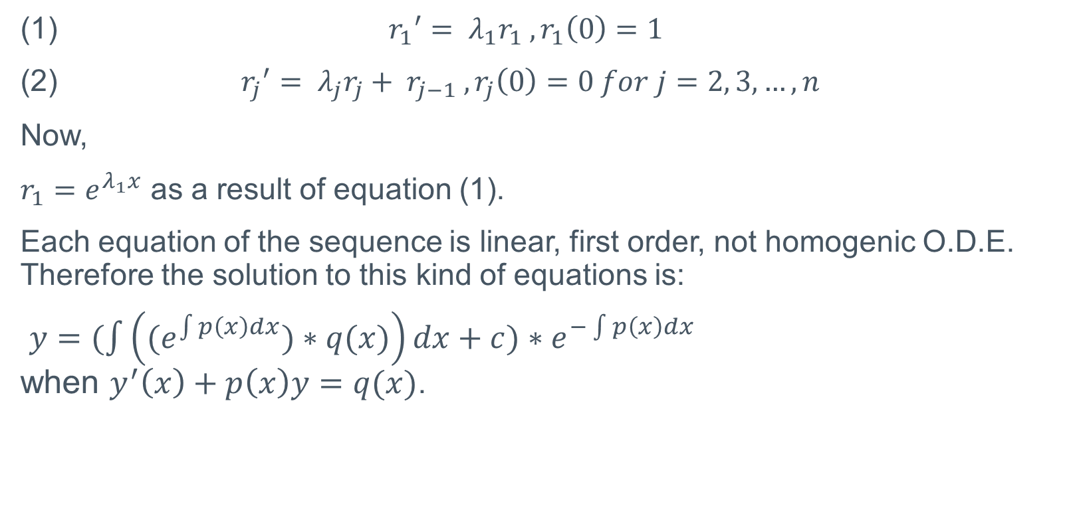

The Improvement – $r_{i}$
$$e^{m}$$
(1) ${r_{1}}^{′}= λ_{1}r_{1} , r_{1}\left(0\right)=1$
(2) ${r_{j}}^{′}= λ_{j}r_{j}+ r_{j−1} , r_{j}\left(0\right)=0 for j=2, 3,…, n$
Now,
$r_{1}=e^{λ_{1}x}$ as a result of equation (1).
Each equation of the sequence is linear, first order, not homogenic O.D.E. Therefore the solution to this kind of equations is:
$y=(\int{\left({(e}^{\int{p\left(x\right)dx}})∗q(x)\right)dx+c)}∗e^{−\int{p\left(x\right)dx}}$ when $y^{′}\left(x\right)+p\left(x\right)y=q(x)$.

Slide 23

The Improvement – $r_{i}$
$$e^{m}$$
When $p\left(x\right)=−λ_{i}, q\left(x\right)=r_{i−1}.$
And the start condition $r_{j}\left(0\right)=0$.
The solution takes the form:
$$r_{i}=\left(\int{\left(e^{−λ_{i}x}r_{i−1}(x)\right)dx−{\left.\int{\left(r_{i−1}\left(x\right)\right)dx}\right|}_{x=0}}\right)∗e^{λ_{i}x}$$

Slide 24
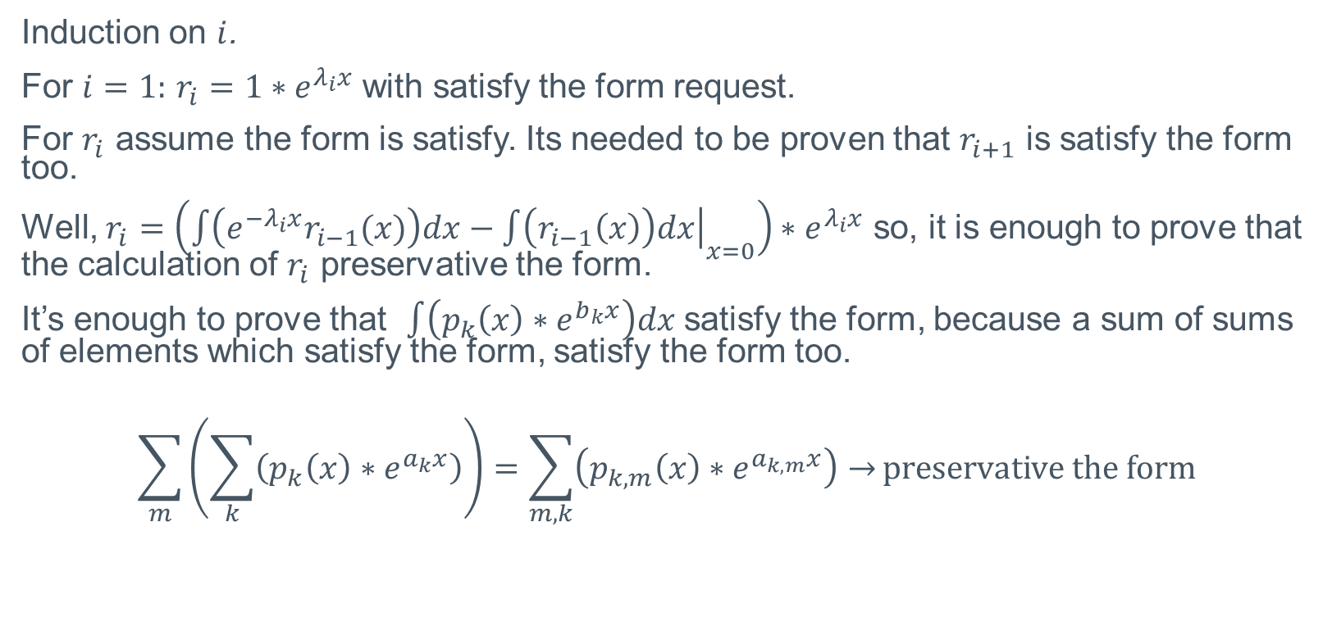
The Improvement - Lemma 1
$$e^{m}$$
Induction on $i$.
For $i=1:$ $r_{i}={1∗e}^{λ_{i}x}$ with satisfy the form request.
For $r_{i}$ assume the form is satisfy. Its needed to be proven that $r_{i+1}$ is satisfy the form too.
Well, $r_{i}=\left(\int{\left(e^{−λ_{i}x}r_{i−1}(x)\right)dx−{\left.\int{\left(r_{i−1}\left(x\right)\right)dx}\right|}_{x=0}}\right)∗e^{λ_{i}x}$ so, it is enough to prove that the calculation of $r_{i}$ preservative the form.
It’s enough to prove that $\int{\left(p_{k}\left(x\right)∗e^{b_{k}x}\right)dx}$ satisfy the form, because a sum of sums of elements which satisfy the form, satisfy the form too.
$$\sum_{m}{\left(\sum_{k}{\left(p_{k}\left(x\right)∗e^{a_{k}x}\right)}\right)}=\sum_{m,k}{\left(p_{k,m}\left(x\right)∗e^{a_{k,m}x}\right)→}preservative the form$$

Slide 25
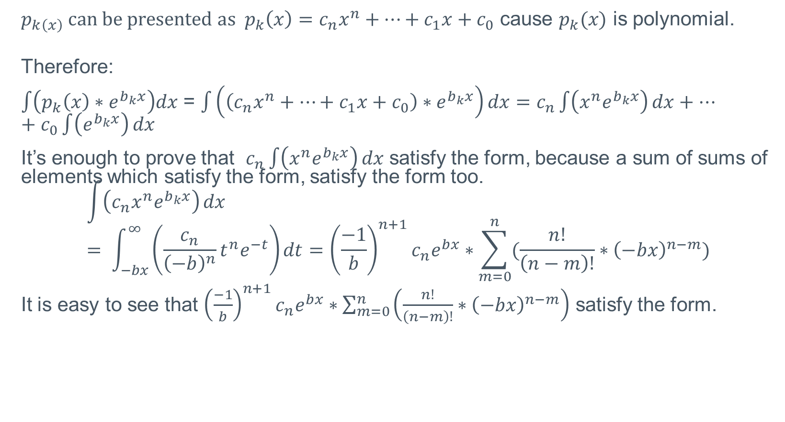
The Improvement - Lemma 1
$$e^{m}$$
$p_{k\left(x\right)} can be presented as p_{k}\left(x\right)=c_{n}x^{n}+…+c_{1}x+c_{0}$ cause $p_{k}(x)$ is polynomial.
Therefore:
$\int{\left(p_{k}\left(x\right)∗e^{b_{k}x}\right)dx}$ = $\int{\left(\left(c_{n}x^{n}+…+c_{1}x+c_{0}\right)∗e^{b_{k}x}\right)dx}=c_{n}\int{\left(x^{n}e^{b_{k}x}\right)}dx+…+c_{0}\int{\left(e^{b_{k}x}\right)}dx$
It’s enough to prove that $c_{n}\int{\left(x^{n}e^{b_{k}x}\right)}dx$ satisfy the form, because a sum of sums of elements which satisfy the form, satisfy the form too. $$\int{\left({c_{n}x}^{n}e^{b_{k}x}\right)}dx= \int_{−bx}^{∞}{\left(\frac{c_{n}}{{\left(−b\right)}^{n}}t^{n}e^{−t}\right)dt={\left(\frac{−1}{b}\right)}^{n+1}c_{n}e^{bx}∗\sum_{m=0}^{n}{(\frac{n!}{\left(n−m\right)!}∗{\left(−bx\right)}^{n−m})}}$$
It is easy to see that ${\left(\frac{−1}{b}\right)}^{n+1}c_{n}e^{bx}∗\sum_{m=0}^{n}{\left(\frac{n!}{\left(n−m\right)!}∗{\left(−bx\right)}^{n−m}\right)}$ satisfy the form.

Slide 26
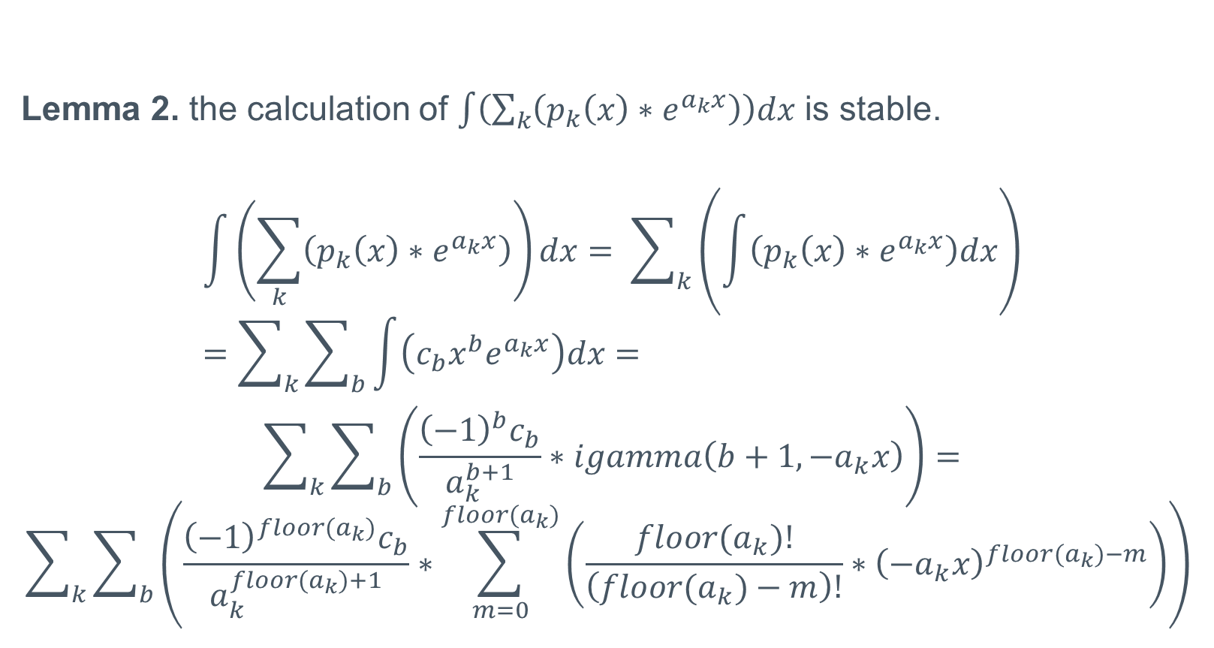
The Improvement - Lemma 2
$$e^{m}$$
Lemma 2. the calculation of $\int{\left(\sum_{k}{\left(p_{k}\left(x\right)∗e^{a_{k}x}\right)}\right)dx}$ is stable.
$$\int{\left(\sum_{k}{\left(p_{k}\left(x\right)∗e^{a_{k}x}\right)}\right)dx}= \sum_{k}{\left(\int{\left(p_{k}\left(x\right)∗e^{a_{k}x}\right)dx}\right)}=\sum_{k}{\sum_{b}{\int{\left(c_{b}x^{b}e^{a_{k}x}\right)dx}=}}$$
$$\sum_{k}{\sum_{b}{\left(\frac{{{\left(−1\right)}^{b}c}_{b}}{a_{k}^{b+1}}∗igamma\left(b+1,−a_{k}x\right)\right)=}}$$
$$\sum_{k}{\sum_{b}{\left(\frac{{{\left(−1\right)}^{floor(a_{k})}c}_{b}}{a_{k}^{floor(a_{k})+1}}∗\sum_{m=0}^{floor(a_{k})}{\left(\frac{floor(a_{k})!}{\left(floor(a_{k})−m\right)!}∗{\left(−a_{k}x\right)}^{floor(a_{k})−m}\right)}\right)}}$$

Slide 27
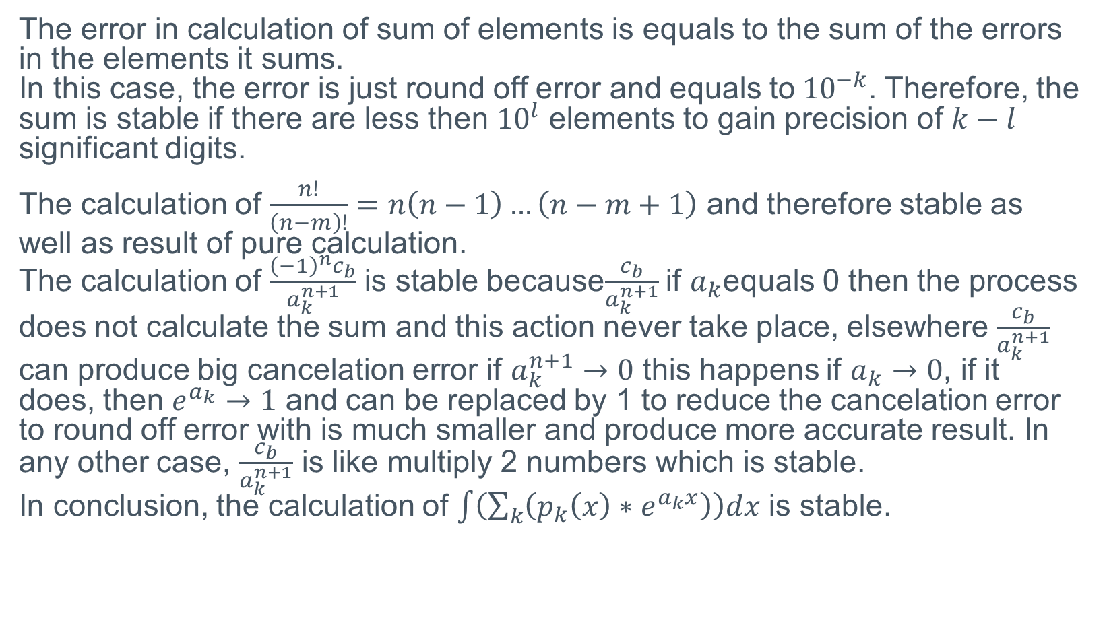
The Improvement - Lemma 2
$$e^{m}$$
The error in calculation of sum of elements is equals to the sum of the errors in the elements it sums. In this case, the error is just round off error and equals to${ 10}^{−k}$. Therefore, the sum is stable if there are less then ${10}^{l}$ elements to gain precision of $k−l$ significant digits.
The calculation of $\frac{n!}{\left(n−m\right)!}=n\left(n−1\right)…\left(n−m+1\right)$ and therefore stable as well as result of pure calculation. The calculation of $\frac{{{\left(−1\right)}^{n}c}_{b}}{a_{k}^{n+1}}$ is stable because$\frac{c_{b}}{a_{k}^{n+1}}$ if $a_{k}$equals 0 then the process does not calculate the sum and this action never take place, elsewhere $\frac{c_{b}}{a_{k}^{n+1}}$ can produce big cancelation error if $a_{k}^{n+1}→0$ this happens if $a_{k}→0$, if it does, then $e^{a_{k}}→1$ and can be replaced by 1 to reduce the cancelation error to round off error with is much smaller and produce more accurate result. In any other case, $\frac{c_{b}}{a_{k}^{n+1}}$ is like multiply 2 numbers which is stable. In conclusion, the calculation of $\int{\left(\sum_{k}{\left(p_{k}\left(x\right)∗e^{a_{k}x}\right)}\right)dx}$ is stable.

Slide 28
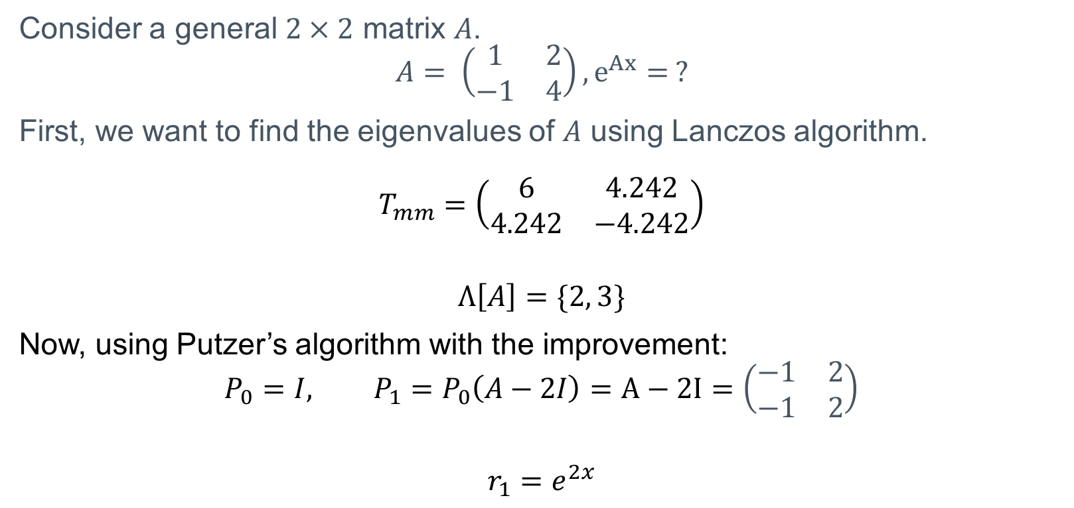

Examples
$$A∈ℝ^{2×2}$$
$$e^{m}$$
Consider a general $2×2$ matrix $A$.
$$A= \left(\begin{matrix}1 & 2 \\ −1 & 4\end{matrix}\right), e^{Ax}= ?$$
First, we want to find the eigenvalues of $A$ using Lanczos algorithm.
$$T_{mm}=\left(\begin{matrix}6 & 4.242 \\ 4.242 & −4.242\end{matrix}\right)$$
$$Λ\left[A\right]=\{2, 3\}$$
Now, using Putzer’s algorithm with the improvement:
$$P_{0}=I, P_{1}=P_{0}\left(A−2I\right)=A−2I=\left(\begin{matrix}−1 & 2 \\ −1 & 2\end{matrix}\right)$$
$$r_{1}=e^{2x}$$

Slide 29

Examples
$$A∈ℝ^{2×2}$$
$$e^{m}$$
$$r_{2}=\left(\int{\left(e^{−3x}e^{2x}\right)dx−{\left.\int{\left(e^{2x}\right)dx}\right|}_{x=0}}\right)∗e^{3x}$$
$$=\left(\int{\left(e^{−x}\right)dx−{\left.\frac{e^{2x}}{2}\right|}_{x=0}}\right)∗e^{3x}$$
$$=\left(\frac{e^{−x}}{−1}−\frac{1}{2}\right)∗e^{3x}=\frac{e^{2x}}{−1}−\frac{e^{3x}}{2}=−\frac{\left(2e^{2x}+e^{3x}\right)}{2}$$

Slide 30

Examples
$$A∈ℝ^{2×2}$$
$$e^{m}$$
$$Y=r_{1}P_{0}+r_{2}P_{1}$$
$$Y=e^{2x}∗\left(\begin{matrix}1 & 0 \\ 0 & 1\end{matrix}\right)−\frac{\left(2e^{2x}+e^{3x}\right)}{2}∗\left(\begin{matrix}−1 & 2 \\ −1 & 2\end{matrix}\right)$$
$$Y= \left(\begin{matrix}2e^{2x}+\frac{e^{3x}}{2} & −2e^{2x}−e^{3x} \\ e^{2x}+\frac{e^{3x}}{2} & {−e}^{2x}−e^{3x}\end{matrix}\right)=e^{Ax}$$

Slide 31
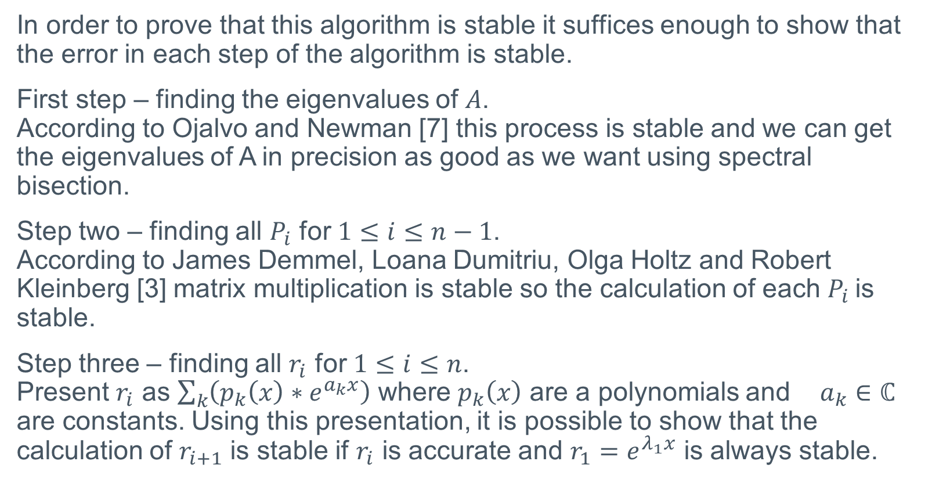
Stability of the algorithm
$$e^{m}$$
In order to prove that this algorithm is stable it suffices enough to show that the error in each step of the algorithm is stable.
First step – finding the eigenvalues of $A$. According to Ojalvo and Newman [7] this process is stable and we can get the eigenvalues of A in precision as good as we want using spectral bisection.
Step two – finding all $P_{i}$ for $1≤i≤n−1$. According to James Demmel, Loana Dumitriu, Olga Holtz and Robert Kleinberg [3] matrix multiplication is stable so the calculation of each $P_{i}$is stable.
Step three – finding all $r_{i}$ for $1≤i≤n$. Present $r_{i}$ as $\sum_{k}{\left(p_{k}\left(x\right)∗e^{a_{k}x}\right)}$ where $p_{k}\left(x\right)$ are a polynomials and $a_{k}∈ℂ$ are constants. Using this presentation, it is possible to show that the calculation of $r_{i+1}$ is stable if $r_{i}$ is accurate and $r_{1}=e^{λ_{1}x}$ is always stable.

Slide 32
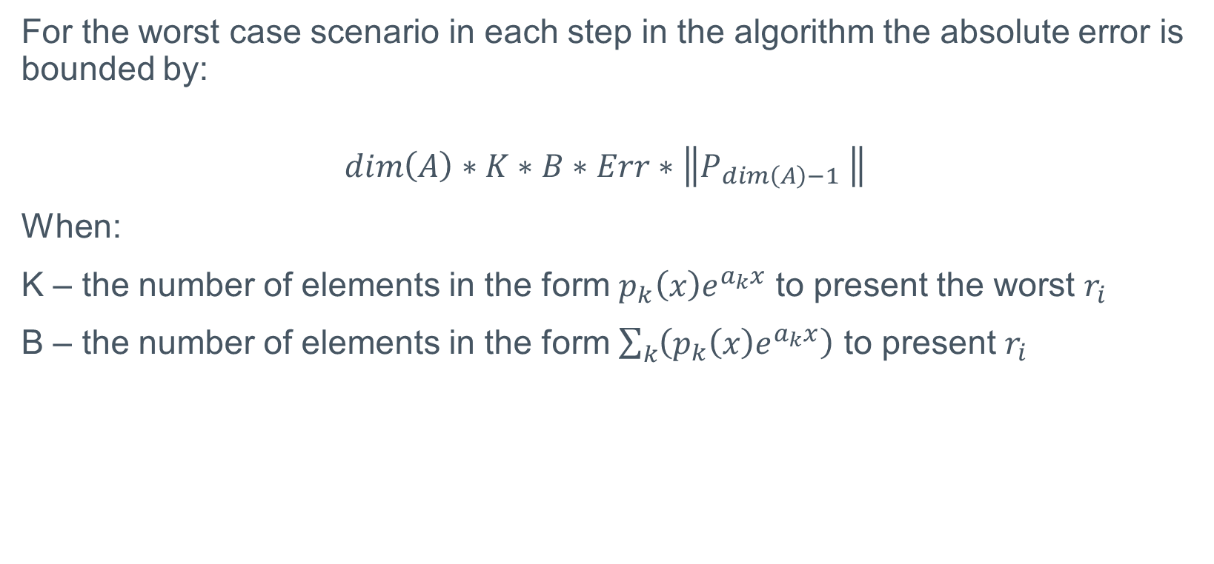

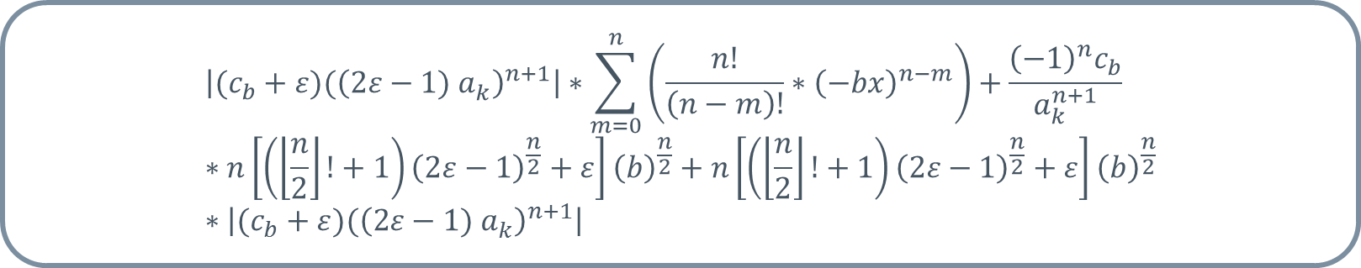
Numerical analysis
$$e^{m}$$
For the worst case scenario in each step in the algorithm the absolute error is bounded by:
$$dim\left(A\right)∗K∗B∗Err∗\left\|P_{dim\left(A\right)−1} \right\|$$
When:
K – the number of elements in the form $p_{k}\left(x\right)e^{a_{k}x}$ to present the worst $r_{i}$
B – the number of elements in the form $\sum_{k}{\left(p_{k}\left(x\right)e^{a_{k}x}\right)}$ to present $r_{i}$
$$\left|(c_{b}+ε)({\left(2ε−1) a_{k}^{ }\right)}^{n+1}\right|∗\sum_{m=0}^{n}{\left(\frac{n!}{\left(n−m\right)!}∗{\left(−bx\right)}^{n−m}\right)}+\frac{{{\left(−1\right)}^{n}c}_{b}}{a_{k}^{n+1}}∗n\left[\left(\left\lfloor \frac{n}{2}\right\rfloor !+1\right){\left(2ε−1\right)}^{\frac{n}{2}}+ε\right]{\left(b\right)}^{\frac{n}{2}}+n\left[\left(\left\lfloor \frac{n}{2}\right\rfloor !+1\right){\left(2ε−1\right)}^{\frac{n}{2}}+ε\right]{\left(b\right)}^{\frac{n}{2}}∗\left|(c_{b}+ε)({\left(2ε−1) a_{k}^{ }\right)}^{n+1}\right|$$
$$Err$$

Slide 33
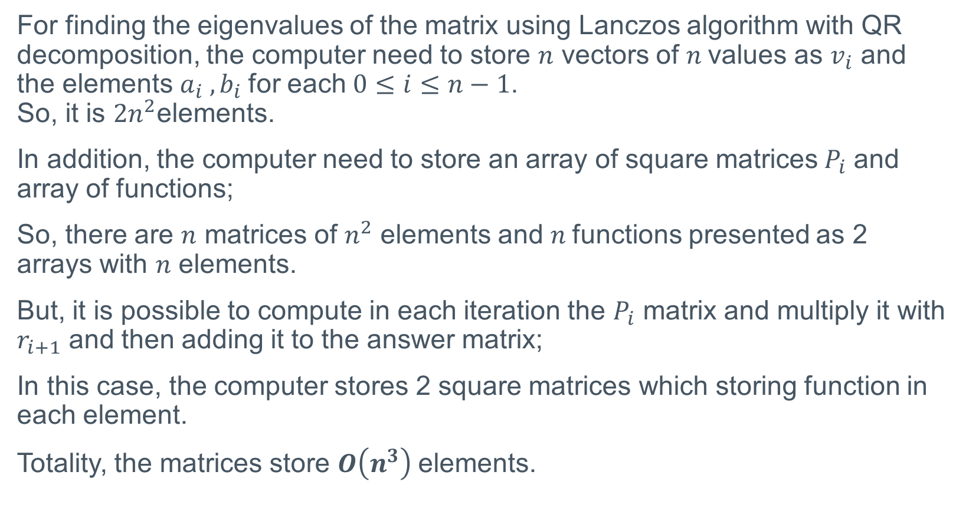
Storage requirements
$$e^{m}$$
For finding the eigenvalues of the matrix using Lanczos algorithm with QR decomposition, the computer need to store $n$ vectors of $n$values as $v_{i}$ and the elements $a_{i} ,b_{i}$for each$0≤i≤n−1$. So, it is $2n^{2}$elements.
In addition, the computer need to store an array of square matrices${ P}_{i}$ and array of functions;
So, there are $n$ matrices of $n^{2}$ elements and $n$functions presented as 2 arrays with $n$ elements.
But, it is possible to compute in each iteration the $P_{i}$ matrix and multiply it with $r_{i+1}$ and then adding it to the answer matrix;
In this case, the computer stores 2 square matrices which storing function in each element.
Totality, the matrices store $O\left(n^{3}\right)$elements.

Slide 34
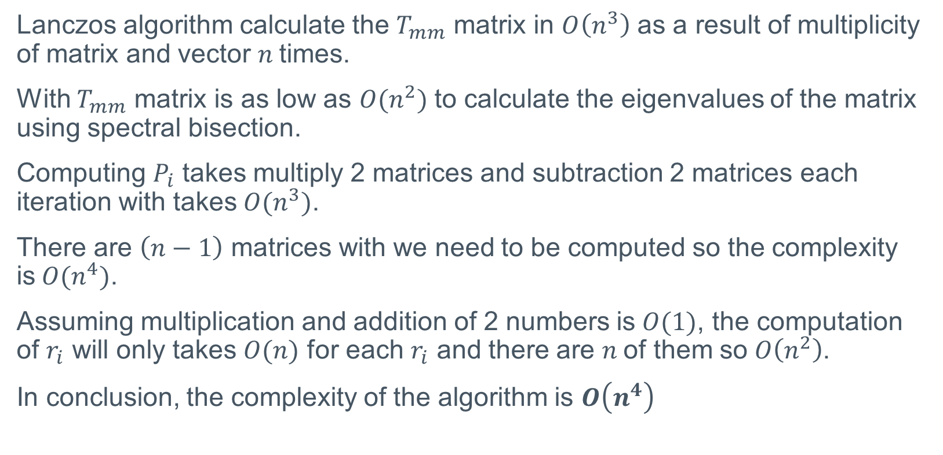
Complexity
$$e^{m}$$
Lanczos algorithm calculate the $T_{mm}$ matrix in $O\left(n^{3}\right)$ as a result of multiplicity of matrix and vector $n$times.
With $T_{mm}$ matrix is as low as $O(n^{2})$ to calculate the eigenvalues of the matrix using spectral bisection.
Computing $P_{i}$ takes multiply 2 matrices and subtraction 2 matrices each iteration with takes$O(n^{3})$.
There are $\left(n−1\right)$ matrices with we need to be computed so the complexity is$O(n^{4})$.
Assuming multiplication and addition of 2 numbers is$O(1)$, the computation of $r_{i}$ will only takes $O(n)$ for each $r_{i}$ and there are $n$of them so$O\left(n^{2}\right)$.
In conclusion, the complexity of the algorithm is $O\left(n^{4}\right)$

Slide 35
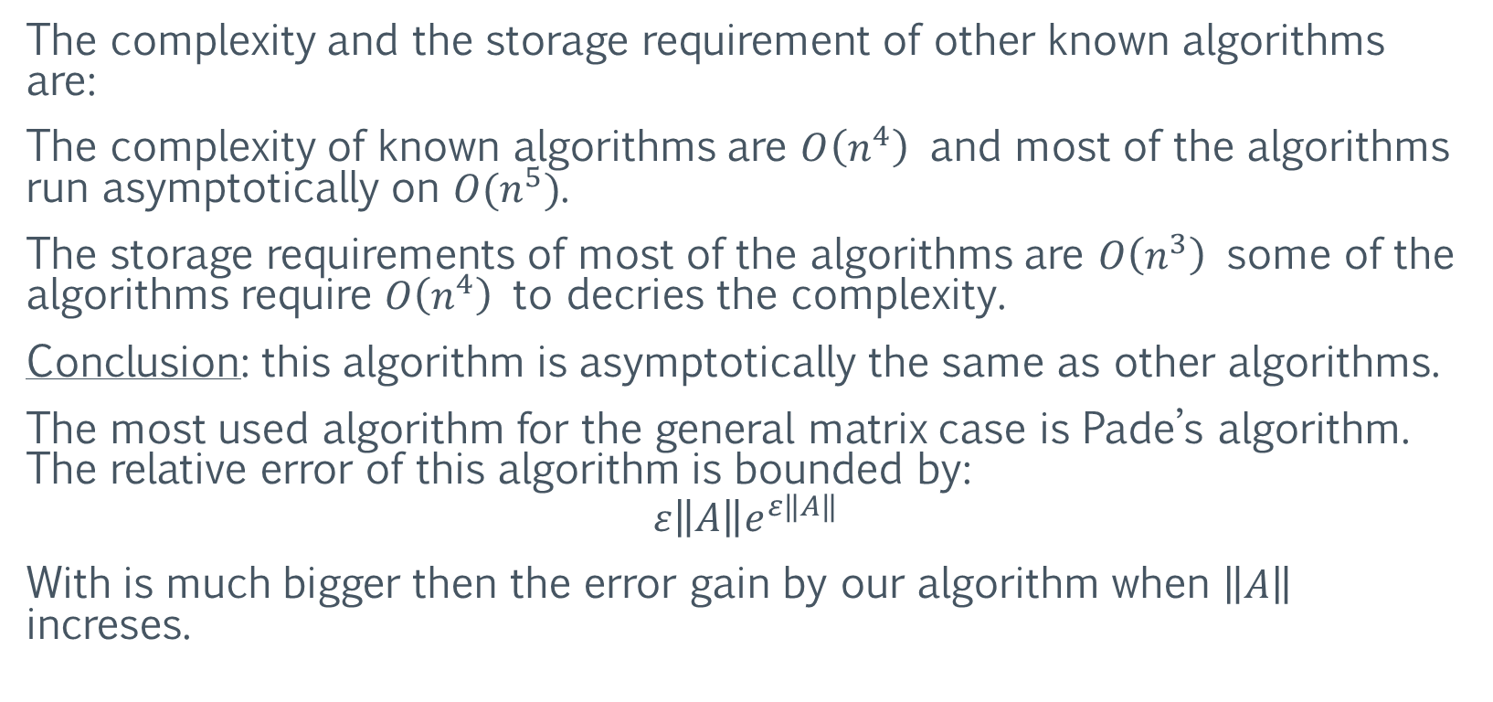
Comparison with other algorithms
$$e^{m}$$
The complexity and the storage requirement of other known algorithms are:
The complexity of known algorithms are $O\left(n^{4}\right)$ and most of the algorithms run asymptotically on $O(n^{5})$.
The storage requirements of most of the algorithms are $O\left(n^{3}\right)$ some of the algorithms require $O\left(n^{4}\right)$ to decries the complexity.
Conclusion: this algorithm is asymptotically the same as other algorithms.
The most used algorithm for the general matrix case is Pade’s algorithm. The relative error of this algorithm is bounded by:
$$ε\left\|A\right\|e^{ε\left\|A\right\|}$$
With is much bigger then the error gain by our algorithm when $\left\|A\right\|$ increses.

Slide 36
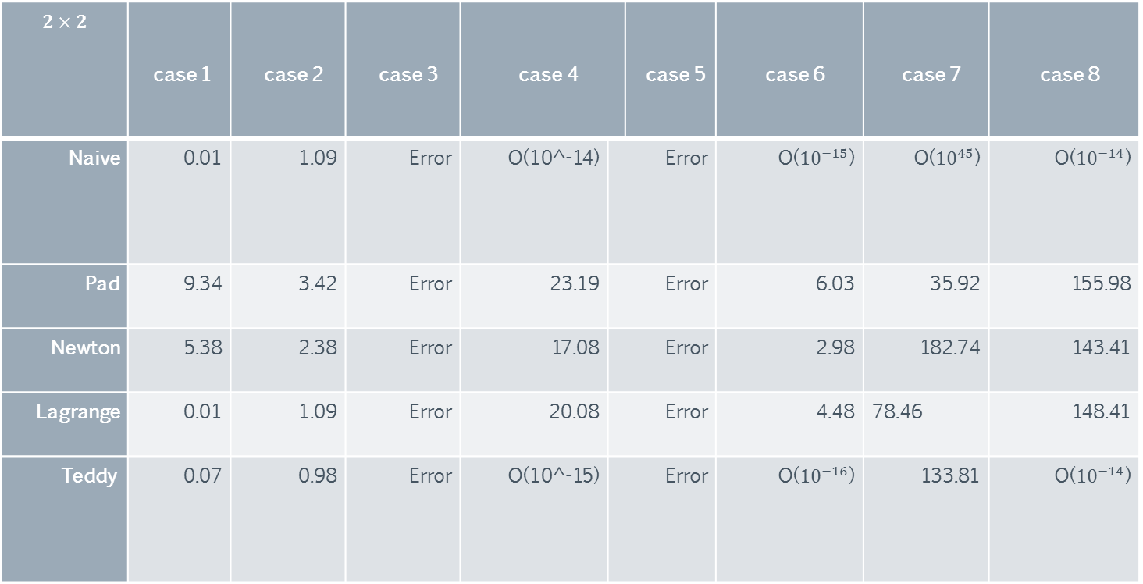
Comparison with other algorithms
$$e^{m}$$
$$2×2$$ | case 1 | case 2 | case 3 | case 4 |  | case 5 | case 6 | case 7 | case 8
Naive | 0.01 | 1.09 | Error | O(10^-14) | Error |  | O(${10}^{−15}$) | O(${10}^{45}$) | O(${10}^{−14}$)
Pad | 9.34 | 3.42 | Error | 23.19 | Error |  | 6.03 | 35.92 | 155.98
Newton | 5.38 | 2.38 | Error | 17.08 | Error |  | 2.98 | 182.74 | 143.41
Lagrange | 0.01 | 1.09 | Error | 20.08 | Error |  | 4.48 | 78.46 | 148.41
Teddy | 0.07 | 0.98 | Error | O(10^-15) | Error |  | O(${10}^{−16}$) | 133.81 | O(${10}^{−14}$)

Slide 37
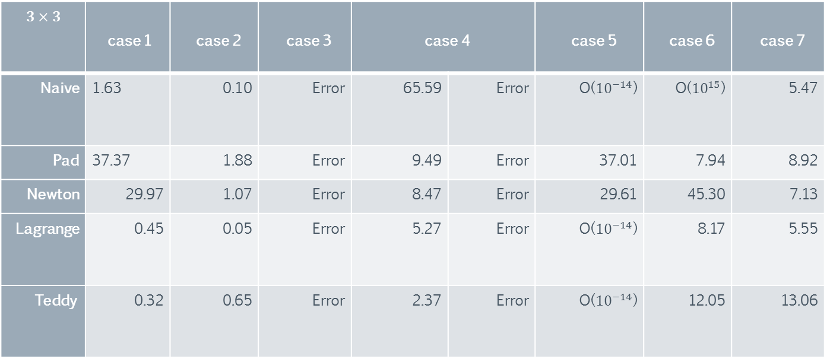
Comparison with other algorithms
$$e^{m}$$
$$3×3$$ | case 1 | case 2 | case 3 | case 4 |  | case 5 | case 6 | case 7
Naive | 1.63 | 0.10 | Error | 65.59 | Error | O(${10}^{−14}$) | O(${10}^{15}$) | 5.47
Pad | 37.37 | 1.88 | Error | 9.49 | Error | 37.01 | 7.94 | 8.92
Newton | 29.97 | 1.07 | Error | 8.47 | Error | 29.61 | 45.30 | 7.13
Lagrange | 0.45 | 0.05 | Error | 5.27 | Error | O(${10}^{−14}$) | 8.17 | 5.55
Teddy | 0.32 | 0.65 | Error | 2.37 | Error | O(${10}^{−14}$) | 12.05 | 13.06

Slide 38
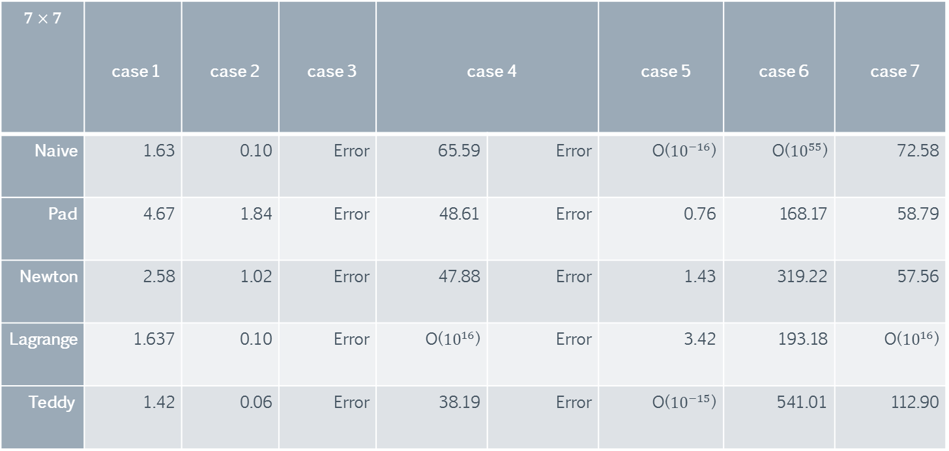
Comparison with other algorithms
$$e^{m}$$
$$7×7$$ | case 1 | case 2 | case 3 | case 4 |  | case 5 | case 6 | case 7
Naive | 1.63 | 0.10 | Error | 65.59 | Error | O(${10}^{−16}$) | O(${10}^{55}$) | 72.58
Pad | 4.67 | 1.84 | Error | 48.61 | Error | 0.76 | 168.17 | 58.79
Newton | 2.58 | 1.02 | Error | 47.88 | Error | 1.43 | 319.22 | 57.56
Lagrange | 1.637 | 0.10 | Error | O(${10}^{16}$) | Error | 3.42 | 193.18 | O(${10}^{16}$)
Teddy | 1.42 | 0.06 | Error | 38.19 | Error | O(${10}^{−15}$) | 541.01 | 112.90

Slide 39
Decision tree algorithm
$$e^{m}$$
The new algorithm presented is stable but not the most effective in most of the cases.
Therefore, we developed an algorithm which preservative stability and trying to improve efficiency as much as possible…
The algorithm based on a choosing tree when the leafs are algorithms for matrix exponent and the other nodes operates as a condition – state for the matrix.

Slide 40
Choose tree algorithm – structure
$$e^{m}$$

Slide 41
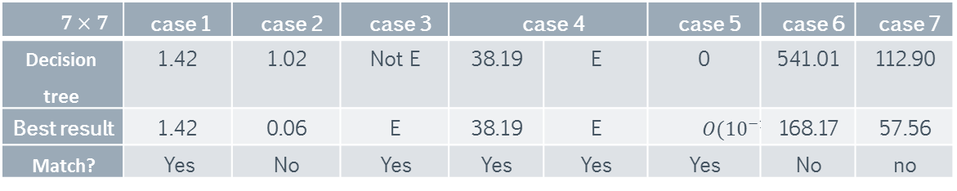
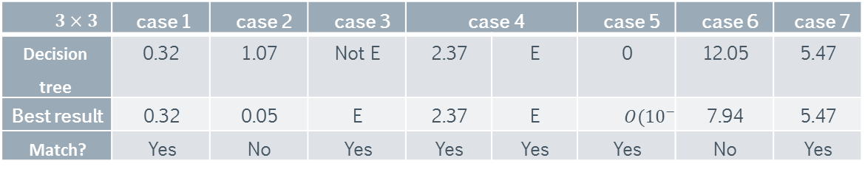
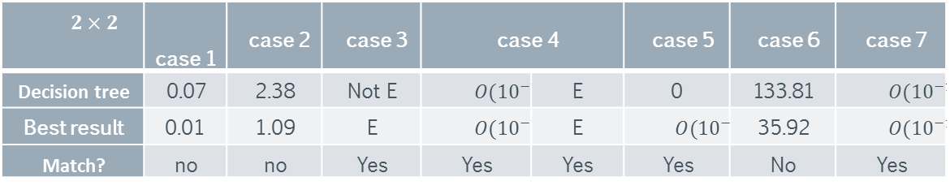
Choose tree algorithm – Compare
$$e^{m}$$
$$2×2$$ | case 1 | case 2 | case 3 | case 4 |  | case 5 | case 6 | case 7
Decision tree | 0.07 | 2.38 | Not E | $$O({10}^{−15})$$ | E | 0 | 133.81 | $$O({10}^{−14})$$
Best result | 0.01 | 1.09 | E | $$O({10}^{−15})$$ | E | $$O({10}^{−16})$$ | 35.92 | $$O({10}^{−14})$$
Match? | no | no | Yes | Yes | Yes | Yes | No | Yes
The decision tree gets the best result 16 out of 24 cases.
This decision tree algorithm is 67% of the time the best choice for EXPM.
$$3×3$$ | case 1 | case 2 | case 3 | case 4 |  | case 5 | case 6 | case 7
Decision tree | 0.32 | 1.07 | Not E | 2.37 | E | 0 | 12.05 | 5.47
Best result | 0.32 | 0.05 | E | 2.37 | E | $$O({10}^{−14})$$ | 7.94 | 5.47
Match? | Yes | No | Yes | Yes | Yes | Yes | No | Yes
$$7×7$$ | case 1 | case 2 | case 3 | case 4 |  | case 5 | case 6 | case 7
Decision tree | 1.42 | 1.02 | Not E | 38.19 | E | 0 | 541.01 | 112.90
Best result | 1.42 | 0.06 | E | 38.19 | E | $$O({10}^{−16})$$ | 168.17 | 57.56
Match? | Yes | No | Yes | Yes | Yes | Yes | No | no

Slide 42
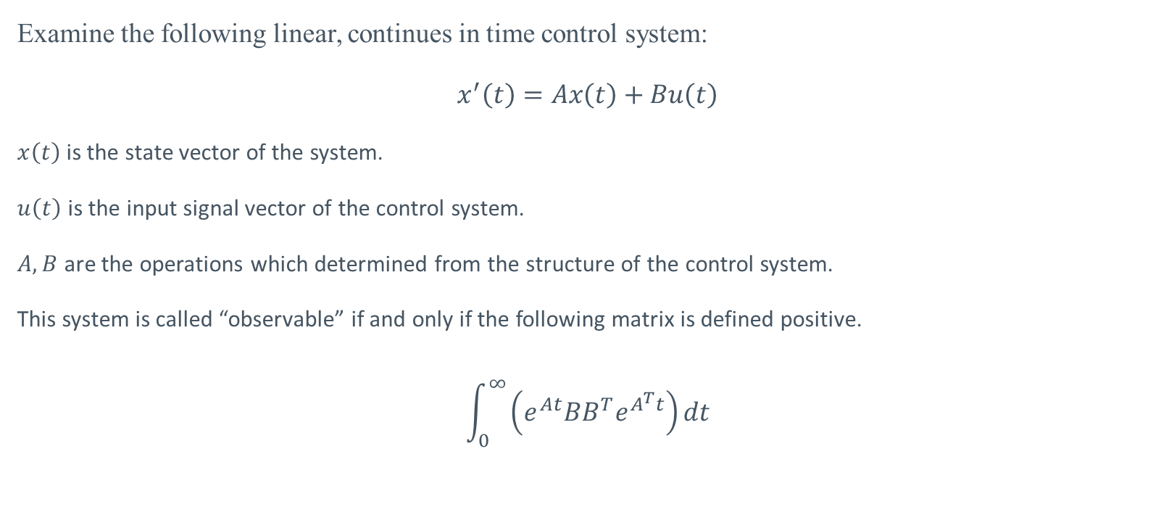
Example to real world application
$$e^{m}$$
Examine the following linear, continues in time control system:
$$x^{′}\left(t\right)=Ax\left(t\right)+Bu\left(t\right)$$
$x\left(t\right)$ is the state vector of the system.
$u\left(t\right)$ is the input signal vector of the control system.
$A, B$ are the operations which determined from the structure of the control system.
This system is called “observable” if and only if the following matrix is defined positive.
$$\int_{0}^{∞}{\left(e^{At}BB^{T}e^{A^{T}t}\right)dt}$$

Slide 43
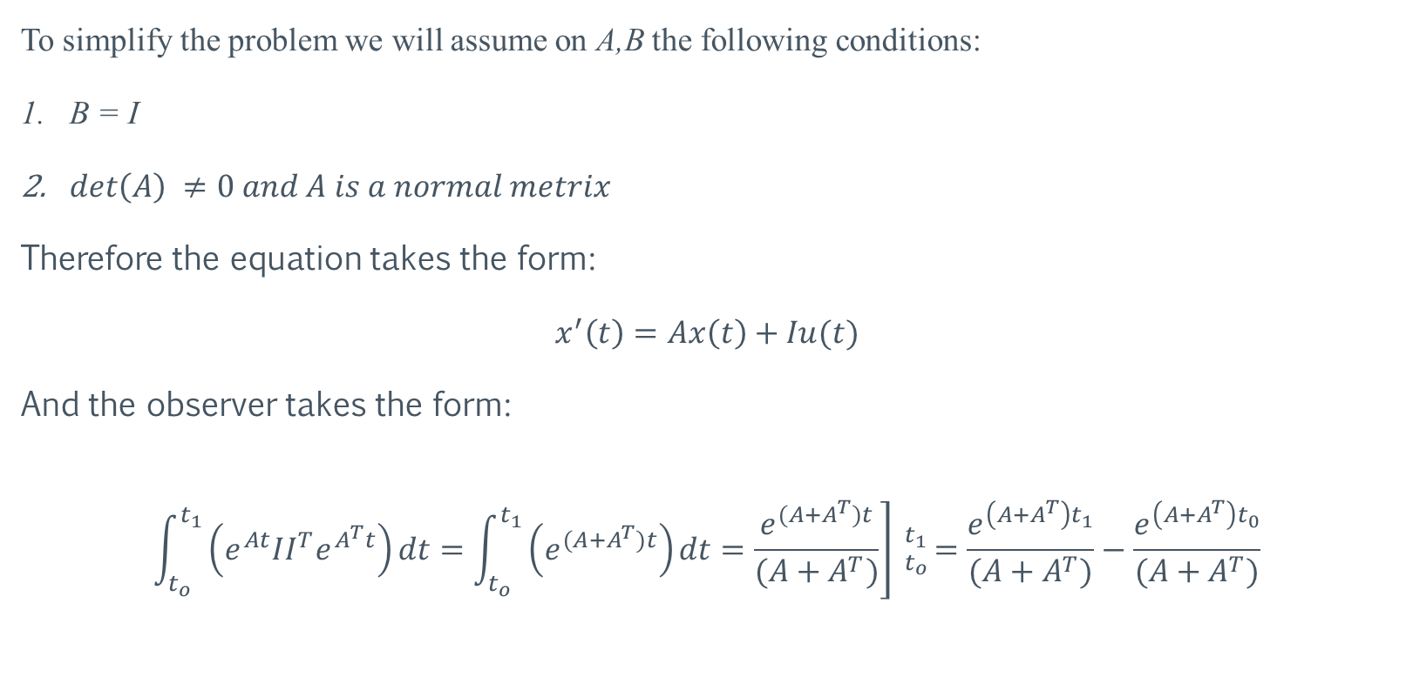
Example to real world application
$$e^{m}$$
To simplify the problem we will assume on A,B the following conditions:
B = I
$\det\left(A\right) ≠0 and A is a normal metrix$
Therefore the equation takes the form:
$$x^{′}\left(t\right)=Ax\left(t\right)+Iu(t)$$
And the observer takes the form:
$$\int_{t_{o}}^{t_{1}}{\left(e^{At}II^{T}e^{A^{T}t}\right)dt}=\int_{t_{o}}^{t_{1}}{\left(e^{(A+A^{T})t}\right)dt}=\left.\frac{e^{(A+A^{T})t}}{(A+A^{T})}\right] _{t_{o}}^{t_{1}}=\frac{e^{\left(A+A^{T}\right)t_{1}}}{(A+A^{T})}−\frac{e^{\left(A+A^{T}\right)t_{0}}}{(A+A^{T})}$$

Slide 44
References
$$e^{m}$$
[1] R. M. Karp, "Reducibility among Combinatorial Problems", Complexity of Computer Computations, (1972), pp. 85-103.
[2] Erik Wahlén, “Alternative proof of Putzer’s algorithm”, (2013) (http://www.ctr.maths.lu.se/media/MATM14/2013vt2013/putzer.pdf)
[3] James Demmel, Ioana Dumitriu, Olga Holtz, and Robert Kleinberg, “Fast matrix multiplication is stable”, (2006) (https://www.math.washington.edu/~dumitriu/fmm_arxiv.pdf )
[4] Grigory Agranovich, Ariel University,” Observer for Discrete-Continuous LTI with continuous-time measurements” (2010)

Slide 45
References
$$e^{m}$$
[5] Cleve Moler, Charles Van Loan, Society for Industrial and Applied Mathematics, “Nineteen Dubious Ways to Compute the Exponential of a Matrix, Twenty-Five Years Later” (2003)
[6] Lanczos, C. "An iteration method for the solution of the eigenvalue problem of linear differential and integral operators", J. Res. Nat’l Bur. Std. 45, 225-282 (1950).
[7] Ojalvo, I.U. and Newman, M., "Vibration modes of large structures by an automatic matrix-reduction method", AIAA J., 8 (7), 1234–1239 (1970).
[8] Trefethen, Lloyd N.; Bau, David, Numerical linear algebra, Philadelphia: Society for Industrial and Applied Mathematics, ISBN 978-0-89871-361-9 (1997)

Slide 46

Implementation
$$e^{m}$$
An example of Matlab code which run this algorithm is:
function [ expm ] = expm_stable( M )
Roots = eigs(M);
syms x;
r = exp(Roots(1)*x);
p = eye(size(M));
Y = r * p;
for i = 2:(size(Roots,1))
r = (int((exp((-1)*Roots(i)*x))*r)-subs(int(r),x,0))*exp(Roots(i)*x);
p = p * (M - Roots(i)*eye(size(M)));
Y = Y + r * p;
end
expm = subs(Y, x, 1);
end
This code is not numeric, it uses a symbolic calculation

Slide 47


Implementation
$$e^{m}$$
Numeric implementation in C#:
Matrix_Ri
2 dim array of Ri
Ri
List of Expoly
Expoly
List of double
Single double
The structure of matrix of $r_{i}$ is a 2 – dimension array of list of [ list of numbers, number ].

Slide 48
Implementation
$$e^{m}$$
The all code is long and out of the scope of this desiccation, I will present only the top function:
public MatrixRi Expm(double[,] originalMatrix, double[] eigs) {
MatrixRi expM = new MatrixRi(originalMatrix.GetLength(0));
MatrixRi p = new MatrixRi(eye(expM.elements.GetLength(0)));
Ri ri = new Ri();
ri = ri.multExp(eigs[0]);
for (int i = 0; i < expM.elements.GetLength(0); i++) {
expM.elements[i,i] = ri;
}
for (int i = 1; i < expM.elements.GetLength(0); i++) {
ri = ri.doStep(eigs[i]);
p = p.mult(subMatrix(originalMatrix, eye(eigs.Length, eigs[i])));
expM = expM.Addition(p.multRi(ri));
}
return expM;
}

