Slide 1
Energy Efficiency in 2d
Quadratic Hamiltonian
Barry Ginat
Teddy Lazebnik
Adviser: Prof. Michael Entov

Slide 2

The problem
Given a quadratic Hamiltonian, start and end positions and a limitation on the size of the initial momenta, can the system get from the starting location to the final for some choice of the initial momenta?
q’’
p
q’
q

Slide 3

Abstract
When the Hamiltonian function $ℋ(p, q)$ is a quadratic form, the equations of motion become linear and can be solved explicitly.
But the answer to the problem is still not immediate.
We start with n = 1 and then move on to the much harder n = 2 case.

Slide 4

BG - Hamiltonian
$$\left\{\begin{aligned}\dot{p}=−\frac{∂ℋ\left(p,q\right)}{∂q} \\ \dot{q}=\frac{∂ℋ\left(p,q\right)}{∂p}\end{aligned}\right.$$
The Hamiltonian encodes all the physics describing the system.
The motion is on the “constant energy contours” and we are looking for an “integral curve”

Slide 5

Generic case – no limit on the energy
For given $ℋ\left(\overline{p},\overline{q}\right)=p^{t}Ap+q^{t}Bq+p^{t}Cq,$
if $\det\left(A\right)≠0$ then for all $q^{′}, q′′$ there is a path from $q′$ to $q′′$.
$$\left(\begin{matrix}\begin{matrix}⋮ & ⋮ \\ −v_{1} & −v_{2}\end{matrix} & \begin{matrix}⋮ & ⋮ \\ e_{ }^{tA_{ℋ}}v_{1} & e_{ }^{tA_{ℋ}}v_{2}\end{matrix} \\ \begin{matrix} & \\ ⋮ & ⋮ \end{matrix} & \begin{matrix} & \\ ⋮ & ⋮ \end{matrix}\end{matrix}\right)$$

Slide 6


$$ℋ\left(p,q\right)=ap^{2}+bpq+cq^{2}$$
Here $p$ is the momentum and $q$ is the position. Want: trajectories from $q^{′}$ to $q′′$ with the initial condition $\left|p\right|≤R$
The corresponding Hamiltonian matrix is:
$A_{ℋ}=\left(\begin{matrix}−b & −2c \\ 2a & b\end{matrix}\right)$ so that $\left(\begin{matrix}\dot{p} \\ \dot{q}\end{matrix}\right)=A_{ℋ}\left(\begin{matrix}p \\ q\end{matrix}\right)$

Slide 7

The 3 cases depend on the discriminant of the characteristic polynomial of the matrix representing the Hamiltonian. The level sets of $ℋ$:
$$b^{2}−4ac>0→hyperbolas$$
$$b^{2}−4ac=0→parabolas$$
$$b^{2}−4ac<0→ellipses$$

Slide 8

p
q’’
q’
q

Slide 9

p
q’’
q’
q

Slide 10

p
q’’
q’
q

Slide 11

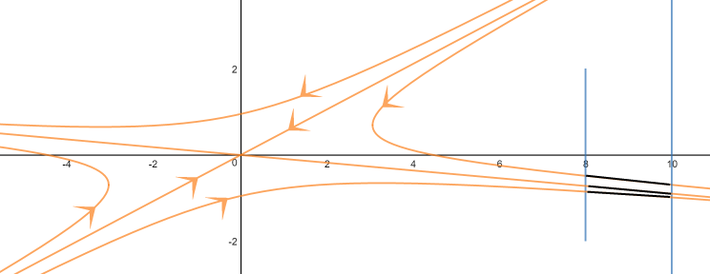

Slide 12
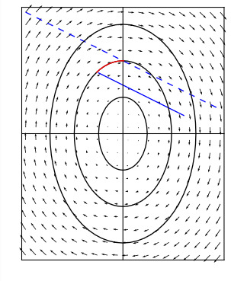
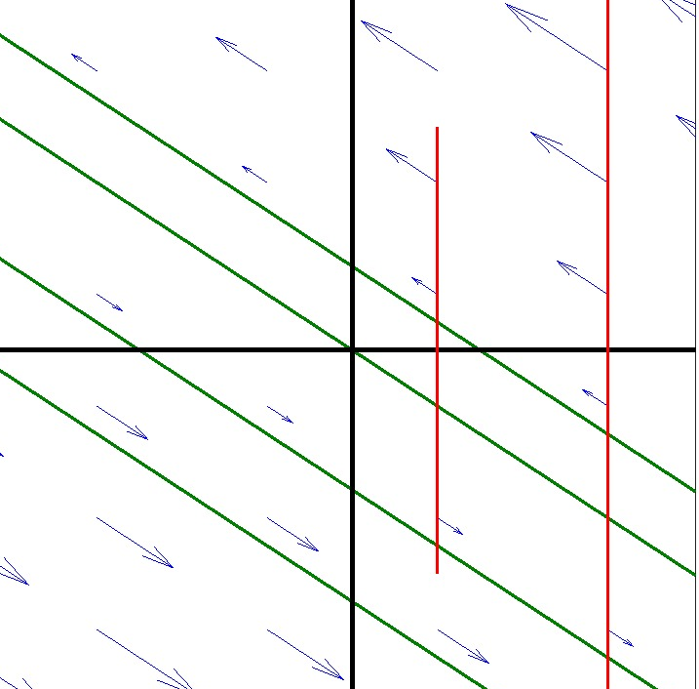

Slide 13

To solve the parabolic case: $t=\frac{\left|q^{′}−q^{′′}\right|}{2\sqrt{aℋ(R,q^{′})}}$
To solve the elliptic case:
Transform the system to a canonical form.
Find new $q^{′}, a, c$.
$t=\frac{arctan\left(\frac{\left(q_{new}^{′}−\sqrt{{q_{new}^{′}}^{2}+R^{2}}\right)}{q_{new}^{′}}\right)}{a_{new}∗c_{new}}$

Slide 14

3. To solve the hyperbolic case:
a. Find a linear functional for t
b. Insert the results here:
$$t_{i}(x)=\frac{ln\left(\frac{\left(q^{′′}+\sqrt{q^{′′2}+16a^{2}x^{2}+16axq^{′}b+4b^{2}−q^{′2}∗\sqrt{b^{2}−4ac}}\right)}{4ax+2q^{′}\sqrt[4]{b^{2}−4ac}+2q^{′}b}\right)}{\sqrt{b^{2}−4ac}}$$
c. Take $R, −R$ into account as well.
d. Return the minimum.

Slide 15



Slide 16


Slide 17

Find the Hamiltonian matrix of $ℋ$ and call it $A_{ℋ}$
$$A_{ℋ}= \left(\begin{matrix}\begin{matrix}{−c}_{11} & −c_{12} \\ −c_{21} & −c_{22}\end{matrix} & \begin{matrix}−2b_{11} & −2b_{12} \\ −2b_{21} & −2b_{22}\end{matrix} \\ \begin{matrix}2a_{11} & 2a_{12} \\ 2a_{21} & 2a_{22}\end{matrix} & \begin{matrix}c_{11} & c_{12} \\ c_{21} & c_{22}\end{matrix}\end{matrix}\right)$$

Slide 18

Find the eigenvalues of $A_{ℋ}$:
We used a numerical approach and got good results. But for a polynomial of order 4 one can solve it by substituting the parameters in a closed formula.
Regula falsi method
Newton's method
Secant method
Aberth methods

Slide 19


Assuming the Williamson transform is given and $A_{ℋ}$ is diagonalizable, transform $A_{ℋ}, q^{′}, q′′$.
Find which case the problem belongs to by checking the eigenvalues of $W(A_{ℋ})$
x | Ellipse | Hyperbola | Parabola
Ellipse | $$\{±k_{1}i, ±k_{2}i\}$$ | $$\left\{±k_{1}, ±k_{2}i\right\}$$ | $$\{0, 0, ±k_{2}i\}$$
Hyperbola | $$\{±k_{1}i, ±k_{2}\}$$ | $$\{±k_{1}, ±k_{2}\}$$ | $$\{0, 0, ±k_{2}\}$$
Parabola | $$\{±k_{1}i, 0, 0\}$$ | $$\{±k_{2}, 0, 0\}$$ | $$\{0, 0, 0, 0\}$$

Slide 20

Special case
This happens when the eigenvalues are:
$$λ_{k}= ±a±ib , 1≤k≤4, a,b, ≠0$$
We did not manage to solve this case fully. It is unknown at the moment how to solve this case but we managed to get a partial result in a particular case.

Slide 21

Special case
$$λ_{k}= ±a±ib , 1≤k≤4$$
The matrix after Williamson transform:
$$ℋ\left(\overline{p}, \overline{q}\right)=−a\left(p_{1}q_{1}+p_{2}q_{2}\right)−b\left(p_{2}q_{1}−p_{1}q_{2}\right)$$
We know that if the start and the end conditions are separated by a sphere centered at the origin, there are no solutions connecting them.

Slide 22

Interesting case
Consider the following Hamiltonian:
$$ℋ\left(\overline{p}, \overline{q}\right)=\frac{1}{2}\left(p_{1}^{2}+p_{2}^{2}\right)+\frac{1}{2}aq_{1}^{2}+bq_{1}q_{2}+\frac{1}{2}cq_{2}^{2}$$
This is a Hamiltonian used in classical mechanics. The corresponding matrix can be diagonalized easily by a symplectic transformation.
Thus it is solvable by the algorithm presented earlier.

Slide 23
Farther Research
As a suggestion for further research, we recommend trying to solve the problem for n=3.
We recommend trying a different approach from ours, because our approach does not look promising for n=3.
A topological approach might be helpful.

Slide 24

Appendix 1: Williamson

