Slide 1
Medical Nanorobotics in the circulatory system

Slide 2
Agenda
Background: Biological, Physical, and Mathematical
Medical nanorobotics in bio clinical settings
Medical nanorobotics in computer science prospective
Numerical-based simulation
Graph-based simulation – next meeting

Slide 3




Blood
Definition: Blood is a body fluid in humans and other animals that delivers necessary substances such as nutrients and oxygen to the cells and transports metabolic waste products away from those same cells.
Water
92%
Plasma
55%
White cells
1%
Red cells
45%

Slide 4

Blood - Newtonian fluid?
Definition: A Newtonian fluid is a fluid in which the viscous stresses arising from its flow, at every point, are linearly correlated to the local strain rate—the rate of change of its deformation over time [2].
Blood
NO [3]
Plasma
YES [3]

Slide 5
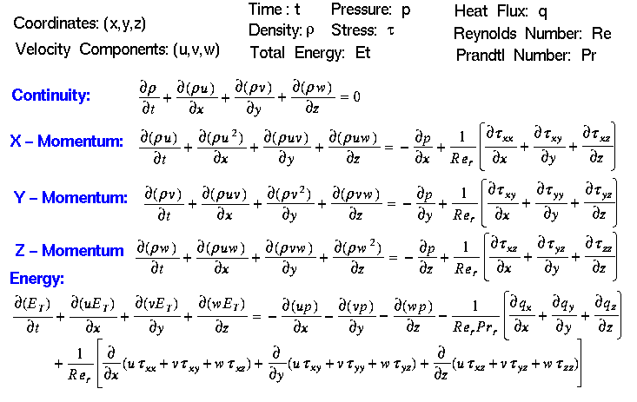
Blood – Physics
In physics, the Navier–Stokes equations are a set of partial differential equations which describe the motion of viscous fluid substances.

Slide 6
Navier–Stokes equations
NS Eq. are non-linear, fully depended, inhomogeneous, parabolic (second order), system of partial differential equations. Therefore, really hard to solve them…
Currently, there is not an global analytical solution and the ones for less “stiff” cases usually are limits or infinite sums.
Best solution so far uses reduction to Helmholtz equation with rectangular boundary and phase transfer conditions.
https://www.nature.com/news/fiendish-million-dollar-proof-eludes-mathematicians-1.15659

Slide 7
Navier–Stokes equations in the blood
Most of the time, it is possible to solve NS Eq. numerically as accurate as one wants. Specifically, for the blood stream case.
Analysis of blood flow in one dimensional elastic artery using Navier-Stokes conservation laws [1]
An exact solution of Navier-Stokes equations for the flow through a diverging artery [4]
Numerical Study of the Blood Flow in a Deformable Human Aorta [5]

Slide 8
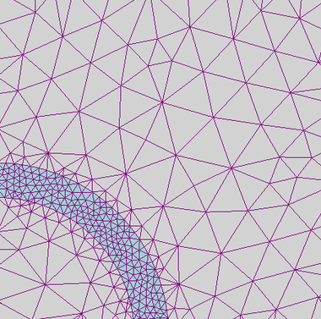
PDE Numerical Analysis
Finite element method
Accurate representation of complex geometry
Inclusion of dissimilar material properties
Easy representation of the total solution
Capture of local effects.
Runge-kutta method [7]

Slide 9
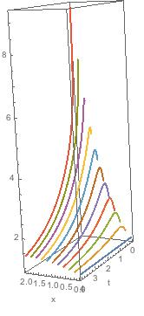
PDE Numerical Analysis
Method of lines
Accurate representation of dynamics from start condition
Easily to see bifurcations
Suitable for chaotic systems

Slide 10
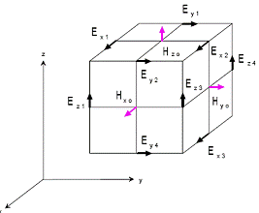
PDE Numerical Analysis
Finite difference method
Fast computation
Capture of local effects.
Analytical boundary of error

Slide 11
PDE Numerical Analysis – honorable mentions
Gradient discretization method
It is based on the separate approximation of a function and of its gradient. Commonly used in deep learning.
Finite volume method
Volume integrals in a partial differential equation that contain a divergence term are converted to surface integrals, using the divergence theorem. These terms are then evaluated as fluxes at the surfaces of each finite volume. Commonly used in computer graphics.
Spectral method
The idea is to write the solution of the differential equation as a sum of certain "basis functions" (for example, as a Fourier series) and then to choose the coefficients in the sum that best satisfy the differential equation. Commonly used in signal processing.

Slide 12
Medical nanorobotics

Slide 13
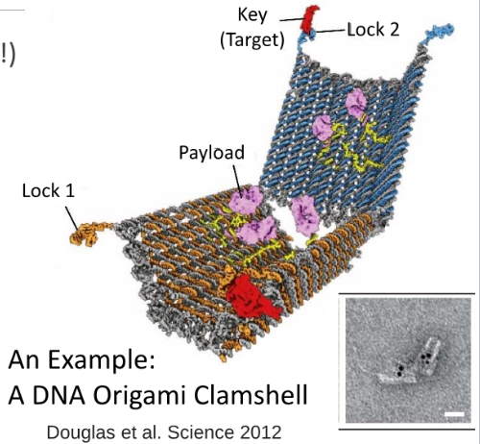
Medical nanorobotics
Nano-scale robots (1-100 nm)
Used for biomedical applications
Targeted drug delivery
Can overcome safety issues

Slide 14
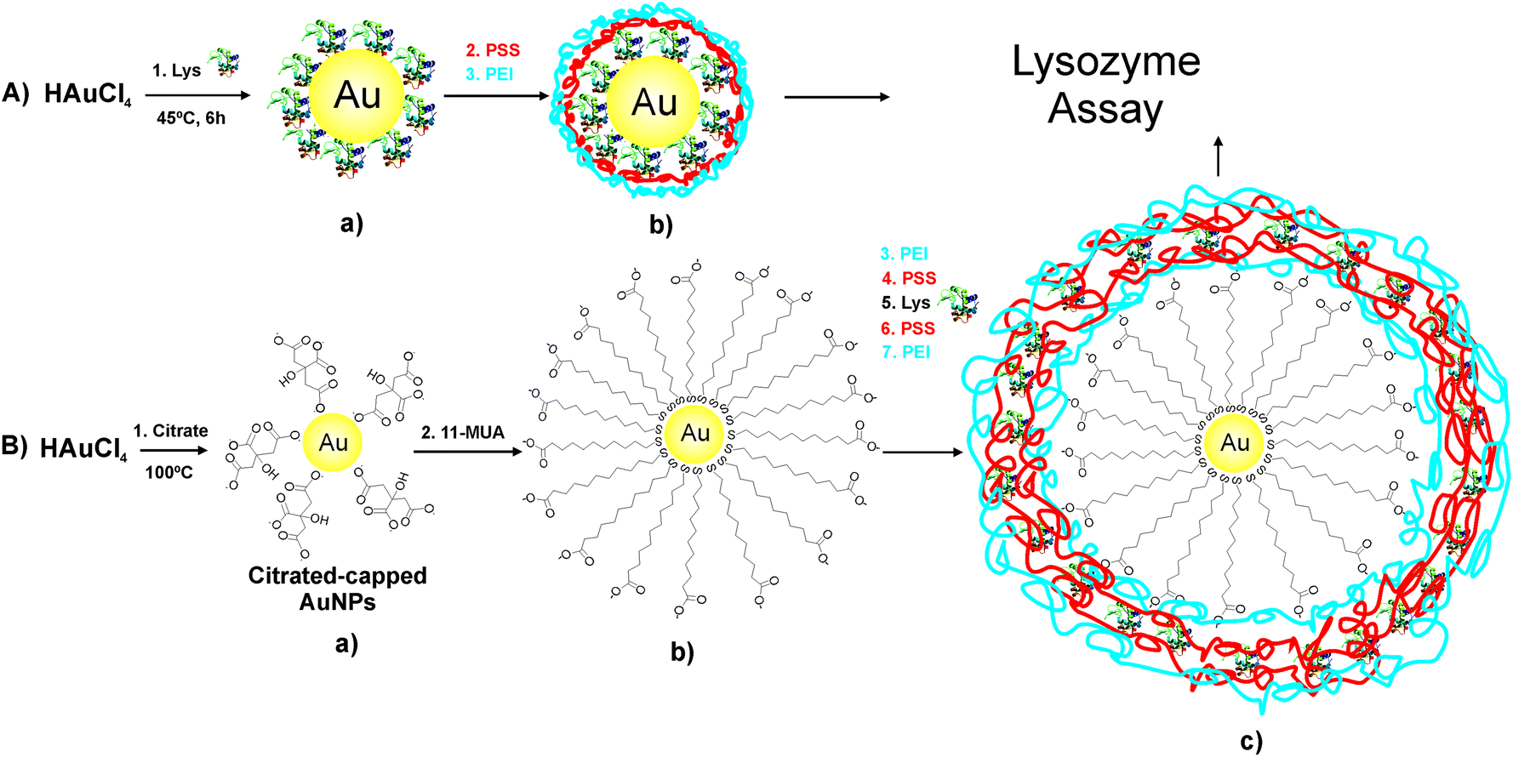
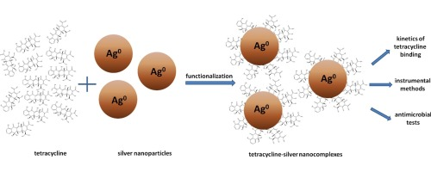
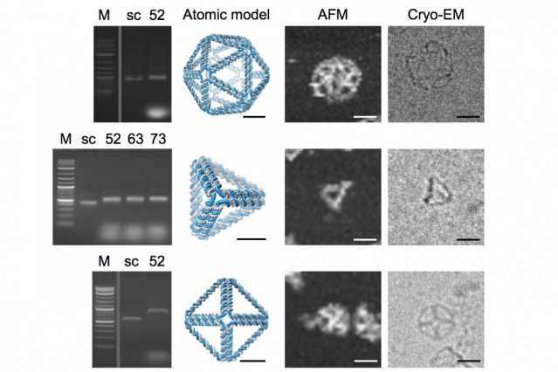
Medical nanorobotics
There are a lot of different medical nanorobots (MNRs) divided by multiple parameters.

Slide 15
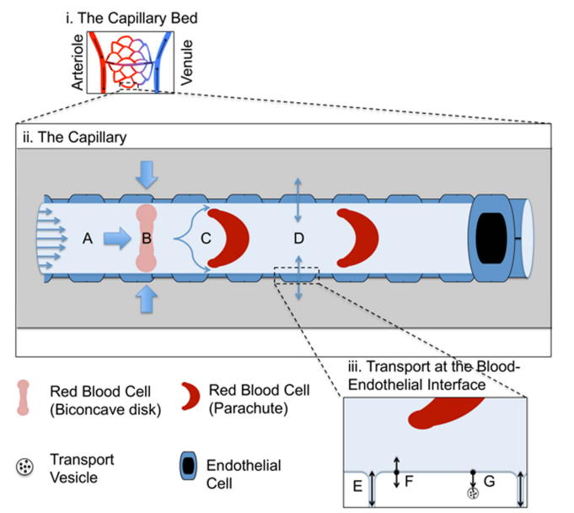
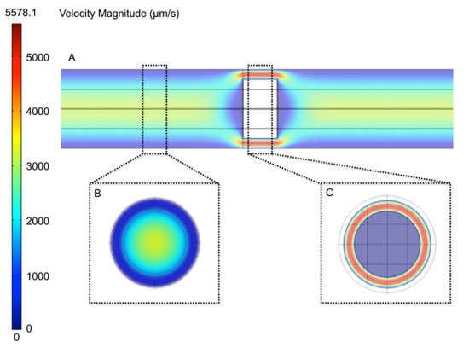
Numerical based MNR simulation

Slide 16
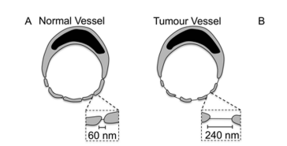
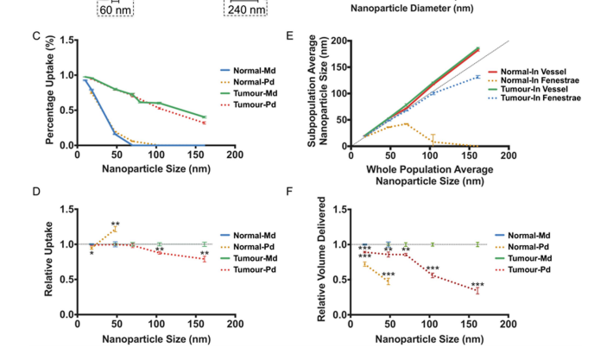
Numerical based MNR simulation

Slide 17
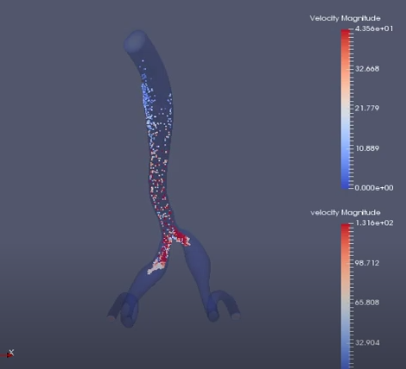
Numerical based MNR simulation
(Simvascular)
http://simvascular.github.io/

Slide 18
You need a dwarf, an elf, a wizard, a man,
and a hobbit to destroy one ring
(or to create MNR based treatment – just saying)

Slide 19
References
[1] https://arxiv.org/pdf/1710.06258;Analysis
[2] Panton, Ronald L. (2013). Incompressible Flow (Fourth ed.). Hoboken: John Wiley & Sons. p. 114. ISBN 978-1-118-01343-4.
[3] Baieth HE. Physical parameters of blood as a non - newtonian fluid. Int J Biomed Sci. 2008;4(4):323-329.
[4] https://www.witpress.com/Secure/elibrary/papers/AFM04/AFM04038FU.pdf
[5] https://ieeexplore.ieee.org/document/19404/
[6] ftp://ftp.tuebingen.mpg.de/pub/kyb/bweber/papers_db/1965/GABE/Physics%20in%20medicine%20and%20biology%201965%20GABE.pdf
[7] https://link.springer.com/article/10.1007/s10483-013-1704-8

